Slide 1
A fair and equal life for girls and boys: Stereotypes and equality
I understand that how I look, how I behave, or my aspirations should not be limited by stereotypes, my sex or expectations of what boys and girls should do.
I can give examples of, and can challenge, stereotypes.
I show respect for others.
I understand and accept diversity amongst my peers.

Slide 2
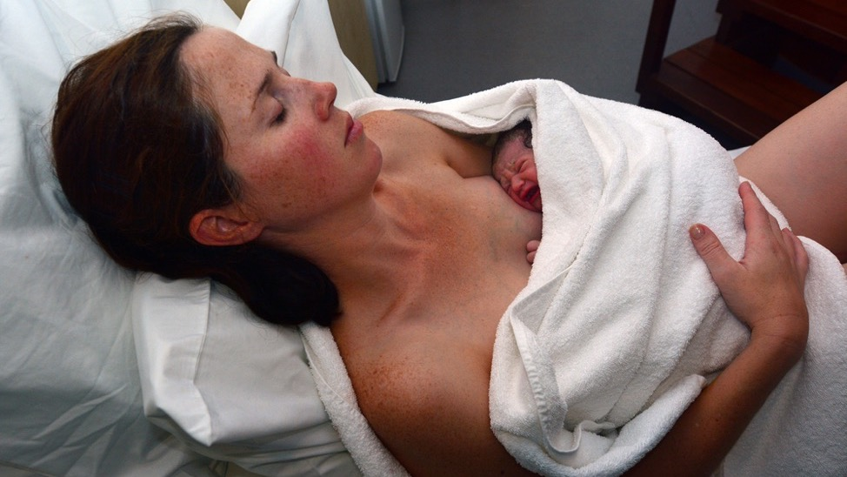
A mum can find out what sex her baby is before it is born, or find out at the birth when the midwife will say the baby is a girl or a boy.

Slide 3
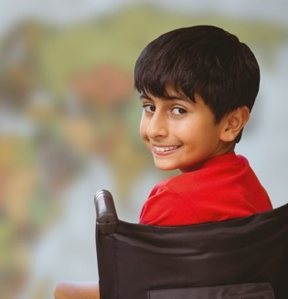
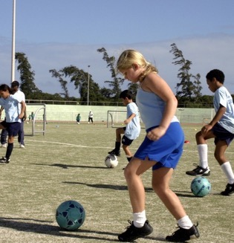
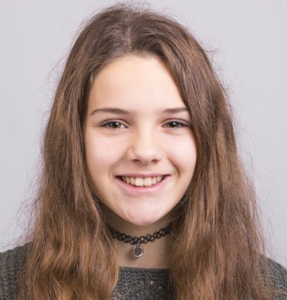
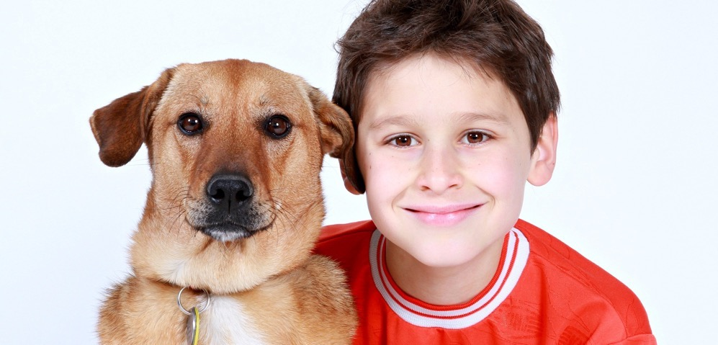
Today we are learning about boys and girls having a fair and equal life.

Slide 4
Have you ever heard someone say “that’s boy’s stuff” or “that’s girl’s stuff”?

Slide 5
What kinds of things do you hear people say this about? Why do you think a person might say such a thing?

Slide 6
Say you are a boy that likes to do ballet, how would you feel if someone told you, you shouldn’t do it because you are a boy?
Billy Elliot film, 2000

Slide 7
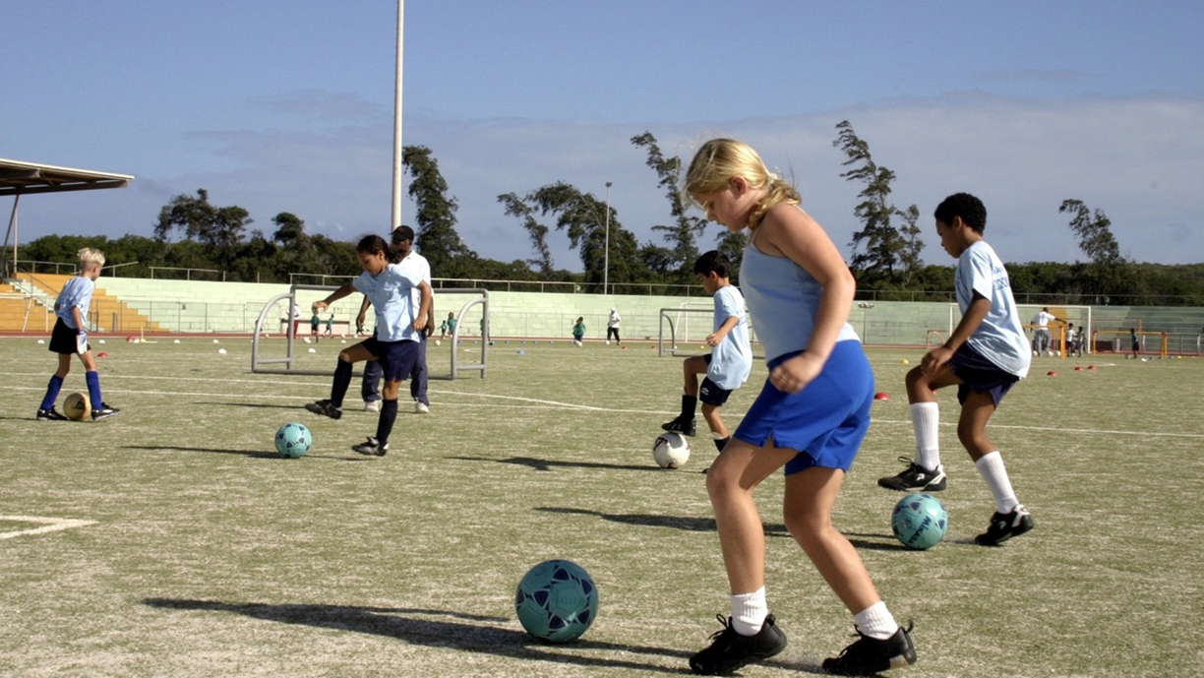
Say you were a girl that liked to play football how would you feel if someone told you, you shouldn’t play it, because you are a girl?
Billy Elliot film, 2000

Slide 8
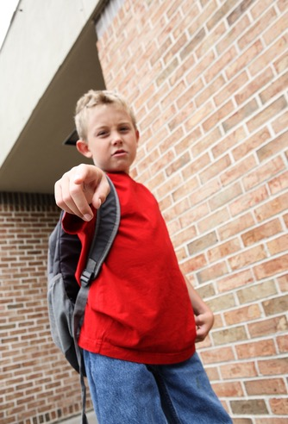
Can you think of any names people call a child if they are doing something that they think the child shouldn’t do, just because they are a boy or a girl?

Slide 9
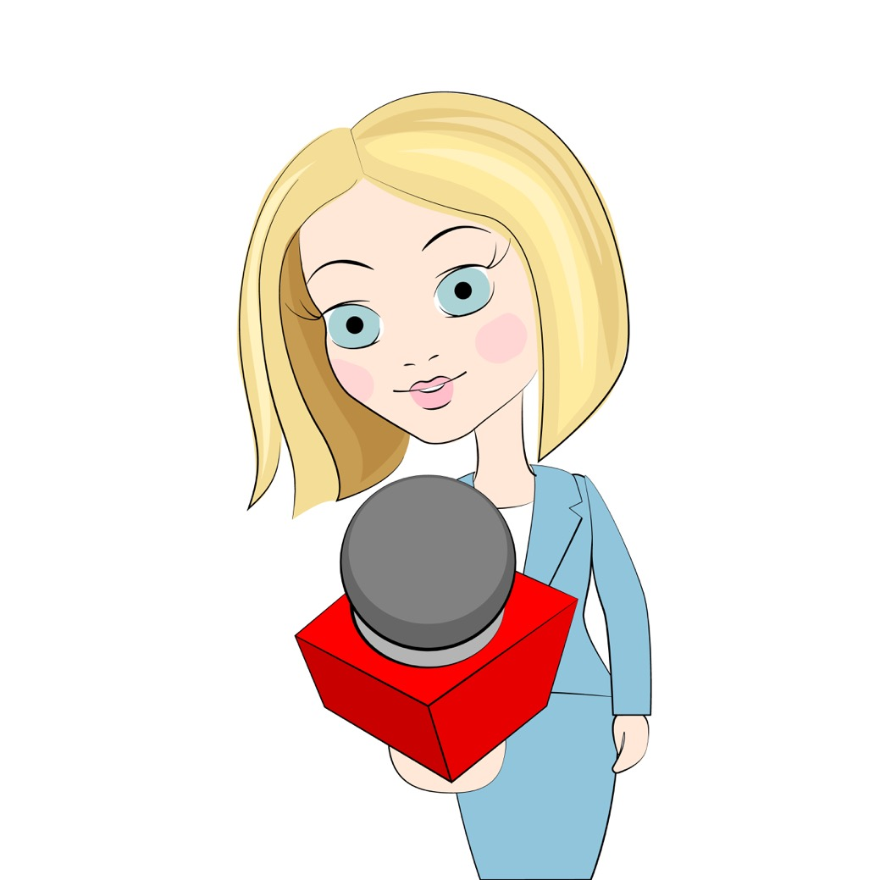
Boys? Girls? The Gameshow
The question is….
Who might people say this rule should apply to?

Slide 10
Who might people say this rule should apply to?
Be sensible

Slide 11
Who might people say this rule should apply to?
Don’t cry

Slide 12
Who might people say this rule should apply to?
Be good at fixing things

Slide 13
Who might people say this rule should apply to?
Be neat and organised

Slide 14
Who might people say this rule should apply to?
Don’t be affectionate

Slide 15
Who might people say this rule should apply to?
Be gentle

Slide 16
Who might people say this rule should apply to?
Take risks and be daring

Slide 17
Who might people say this rule should apply to?
Love sport

Slide 18
Boys? Girls?
Be sensible
Don’t cry
Be good at fixing things
Be neat and organised
Don’t be affectionate
Be gentle
Take risks and be daring
Love sport
What do you really want girls and boys to be able to do equally?

Slide 19
A stereotype is an idea that people might have about a group of people based on how they look on the outside. When you stereotype people this is wrong because what is on the outside is only a small part of a person. Sometimes, what you might think about a group of people might be true for some of them, but to say they are ALL something (and especially something bad), then that’s a stereotype.

Slide 20
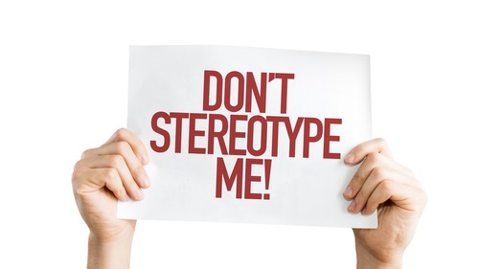
Help kids learn about gender with Foxy (duration 2 minutes 30 seconds) https://youtu.be/lbhd-23mloc

Slide 21
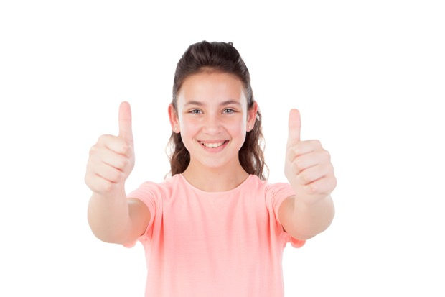
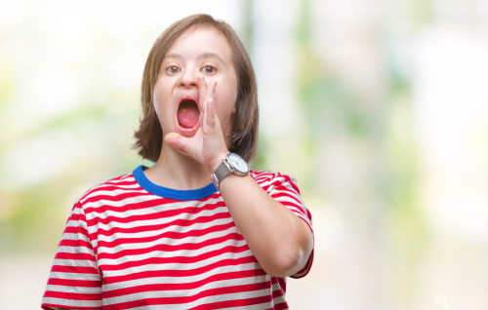
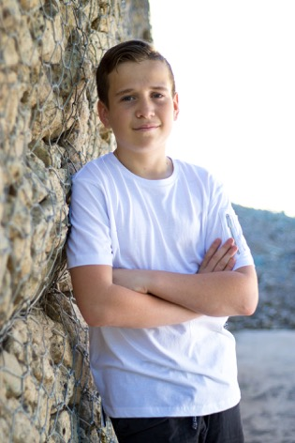
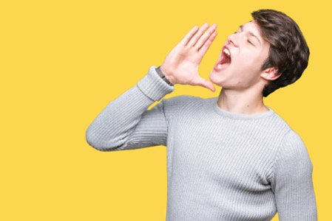

Slide 22
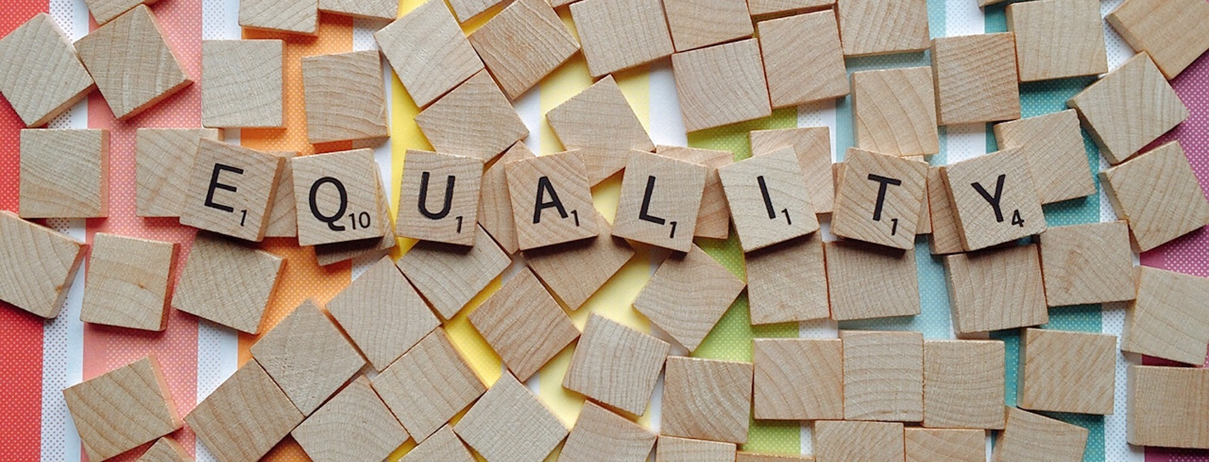
Equality is about being fair.
Equality means making sure that every girl and boy, and every woman and man, has the same chances to make the most of their lives and talents.

Slide 23
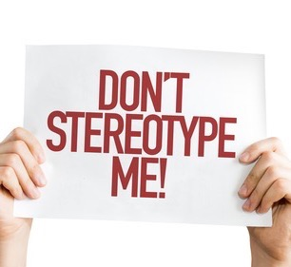
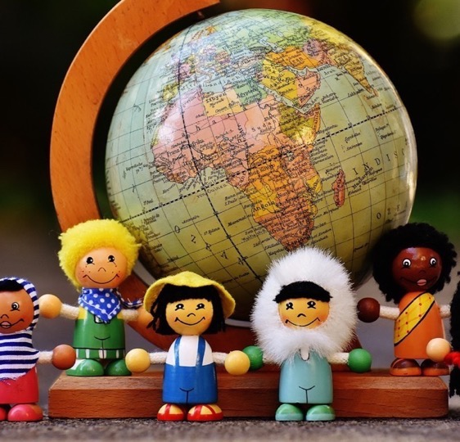
You are a unique person, you know who you are. There are no rules about how to be a girl or a boy - be who you want to be. That’s why we say… in this class, we are all individuals, different, unique and special.

