Slide 1
Stereotypes and Equality
I understand that how I look, how I behave, or my aspirations should not be limited by stereotypes, my sex or expectations of what boys and girls should do.
I can give examples of, and can challenge, stereotypes.
I show respect for others and I understand and accept diversity amongst my peers.

Slide 2
Activity:
Who should be doing this?

Slide 3
What is a stereotype?

Slide 4
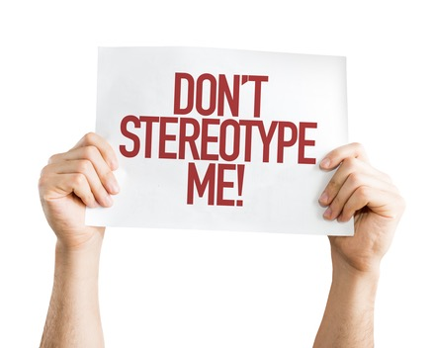
A stereotype is an idea that people might have about a group of other people.
Sometimes, what you might think about a group of people might be true for some of them, but to say they are ALL something (and especially something bad) then that’s a stereotype.

Slide 5
Activity:
Stereotypes of men
Stereotypes of women

Slide 6
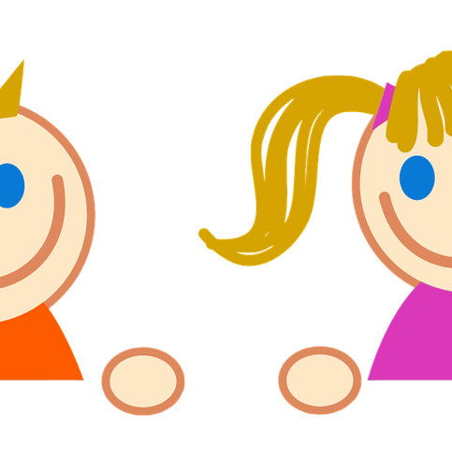
Exploring stereotypes:
Nursery Rhyme
What Are Little Boys/Girls Made of?
What are little boys made of? What are little boys made of? Frogs and snails, And puppy-dogs' tails; That's what little boys are made of. What are little girls made of? What are little girls made of? Sugar and spice, And all that's nice; That's what little girls are made of.

Slide 7
Science and technology subjects are for boys
Is this true or false?

Slide 8
Science and technology subjects are for boys FALSE
The truth is: Girls and women have been under-represented in these subjects at school, and in University and the workplace.
But things are changing. Girls are choosing these subjects and doing better at school and so becoming students and workers in these areas of work.

Slide 9
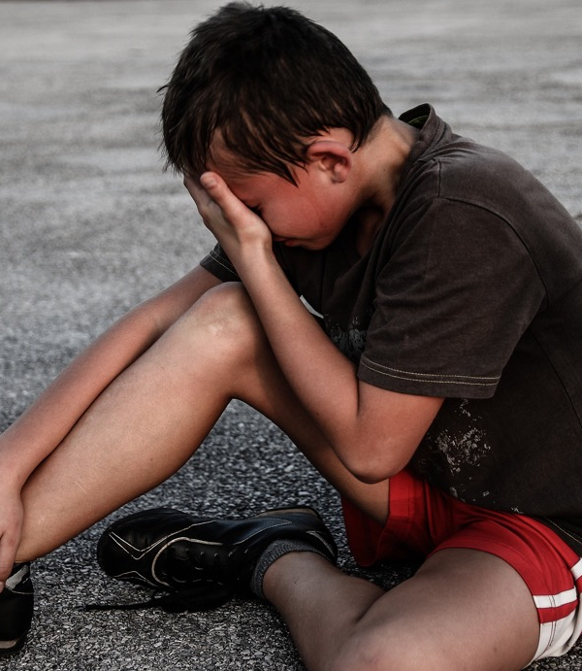
Boys don’t get emotional. Boys don’t cry.
Is this true or false?

Slide 10
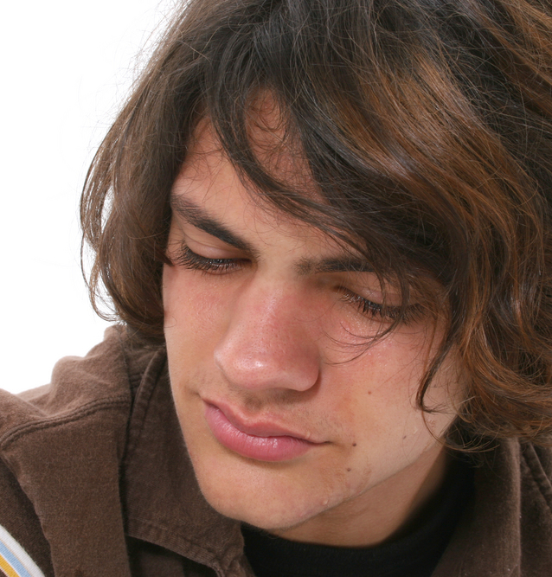
Boys don’t get emotional. Boys don’t cry.
FALSE.
The truth is: They do, and its important that boys and men can show their emotions.
Man up Means… https://youtu.be/lZyHCT-hdNs (duration 47 seconds)

Slide 11
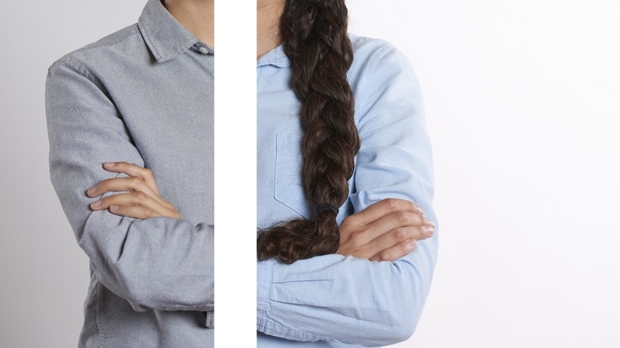
What is equality?

Slide 12
What is equality?
Equality is about making sure that every person has the same chances to make the most of their lives and talents.
It is also the belief that no one should have poorer life chances because of the way they were born, where they come from, what they believe, or whether they have a disability.

Slide 13
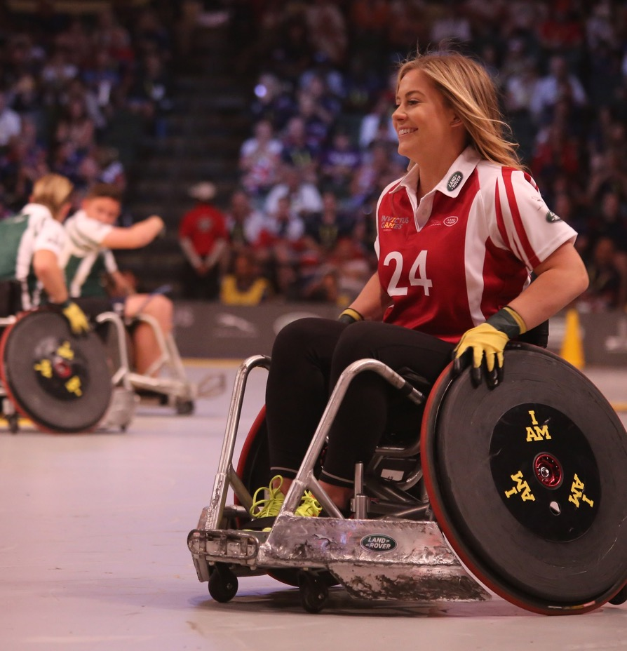
Can you think of any groups of people who might feel discriminated against or stereotyped?

Slide 14
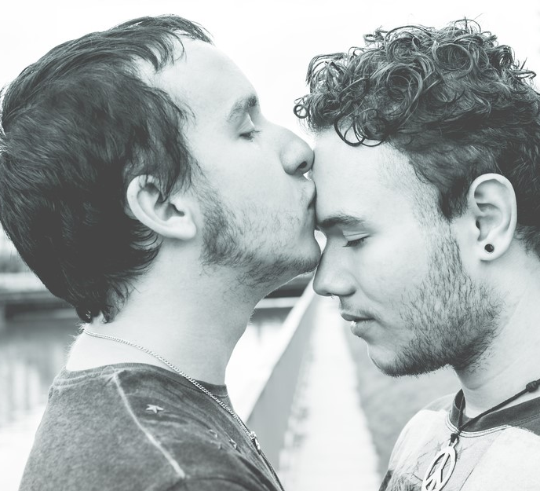
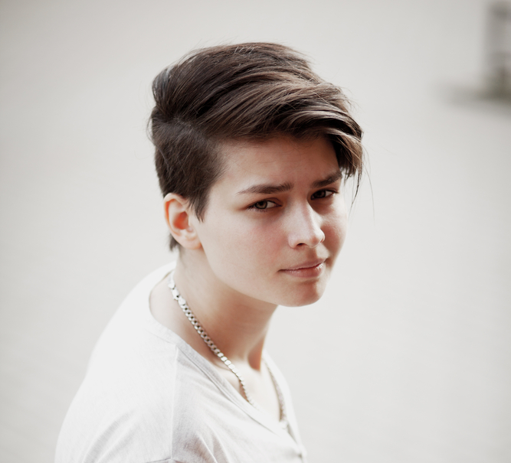
To believe in equality means that we recognise that certain groups of people like girls and women, LGBT people, people with disabilities or people from Black/Minority Ethnic communities have experienced discrimination.

Slide 15
Who do I look up to?
Who inspires me to be the best person I can be?

Slide 16
There are no rules about how to be a girl or a boy - be who you want to be.

