Slide 1
People who help me and look after me: People who are important to me
I can identify the adults in my life who help, care for me and look after me.
I can talk about how adults help, care and look after me.
I can name who I can go to with a question or a worry or if I need help.

Slide 2
Helping and caring for others.

Slide 3
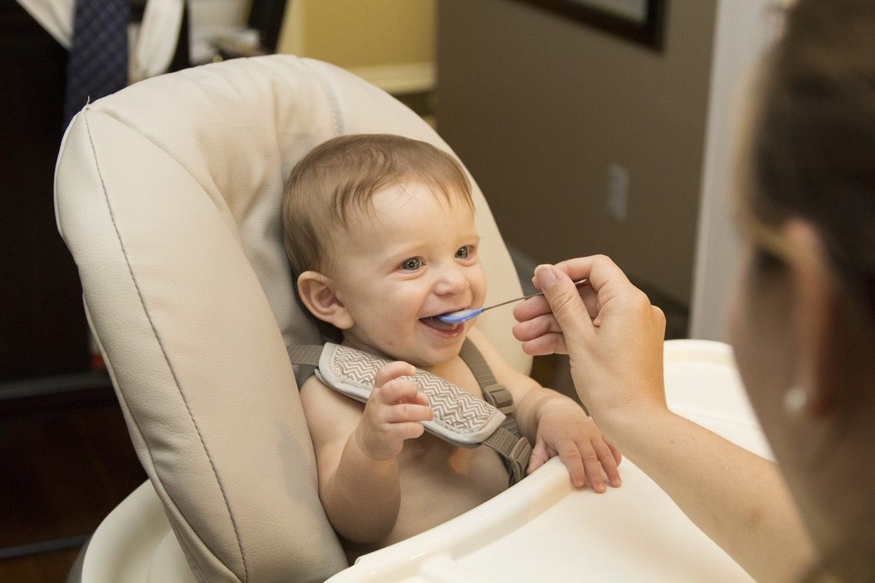

Slide 5
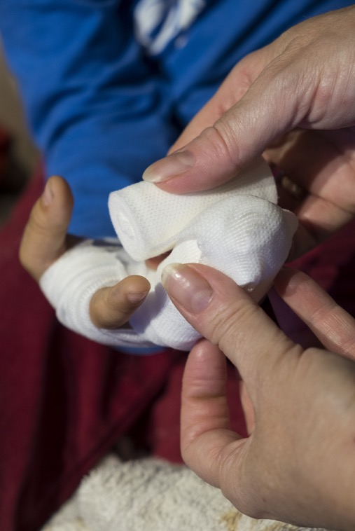

Slide 6
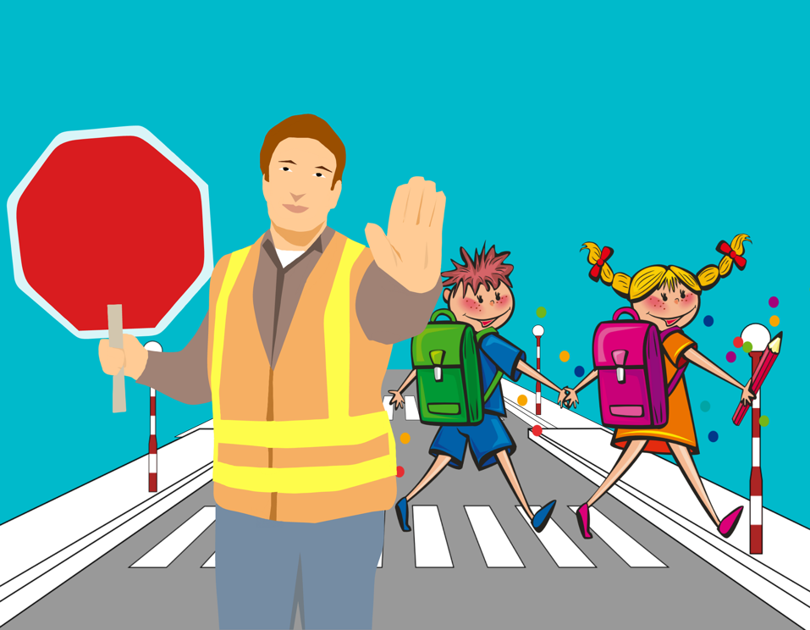

Slide 7
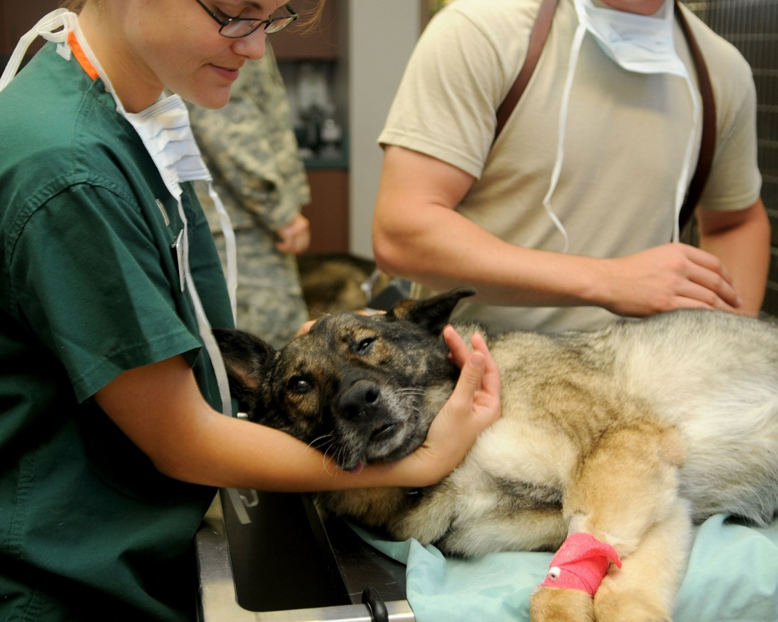

Slide 8
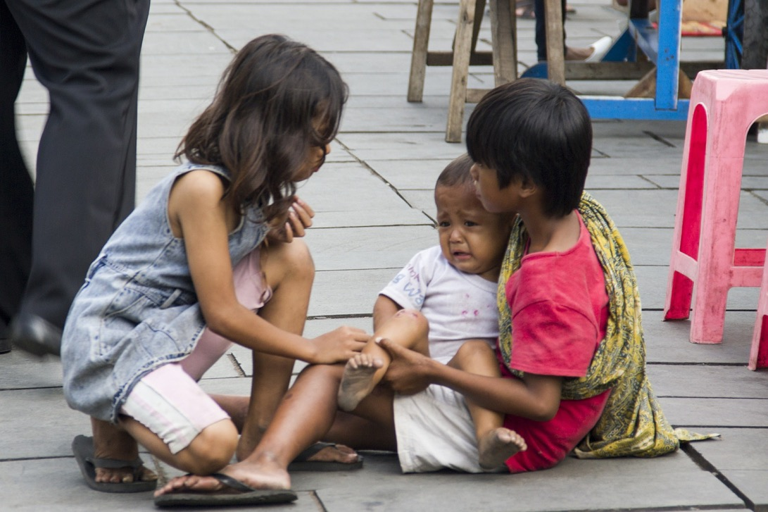

Slide 9
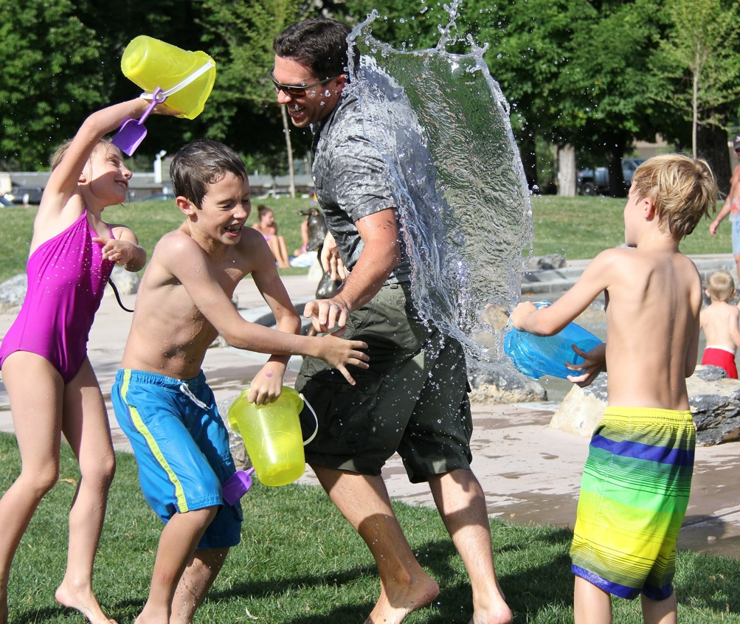

Slide 10
What help or care do these people or animals need?

Slide 11
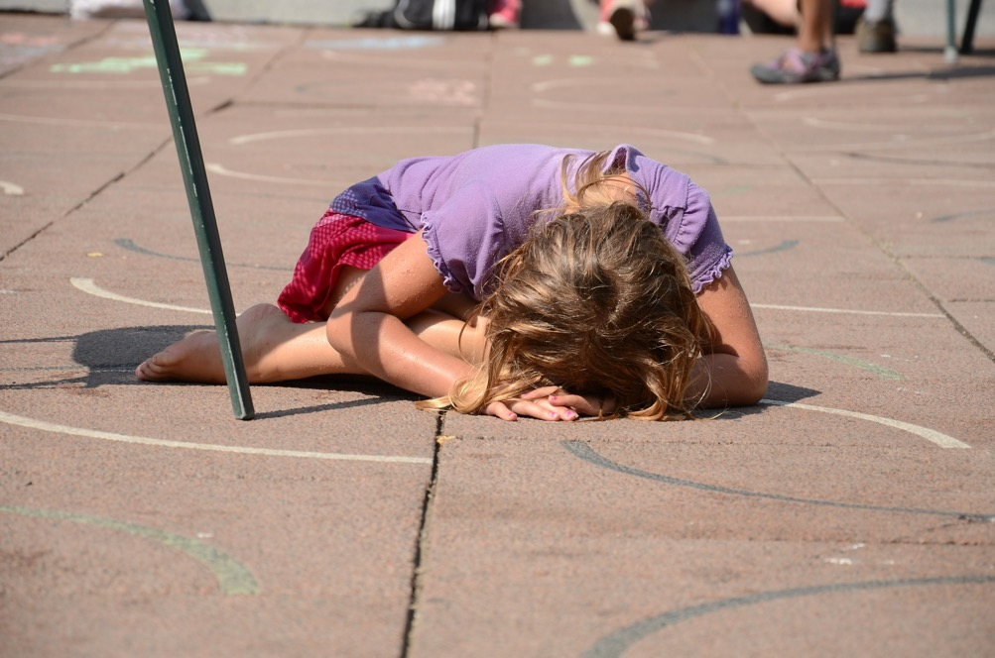

Slide 12
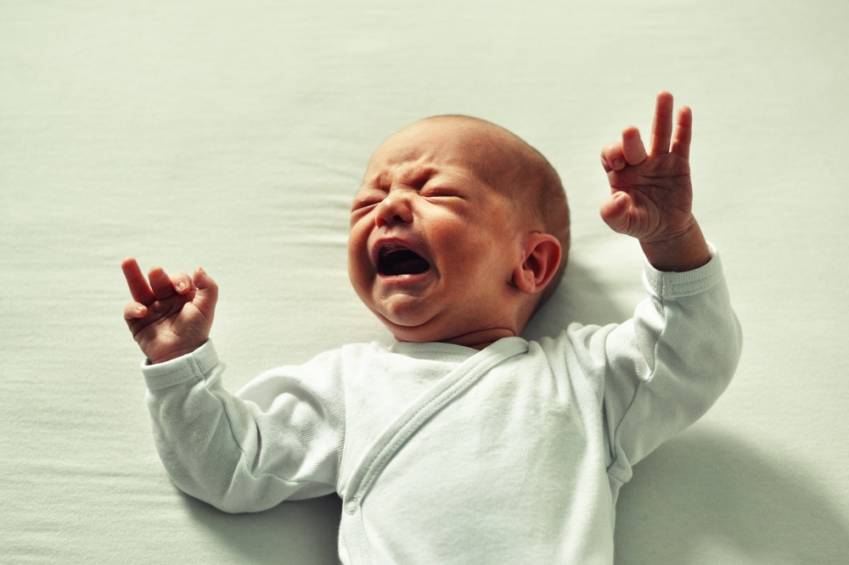

Slide 13
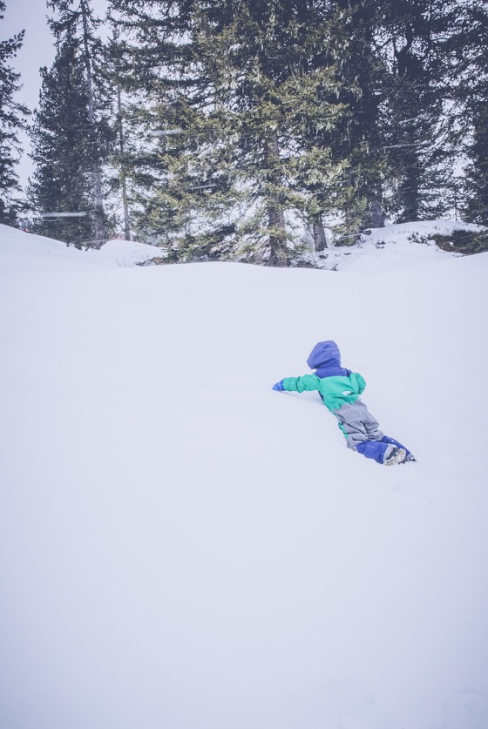

Slide 15
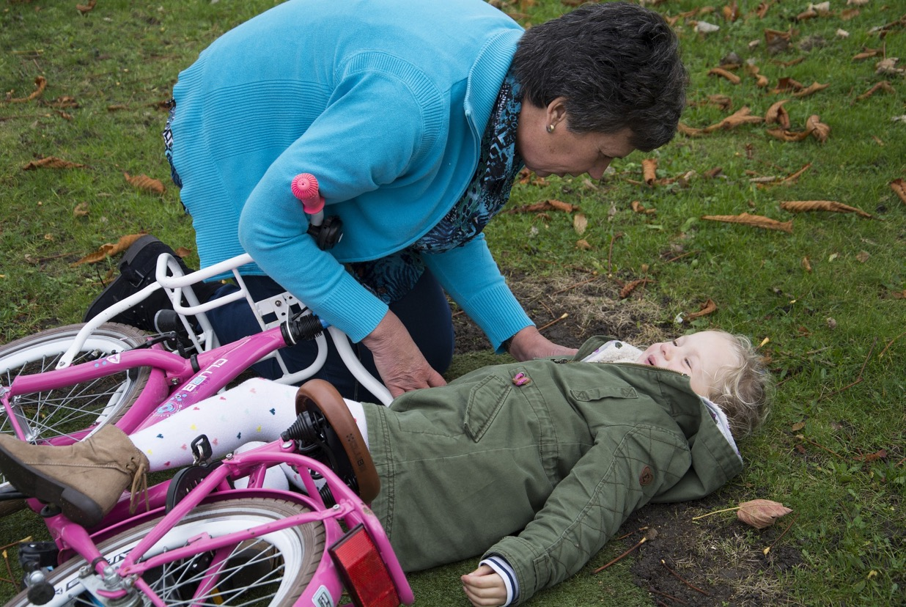

Slide 16
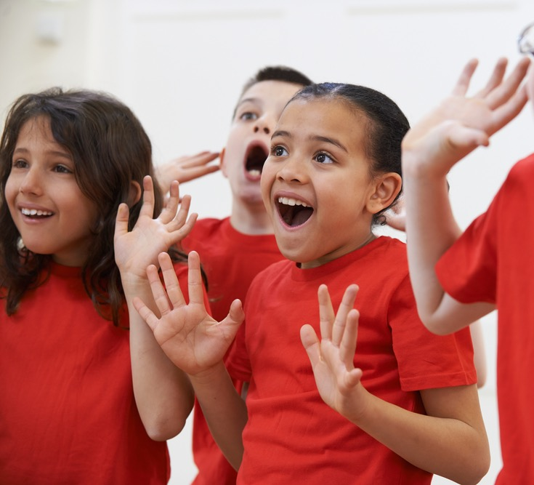
Activity
Work with a partner.
Make a ‘freeze-frame’ as if someone has taken a picture. The picture must show one person caring for another person or animal or thing.
We will guess what is happening in your picture.

Slide 17
Talking about people who care for and look after us. Activity: Make a thank-you card

Slide 18
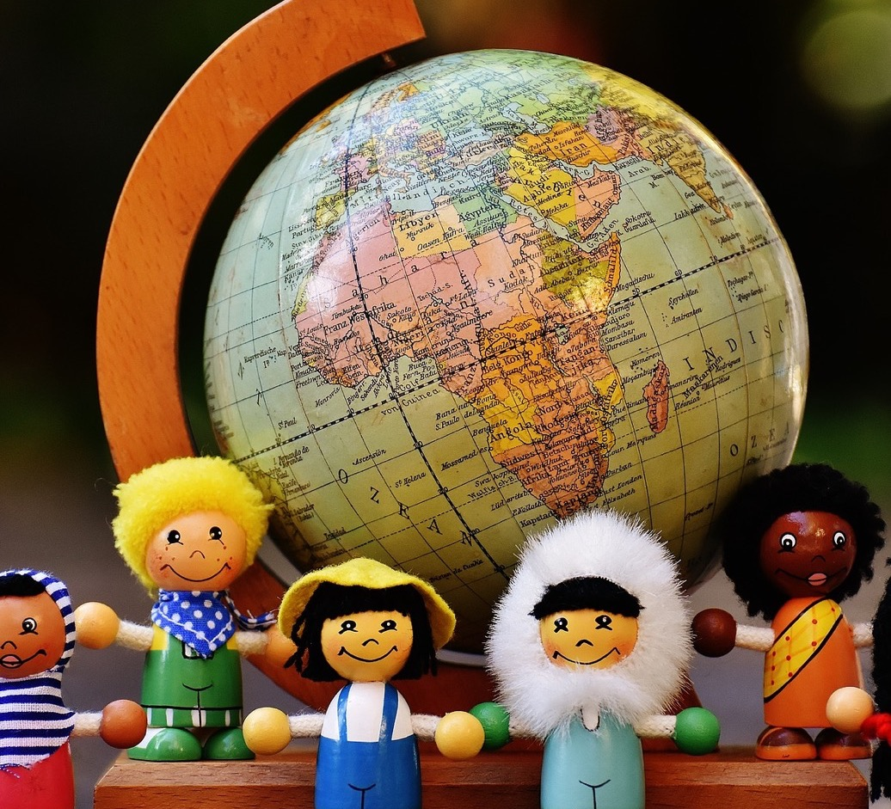
In this class, we are all individuals, different, unique and special.

