Slide 1
My body now: Names of parts of my body
I can name parts of my body.
I can talk about the different parts of my body and what they do.
I can describe the changes that take place with puberty.

Slide 2
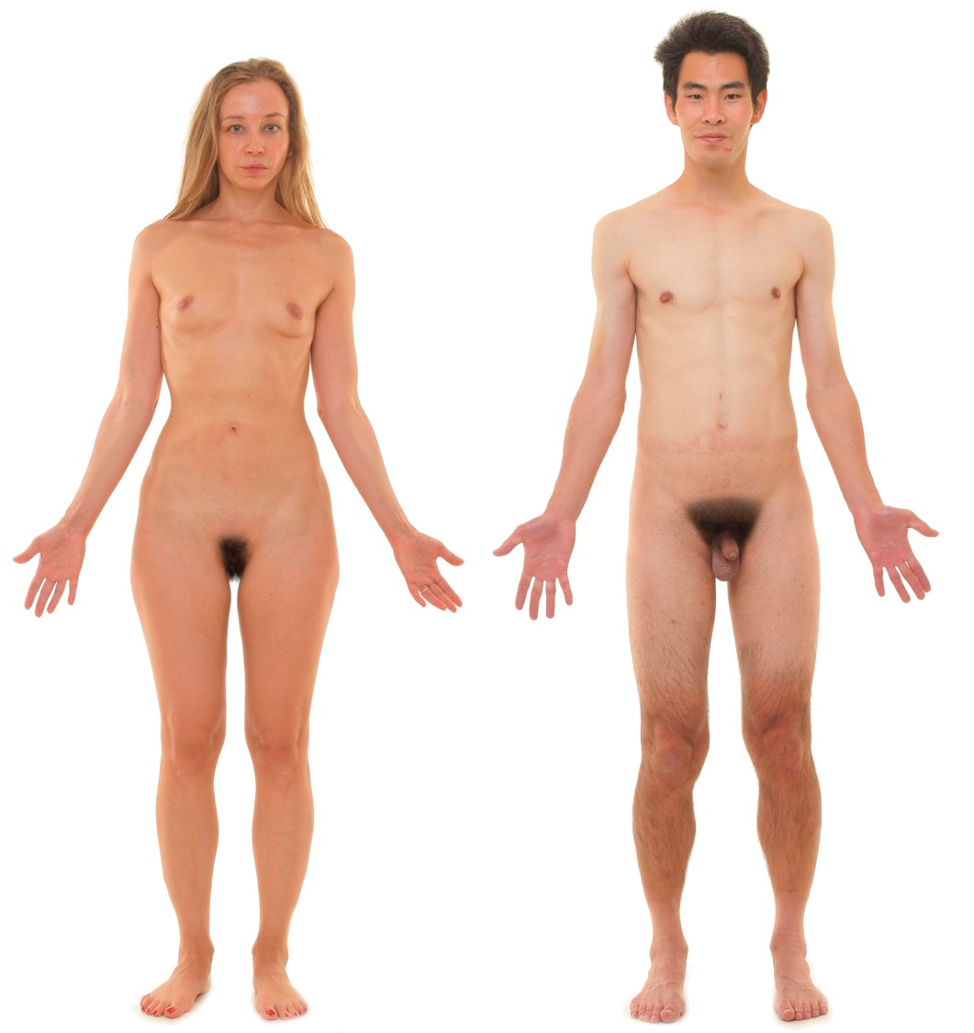
The genitals are the private parts of our bodies. For the boy/man the penis and scrotum and for a girl/woman the vulva.

Slide 4
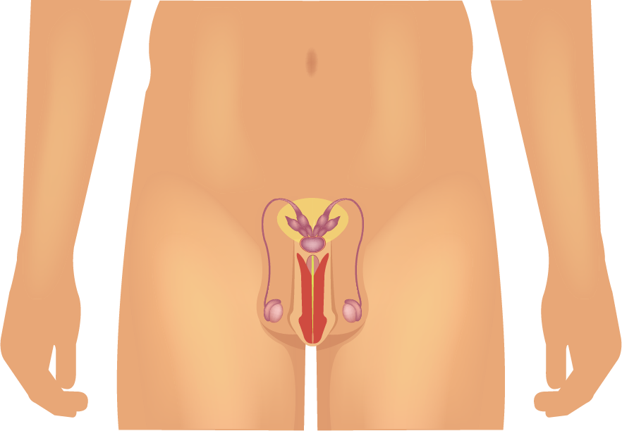
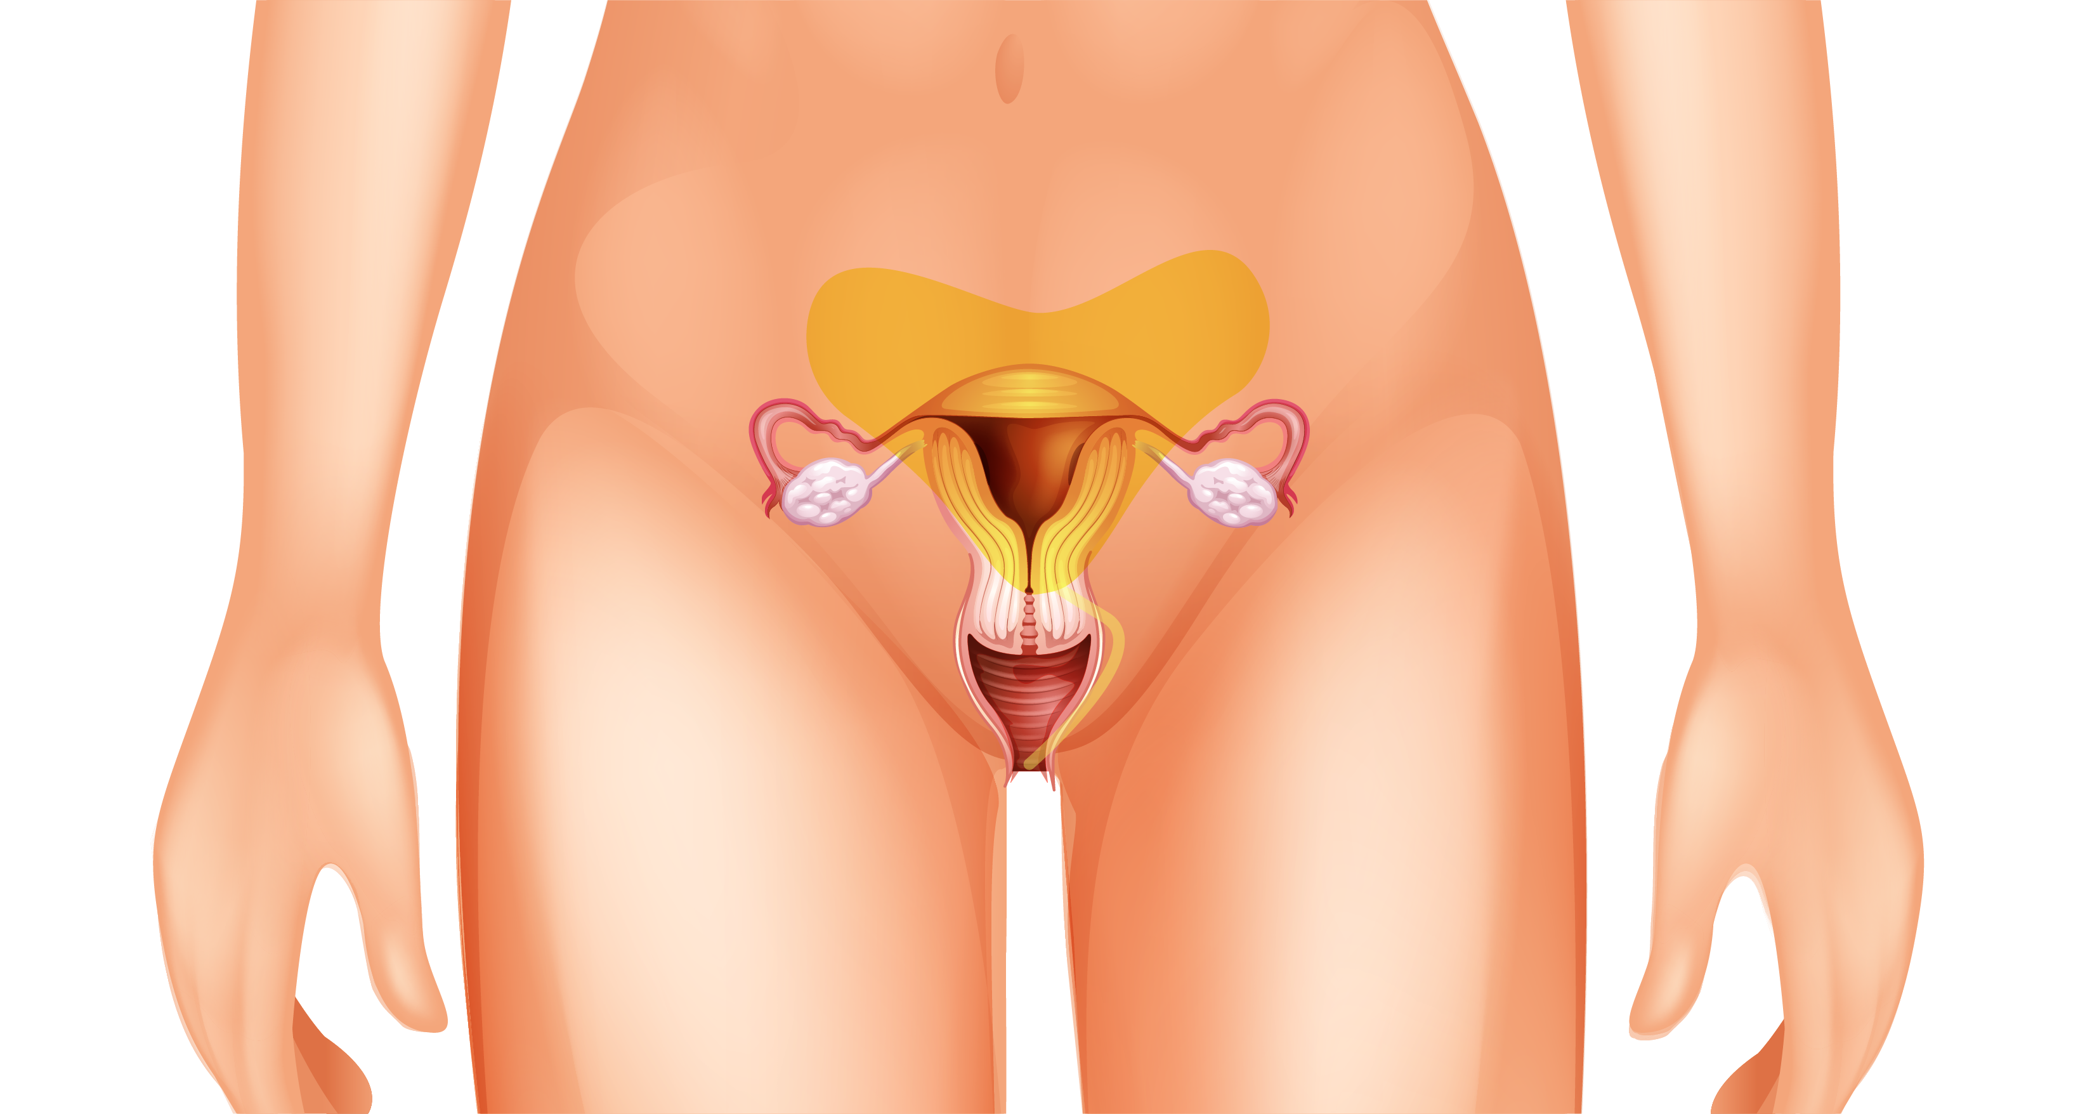
Connected to our genitals, inside our body, are parts of our body called reproductive organs because they are used to make a baby.

Slide 5
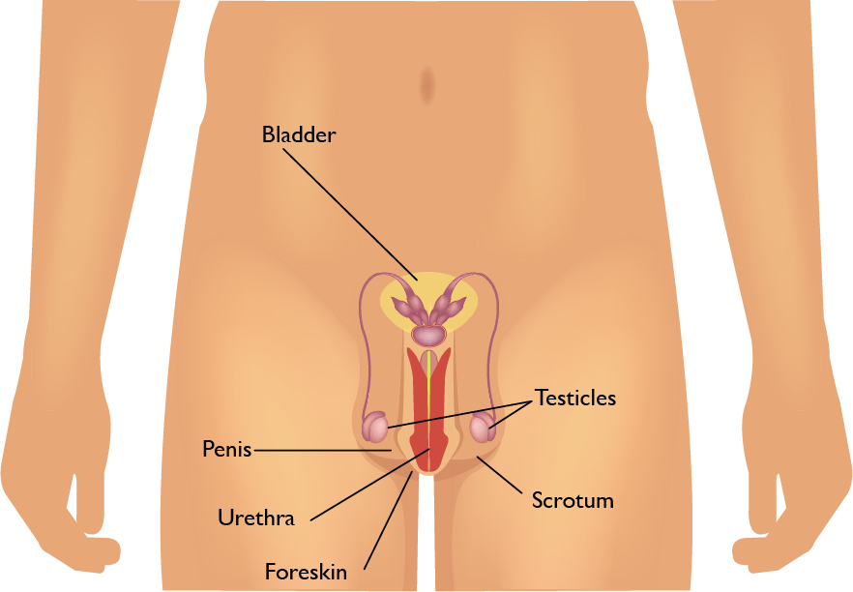
Male reproductive organs

Slide 6
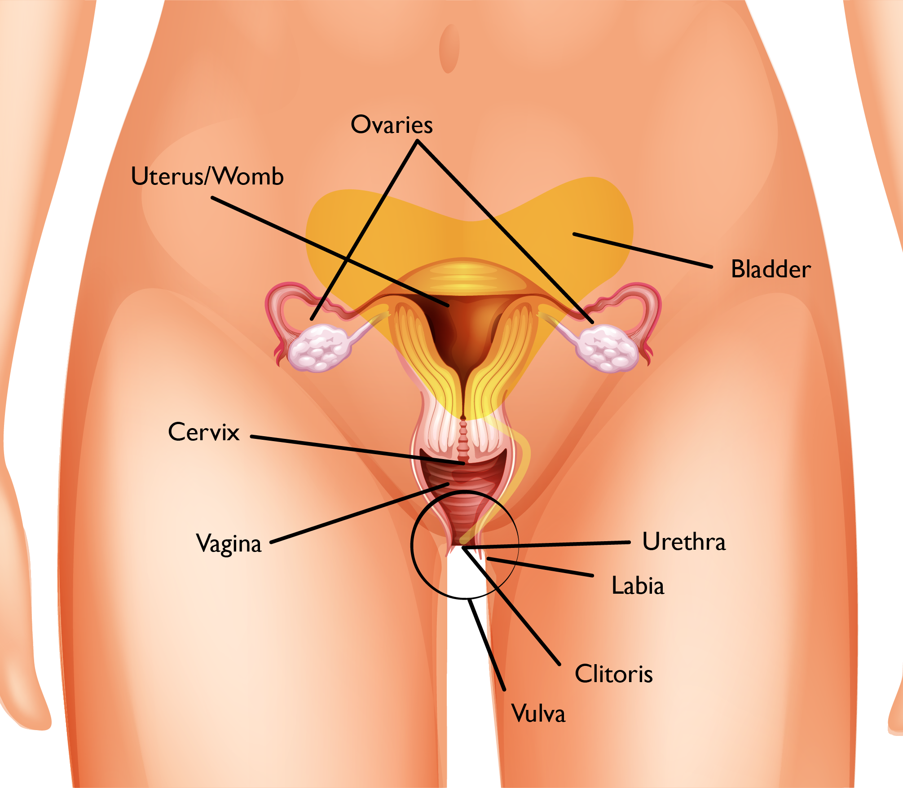
Female reproductive organs

Slide 7

Male anatomy (3 minutes 21)
https://youtu.be/G2ciOhidKpg
Female anatomy (2 minutes)
https://youtu.be/j9QgcCK6FKM

Slide 8

Names for parts of our body
Do you think it’s important to know the names of parts of your body?

Slide 9

Names for parts of our body
Why do people sometimes use words that are different from the real words?
Especially when they talk to children?

Slide 10
Names for parts of our body
Is it helpful to know the details of the bodies of someone of a different sex?
How might this kind of knowledge be useful?

Slide 11

Names for parts of our body
Do you think knowing this will help when it comes to understanding sex?
Or conception (how babies are made?)
Or pregnancy?

Slide 12


What questions do you have about the body?

