Slide 1
My body belongs to me
I can talk about what I like about me and my body.
I can explain that my body belongs to me.
I can say who I would go to if I have a question or worry.

Slide 2
How do I communicate with my body?

Slide 3
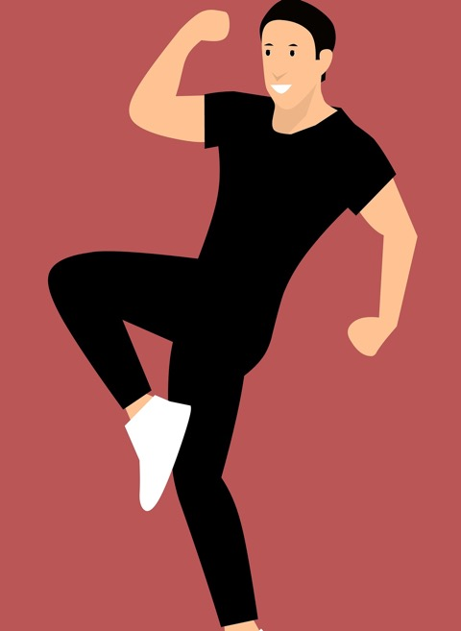
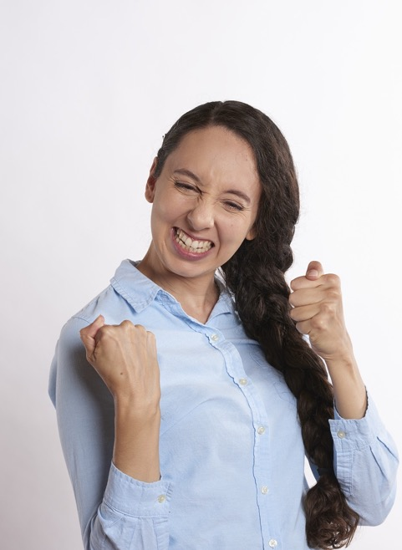
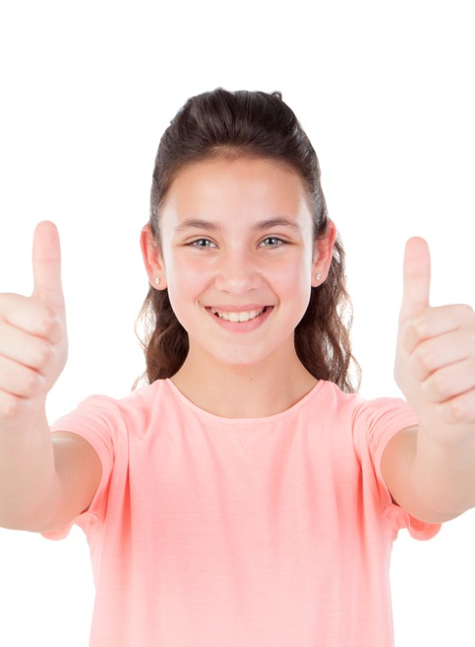
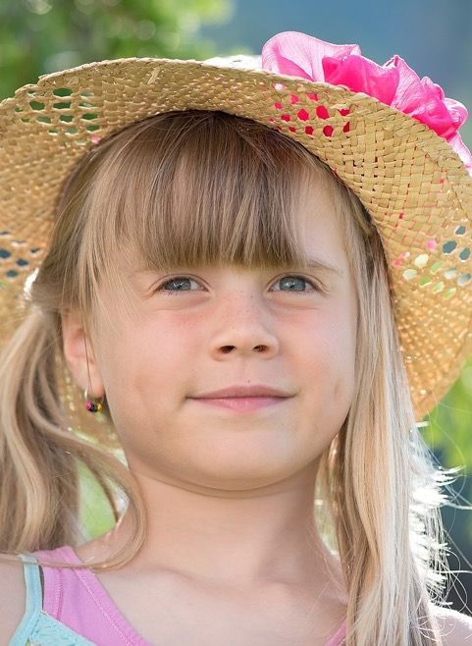
How do you say YES?

Slide 4
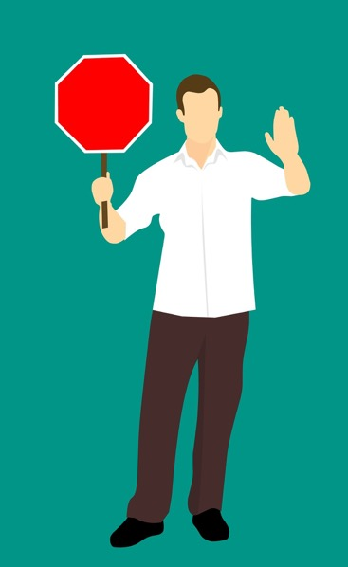
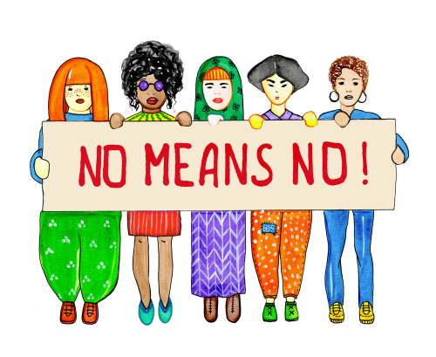
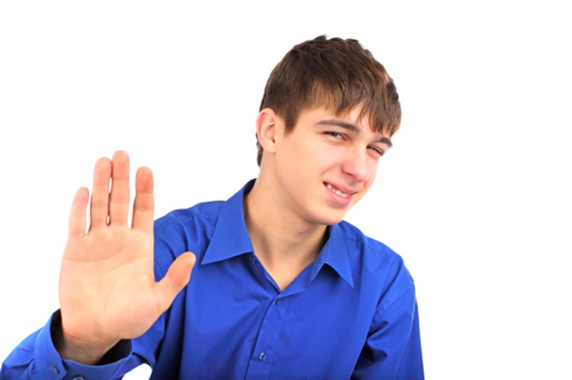
How do you say NO?

Slide 5
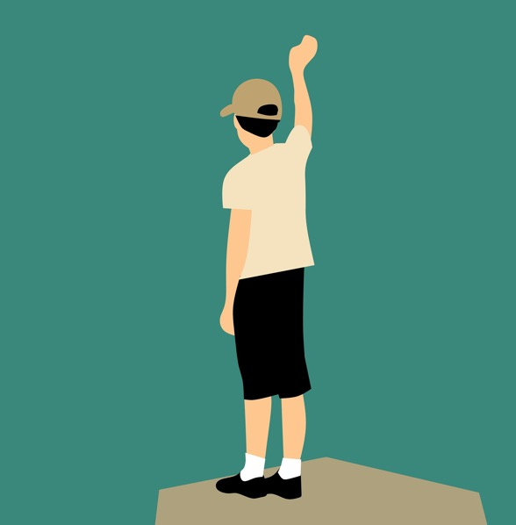
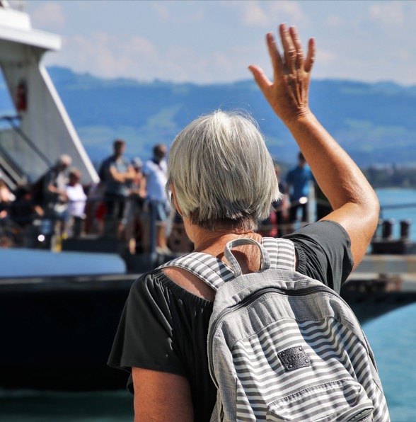
How do you say goodbye?

Slide 6
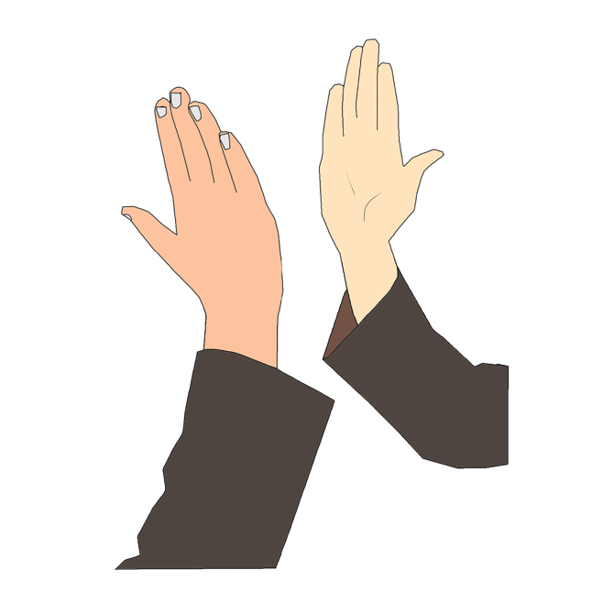
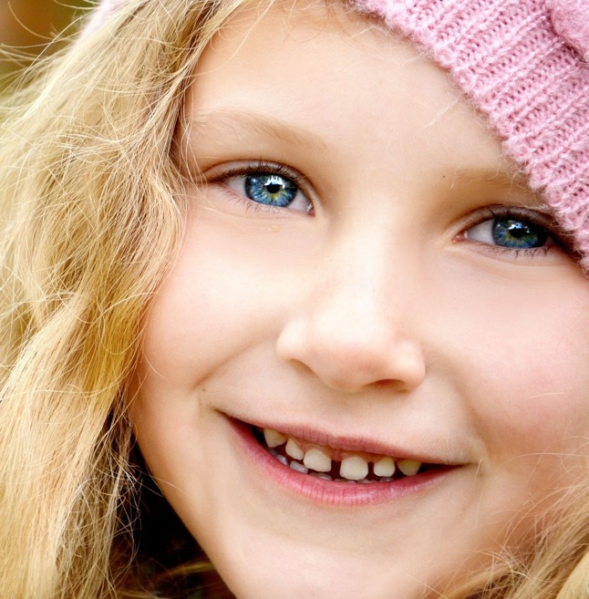
How do you say hello?

Slide 7
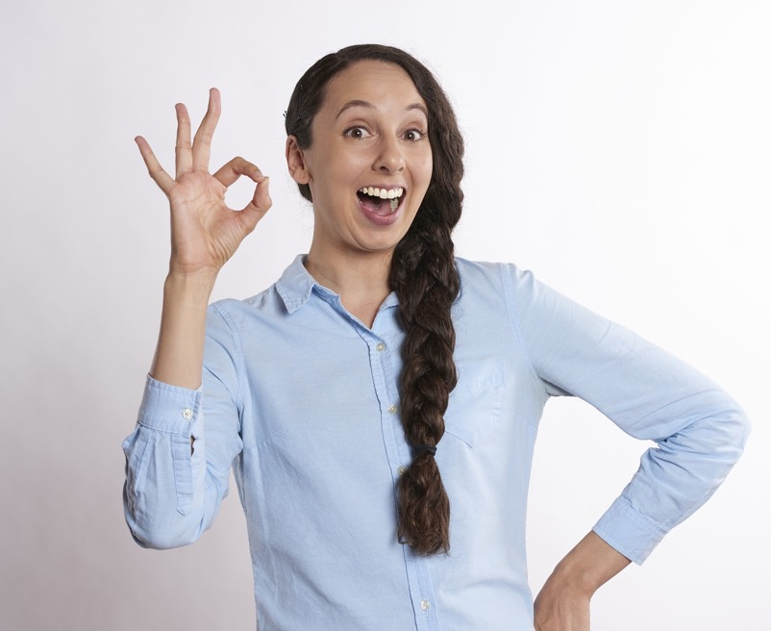
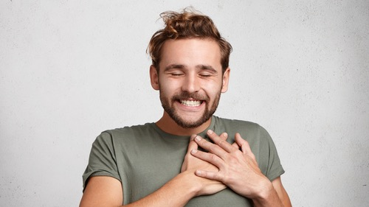
How do you say:
‘I like that’!

Slide 8
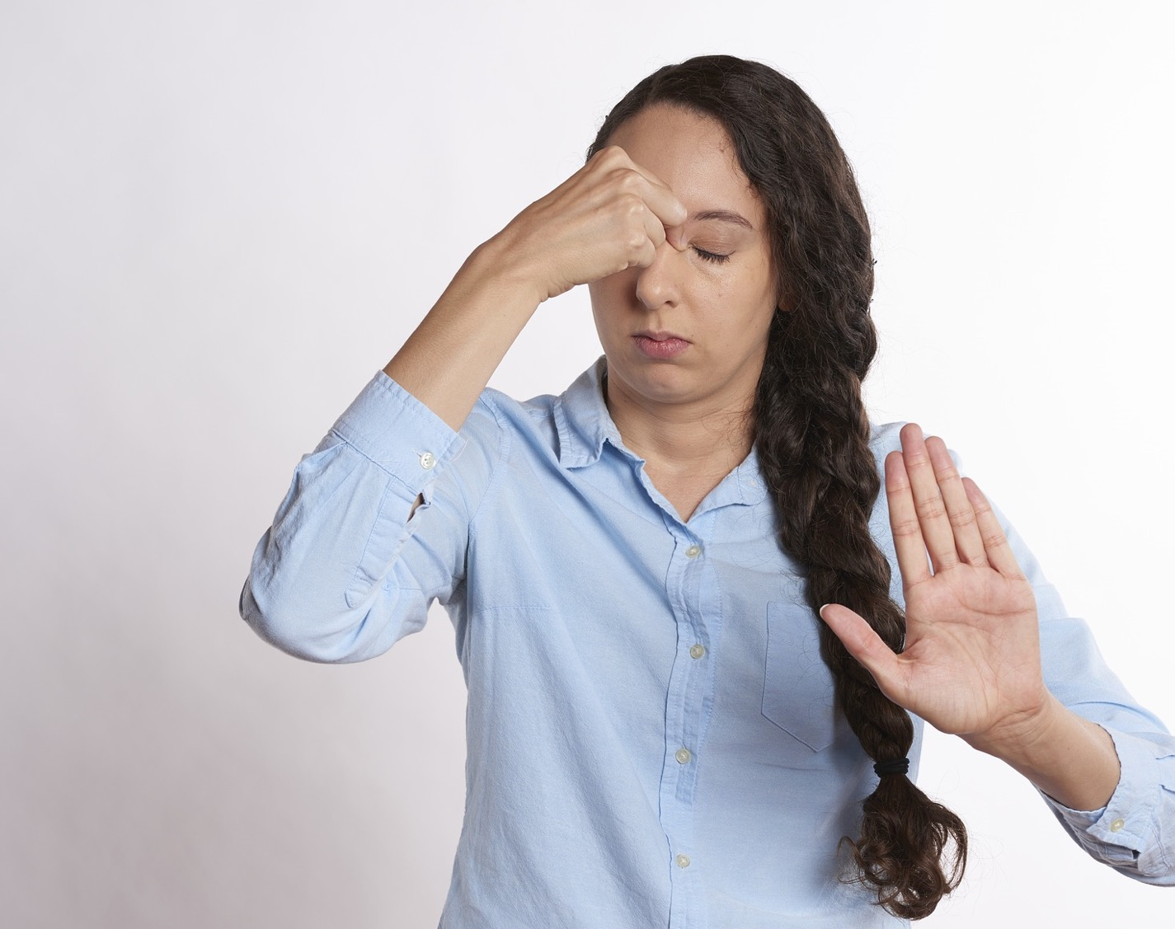
How do you say:
‘I don’t like that’?

Slide 9
How do I look after my body?

Slide 10
The mystery body challenge
Let’s think about the questions before you start:
Do you think you are short, medium height or tall?
What colour is your hair?
What colour are your eyes?
What do you like about your body?
What can you do with your body?

Slide 11
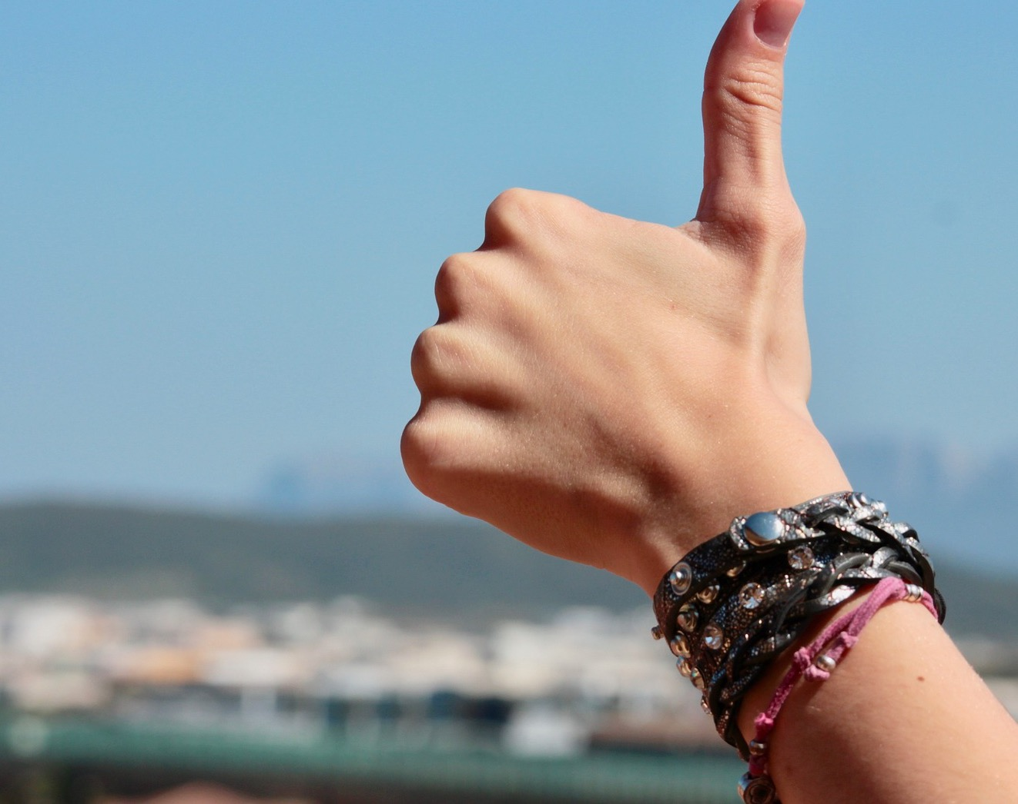
Being positive about your body
You are an individual. You are you!
You have the right to feel comfortable in your body and to know how you look is fine.
You can feel good about the things your body can do.
You can do your best to take care of your body.
Be kind to others – and you will get kindness back.

Slide 12
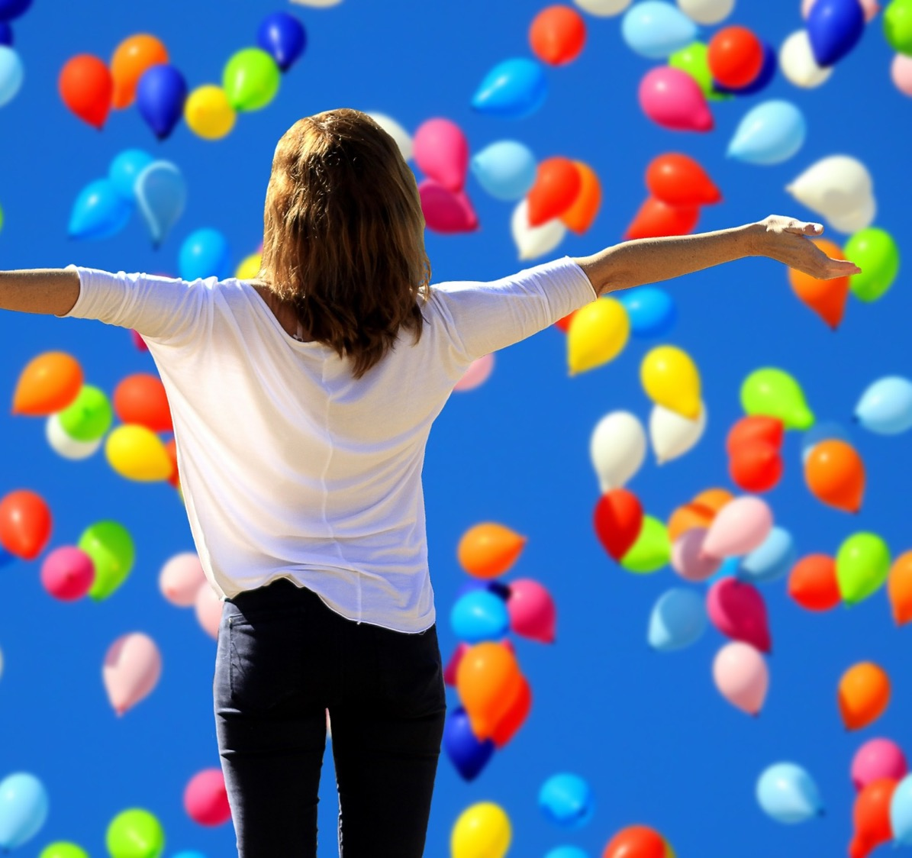
I’m Glad I’m Me
By Jack Prelutsky
I’m glad I’m me, I’m glad I’m me
There’s no one else I want to be.
I’m happy I’m the person who
Can do the things that I can do.
If I were someone else, then I
Would feel so strange, I’d wonder, ‘why?’
I’m positive that I’d be sad –
But I am me and I am glad.

Slide 13
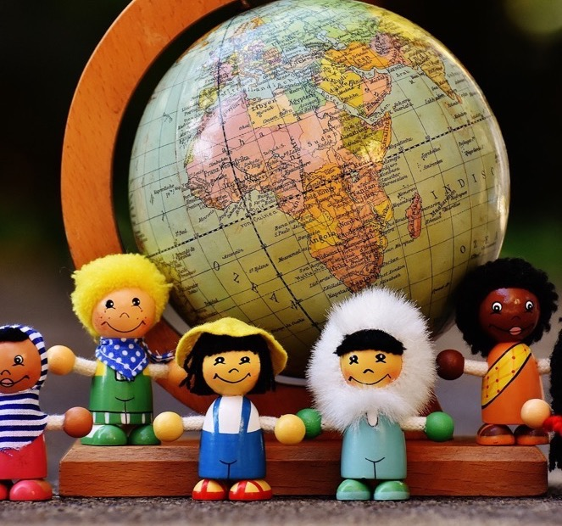
In this class, we are all individuals, different, unique and special.

