Slide 1
My body: Names of parts of the body and their functions
I can name parts of my body.
I can talk about the different parts of my body and what they do.
I can describe the changes that take place with puberty.
I can talk about my growing independence.
I can talk about things I can do when I am upset and can identify an adult to speak to if I am upset.
I understand how to maintain personal hygiene.

Slide 2

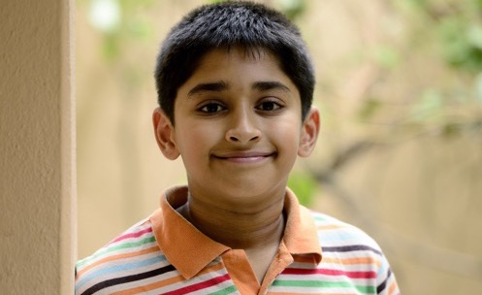
What is puberty?
Puberty is the time in your life when your body begins to change.
Some changes you can see.
Some changes happen inside your body. You can’t see these.

Slide 3
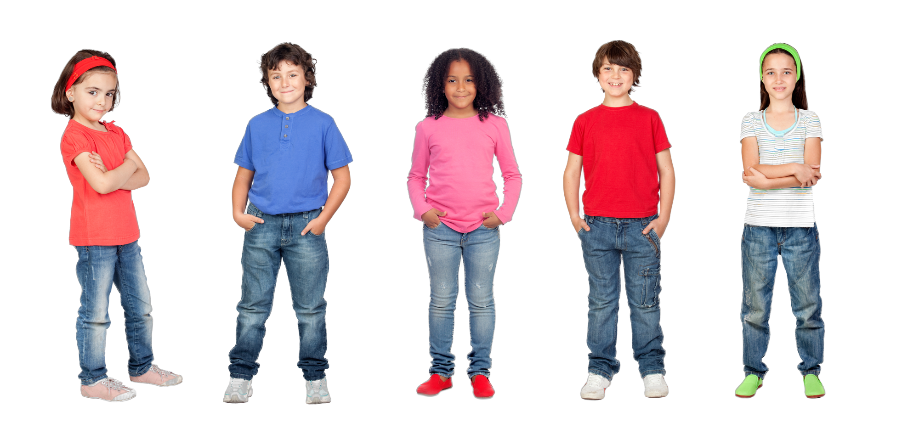
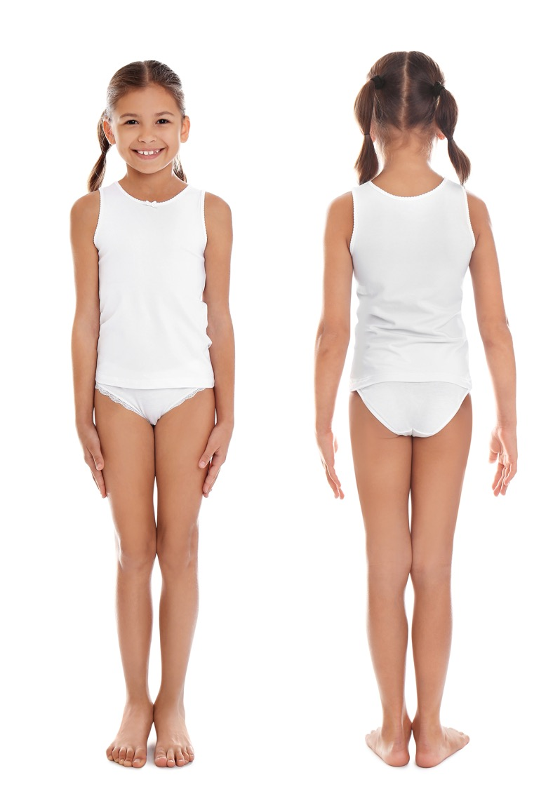
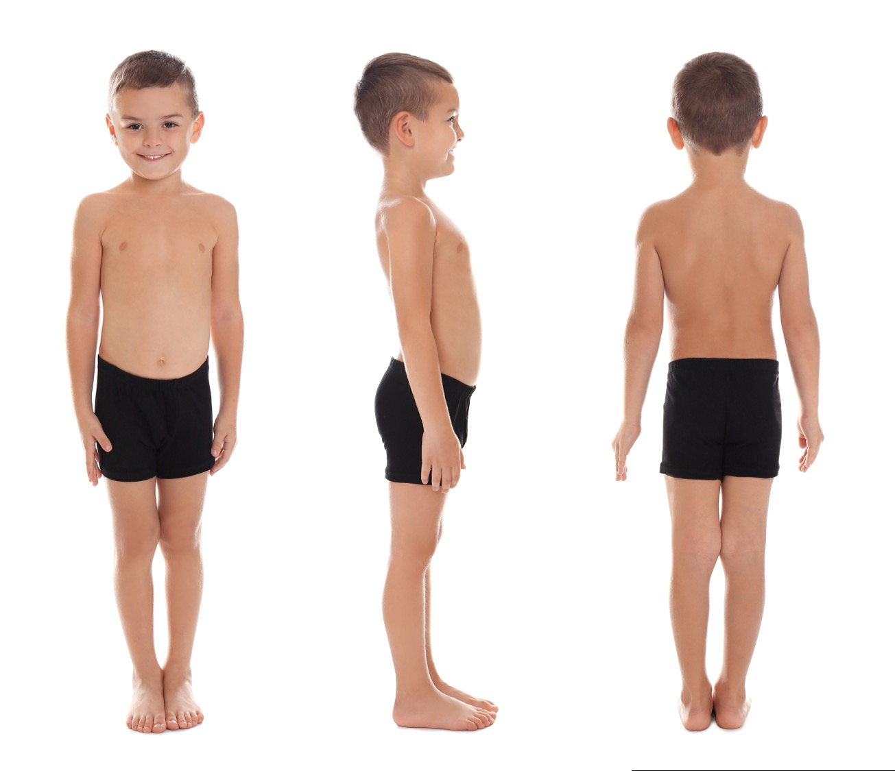
Activity:
Names for parts of our body

Slide 4
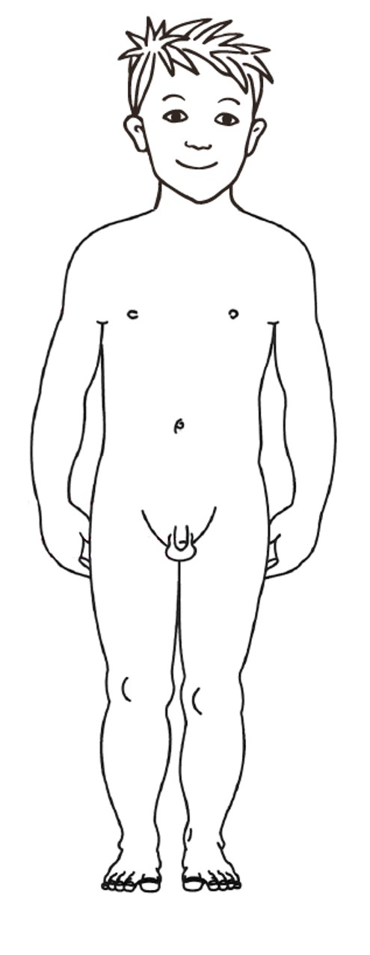
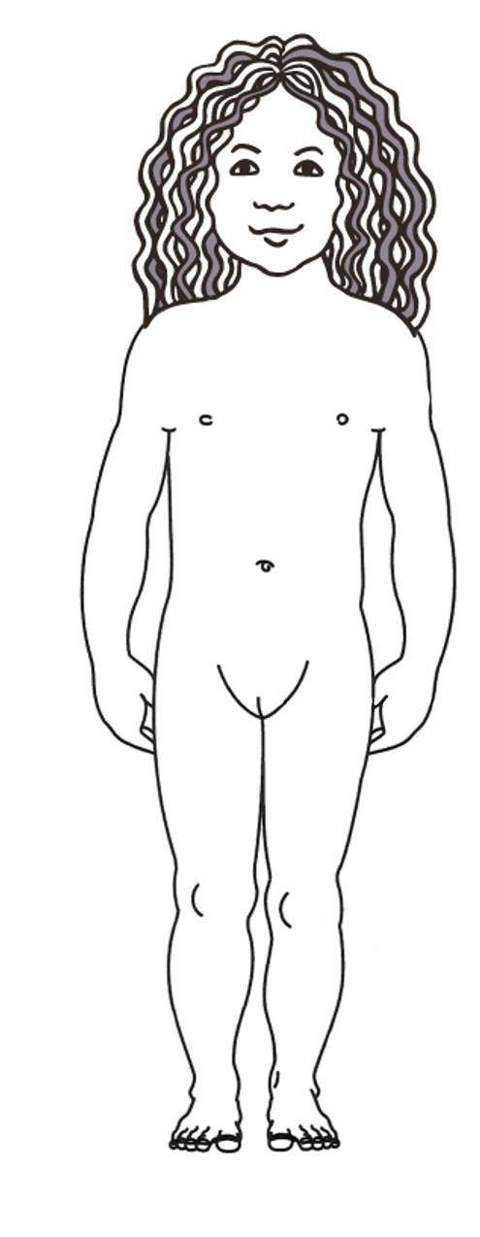
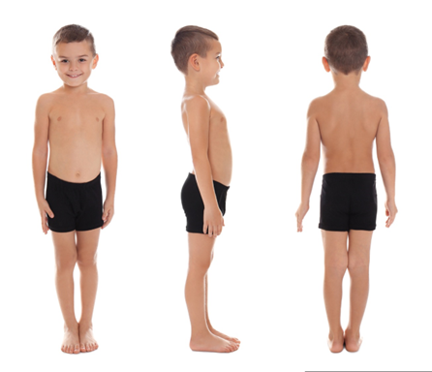
Nipples
Both boys and girls have nipples.
When a girl grows, she will develop breasts.
If a woman has a baby, then she can breast feed her baby; the baby would get milk from its mum’s nipples.

Slide 5
Penis
Boys have a penis. Every penis is different. When a boy urinates, it comes down a tube called the urethra that goes to the end of his penis where it comes out.
Scrotum and testicles
The scrotum is the sack of skin that hangs under the boy’s penis. Inside there are the testicles.

Slide 6
Vulva
Girls have a vulva. Every vulva is different. When a girl goes to the toilet to urinate, it comes down a tube called the urethra which ends just inside the vulva, so that’s where the urine comes out.

Slide 7
Names for private parts of my body

Slide 8
Names for private parts of my body

Slide 9
Names for private parts of the body

Slide 10
Names for private parts of the body
The genitals are the private parts of our bodies. For the boy the penis and scrotum and for a girl the vulva.

Slide 11
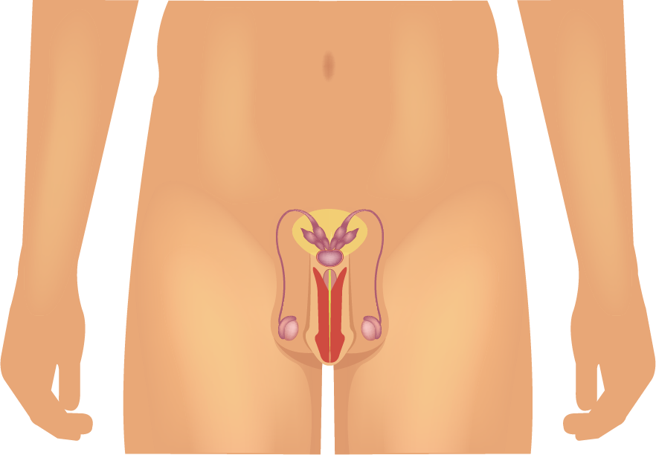
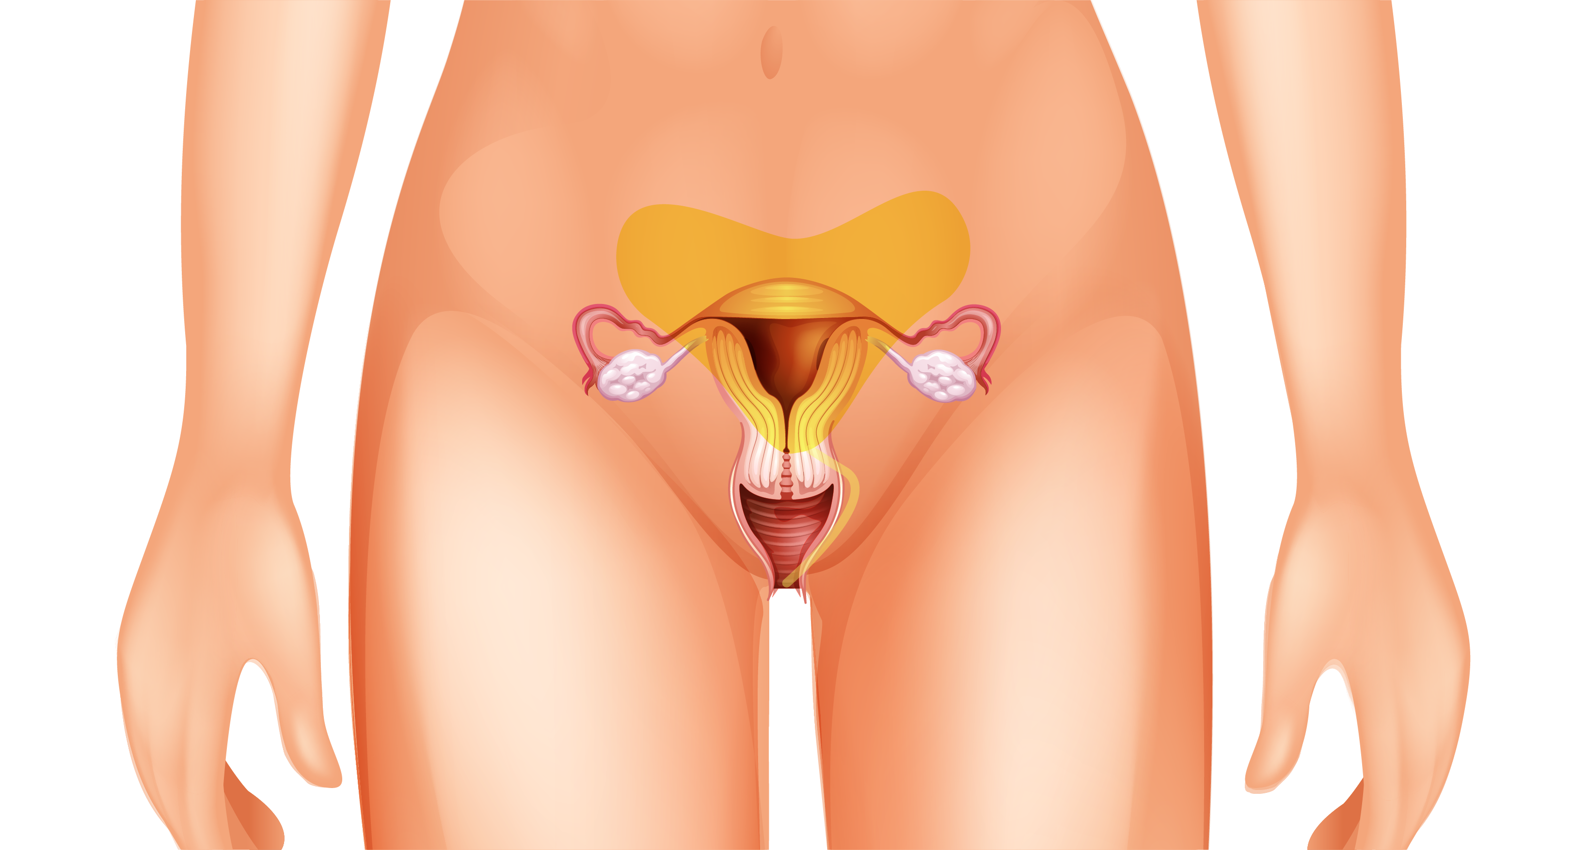
Connected to our genitals, inside our body, are parts of our body called reproductive organs because they are used to make a baby.

Slide 12
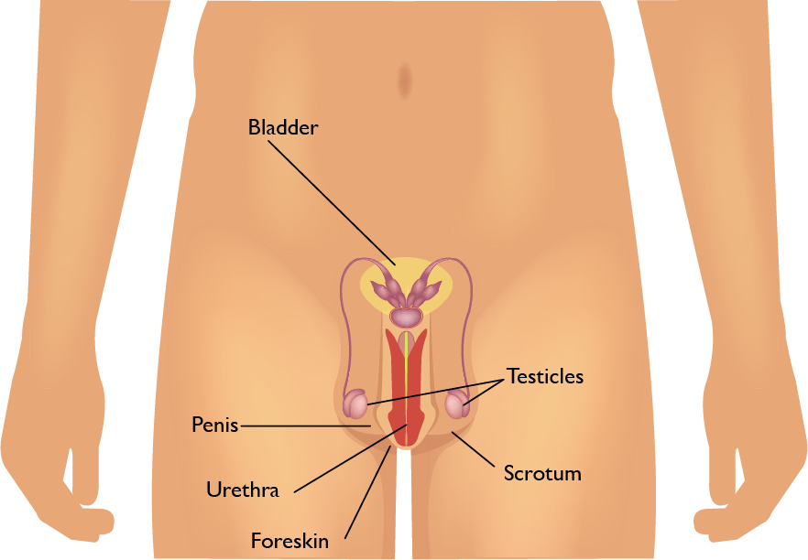
Male reproductive organs

Slide 13
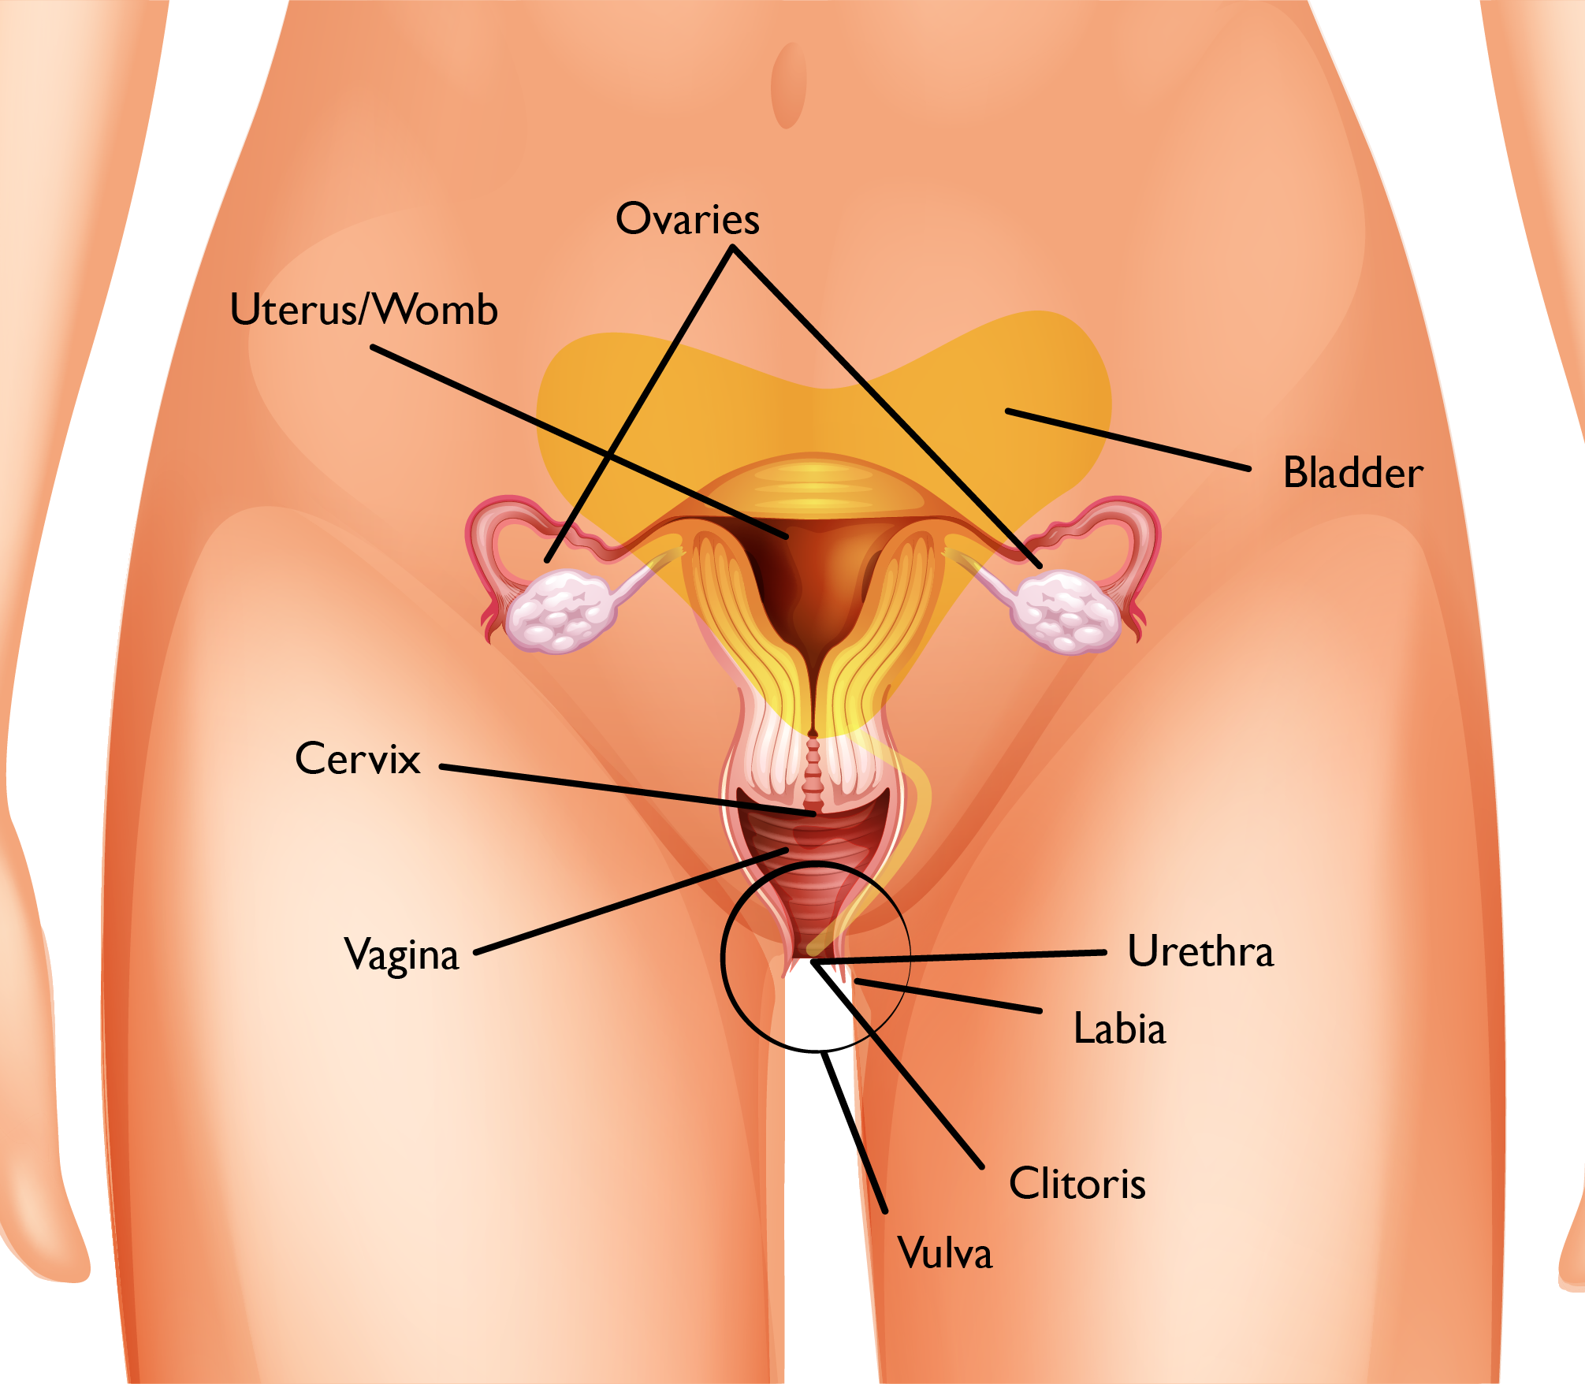
Female reproductive organs

