Slide 1
Social Media: Me online/How we use social media
I can describe what I do online.
I reflect on my own behaviour and actions when I am online.
I can reflect on the benefits and risks involved in being online.
I have strategies to deal with situations that cause me concern.
I can identify people or places to go to when I have questions or a worry.

Slide 2
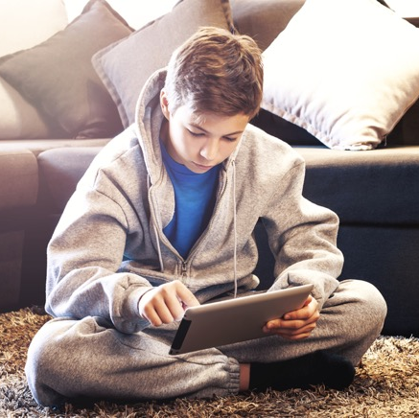
Me online now
What are the main sites or apps or games that I use day to day?
How much time in a day do I spend on each?

Slide 3
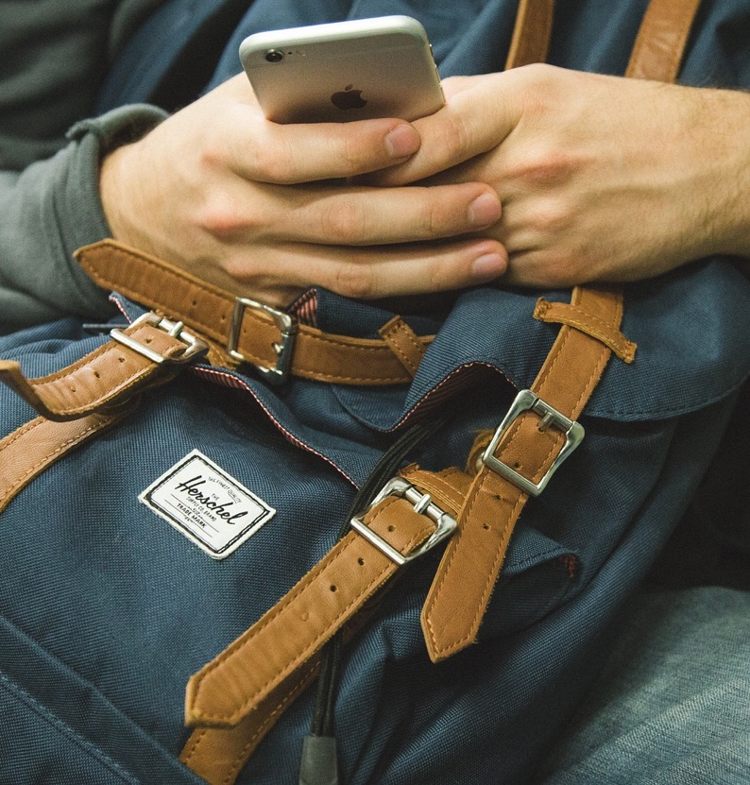
Do your parents/carers know much about what you do online?
If someone said something unkind about you on social media, would you block them?
Would you consider any followers you have on any site as friends?

Slide 4
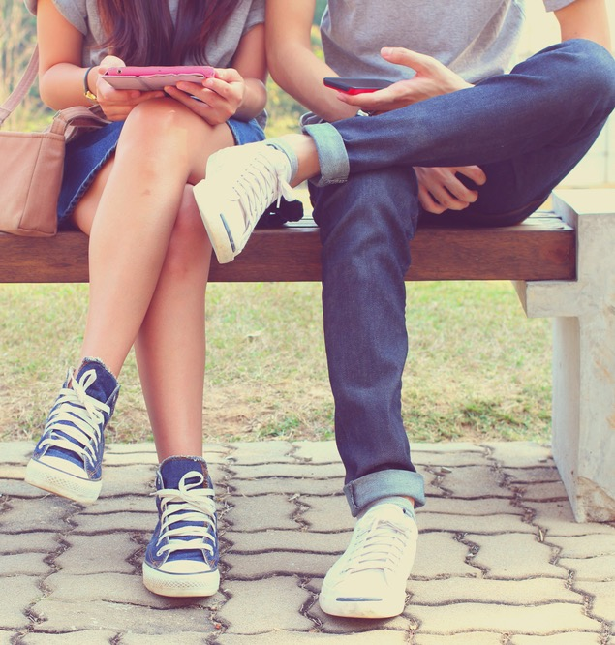
Social media – good or bad?

Slide 5
Excessive social media use harms children's mental health
Children who go on social networking sites for more than three hours a day are more likely to have mental health problems, a study has shown

Slide 6
Using social media for good

Slide 7
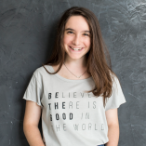
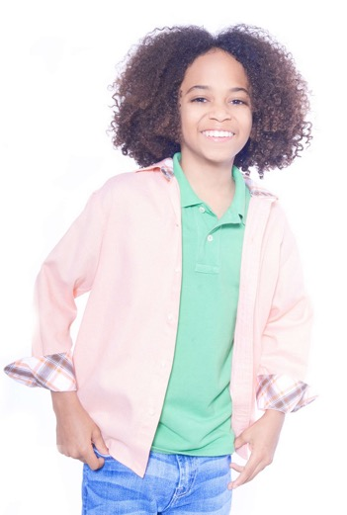
Young people using social media for good
Example 1: Hannah Alper motivates people of all ages to identify their passion and take action People might donate money or carry our acts of kindness to help others.
Example 2: Joshua Williams is on a mission to end hunger locally, across the country and around the world https://joshuasheart.org/
Volunteers distribute donated clothes, toys and food.
Notes:
Might want to add more examples to teaching notes in case teachers not familiar. Nicer to have a photo of Joshua and Hannah here.

Slide 8
Do you know of other examples of using social media for good?
Can you think of any ways young people could use social media for good?

Slide 9
Social media – good or bad?

