Slide 1
Romantic and Loving Relationships: Love
I can talk about the importance of communication, honesty and trust in relationships.
I can talk about the kind of partner I would want to involved with, and what I would bring to a relationship.
I understand that adults can be married, in a civil partnership or live together.
I am developing skills and confidence to make decisions about the relationships I want.

Slide 2
What is love?

Slide 3
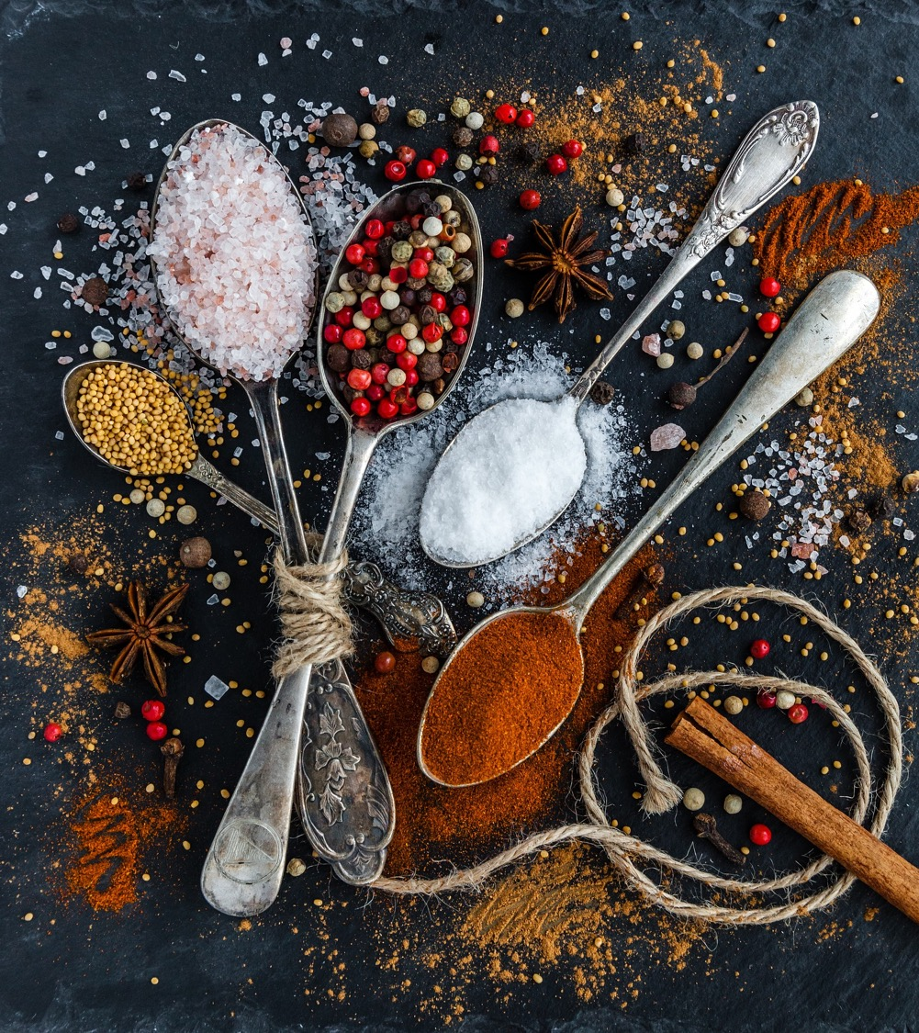
The ingredients of a loving relationship

Slide 4
‘What does it mean to love someone?’
A theory of love.
Robert Sternberg, from Yale University in the United States, says that love is made up of 3 things in a relationship. He says a couple needs at least 2 of these to have a good enough relationship, but to be in love with someone, all 3 need to be present.

Slide 5
Intimacy
Passion
Love
Commitment

Slide 6
What does Intimacy mean?

Slide 7
Intimacy means feelings of closeness, connectedness, and bondedness in loving relationships. It is the experience of warmth in a loving relationship.
Intimacy

Slide 8
What does Passion mean?

Slide 9
Passion refers to the strong feelings we have that lead to romance and physical attraction and possibly to having sex.
Passion

Slide 10
What does Commitment mean?

Slide 11
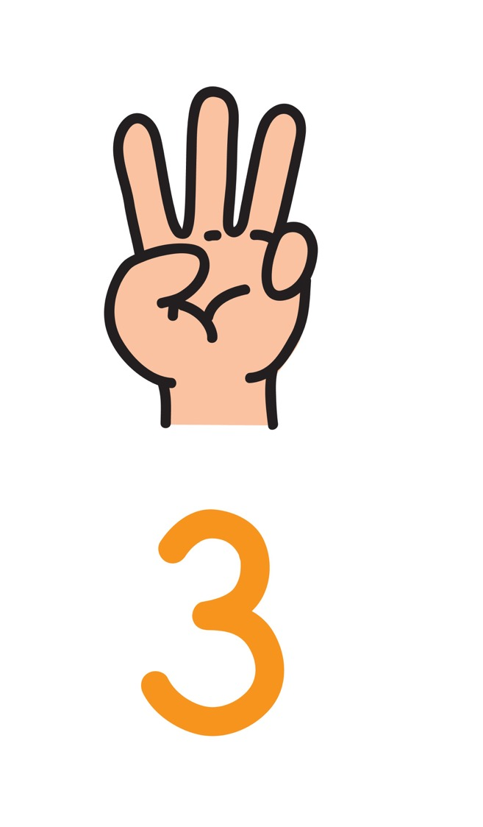
Commitment is about the decision that one loves someone else, and in the long term, the commitment to maintain that love.
Commitment

Slide 12
Passion refers to the strong feelings we have that lead to romance and physical attraction and possibly to having sex.
Intimacy means feelings of closeness, connectedness, and bondedness in loving relationships. It is the experience of warmth in a loving relationship.
Intimacy
Relationship
Passion
Love
Relationship
Relationship
Commitment is about the decision that one loves someone else, and in the long term, the commitment to maintain that love.
Commitment

Slide 13
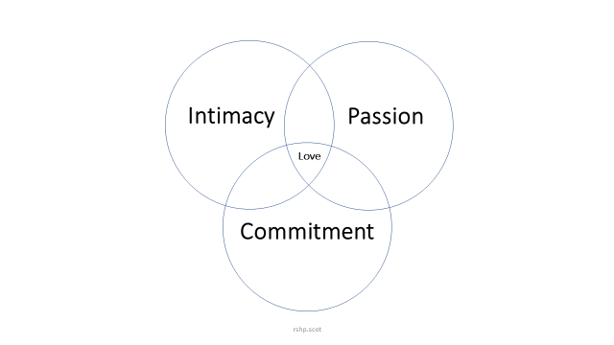
Intimacy, Passion and Commitment
Do you think there is more to love than these three things?
Is one more or less important to you?
Thinking about passion…. Does that have to mean having sex?
Is sex necessary for love?

Slide 14
So, how important is the idea or the experience of love to young people today?

