Slide 1
Gender Equality: Relationships
I can talk about what equality means to me.
I can explain what the law says about gender equality and sex discrimination.
I know that learning and work environments must be places of equality and safety for me.
I am building skills and confidence to seek information, support or help when I need it and if my rights are infringed.

Slide 2
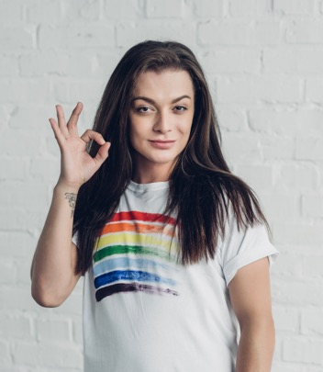
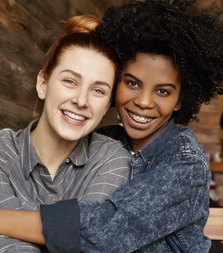
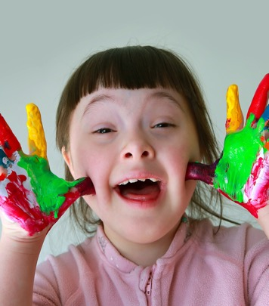
What is equality?
Equality is about making sure that every person has the same chances to make the most of their lives and talents.

Slide 3
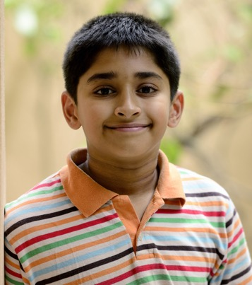
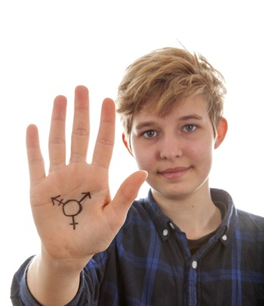
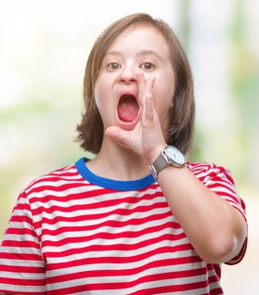
What is equality?
It is also the belief that no one should have poorer life chances because of the way they were born, where they come from, what they believe, or whether they have a disability.
Equality recognises that certain groups of people like girls/women, LGBT people, people with disabilities or people from Black/Minority Ethnic communities have experienced discrimination.

Slide 4
What is gender equality?
Gender equality, also known as sex equality, or equality of the genders, is the view that everyone should receive equal treatment and not be discriminated against based on their gender.

Slide 5
Gender Equality in relationships

Slide 6
Equality between men and women in the family/at home.
What would this mean?

Slide 7
Equality between men and women in friendships.
What would this mean?

Slide 8
Equality between men and women if they are in a relationship.
What would this mean?

Slide 9
Equality between men and women in society, in general.
What would this mean?

Slide 10
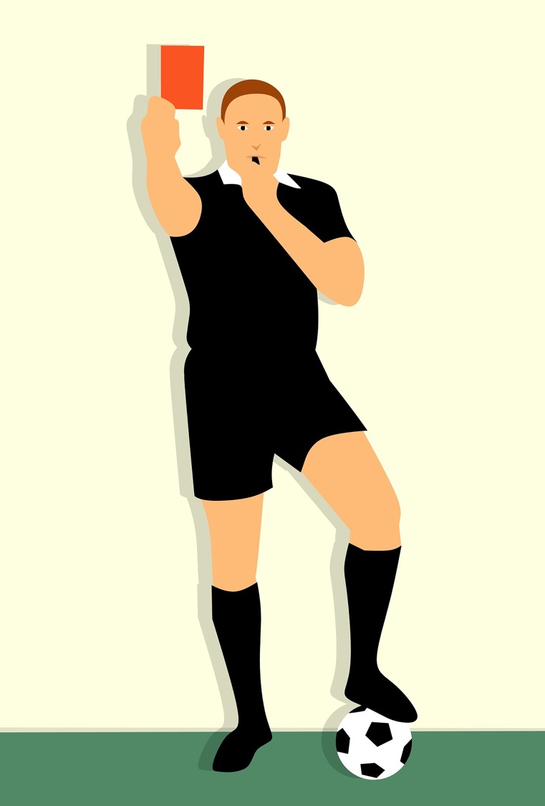
Activity:
Red Card
An equal relationship is one where one person doesn’t use power to put down or control their partner.

Slide 11
1. Your partner tells you what to do.

Slide 12
2. You like to spend time with each other.

Slide 13
3. You are expected to clean or tidy up your partner’s stuff.

Slide 14
4. Your partner wants to know the password to your social media.

Slide 15
5. Your partner puts you down in front of pals.

Slide 16
6. You both like to pay for things when you are out.

Slide 17
7. Your partner is moody.

Slide 18
8. It’s okay to say:
‘No I won’t be able to see you tonight’.

Slide 19
9. Your partner wants to meet your family.

Slide 20
10. Your partner grabs you by the arm and it hurts.

Slide 21
11. Your partner likes to do romantic things.

Slide 22
12. Your partner pressures you to have sex.

Slide 23
13. Your partner has a temper, you don’t want to upset them.

Slide 24
14. You like to buy each other presents.

Slide 25
15. You can both see your friends without each other also being there.

Slide 26
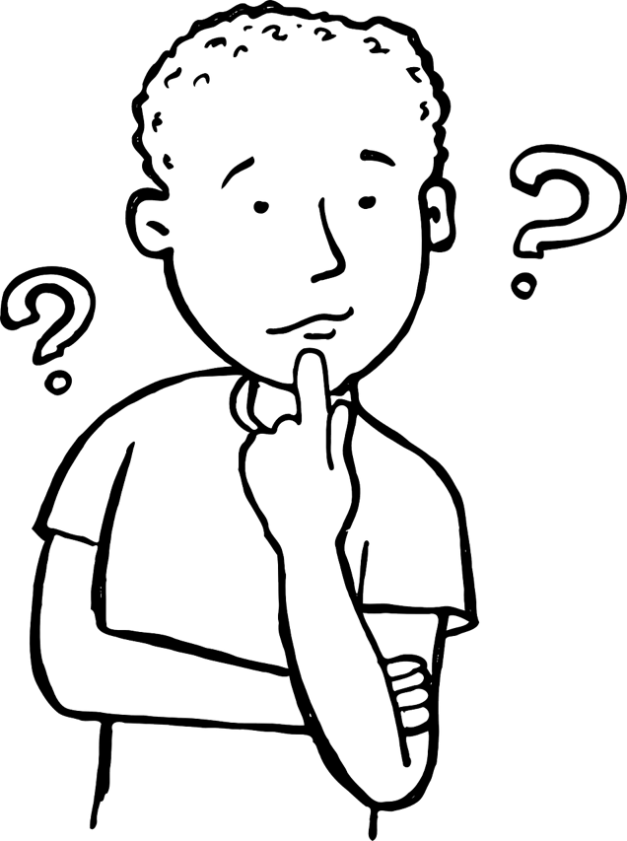
1. Your partner tells you what to do.
2. You like to spend time with each other.
3. You are expected to clean or tidy up your partner’s stuff.
4. Your partner wants to know the password to your social media.
5. Your partner puts you down in front of pals.
6. You both like to pay for things when you are out.
7. Your partner is moody.
8. It’s okay to say: ‘No I won’t be able to see you tonight’.
9. Your partner wants to meet your family.
10. Your partner grabs you by the arm and it hurts.
11. Your partner likes to do romantic things.
12. Your partner pressures you to have sex.
13. Your partner has a temper, you don’t want to upset them.
14. You like to buy each other presents.
15. You can both see your friends without each other also being there.

Slide 27
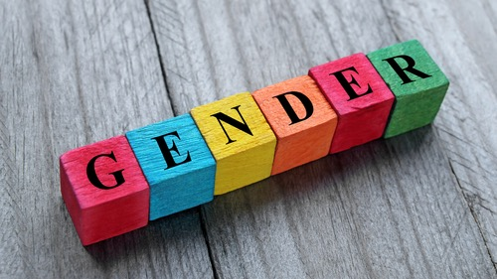
Regardless of gender, in an equal relationship you feel….

Slide 28
Feminism is a movement to bring about equal rights for women.
Feminism is about making sure women and girls can be free to be who they want to be.
Feminism is important now because while in many ways men/boys and women/girls have the same opportunities there are still important ways in which women and girls are discriminated against.

Slide 29
The personal is political

Slide 30
The personal is political.
We are talking about equality. This means changing society to make it fairer for everyone (the political) and for feminism there is a need to think about how we live together in equal ways day-to-day (the personal). Everything we do in our interactions with others is in some way political.

Slide 31
“Where, after all, do universal human rights begin? In small places, close to home - so close and so small that they cannot be seen on any maps of the world. Yet they are the world of the individual person; the neighbourhood he lives in; the school or college he attends; the factory, farm, or office where he works... Unless these rights have meaning there, they have little meaning anywhere”.
Eleanor Roosevelt

Slide 32
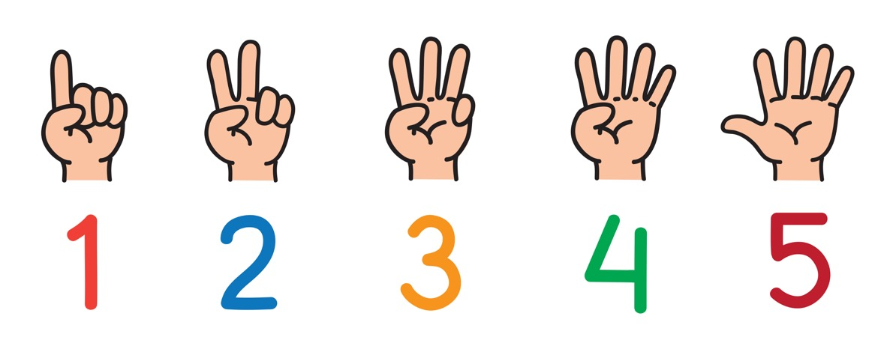
What can I do to bring about equality between girls/women and boys/men?

Slide 33
ChildLine
www.childline.org.uk
If you're under 19 you can confidentially call, email or chat online about any problem big or small
Freephone 24h helpline: 0800 1111
Sign up for a ChildLine account on the website to be able to message a counsellor anytime without using your email address
Chat 1:1 with an online advisor

