Slide 1
Emotional Wellbeing: Feeling emotional
I reflect on the importance of both my physical and mental/emotional health.
I can recognise when I feel sad, depressed, anxious or stressed.
I understand that mental ill-health is stigmatised and I can show empathy and understanding for others.
I know who or where I can go to for support or if I have a worry or a question.

Slide 2
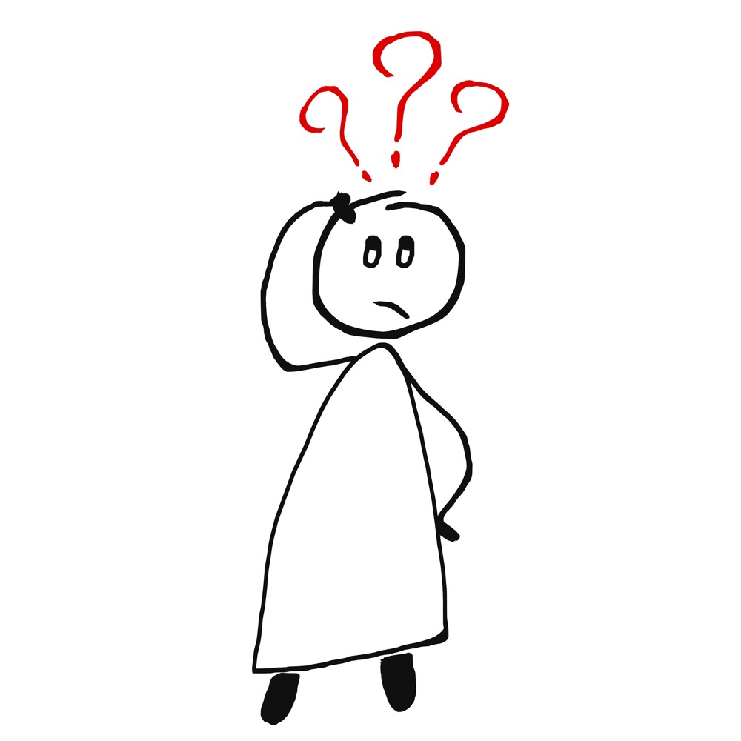
Feelings check-in.
When I woke up this morning, I felt…
Just before coming into this class, I felt…
Right now, I feel…

Slide 3
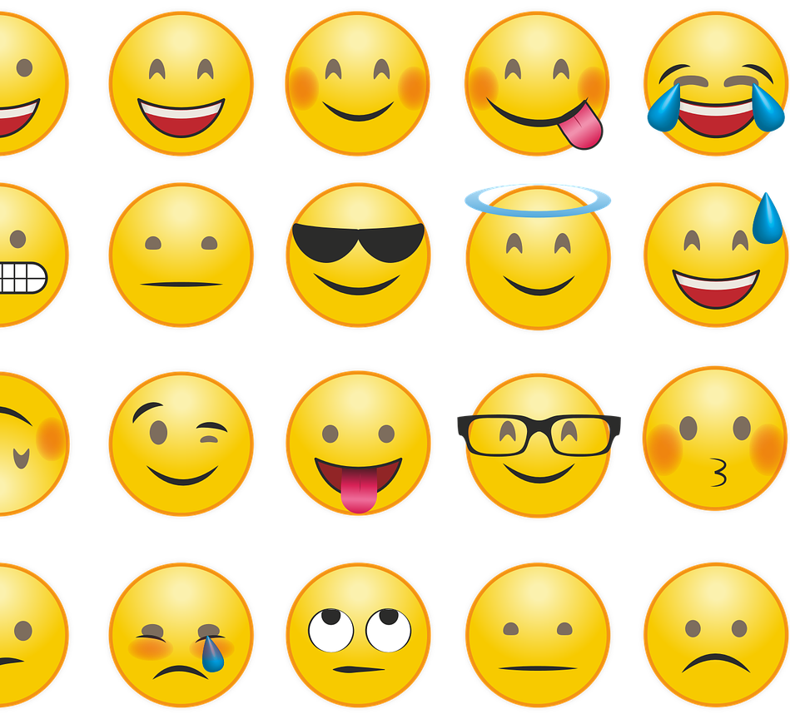
Our feelings really matter.
Sad and happy: Feelings happen
(5 minutes 8) https://youtu.be/Ocj0gyZwL5Y

Slide 4
How many feelings can a person have?

Slide 5
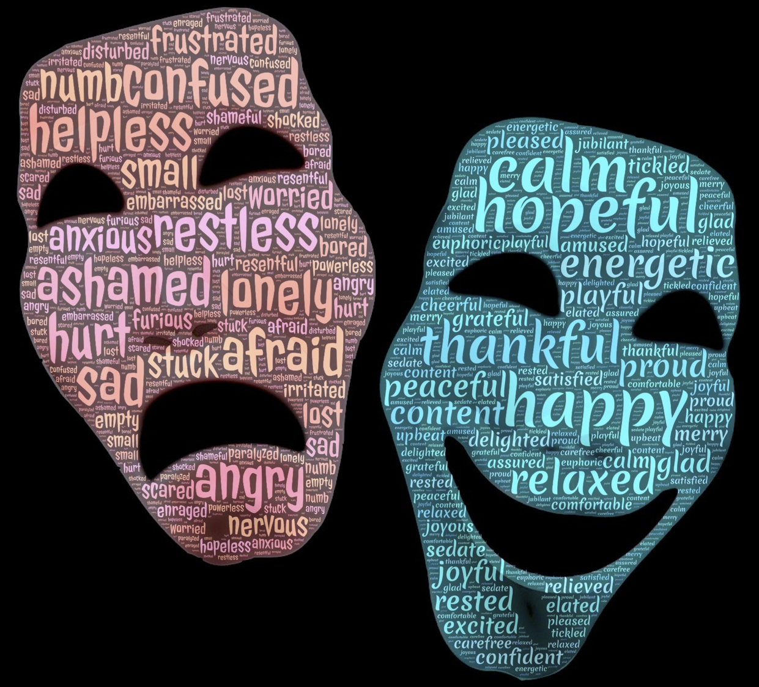

Slide 6
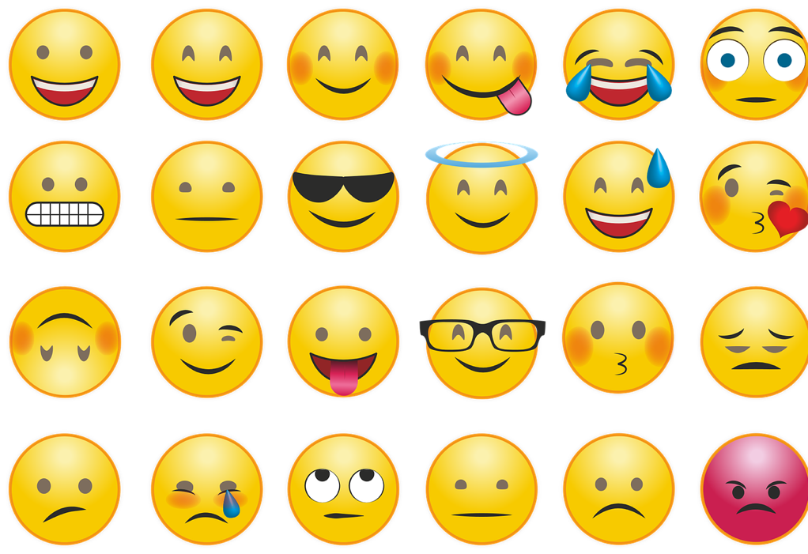
Psychologist Robert Plutchik says there are 8 Basic Human Emotions:
Joy
Surprise
Sadness
Anger
Disgust
Fear
Trust
Anticipation

Slide 7
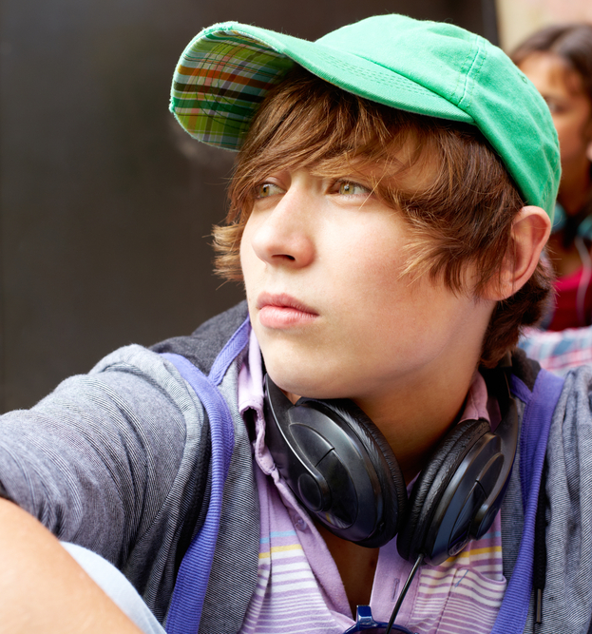
Just like we all have our physical health, we all have mental health.
When we have good mental health, this means we can think, feel and act in a way that allows us to enjoy life and deal with the challenges it presents.

Slide 8
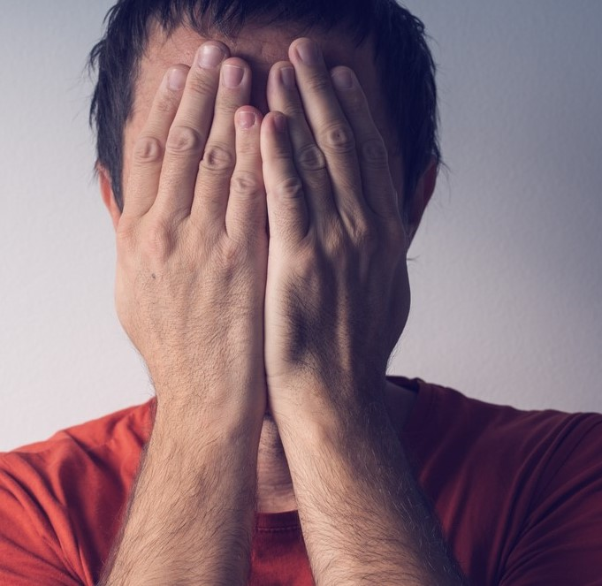
When we have a mental health problem, we might feel stressed or unable to cope with everyday things.
This might make it difficult to do things like go to school or be with other people.

Slide 9
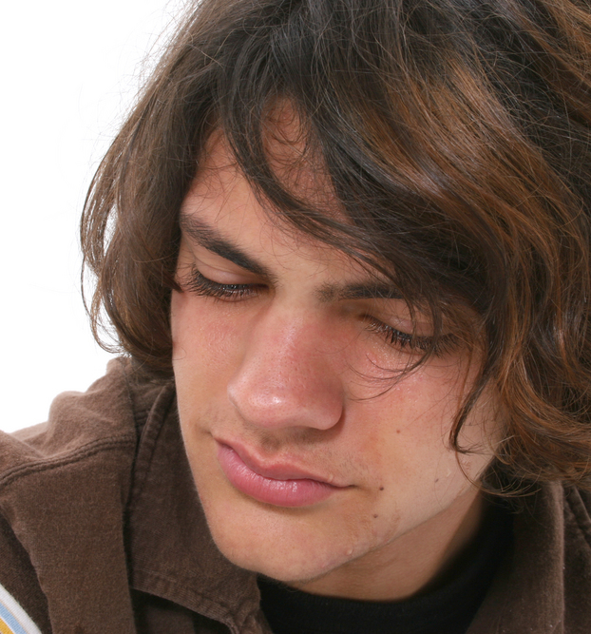
What is a mental health problem?
The most common are:
Depression
Anxiety and feeling fearful
Stress – this is feeling overwhelmed or unable to cope

Slide 10
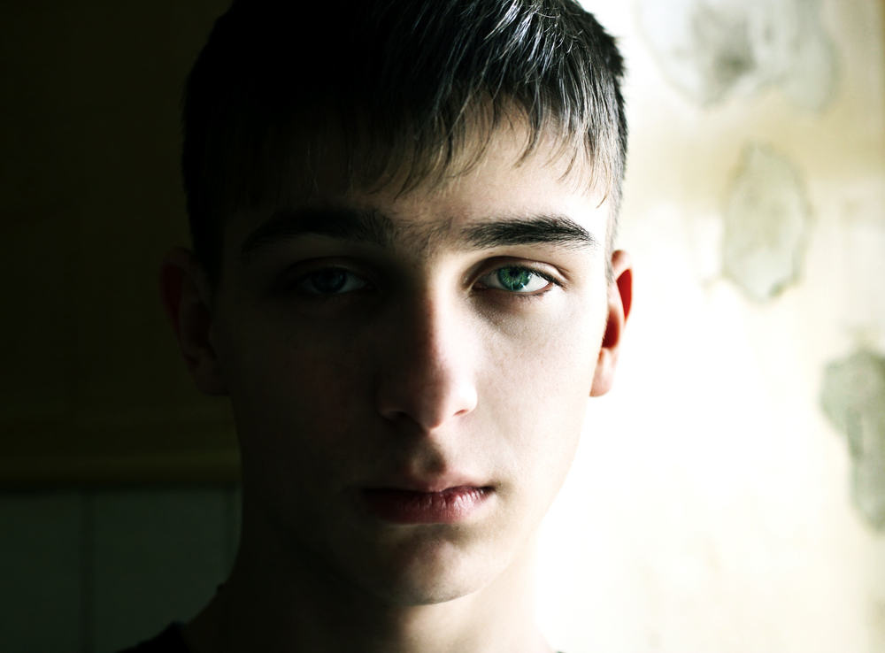
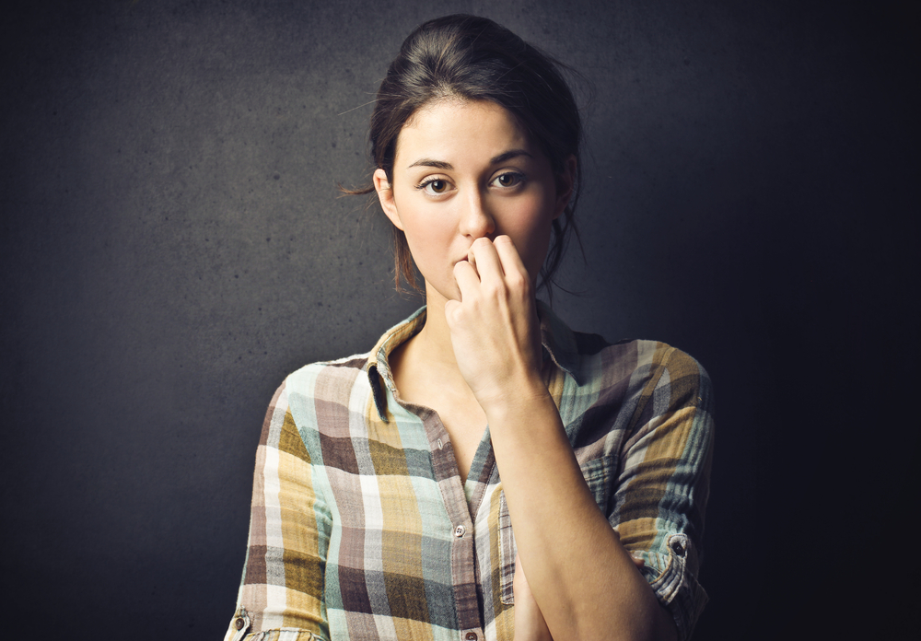
When people have a mental health problem, they may do things that are not good for them as they try to cope, things like:
Eating too much or eating unhealthily
Becoming isolated or lonely
Self-harm
Drinking alcohol or taking drugs

Slide 11
Thinking about the mental health of young people
Create a scenario:
What is your character’s name?
What age are they?
What is happening in their lives at the moment?
How are they feeling about it?

Slide 12
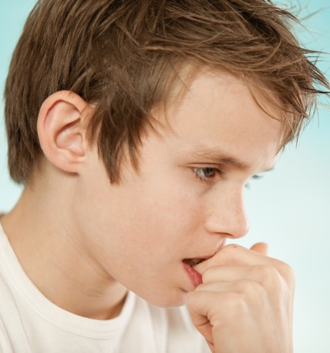
The scenario example
What is your character’s name? Charlie
What age are they? 13
What is happening in their lives at the moment? His mum and dad have been fighting a lot for a long time. His little sisters are upset. He overheard his mum talk about getting divorced. Nobody seems to care how he is feeling.
How are they feeling about it? He just feels nervous and sick all the time. He’s been missing school because he is worried his mum or dad just won’t be there when he gets home.

Slide 13
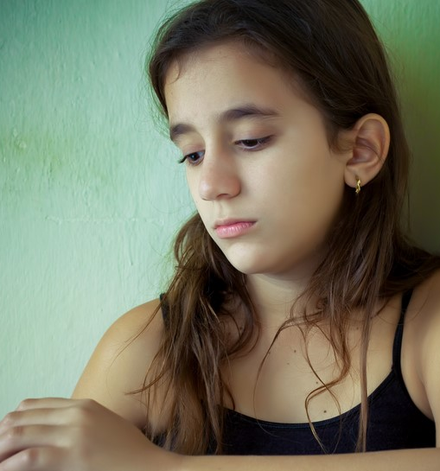
What’s your character’s name? Gina
What age are they? 14.
What is happening in their lives at the moment? She has an important class test coming up. Her granny has been paying for extra lessons, but Gina is still struggling.
How are they feeling about it? She is worried she will fail her test but can’t tell her granny in case she is angry.
Notes:
Picture of Gina. This one taken from 2.12 How human life begins

Slide 14
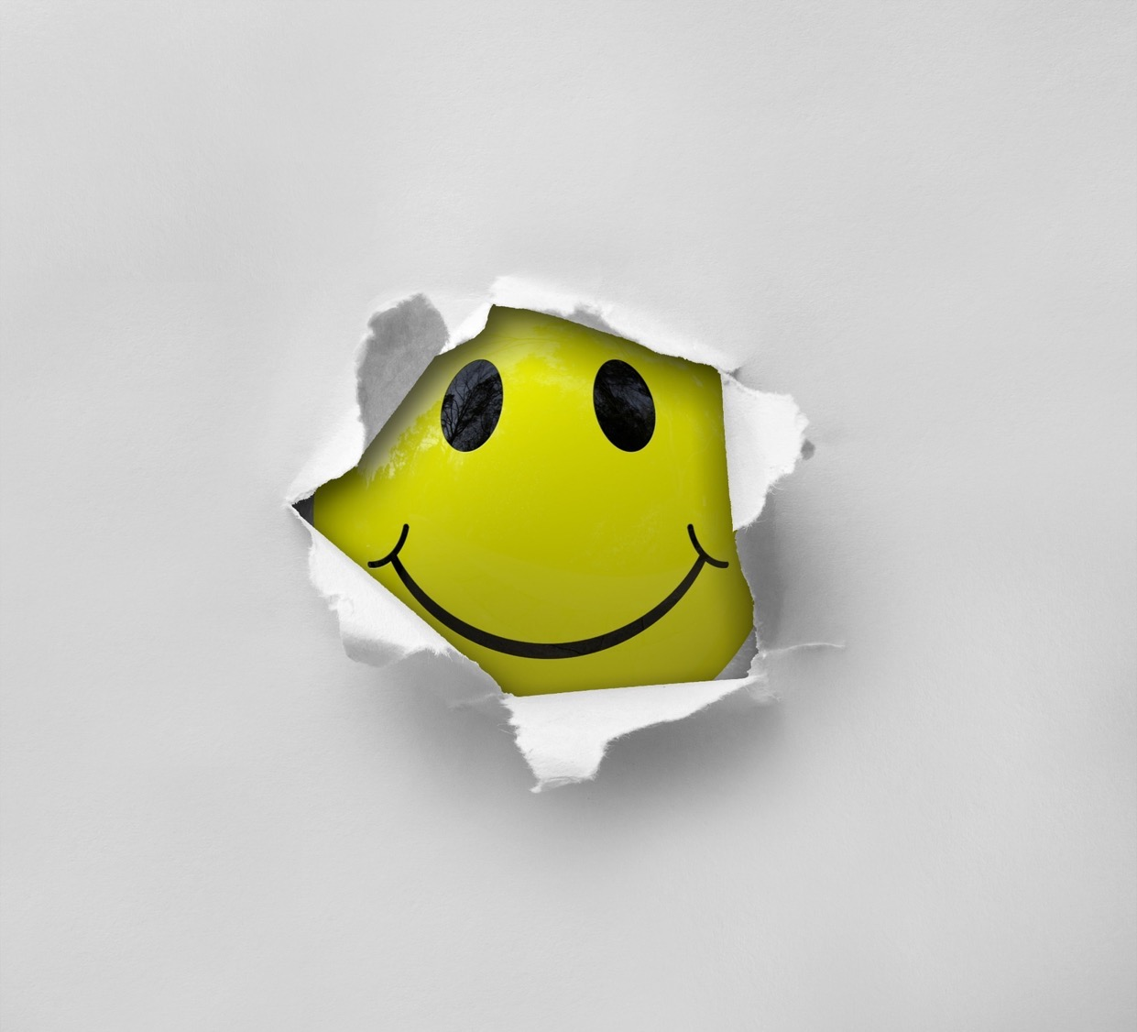
Reflection
What have you done right today?
Have you done something good for another person?
Have you had fun?
Have you felt proud of yourself?

Slide 15
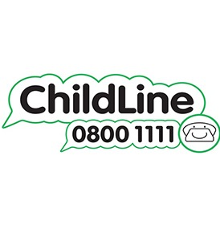
ChildLine
www.childline.org.uk
If you're under 19 you can confidentially call, email or chat online about any problem big or small
Freephone 24h helpline: 0800 1111
Sign up for a ChildLine account on the website to be able to message a counsellor anytime without using your email address
Chat 1:1 with an online advisor

