Slide 1
Equality and Feminism
I understand what gender/sex-based equality means.
I can talk about what gender/sex-based equality and feminism mean to me.
I am developing skills and confidence to challenge inequality and abuse of power.

Slide 2
Men can…
Women can….

Slide 3
Question time
Do you believe in the equality of all people?

Slide 4
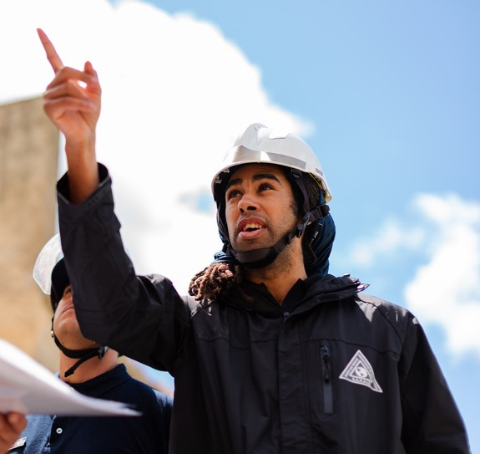
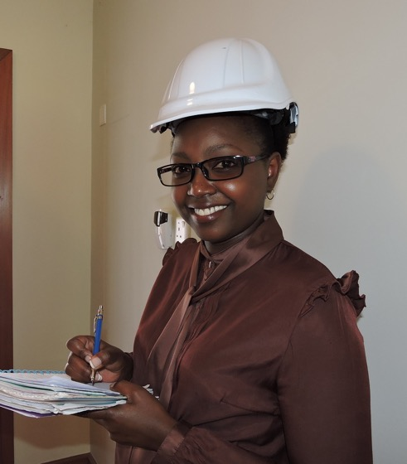
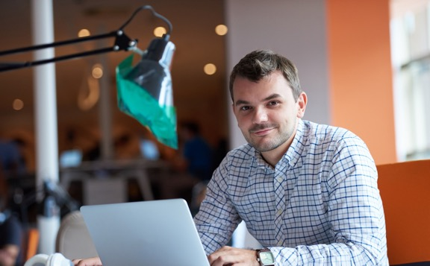
Do you believe that women and men should be paid the same money for the same job?

Slide 5
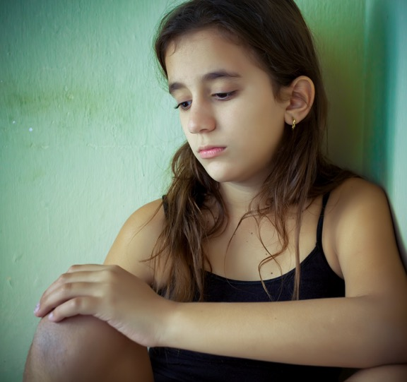
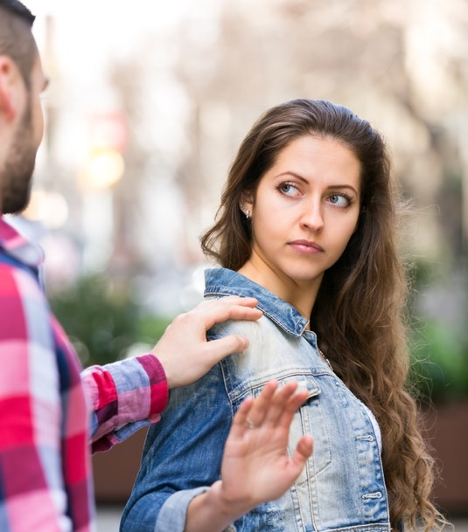
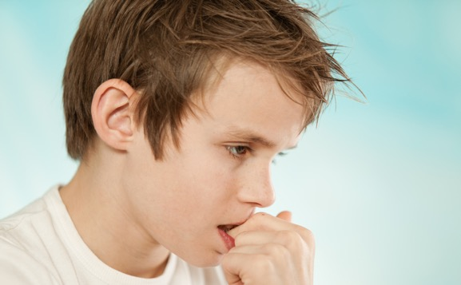
Do you believe that everyone should be safe in their own home and in the street?

Slide 6
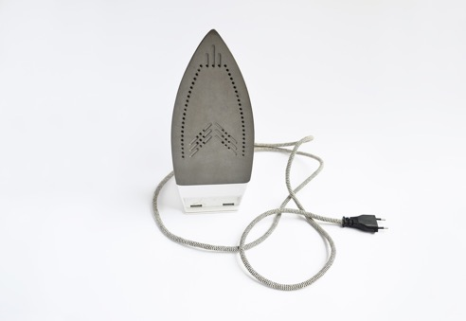
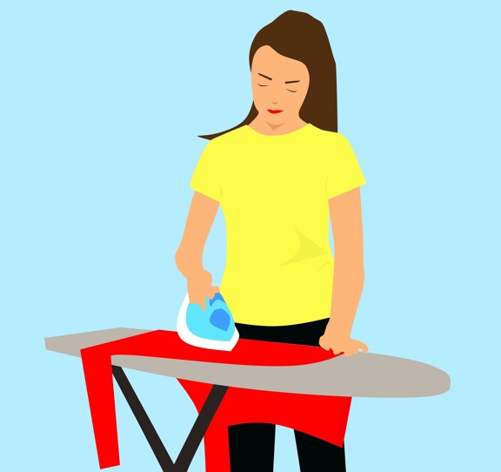
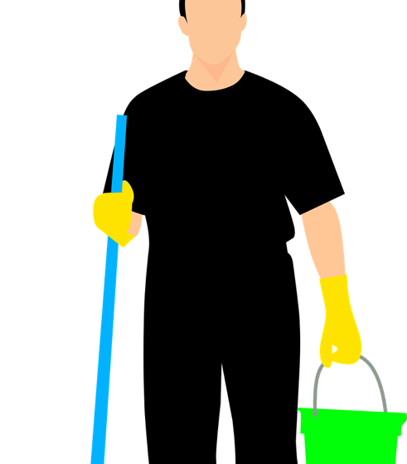
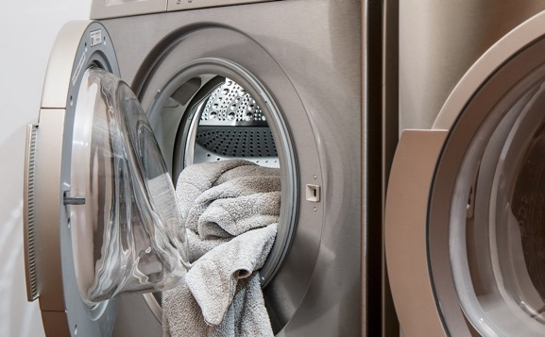
Do you think boys/men and girls/women should do the same amount of work at home?

Slide 7
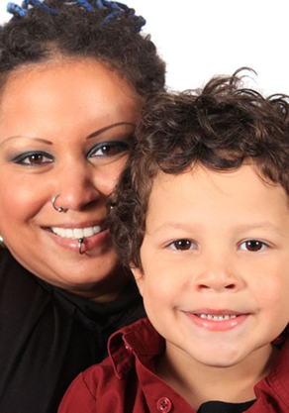
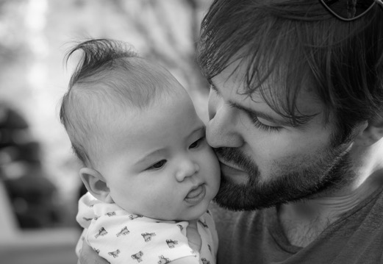
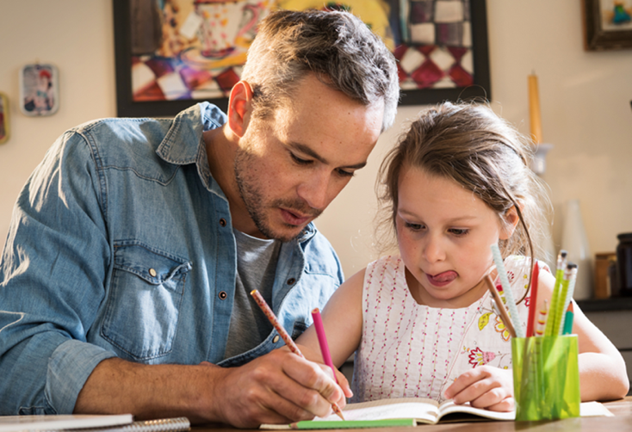
Do you think that women and men should be equally involved in bringing up their children?

Slide 8
What is equality?
Equality is about making sure that every person has the same chances to make the most of their lives and talents.

Slide 9
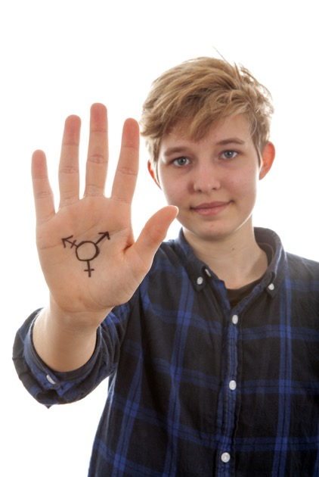
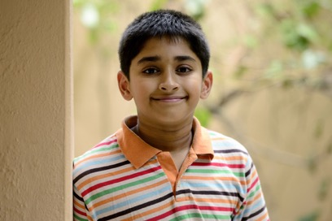
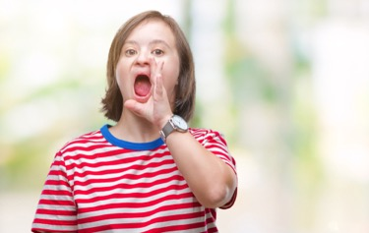
What is equality?
It is also the belief that no one should have poorer life chances because of the way they were born, where they come from, what they believe, or whether they have a disability.
Equality recognises that certain groups of people like girls/women, LGBT people, people with disabilities or people from Black/Minority Ethnic communities have experienced discrimination.

Slide 10
Feminism is a movement to bring about equal rights for women. Feminism is about making sure women and girls can be free to be who they want to be.

Slide 11
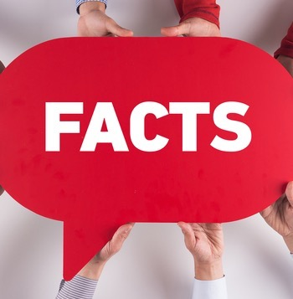
Feminism is important now because while in many ways men/boys and women/girls have the same opportunities, there are still important ways in which women and girls are discriminated against.

Slide 12
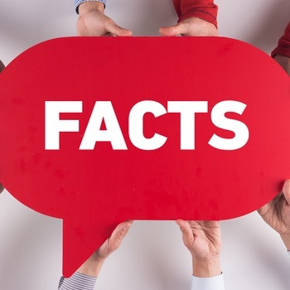
Although women make up 51% of the population, they are in the minority in positions of power such as being an MSP (45% are women). Only 11% of countries have a woman who is Head of State, like a President or Prime Minister.
Girls can be made to feel that certain subjects (like science or computing) or activities (like football or gaming) are not for them. This can apply to boys too; they might not feel they can do subjects like home economics or dance.

Slide 13
Women might be paid less than men for doing the same/similar job. In almost all big companies there is gender pay gap – so on average women workers earn less than men do.
In many families, women/girls are expected to do more of the domestic chores or childcare.

Slide 14
Women/girls are often expected to look and behave in certain ways – to be a stereotype of what feminine should be. On the other hand, when they enjoy dressing up, they can be called negative things and blamed if they are harassed or attacked.
Women and girls are more likely to experience sexual harassment and sexual violence. Women and girls can be blamed or shamed when they are the ones who experience these things.

Slide 15
Question time Part 2:
Feminism is a movement to bring about equal rights for women. Feminism is about making sure women and girls can be free to be who they want to be.
Do you consider yourself to be a feminist?

Slide 16
Can a man be a feminist?
What has feminism got to do with boys and men?

Slide 17
Can you imagine a world in which women and men are equal?

Slide 18
He for She
The world is at a turning point. People everywhere understand and support the idea of gender equality. They know it’s not just a women’s issue, it’s a human rights issue. And when these powerful voices are heard, they will change the world. The time for that change is now. HeForShe is inviting people around the world to stand together to create a bold, visible force for gender equality. And it starts by taking action right now to create a gender equal world.
http://www.heforshe.org/en

