Slide 1
About Sexually Transmitted Infections (STIs) and Blood Borne Viruses (BBVs)
I can name STIs/BBVs and explain how they are transmitted.
I can recognise general symptoms (including that there might be none) of STI infection.
I have knowledge and skills that support me to make decisions to protect my own sexual health and that of others.
I know where to go for information, advice or support.

Slide 2
Why are we talking about STIs/BBVs?
STI stands for Sexually Transmitted Infection
BBV stands for Blood Borne Virus
In Scotland 64% of all STI diagnoses made (that’s 2 in every 3) are in those younger than 25 years.
There was an 80% increase in gonorrhoea diagnoses in young people between 2018 and 2022.
In some areas diagnoses of chlamydia has nearly doubled in the past year.

Slide 3
Why are we talking about STIs/BBVs?
Since the covid pandemic, fewer young people now go for testing.
Young people might not go for an STI test because they feel embarrassed, they don’t have symptoms, they worry it isn’t confidential or they are worried what a positive result might mean.

Slide 4
How many STIs or BBVs have you heard of?

Slide 5
How many STIs or BBVs have you heard of?
Chlamydia
Genital Herpes
Genital Warts (HPV)
Gonorrhoea
Hepatitis
HIV
Pelvic Inflammatory Disease
Pubic Lice (Crabs)
Syphilis
Trichomoniasis (Trich)
Mpox

Slide 6
STIs and BBVs
Some are viruses.
A virus is a small infectious agent that grows inside the living cells of other organisms.
Viruses can infect humans, other animals and plants. For example, the common cold and the flu are caused by a virus.
Genital Herpes, Genital Warts, Hepatitis A, B and C, HIV and Mpox are sexually transmitted viruses.
Treatment can include lotion, anti-viral drugs and medicine.

Slide 7
STIs and BBVs
Some are bacteria.
Bacteria are very small organisms. Some bacteria can cause disease.
Treatment is often with antibiotics.
STIs that are a bacteria include Chlamydia, Gonorrhoea and Syphilis.
Treatment is often with antibiotics.

Slide 8
STIs and BBVs
Some are parasites.
A parasite lives or feeds on the body.
STIs that are a parasite include Pubic Lice (also called crabs), Trichomoniasis (Trich for short).
The parasite lives in body hair or the genital area. They are very small. Treatment for lice is a cream or lotion. Treatment for Trich is antibiotics.

Slide 9
How are STIs or BBVs transmitted? (How do you get them?)

Slide 10
How are STIs or BBVs transmitted? (How do you get them?)
STI’s like chlamydia and gonorrhoea are transmitted through unprotected oral, anal or vaginal sex (sex without a condom). These can also be caught by sharing sex toys.
Some STI’s can be caught by close bodily contact (such as being naked and intimate together). This includes pubic lice, syphilis, genital warts and mpox.
BBV’s such as HIV can be caught through other means, such as sharing needles and other drug injecting equipment. However, most people in the UK diagnosed with HIV acquired the virus through unprotected vaginal or anal sex.
You can catch HIV through oral sex, but the risk is extremely low.

Slide 11
STIs: symptoms and treatment
A symptom is a change that you notice.
For example if you have chicken pox you would get a fever and feel sick, then you would get spots.
Some STIs/BBVs do not have symptoms.
A symptom of an STI could be sores, blisters, redness, bumps or lumps on or around the genitals (private parts). Or it could be an unusual, coloured or smelly discharge (liquid) from the vagina or penis. Or maybe itching around the genitals or pain when peeing or having sex. But some STIs have no symptoms.

Slide 12
Testing: To find out if you have an STI the doctor or nurse needs to do some tests. This could be a swab from your genitals, a test of your urine or a blood test.

Slide 13
Treatment
Treatment can be a medicine or other advice, like to eat a certain way or rest. Treatment by a doctor or nurse is confidential.
The condition will often get worse without treatment and you will be more likely to pass on the infection to others, which is why testing is important.

Slide 14
What are the best ways to make sure you don’t get an STI/BBV?

Slide 15
What are the best ways to make sure you don’t get an STI/BBV?
To not have sex
To always use a condom for oral, anal or vaginal sex
To not have sex or close genital contact unless you and your partner have both been tested for STI’s/BBV’s

Slide 16
What are the best ways to make sure you don’t get an STI/BBV?
To have a vaccine that is available to prevent certain STIs. For example, you can get a vaccine to prevent types of Hepatitis and mpox. When you got to a sexual health clinic your nurse or doctor can talk to you about this.
If you are at risk of HIV, you can take a preventative treatment called PrEP. The tablets can be taken every day or can be taken in the days before and after sex, depending on what type of sex you have and how often. (More about this in our next lesson).

Slide 17
STIs: True or False?

Slide 18
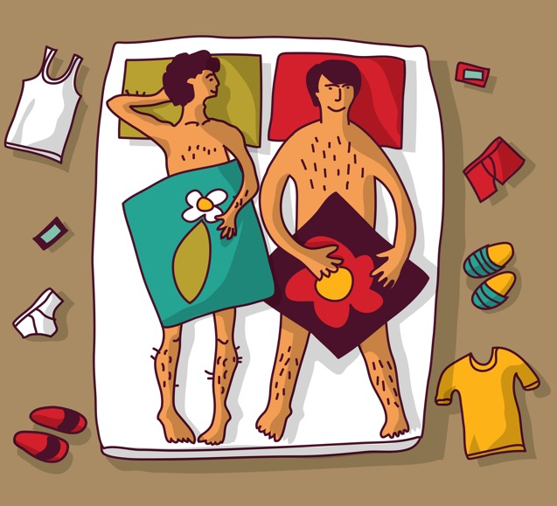
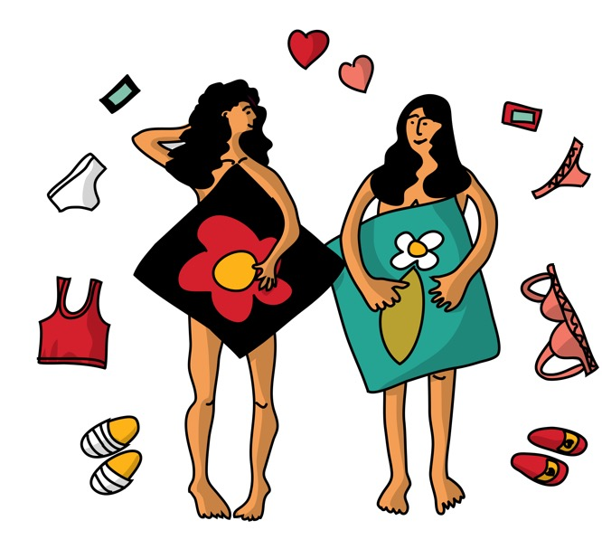
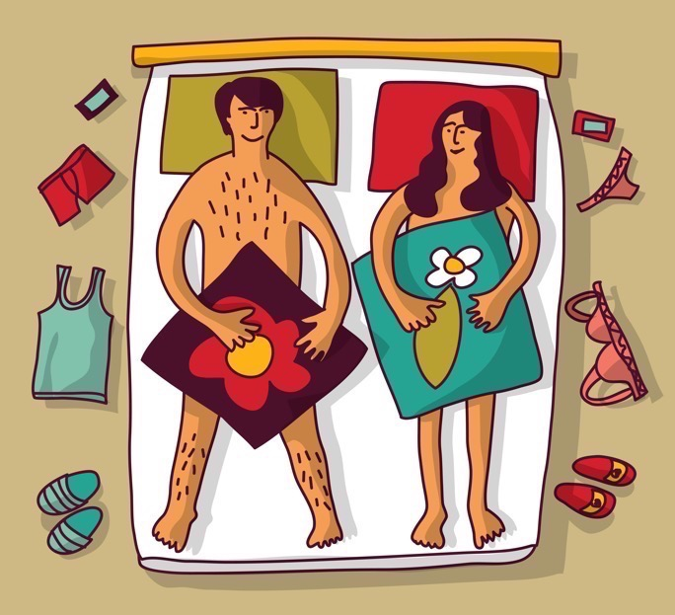
True or False?
Only people who sleep around get an STI/BBV.

Slide 19
Only people that sleep around get an STI/BBV. |  | STIs and BBVs don’t discriminate. If you have sex you are at risk. You can reduce the risk by using condoms.

Slide 20
True or False?
If someone has an STI/BBV you will see it.

Slide 21
If someone has an STI/BBV you will see it. |  | Even a nurse or doctor won’t necessarily know if a person has an STI/BBV just by looking. That’s why they do tests.

Slide 22
True or False?
The best protection against most STI’s/BBV’s is using condoms when having sex.

Slide 23
The best protection against most STIs/BBVs is using condoms when having sex. |  | Condoms don’t provide 100% protection but they are the most effective way to protect yourself.

Slide 24
True or False?
You can avoid STI’s/BBV’s by having oral sex.

Slide 25
You can avoid STIs/BBVs by having oral sex |  | The virus or bacteria that causes most STIs/BBVs can enter the body in the mouth, especially if there are little tears or cuts in the mouth you don’t realise are there.

Slide 26
True or False?
You can protect yourself by limiting the number of sexual partners you have.

Slide 27
You can protect yourself by limiting the number of sexual partners you have. |  | When you are ready to have sex – any kind of sex – have it with just one person and talk to them about it first. The fewer partners you have the less chance you will get an STI/BBV.

Slide 28
True or False?
You can protect yourself by choosing not to have some kinds of sex.

Slide 29
You can protect yourself by choosing not to have some kinds of sex. |  | Sex can include a lot of things. If you choose NOT to have penetrative (oral, vaginal or anal) sex then you will be more protected from STIs/BBVs.

Slide 30
True or False?
Once you’ve had an STI/BBV, you can’t get it again.

Slide 31
Once you have had an STI/BBV you can’t get it again. |  | Some STIs/BBVs like Herpes or HIV are for life. You have to manage them so that you don’t pass them on to others. For other STI’s/ BBV’s you have to protect yourself every time you have sex because you can get them again.

Slide 32
True or False?
If you get checked and you don’t have an STI/BBV, then your partner doesn’t need checked.

Slide 33
If you get checked and you don’t have an STI/BBV then your partner doesn’t need checked. |  | Your partner could have an STI/BBV and not know it. You both need checked.

Slide 34
True or False?
If you are in a relationship and only have sex with each other, you will be protected from STI’s/ BBV’s.

Slide 35
If you are in a relationship and you only have sex with each other you will be protected from STIs/BBVs. |  | This is called being faithful or being monogamous. At the start of a relationship though both partners should have tests to make sure they don’t already have an STI/BBV.

Slide 36
True or False?
Some young people say they are embarrassed or ashamed about going to a Sexual Health clinic in case they have STI/BBV.

Slide 37
Some young people say they are embarrassed or ashamed about going to a Sexual Health clinic in case they have STI/BBV. |  | Yes, but anyone can get an STI/BBV. There is no need to feel embarrassed or ashamed. Your local sexual health clinic has helped lots of young people. No-one will embarrass you or make you feel ashamed. They will get you sorted with anything you need.

Slide 38
Things to remember about STIs
Sex without a condom increases risk of STIs.
Anything that is different or unusual about your genitals (private parts) or body like rashes, blisters, itchiness or spots needs to be checked out at a clinic.

Slide 39
Things to remember about STIs
Remember that not all STIs have symptoms, so when you are sexually active it’s a good idea to have a regular check-up.
More information about STIs and BBVs here: Sexual and reproductive | NHS inform

Slide 40
Where can I go for information, help and advice?
INSERT LOCAL INFORMATION HERE
ChildLine provides confidential information on any subject Information and chat online https://www.childline.org.uk/
Phone 0800 1111
You can speak to an adult you trust and who will help you with any worry.

