Slide 1
Being a parent/carer: Would having a baby change my life? What do parents and carers need?
I can discuss the skills and qualities of a parent/carer.
I can talk about what a parent/carer does to make sure their child is healthy, happy and safe.
I can discuss some of the challenges of being a parent/carer and how to seek help and support.
I talk about the kind of parent or carer I would be.

Slide 2
Do you think having a baby would change your life?
What kind of parent do you think you would be?

Slide 3
Baby Borrowers
https://youtu.be/uBFG-OeRwh4
(duration 19 minutes 16 seconds)

Slide 4
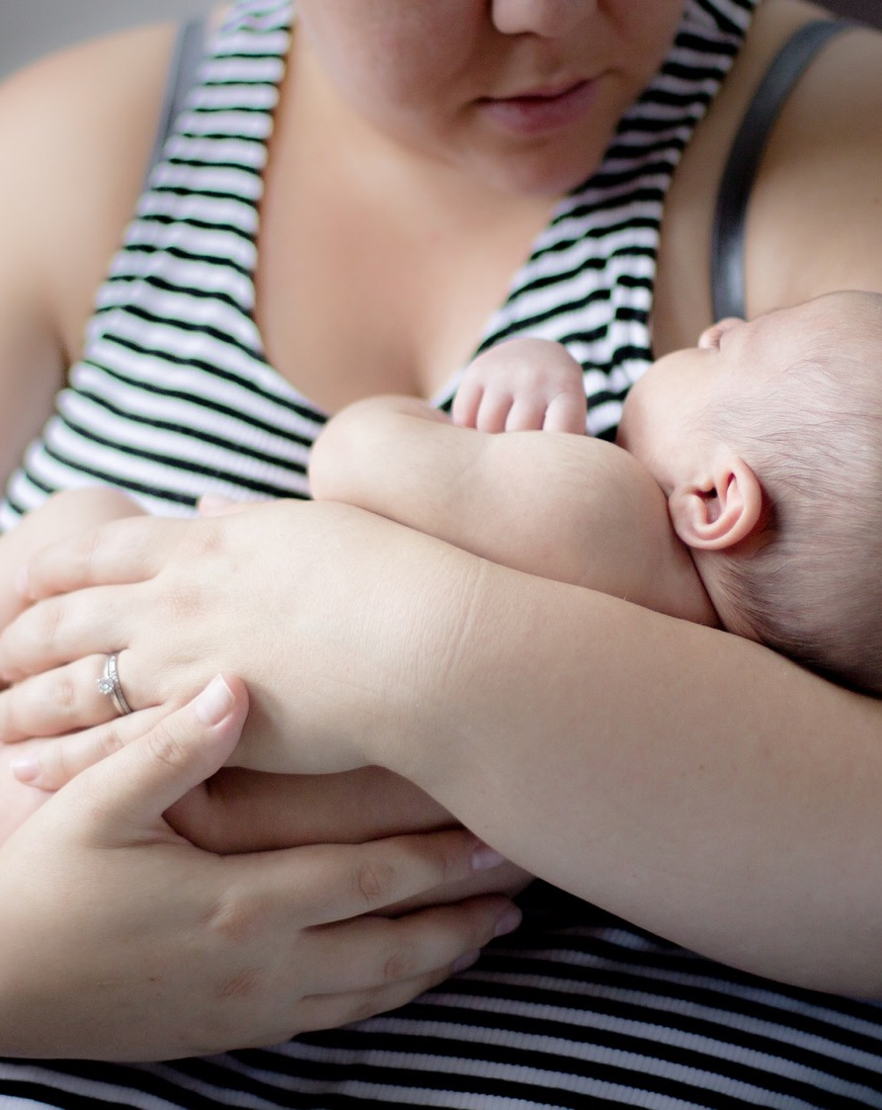
Good parenting
“You try so hard to be the perfect parent only to realise there is no perfect parent”. - Kerry, a young parent
Good parenting
No parent is perfect, but apart from providing the basics of good diet and basic care, what do you think the rules or foundations for being a good parent should be?

Slide 5
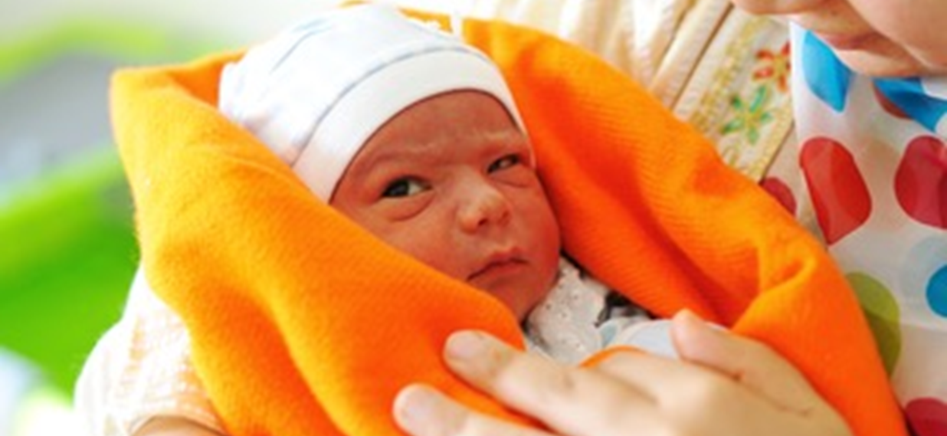
In a recent book Dr Laurence Steinberg says there are 10 basic principles of good parenting.
What do you agree or disagree with?
What seem most important to you?
What you do matters: The children watch you and learn from you.
You cannot be too loving: A child can never have too much love.
Be involved in your child’s life. This might mean missing out or giving up things you want to do, just to be available for your child.

Slide 6
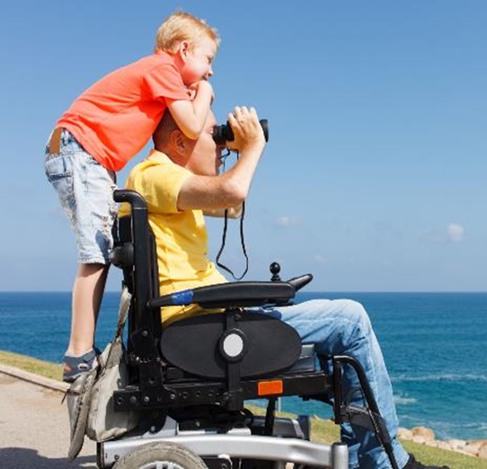
4. Adapt your parenting as your child grows and they change. You can’t parent an 8 year old and a 14 year old the same way.
5. Make rules and keep to them. Remember these rules can change as your child grows.
6. Help your child be independent. Always care and pay attention, but give your child space.

Slide 7
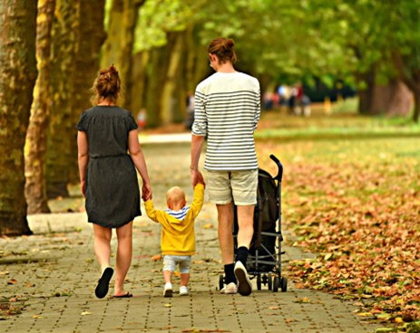
7. Be consistent. Otherwise, children get confused and too much is up for negotiation.
8. Avoid harsh discipline. Never be unfair or cruel. Never hit a child.
9. Explain rules and decisions. Questions are good, but the adult needs to be clear why a rule is a rule, and why a decision has been made.
10. Treat your child with respect. Kindness and respect will be returned.

