Slide 1
What is porn and what is it doing to us?
I can describe the affect that exposure to pornography can have on the individual.
I can explain that pornography presents behaviours that can be violent or degrading, and that these behaviours are not appropriate in real-life relationships.
I understand the law on pornography.
I can express my own views on pornography.

Slide 2
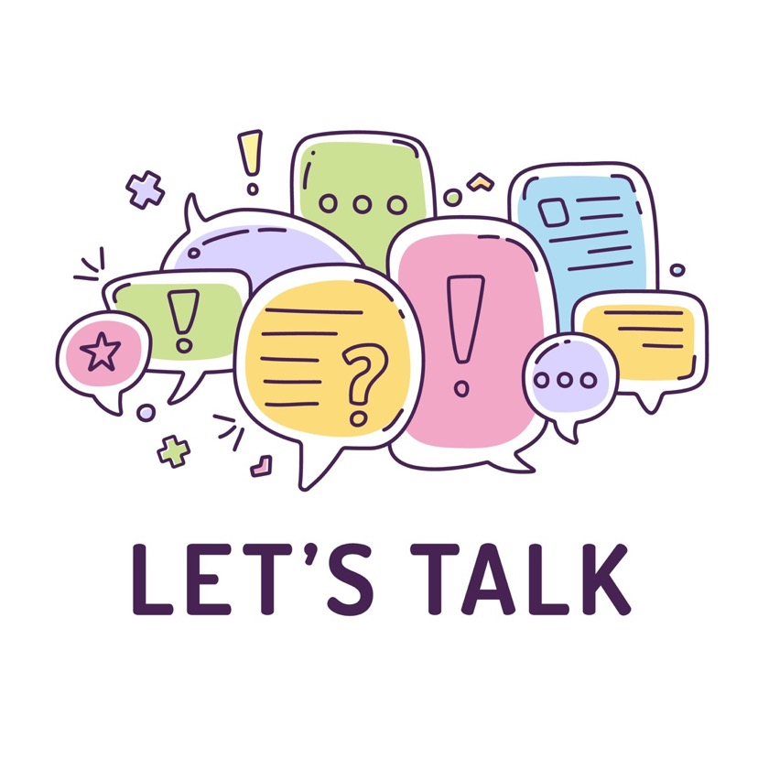
A survey was conducted amongst 500 UK 18 year olds to find out their views about pornography. Most of the young people questioned said that viewing por (either accidently or on purpose) is common throughout the school years, with most people starting at around 13 to 15 years. - Thinkuknow (2021)

Slide 3
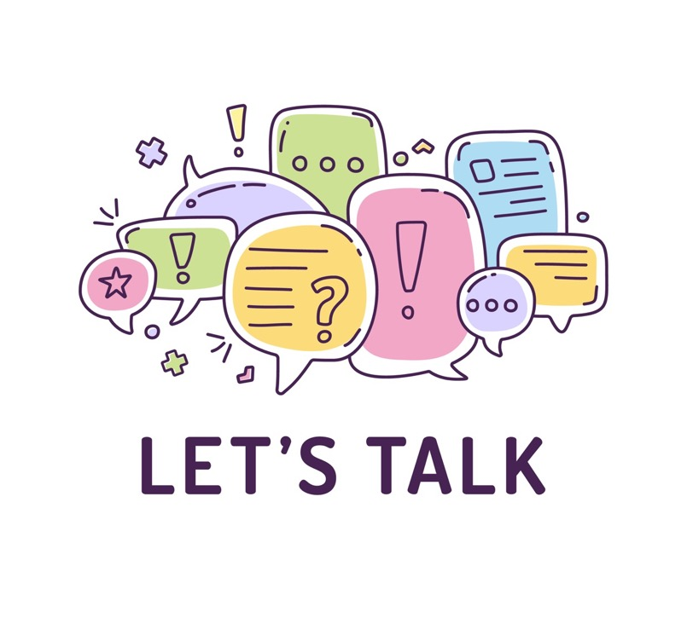
Porn: Fact or Myth

Slide 4
How do you think porn affects boys?
How do you think porn affect girls?
Do you think porn puts young people under pressure to have sex (or say they are doing it)?

Slide 5
Personal experiences with porn: Emma’s story
Emma’s Story: Overcoming Her Struggles with Pornography, Shame, and Self-Worth - Fight the New Drug (5 minutes 27) Emma is a 19-year-old student who was just 11 when she was first exposed to pornography. By the time she was 12, she says she consumed it multiple times a day on the iPod Touch her parents gave her. Her uncontrollable porn habit was also accompanied by feelings of shame and worthlessness that came from being a young girl who was told people who consume porn aren’t worth dating. Hear Emma’s story of how she overcame not only her pornography struggle, but also the struggle to love herself.

Slide 6
Personal experiences with porn: Dan’s story
Dan's Story: “I Feel Human Again” After Quitting Porn - Fight the New Drug (3 minutes 15) For six years, Dan compulsively consumed porn roughly 2-3 times a day. He describes how it made him feel “horrible,” “flat,” “empty,” and “like a robot.” Dan explains how his addiction to pornography made him “asexual,” saying that he was aroused by porn but was unable to be aroused with other humans. Then, at the age of 21, Dan decided to take back his life and break free from porn. Now, Dan is able to connect with his friends, family, and even girlfriend in a way he never thought possible. “I hadn’t felt human for a long time, and I felt human again.”

Slide 7
Personal experiences with porn: Paul’s story
Paul’s Story: “I’m Not Discouraged and Ashamed Anymore” by My Porn Struggle - Fight the New Drug (5 minutes 52) When he was 13, Paul was exposed to pornography for the first time. His consumption escalated toward the end of high school as he used pornography as a coping mechanism when he was feeling alone, rejected, or not good enough. Rather than feeling ashamed about his struggle, Paul has found allies to help him with his recovery, giving him hope in his ongoing journey to recovery.

Slide 8
Personal experiences with porn: Ash’s story
Ash’s Story: How an Online Porn Habit Nearly Led to a Risky In-person Encounter - Fight the New Drug (3 minutes 35) What started as a curiosity about the human body led Ash to look up porn every other night, if not every night. This habit not only changed the way she viewed men but also how she thought of relationships in general. She recognized her porn consumption was an issue when she almost met up with a stranger she met on an internet chat room. Nearly doing something that could have been potentially dangerous and life-threatening caused her to stop and think, “I can’t do this, this is too much, this has gone too far.” Now, she has invested her focus and happiness in her relationships, and she feels freer than ever before.

Slide 9
Porn is everywhere
Just how much are we all exposed to that is sexualised or pornographic in our day-to-day lives?

Slide 10
Things to remember about porn
You don’t have to watch porn and you also don’t have to watch it just because your friends are. You have a choice to switch off anything that you don’t want to see.

Slide 11
Things to remember about porn
Pornography is fantasy, and not realistic. People who act in porn do not have realistic bodies. Porn can show some extreme and uncommon sex acts. It does not show the kind of sex that most people enjoy in real life. Watching porn a lot can sometimes make real-world sex less enjoyable.

Slide 12
Things to remember about porn
Pornography is a business designed to make money.

Slide 13
Things to remember about porn
You can legally buy porn at 18. Porn websites are legally obliged to ensure a user is 18+ (called age verification).
It is illegal for an adult over 18 to show an under 18 pornography, or allow the under 18 year old to watch it.

Slide 14
Things to remember about porn
There are certain types of porn that are illegal even for adults. These are called "extreme pornographic images". This includes porn where what people do threatens a person's life, or things they do that are likely to or will cause serious injury. This also includes degrading porn, violent porn (which includes rape and abuse) or anything involving young people under the age of 18.

Slide 15
Things to remember about porn
If you view porn that upsets you talk to someone you trust. If you view porn be very careful about what you watch and click through to, it is very easy to get to a place you didn’t intend to go and to view something upsetting or illegal.

