Slide 1
Feelings and Safety: This is how I feel
I can communicate my feelings.
I can discuss friendships and relationships.
I know who can help me and keep me safe and who I can talk to if I am worried.
I am learning how to communicate effectively.

Slide 2
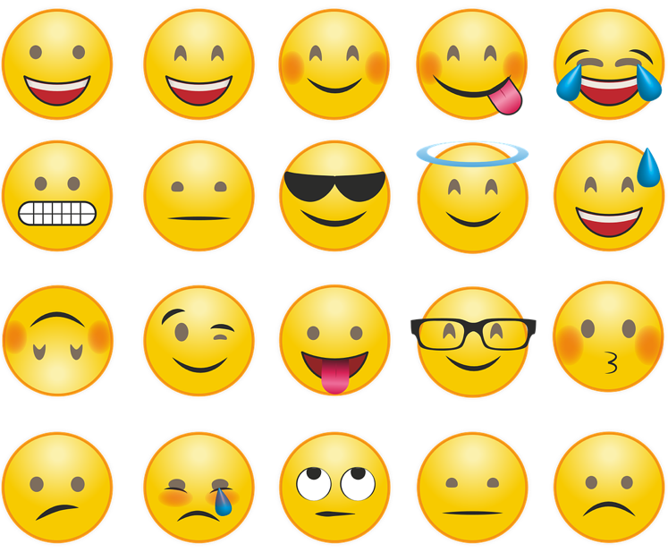
Showing a feeling with our faces and bodies:
Angry
Confident
Happy
Kind
Nervous
Proud
Sad
Tired
Upset

Slide 3
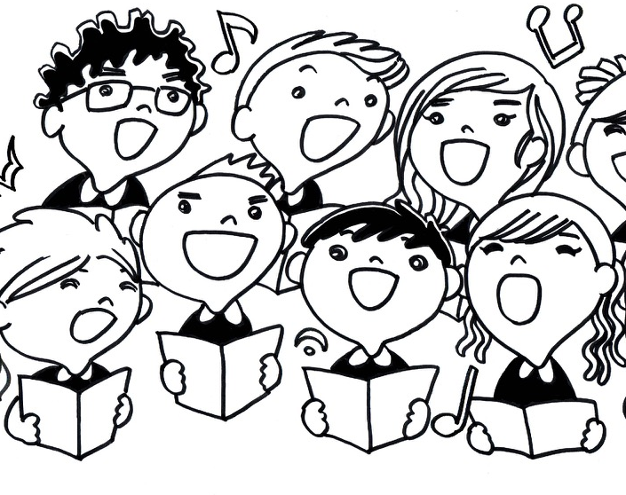
The excited song
The shy song
The worried song
https://www.bbc.co.uk/cbeebies/watch/feeling-better-songs-playlist#playlist

Slide 4
The Present a film by Jacob Frey https://vimeo.com/jacobfrey/thepresent
How does the boy feel at the start of the film?
Are there some feelings that feel very strong?
Are there some feelings that are feel uncomfortable or not good to feel?
How do his feelings change, and how does he feel at the end of the film?

Slide 5
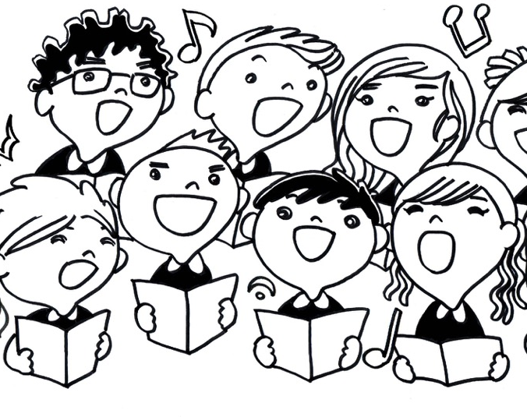
The Feelings Song
(duration 3 minutes 12 seconds)
https://youtu.be/UsISd1AMNYU

