Slide 1
Abuse and relationships: Partner control, Coercion and Violence
I can identify the signs of unhealthy relationship.
I can talk about my right to be safe in intimate and sexual relationships.
I can name sources of information, help and support.

Slide 2
What is abuse in a relationship?
There are different kinds of abuse that can happen.
Emotional abuse
Physical abuse
Sexual abuse
Digital abuse
Financial abuse

Slide 3
Domestic abuse is when someone uses physical, emotional, digital or financial abuse or sexual violence to control, force, threaten or degrade a partner or an ex-partner.
There are 60,000 incidents of domestic abuse reported in Scotland every year – but it’s thought that many are not reported.

Slide 4
Domestic abuse
Around four out of every five incidents of domestic abuse have a female victim, with one in five incidents there is a male victim.

Slide 5
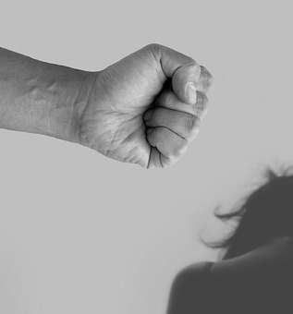
Domestic abuse
One in four lesbian/bi women have experienced domestic abuse in a relationship. Two thirds of those say the perpetrator was a woman, a third a man. Almost half (49%) of all gay/bi men report experience of domestic abuse from a family member or partner.

Slide 6
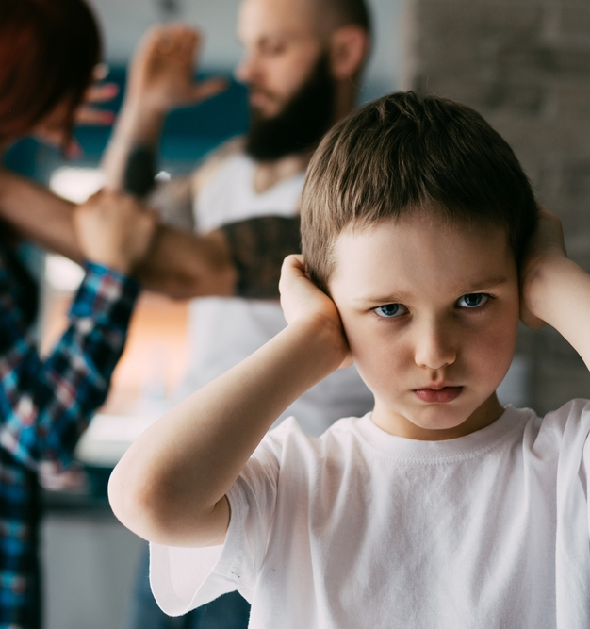
Domestic abuse
1 in 5 children and young people live in a home where there has been domestic abuse.

Slide 7
What about young people?
A study of 13 to 17 year olds by NSPCC suggests this abuse can begin in their teenage years.
25% of girls and 18% of boys in the study reported having experienced some form of physical violence from an intimate partner.

Slide 8
This is Abuse (Part 1)
https://www.youtube.com/watch?v=r6G4BEfJ0pM
This is Abuse (Part 2)
https://www.youtube.com/watch?v=zthG1nzn0uY
This is Abuse (Part 3)
https://www.youtube.com/watch?v=UO_7qHQsIIs

Slide 9
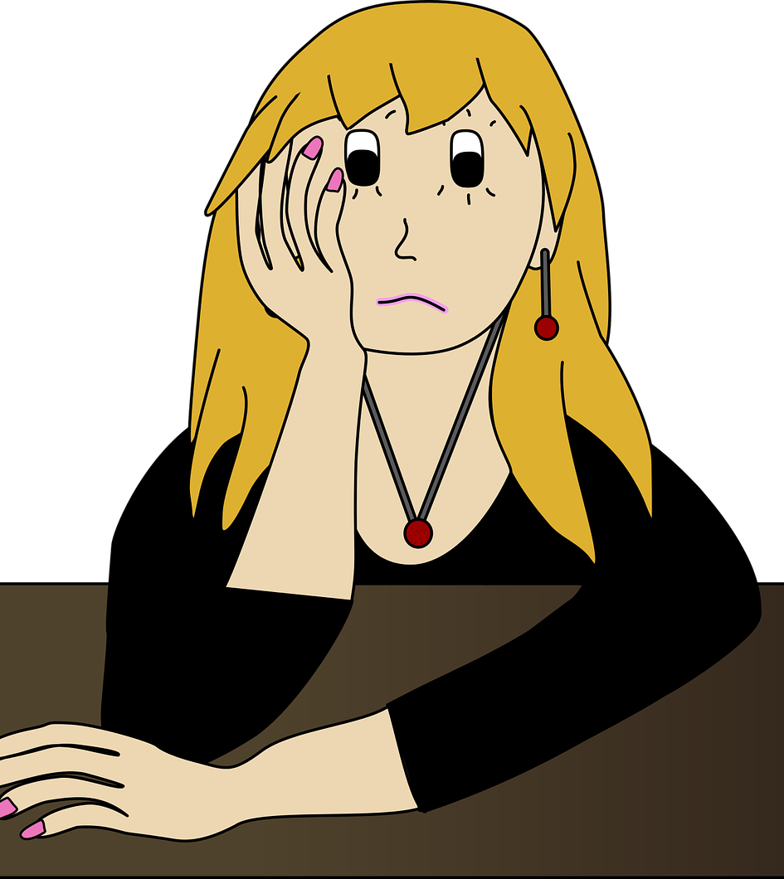
What is stalking?
Stalking is unwanted, focussed behaviours carried out by one person, or persons, against another, causing fear and alarm.
A wide range of behaviours may qualify as stalking – including sending unwanted messages, harassment and monitoring on social media, following or loitering, or verbal abuse. In Scots law, stalking is defined as a ‘course of conduct’ that places another person in a state of fear or alarm. A ‘course of conduct’ is defined as two or more incidents. That’s all it takes for stalking incidents to become criminal.
Stalking and harassment | Scottish Women’s Rights Centre (scottishwomensrightscentre.org.uk)

Slide 10
Important things to remember
Healthy relationships are all about respecting each other. You should feel loved, safe and free to be yourself.

Slide 11
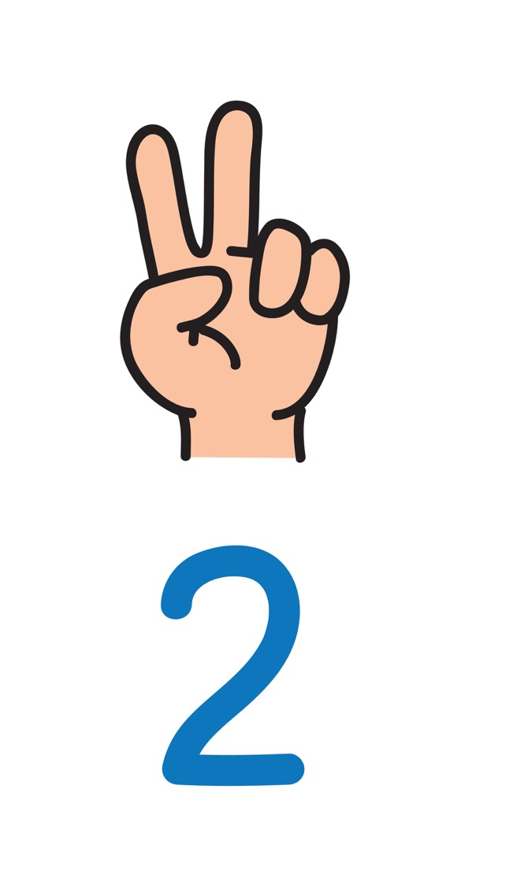
Abuse in relationships can happen to anyone. It’s not normal, it’s never OK and definitely not part of a healthy relationship.

Slide 12
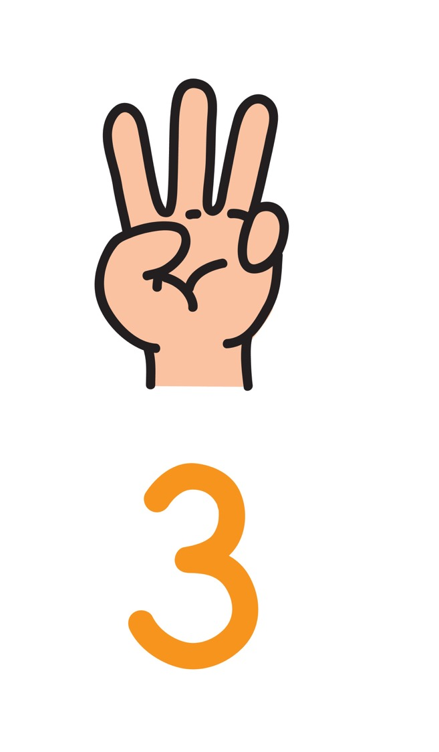
It isn’t always physical, it can be emotional and sexual abuse too. If your relationship leaves you feeling scared, intimidated or controlled, it’s possible you’re in an abusive relationship.

Slide 13
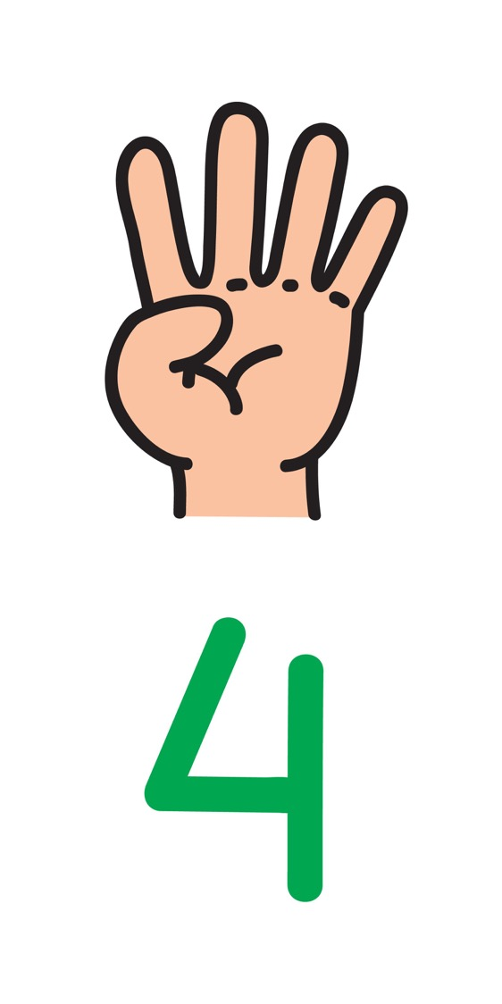
Relationship abuse can destroy someone’s self-confidence, have a negative impact on their health and wellbeing and leave them feeling isolated, lonely or depressed.

Slide 14
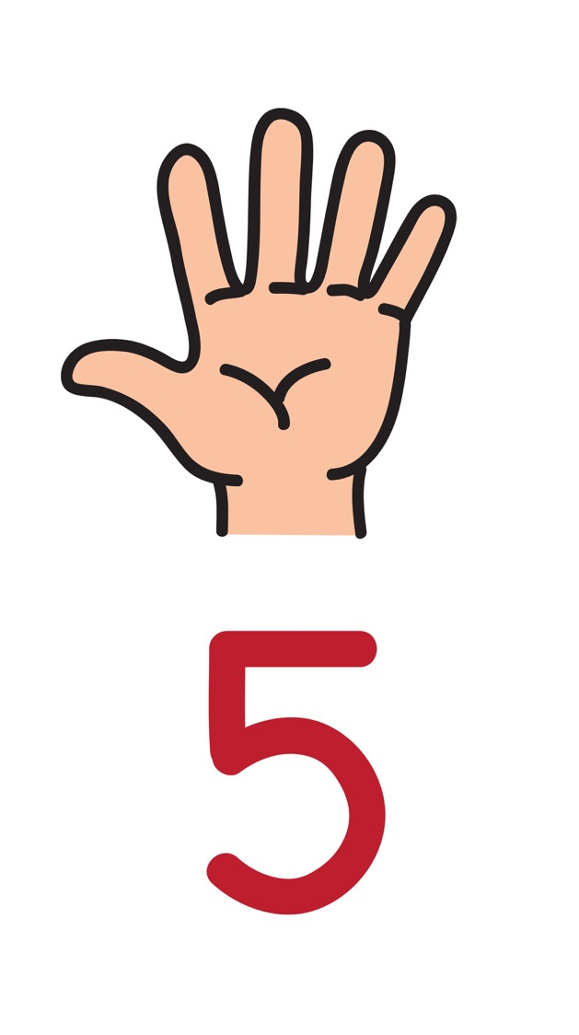
There’s never an excuse for relationship abuse. Anger, jealousy, alcohol or wanting to protect the other person – none of these justify abuse.
If you are in an abusive relationship, or someone you love is, then you should talk to someone you trust.

Slide 15
Childline provides free confidential advice and support for all young people your age.
Whatever your worry, if it’s about you or someone you love, Childline counsellors are there to help.
Speak to them by phone, online or email 24 hours a day.
Information and chat online https://www.childline.org.uk/
Phone 0800 1111

