Slide 1
Friends and Friendship: My friends/Being a friend
I can talk about how to make and sustain friendships.
I understand the importance of kindness and empathy.
I understand that friends have disagreements and can think of positive ways to cope and respond.

Slide 2
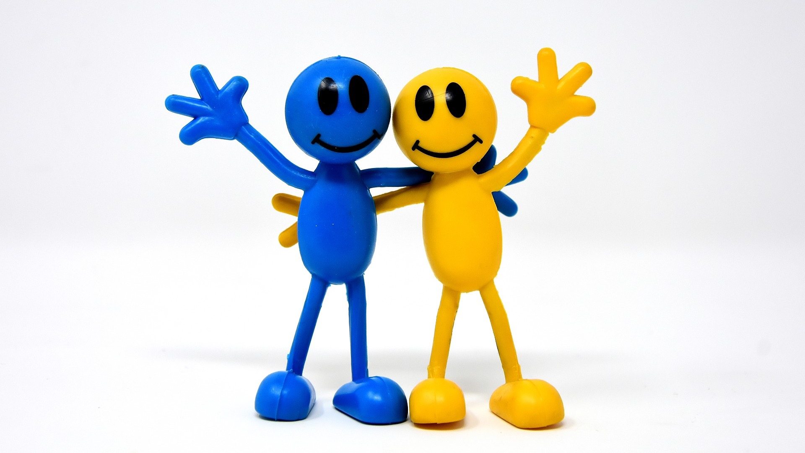
What is a friend?

Slide 3
What makes a good friend?
(film duration 2 minutes) https://youtu.be/ReMq3KX8F94

Slide 4
Are you a good friend?

Slide 5
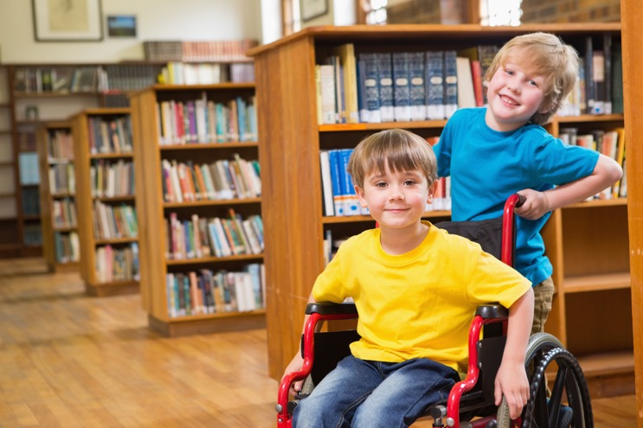
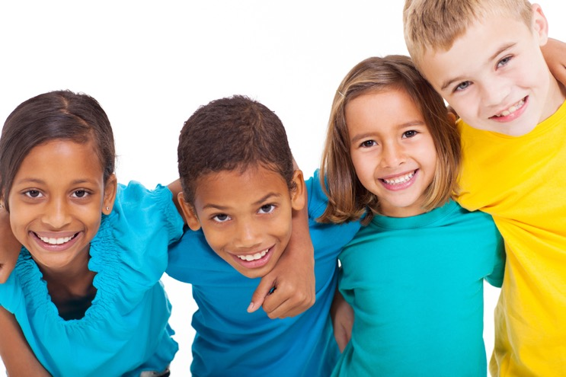
What makes a friend a good friend?
What do friends do for each other?
Why do children need friends?

Slide 6
The friendship tree

