Slide 1
Being a parent/carer: Important things about child development
I can talk about what a parent/carer does to make sure their child is healthy, happy and safe.
I understand the challenges of being a parent/carer.
I know that all families are different.
I talk about the kind of parent or carer I would be.
I understand that parents/carers need support and help.

Slide 2
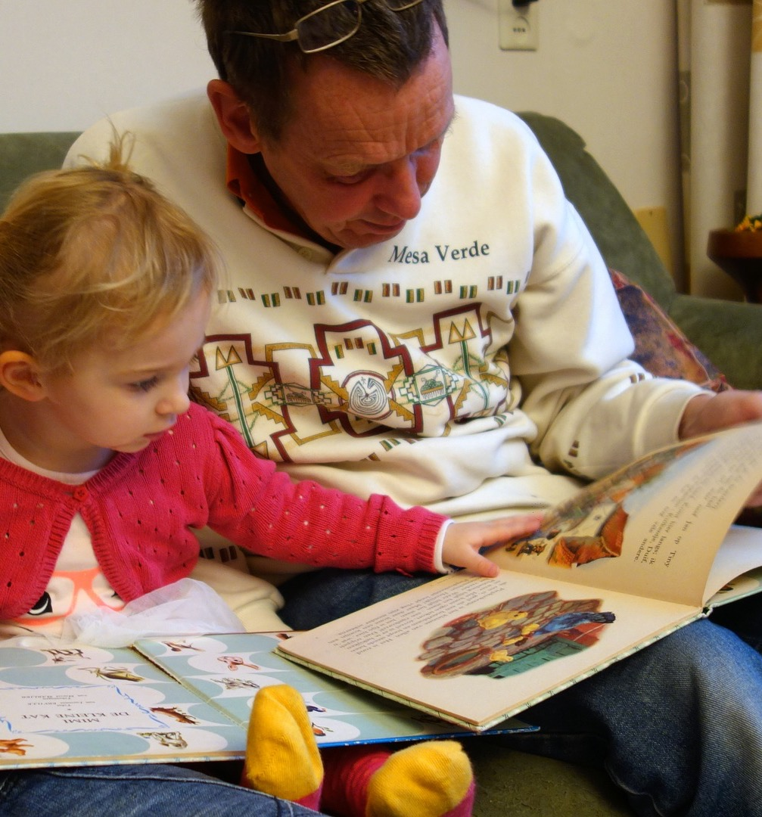
What is child development?
Child development is the story of growing up. It is about the changes that happen to the child’s body, the child’s brain and behaviour and the emotional changes that happen between birth and the teenage years.

Slide 3
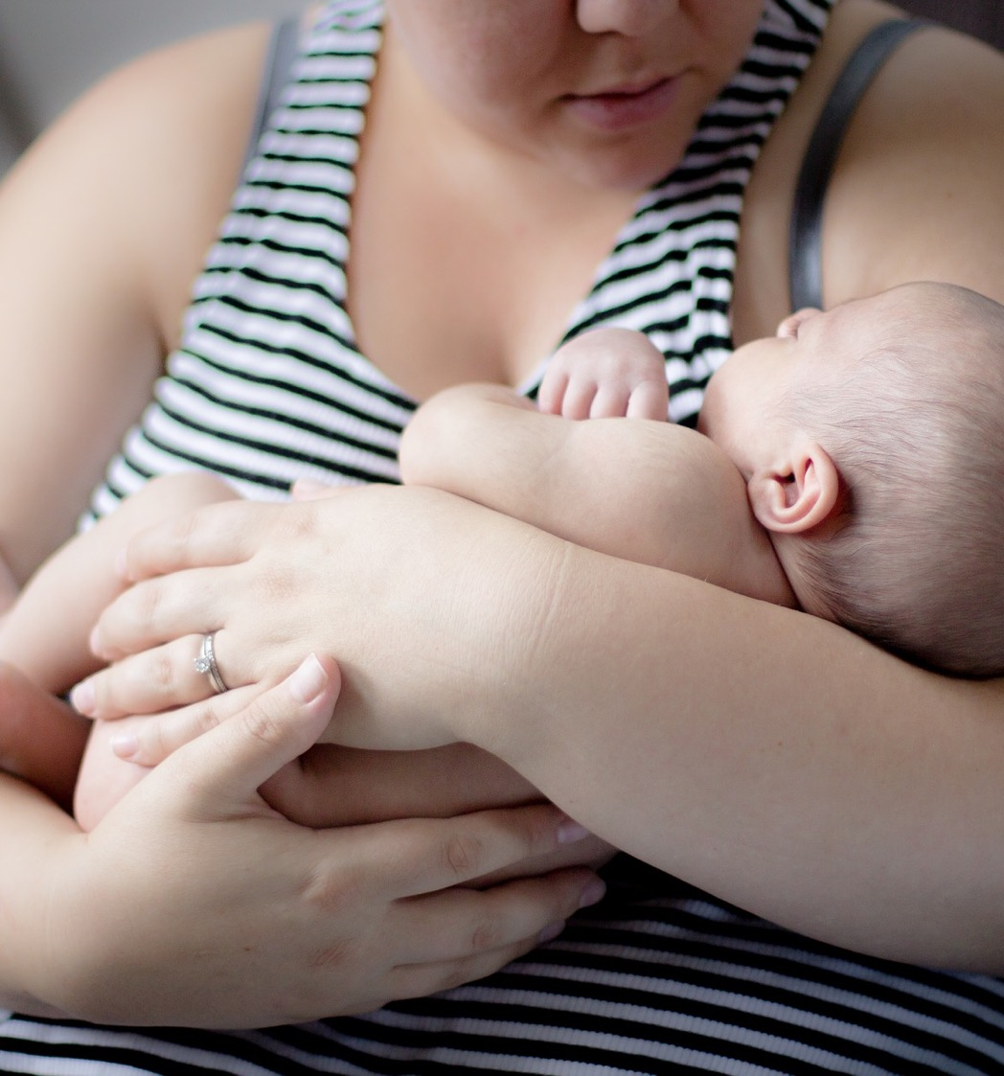
What is child development?
Child development starts with the baby who is completely dependent on parents and carers, who then in time becomes an independent young person.
Every child is unique and individual and so how they develop will follow a path, but will be different for everyone.

Slide 4
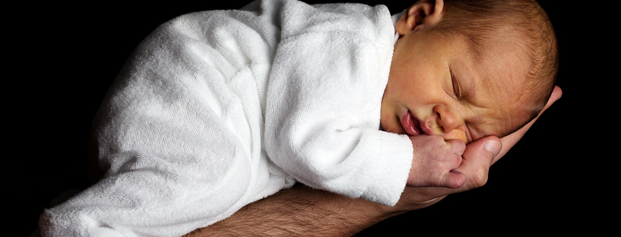
When does a baby…..

Slide 5
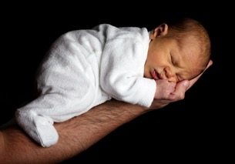
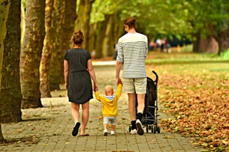
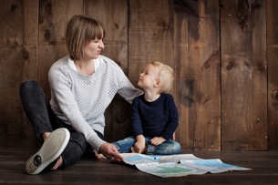
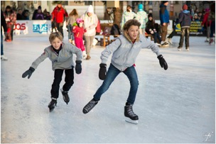
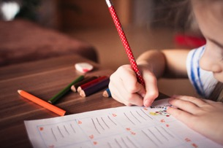
Baby
Stages of child development
Baby: birth to 18 months/2 years old
Toddler: 18 months to 3 years old
Early childhood: 3 to 6/ years old
Primary school age: 5 to 12 years old
Teenagers: 13 to 18 years old
Toddler
Teenagers
Primary school age
Early childhood

Slide 6
Baby
Stages of child development
Thinking of the stage you are being asked to consider:
What does the child need to be healthy, happy and safe?
Toddler
Teenagers
Primary school age
Early childhood

Slide 7
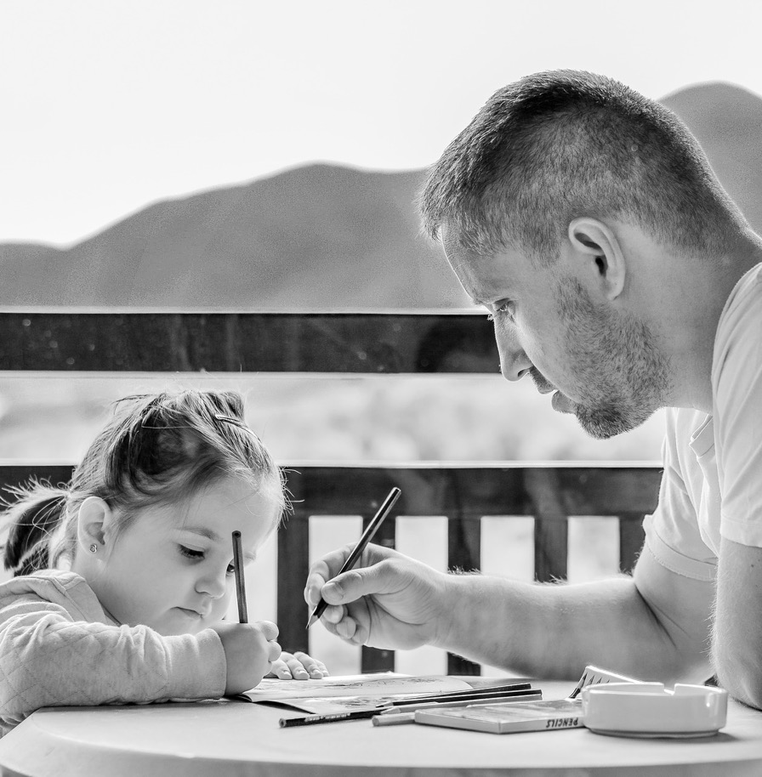
Children need security
When children feel safe from harm and secure, they learn to trust other people. We make children feel safe by meeting their basic needs and by showing them that we love them and providing them with a safe space to live and play.

Slide 8
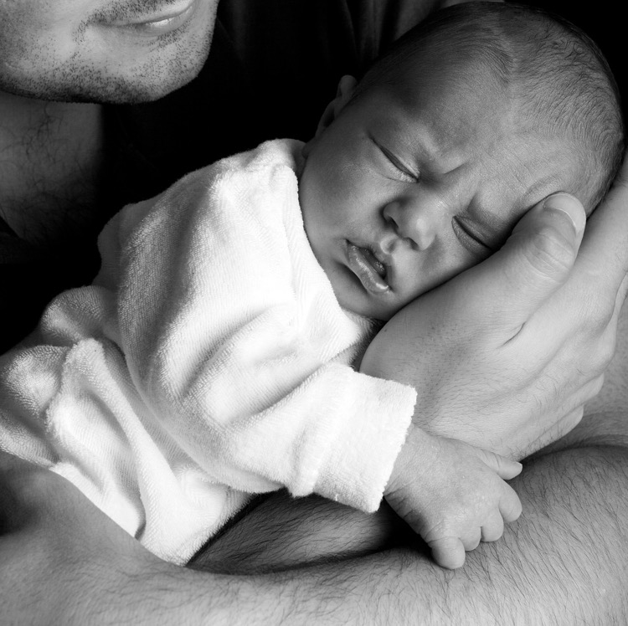
Children need stability
Children benefit from a life that is predictable and consistent. When children have stability, they are able to develop positive emotional health. We provide children with stability by having consistent relationships (with parents, grandparents, adult carers, friends and family), routines and daily structures, and a place to call home.

Slide 9
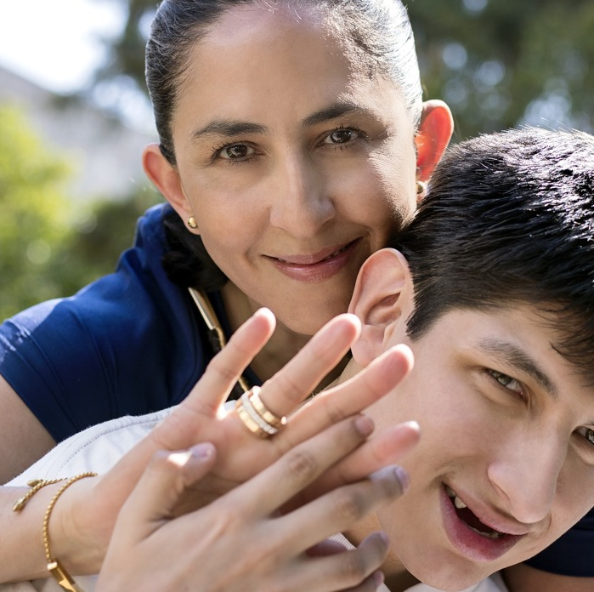
Children need happiness
Happiness is a positive emotional state of wellbeing, feeling contentment, joy and pleasure. Happiness for children can come in many forms and is supported by positive relationships, opportunities for play, having positive experiences, freedom to explore and security to be comforted in times of need.

Slide 10
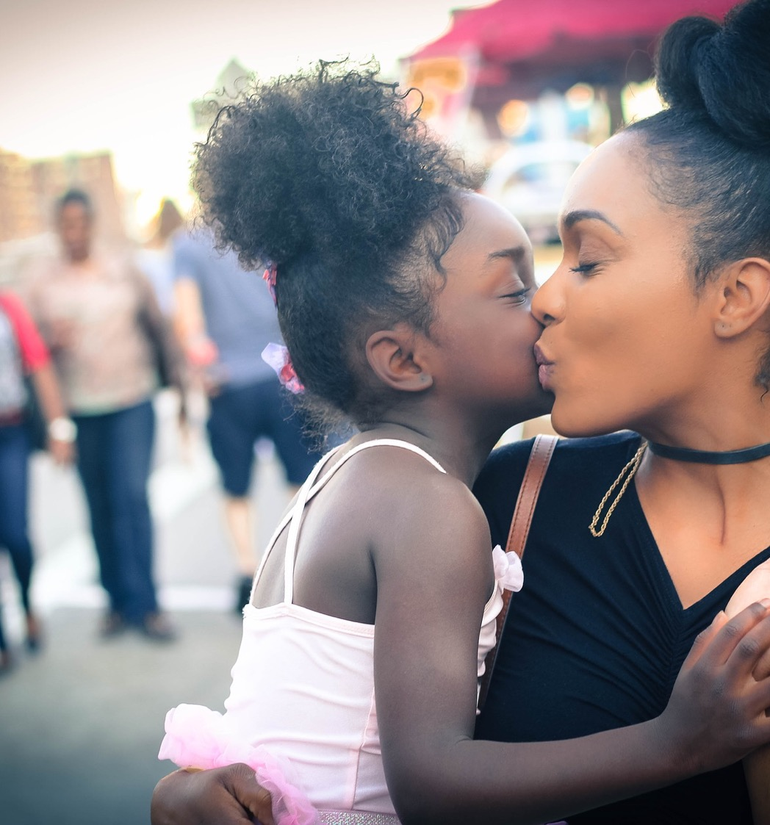
Children need love
Love is the strong feeling of affection and care – including warmth, tenderness, nurturing and other positive qualities. When children feel loved, they feel valued, respected, supported and cared for. Children feel loved when they are cuddled, played with, listened to, talked to, understood and appreciated.

Slide 11
Baby says I love you
https://youtu.be/87n98ayRdEg
(duration 37 seconds)

