Slide 1
Similarity, diversity and respect: I am unique/My self-portrait
I can give examples of what makes me a unique individual.
I show respect for others.
I understand that how I look, how I behave, and my aspirations should not be limited by stereotypes, my sex or expectations of what boys and girls should do.
I understand that some children have a disability that can affect how they walk, see, hear, speak, learn, or do other things.
I understand that the terms heterosexual, gay, lesbian, and bisexual can be used to describe who a person is attracted to or falls in love with.

Slide 2
This means one of a kind. Every human being is special and different, we are all unique. You are unique!
UNIQUE:

Slide 3
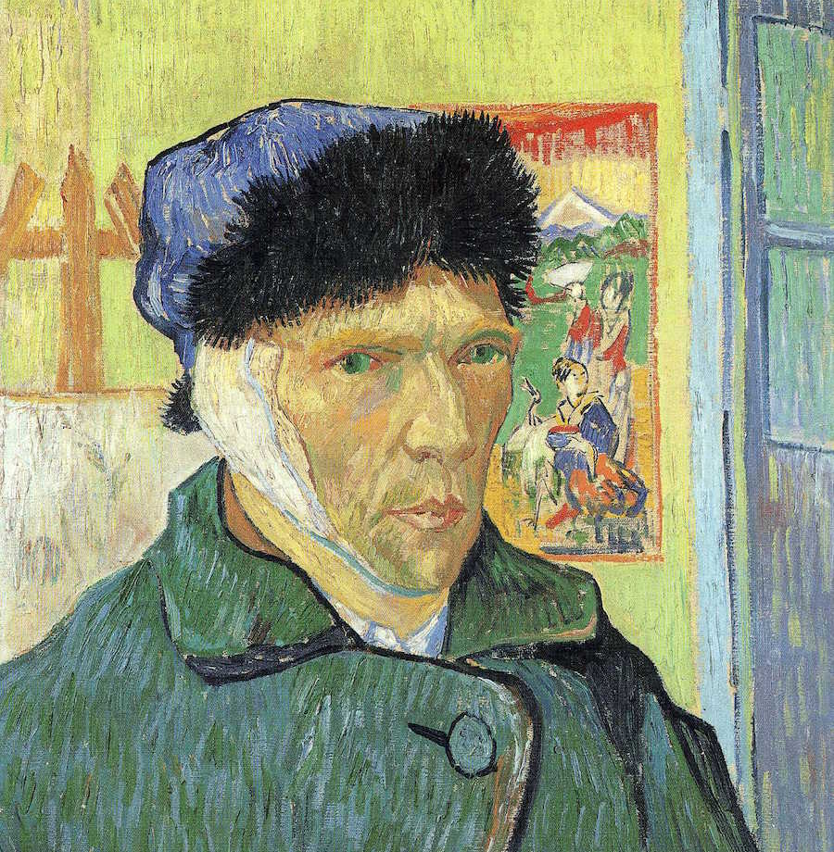
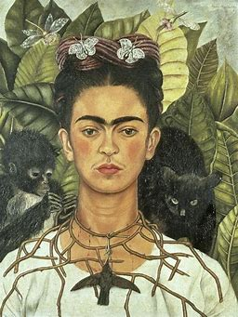
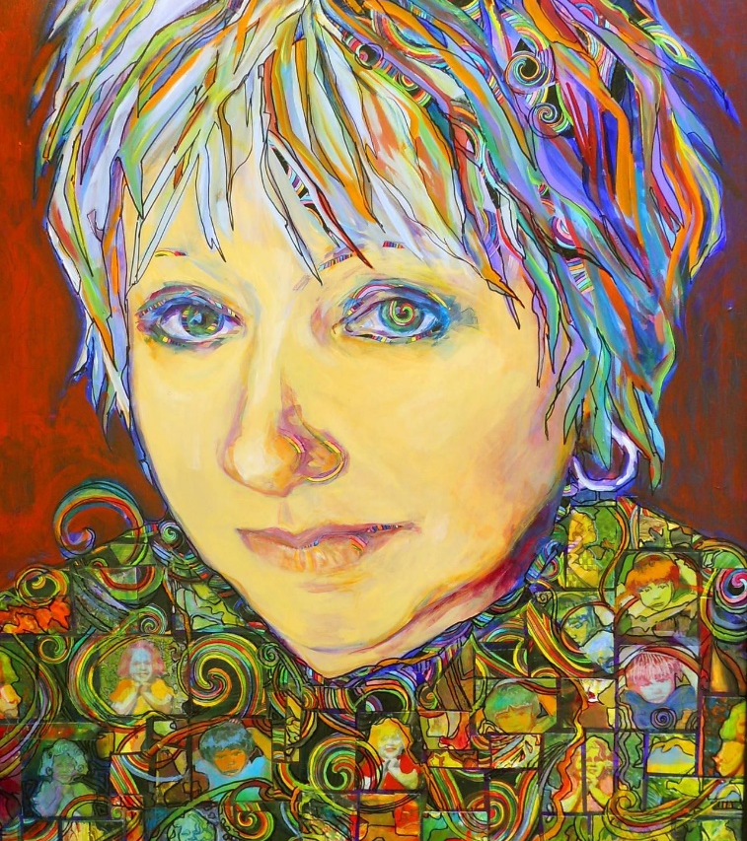
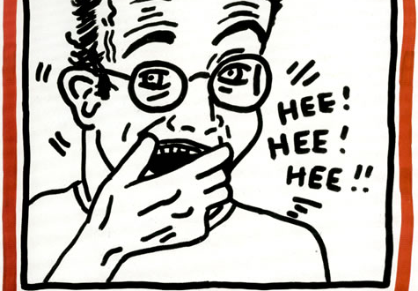
A portrait is a painting or photograph of a person. It usually shows their face.
A self-portrait is a portrait that an artist makes of themselves.

Slide 4
Frida Kahlo Self-Portrait with Thorn Necklace and Hummingbird Frida Kahlo de Rivera was a Mexican artist who painted many portraits, self-portraits and works inspired by the nature and artifacts of Mexico.

Slide 5
Vincent van Gogh Self-Portrait Vincent Willem van Gogh was a Dutch painter who is among the most famous and influential figures in the history of Western art. He created about 2,100 artworks.

Slide 6
Keith Haring Self-portrait Keith Allen Haring was an American artist whose pop art and graffiti-like work grew out of the New York City street culture of the 1980s.

Slide 7
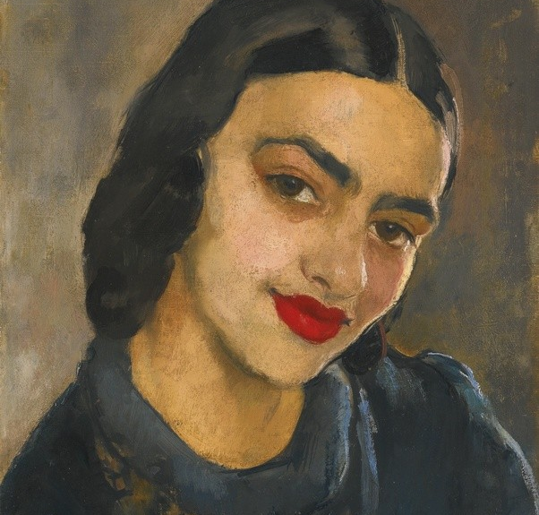
Amrita Sher-Gil was one of the greatest women artists of the last century. She started with drawing lessons at the age of 8.

Slide 8
Gayle Sanchirico Self-portrait Gayle Sanchirico is a painter, with a fresh approach to painting that is colourful.

Slide 9
A portrait of Billy Connolly by John Byrne Billy Connolly is a Scottish comedian and actor

Slide 10
My self-portrait:
What could I have in my self-portrait?

Slide 11
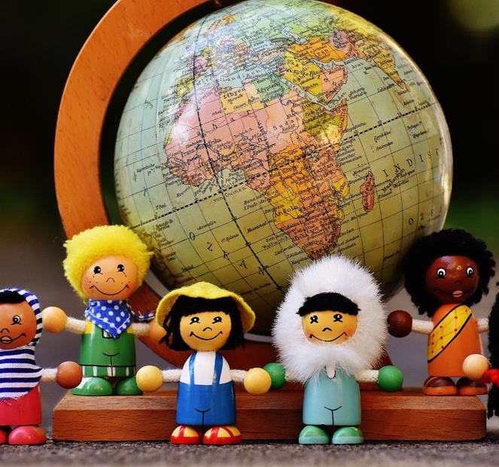
In this class, we are all individuals, different, unique and special.

