Slide 1
How human life begins, pregnancy and birth
I can explain how human life begins, what pregnancy is and how a baby is born.
I know, understand and can discuss some of a baby’s basic needs such as feeding, changing, washing, cuddling and sleeping.
I can demonstrate some basic skills needed to look after a baby.

Slide 8
Part 1
How a baby is made

Slide 9
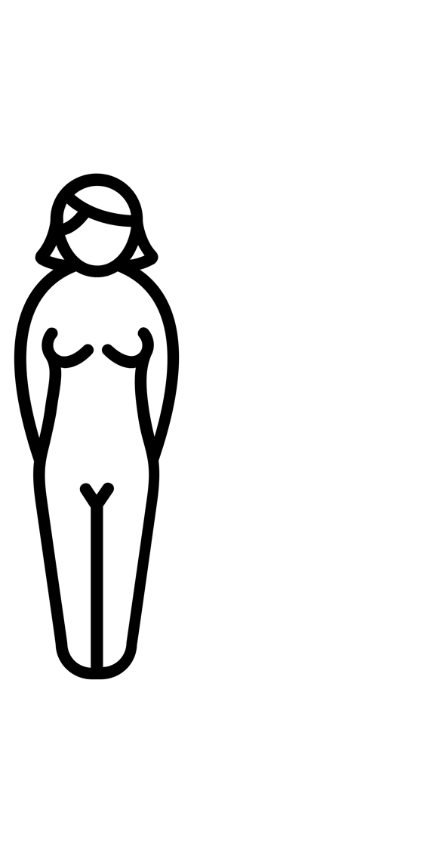
A baby is made by grownups. To make a baby you need a tiny little egg from a woman and you need the seed (called the sperm) from a man.

Slide 10
A woman’s eggs are inside her body, a part called the ovaries. Every month a woman releases an egg.

Slide 11
A man’s sperm is made in his testicles which are inside the bag of skin that hangs behind his penis.

Slide 12
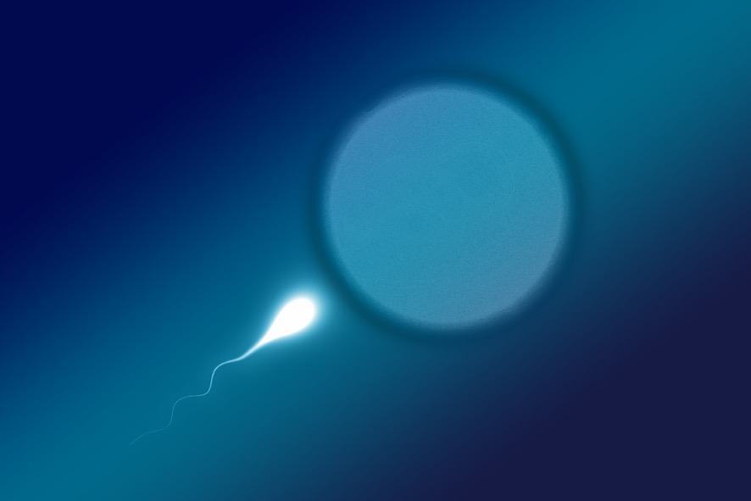
When the egg and the sperm come together they can start a baby. This is called fertilisation.

Slide 13
Once the egg and sperm meet, then the egg grows in a safe place called the womb. The woman will be pregnant for 9 months.

Slide 14
Part 2
The baby grows - Pregnancy

Slide 15
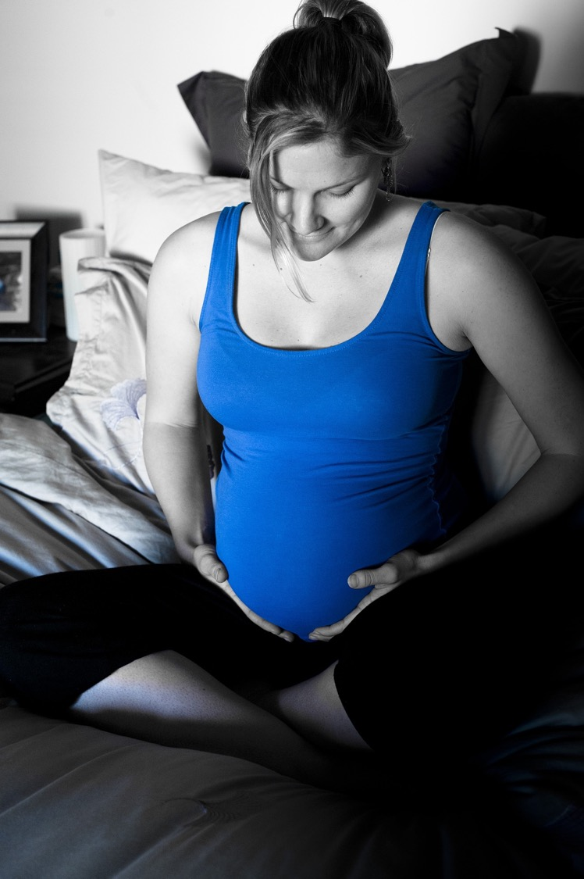
A baby lives and grows inside the woman’s womb for 9 months.

Slide 16
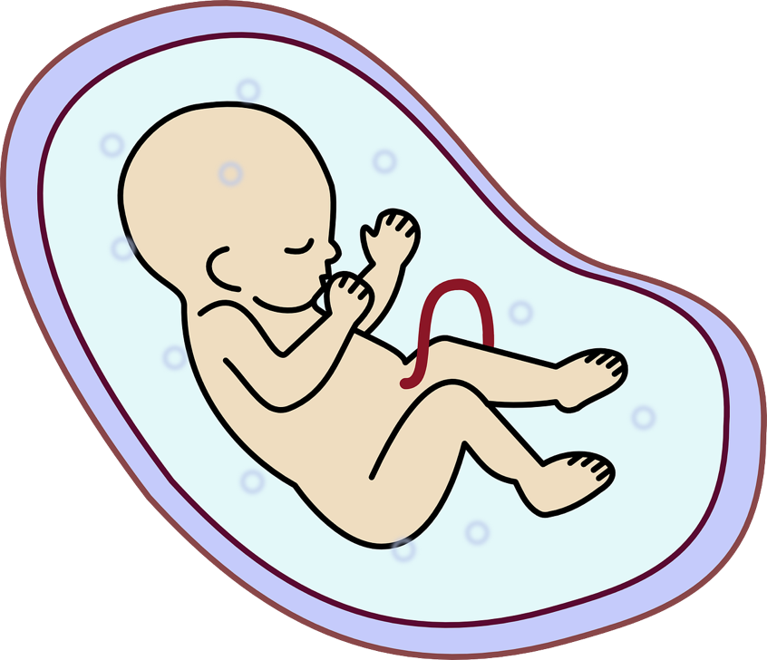
The baby and woman are connected by the umbilical cord that attaches to the baby to the mum. This is where your belly button is now. The baby gets everything it needs to grow through the cord.

Slide 17
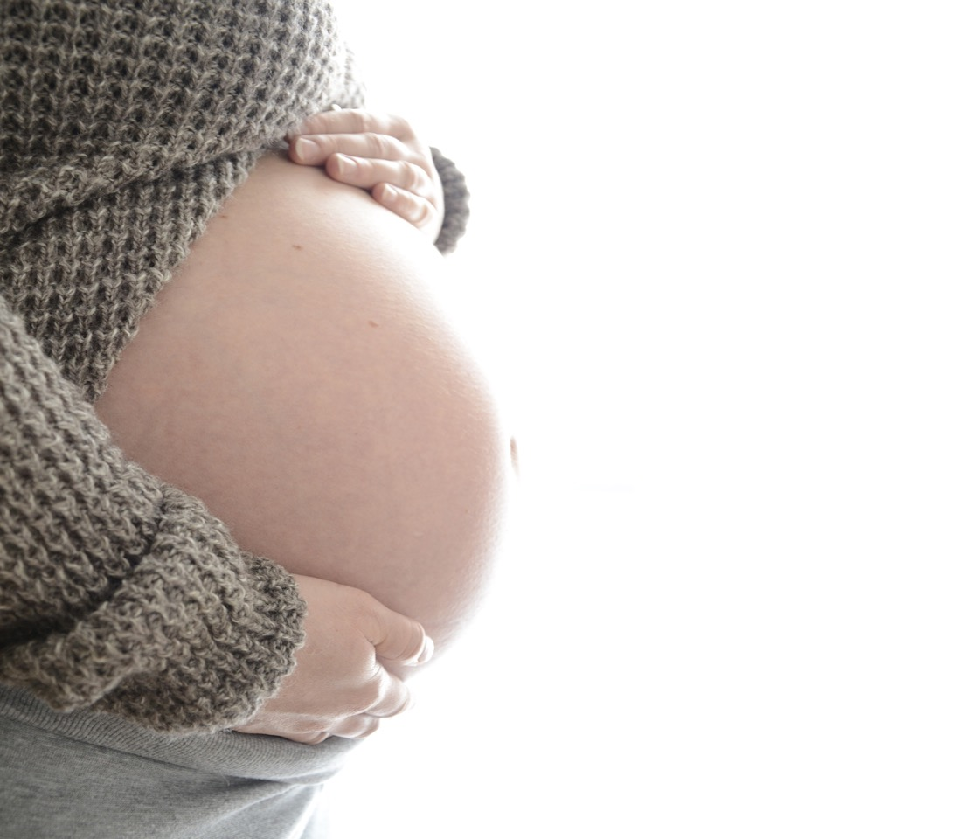
For the baby, the womb is like a bag of warm cosy water and the baby can hear the mum’s heartbeat like a drum.

Slide 18
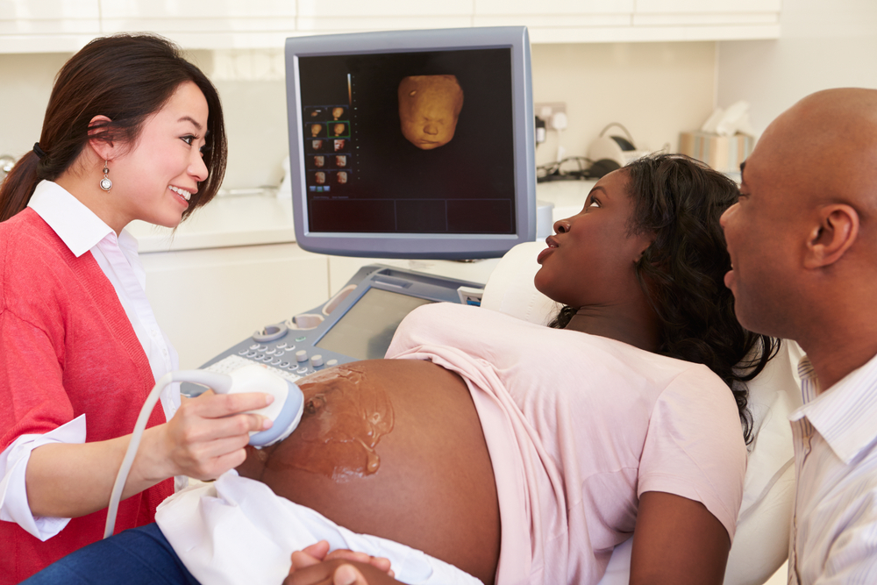
When a woman is pregnant she will go to see the doctor and nurse to make sure everything is going well with her pregnancy.
The woman can take the baby’s dad or her partner or friend with her.

Slide 19
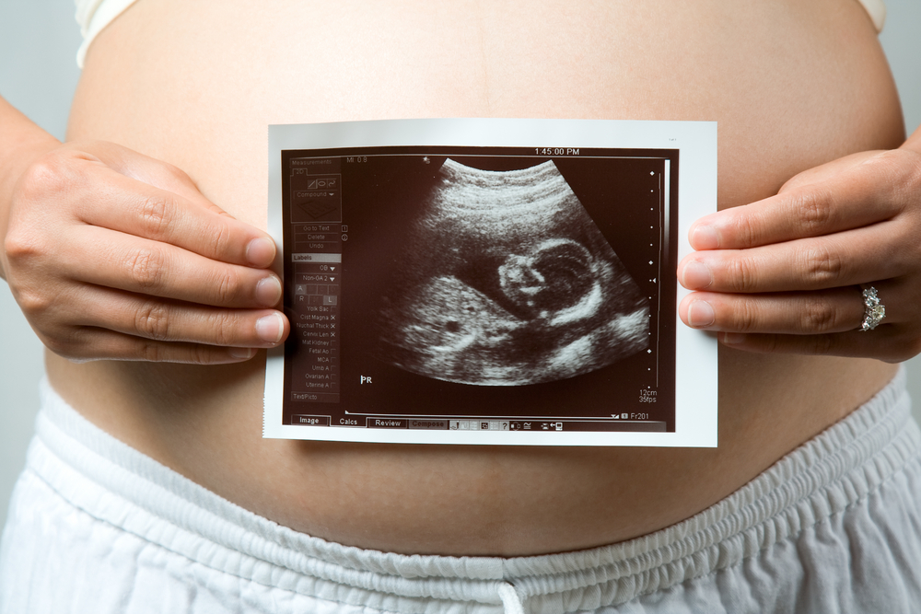
Sometimes they get a picture of the baby inside the woman.

Slide 20
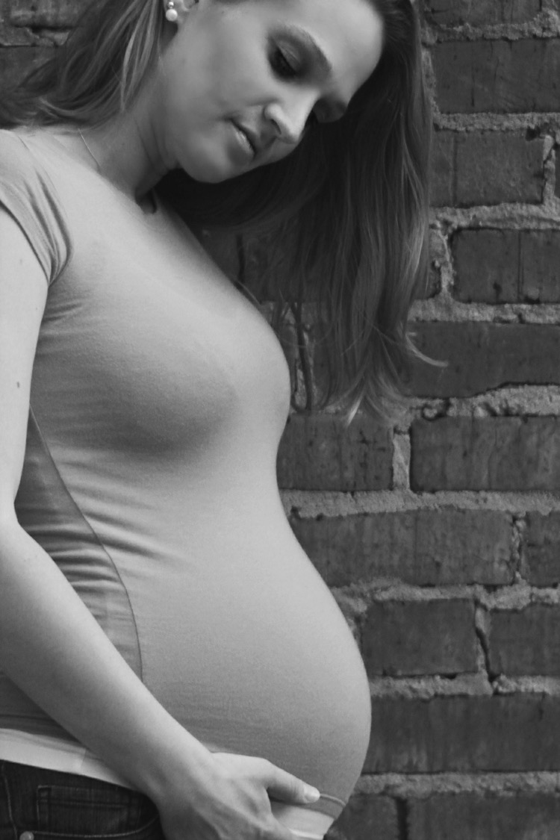
In the first 3 months inside the woman’s womb the baby is very small.
After 1 month the baby is just the size of a pea. Then the baby begins to grow arms and legs. The baby has a little beating heart.
By the second month the baby has grown fingers and toes.

Slide 21
In the next 3 months inside the woman’s womb the baby keeps growing. By the 4th month the baby is the size of the mum’s hand. The baby can start to hear. The woman will start to feel her baby moving around inside.

Slide 22
In the final 3 months inside the womb the baby keeps growing, so much that it needs to be curled up.
The baby’s brain grows all this time too.
The baby is getting stronger and getting ready to be born.

Slide 23
Part 3
How a baby is born

Slide 24
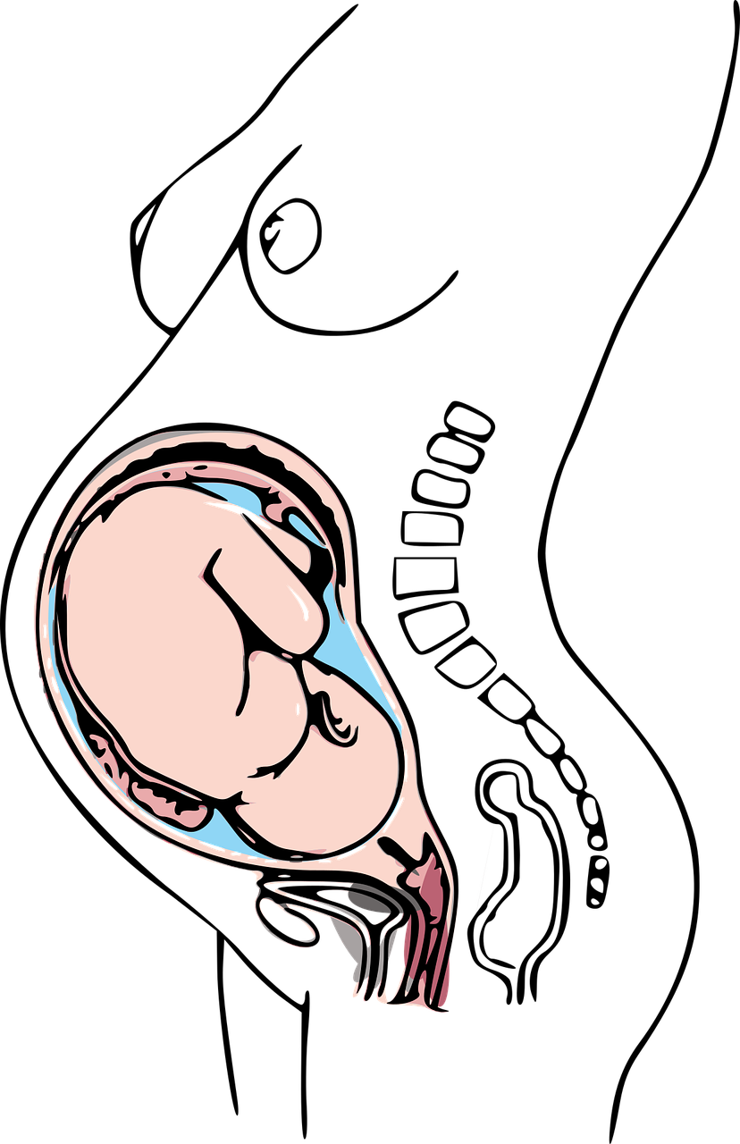
How a baby is born.
After 9 months of being safe and cosy inside the womb it is time for the baby to be born.
The baby changes its position so that the head is downwards getting ready to come out.

Slide 25
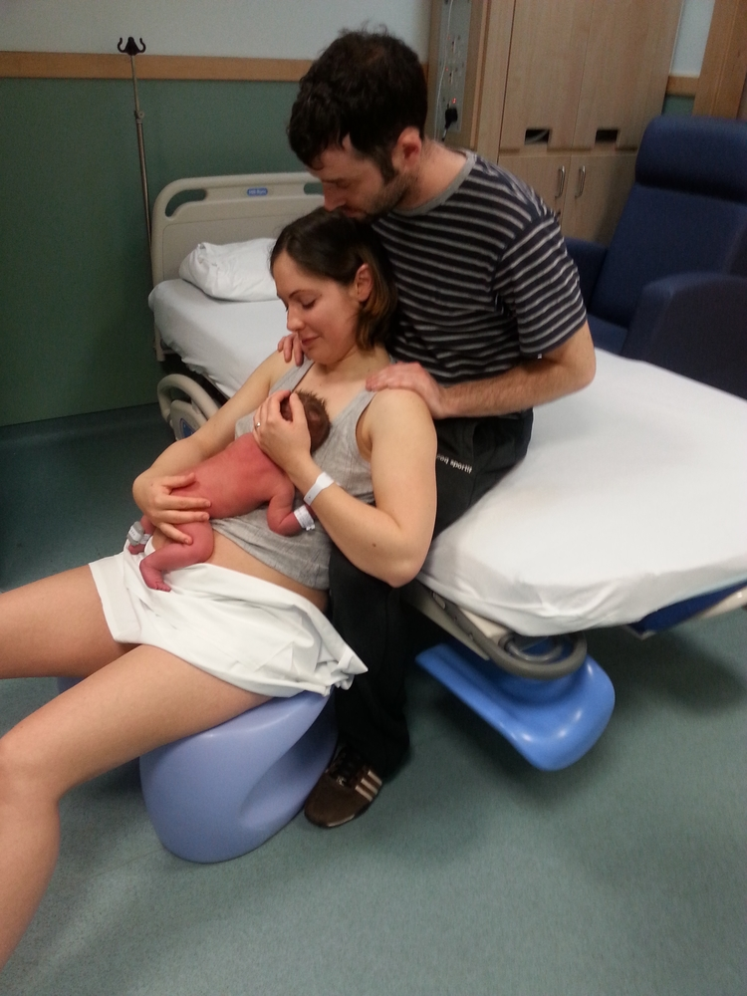
The woman feels some pains in her tummy and she feels the need to push down so that the baby can come out.

Slide 26
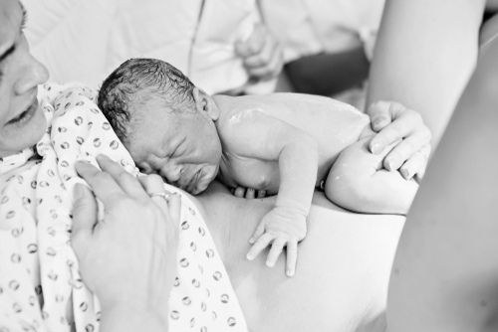
The baby comes down from the womb and it comes out of the woman’s vagina. This take a few hours to happen.
Notes:
Nearly all babies are born this way but some babies can’t be born like this and a doctor has to make an opening in the mummy’s tummy to lift the baby out – this is called a Caesarean.

Slide 27
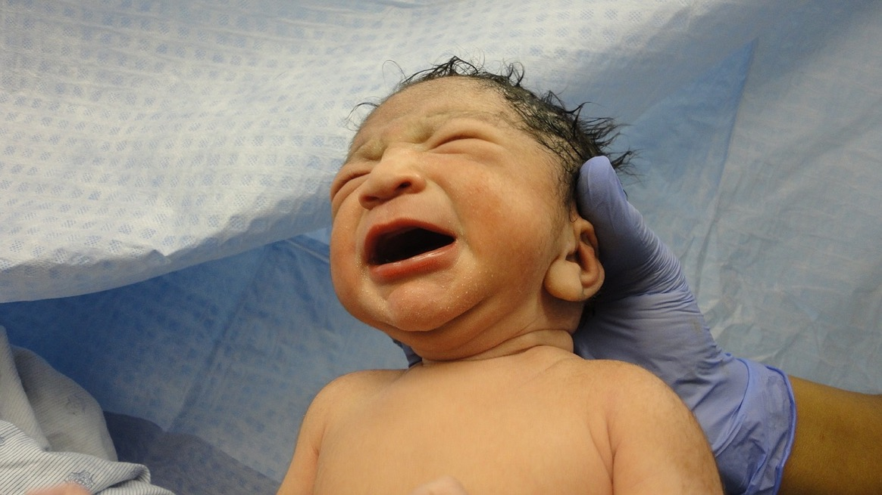
The woman will be very tired after all this effort. And the baby will cry as it leaves the cosy womb and enters the world.

Slide 28
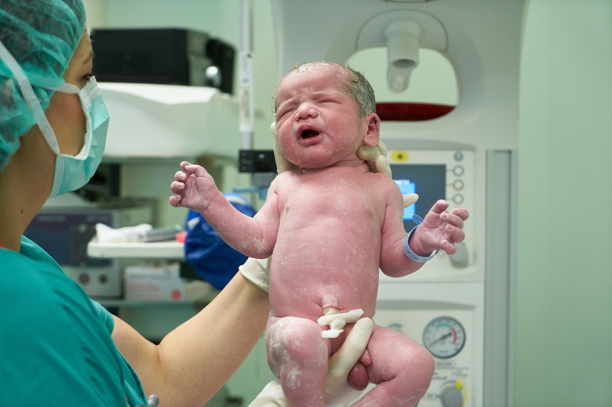
Remember that the baby feeds through the umbilical cord? Well this is cut (its not sore) and then the baby is separate from the mum. This leaves you with your belly button!

Slide 29
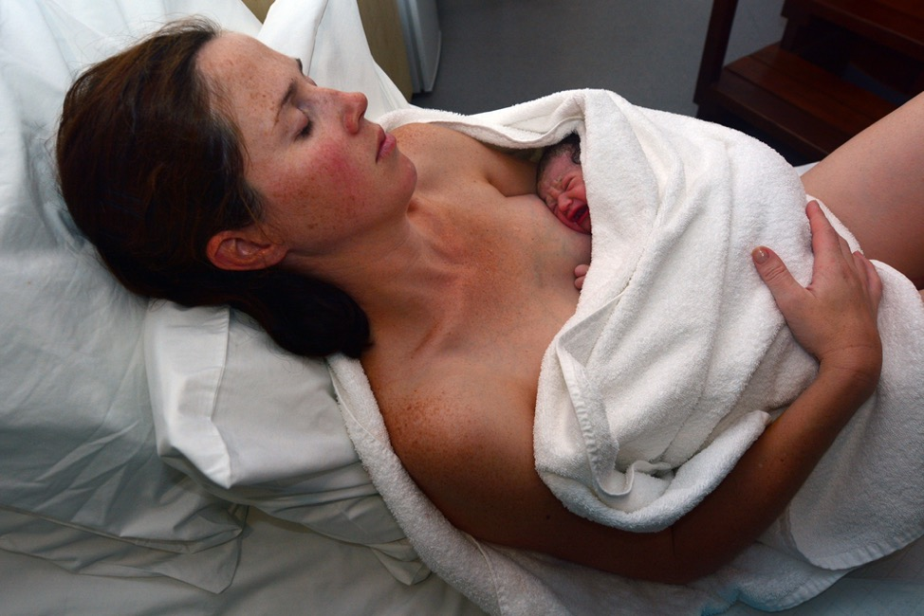
Some babies are born in hospital.
Some babies are born at home.
The baby’s dad, mum’s partner or friend or other family member can be there to help and support the mum.

Slide 30
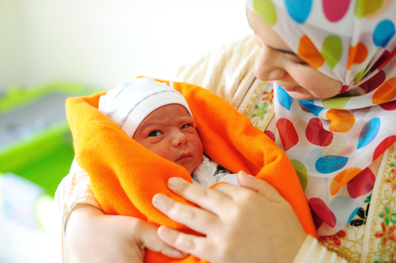
Isn’t this an amazing story!

Slide 31
Q: How do the sperm and egg come together?
NOTE FOR EDUCATORS ABOUT SLIDES 32/33: When it comes to learning about how a baby is made, we have explained that this requires the sperm to meet the egg. As delivery of this lesson is likely to come toward the end of First Level learning (say P4) it might be expected that a child will ask ‘but how does the egg and sperm meet?’ If this happens, we have provided some additional slides at the end of this PowerPoint presentation that answer this question, the PowerPoint text in slides 32/33 provides enough detail for children of this age and will satisfy their natural curiosity about how babies are made – so the slides explain in a straightforward/factual way about sex, that fertilisation can be assisted by a doctor or can be by donor. In terms of the latter two, there may be children in the group conceived using such means (which they may know and share) and they should be able to recognise this in the factual presentation. This content is provided so that the educator can be led by and be responsive to what might be asked.

Slide 32
One way is that the woman and man love each other and they have sex, this is a special thing that grownups can do.
When they have sex the man’s penis goes inside the woman’s vagina and sperm comes out and goes to meet the egg inside the woman’s body.

Slide 33
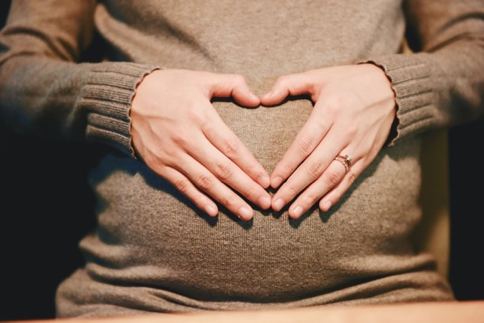
Some parents need help to start the pregnancy. Some babies start when the egg and sperm come together in a laboratory. The doctor then puts the fertilised egg back into the woman’s womb. This is called IVF.
Other babies are created when a man gives his sperm to the woman. She puts the sperm inside her vagina. If the sperm meet her egg, she can become pregnant.

