Slide 1
My body: Names of parts of my body
I can name parts of my body.
I can talk about the different parts of my body and what they do.

Slide 2
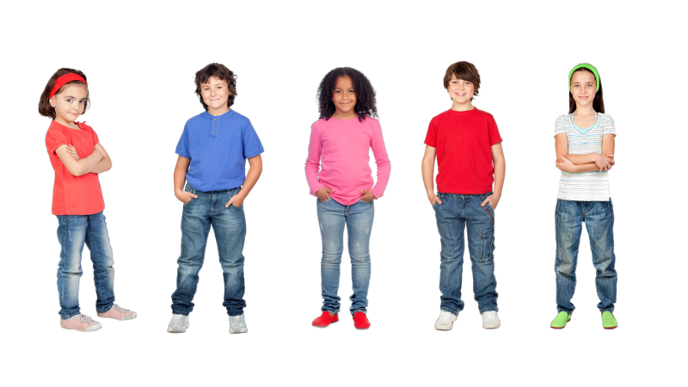
Draw a picture of you.
On your picture write down:
The colour of your eyes
Your shoe size
Your height
Your hair colour.

Slide 3
Arms
Back
Ears
Eyes
Feet
Fingers
Hair
Hands
Head
Knees
Legs
Mouth
Nose
Shoulders
Stomach
Toes

Slide 4
Names for parts of my body

Slide 5
Names for parts of my body

Slide 6
Bottom
Nipples
Penis
Scrotum/Testicles
Vulva

Slide 7
Names for private parts of my body

Slide 8
Names for private parts of my body

Slide 9
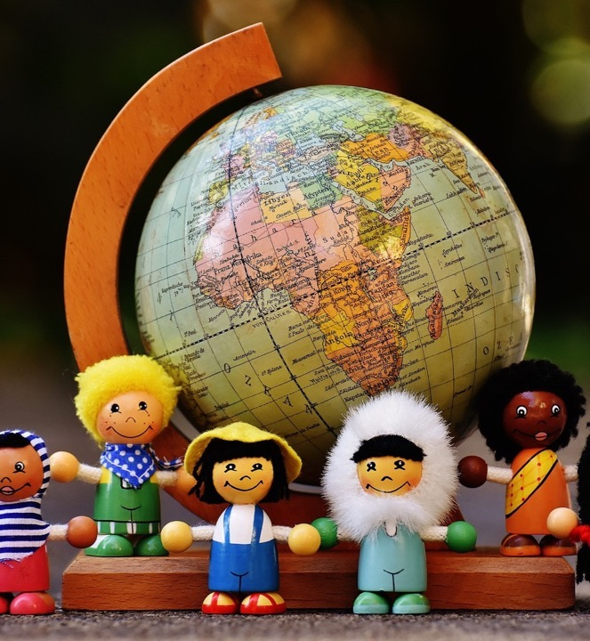
In this class, we are all individuals, different, unique and special.

