Slide 1
My body: Feelings and Puberty
I can name parts of my body.
I can talk about the different parts of my body and what they do.
I can describe the changes that take place with puberty.
I can talk about my growing independence.
I can talk about things I can do when I am upset and can identify an adult to speak to if I am upset.
I understand how to maintain personal hygiene.

Slide 2
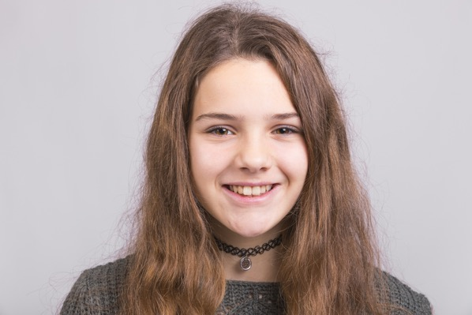
When we go through puberty what happens to…
Hair
Voices
Body shape
Smell
Skin
Breasts

Slide 3
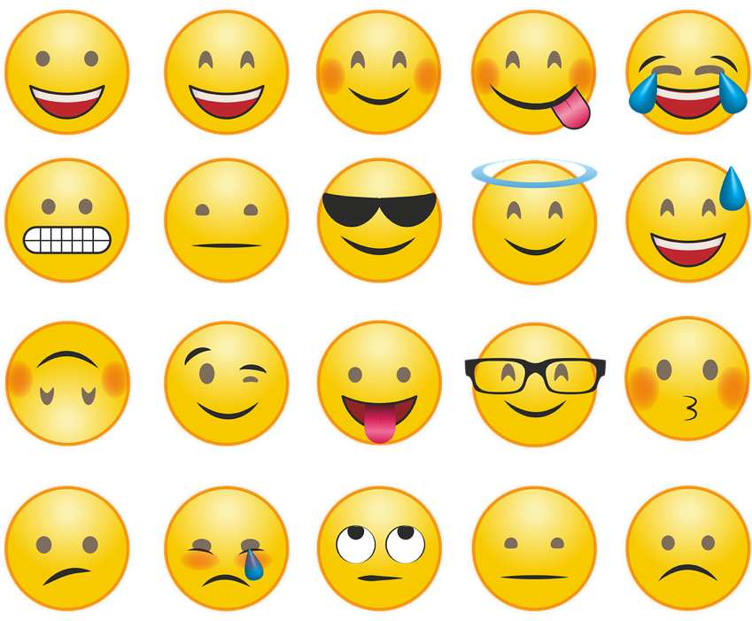
Feelings, moods and emotions
People use different words like feelings or emotions or mood to describe how a person feels at times.

Slide 4
Feelings, moods and emotions
When your body changes with puberty, you might feel things more strongly, or your feelings can change quickly.
You might hear people say that with puberty you get moody or have mood swings.

Slide 5
All the changes that happen during puberty are caused by chemicals in your body. These chemicals are called Hormones.
When your body is ready to begin puberty, your pituitary (say: pih-TOO-uh-ter-ee) gland (a pea-shaped gland located at the bottom of your brain) releases these special hormones.
Depending on whether you're a boy or a girl, these hormones go to work on different parts of the body.

Slide 6
Feelings game

Slide 7
What do you do if you feel sad?

Slide 8
What do you do if you feel angry?

Slide 9
When you like someone
During puberty, you can start to have feelings of attraction to someone.
You might ‘fancy’ other boys and girls.
You may even feel like you’re in love!

Slide 10
When you like someone. That’s okay.
They might like you back.
But they might not feel the same way, and that’s okay too.
You should never try to make someone feel something that they don’t want to feel!

Slide 11
Independence is when you learn to think and do things for yourself.
As you get older you might become more independent and want to do things for yourself.

Slide 12
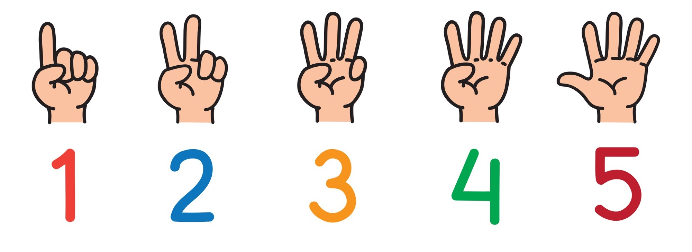
What do you do now for yourself that you didn’t used to do?

Slide 13
What things would you like to do more on your own or for yourself because you are getting older?

Slide 14
It’s good to talk about your feelings and emotions.
Who can you talk to?

Slide 15
Its good to talk about our feelings and emotions.
You can talk to someone at school or at home.
You can contact ChildLine whatever your worry, if it’s about you or someone you love.
Childline counsellors are there to help. Speak to them by phone, online or email 24 hours a day.
Information and chat online https://www.childline.org.uk/
Phone 0800 1111

