Slide 1
Lesbian, Gay and Bisexual equality
I understand that every individual is unique and that people of all sexualities deserve recognition and respect.
I understand my own developing sexuality.
I am building skills and confidence to challenge bullying or harassment of LBG people.

Slide 2
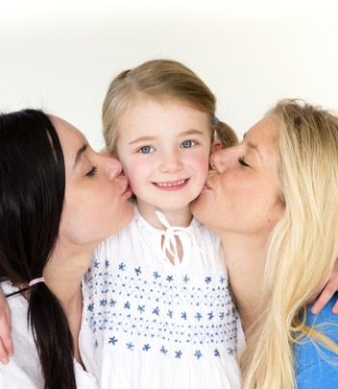
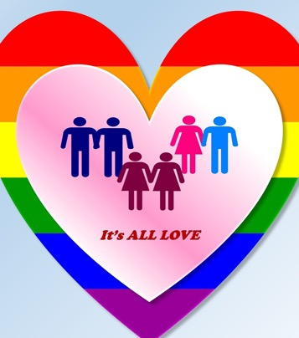
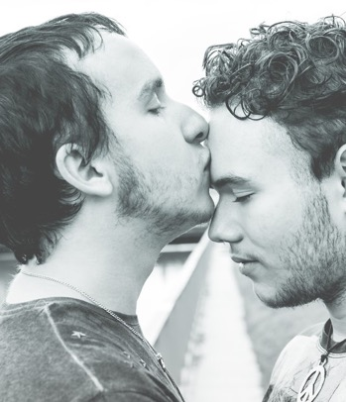
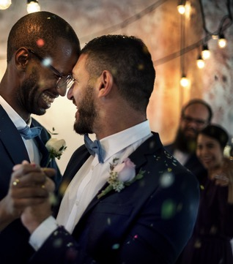
The words we use to describe sexual orientation
Sexual orientation is about who you are attracted to.
We say a person is gay when they are attracted to or love someone of the same sex, this can be used when we talk about two men together or two women together.
We say a person is lesbian when a woman is attracted to or loves a woman (for women we can also say gay).

Slide 3
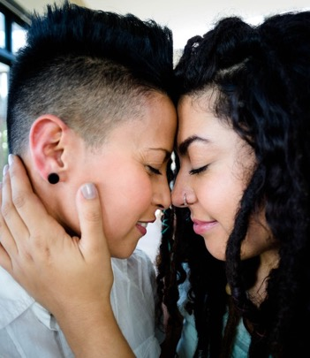
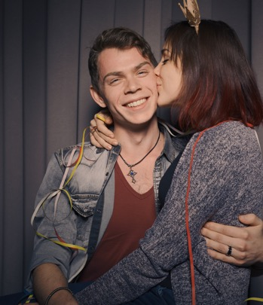
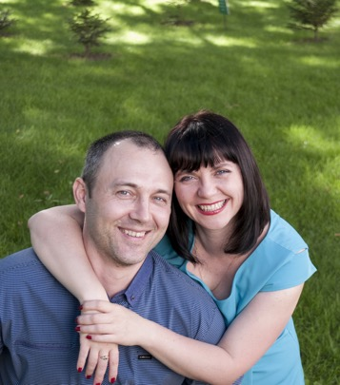
We say a person is bisexual when they feel they can be attracted to or in love with a person who is the same sex as them, or someone of a different sex.
We say a person is heterosexual (sometimes people say ‘straight’) when people of different sex are attracted to or love each other, so a man and a woman.
There may be other terms that a person might use – maybe you have heard of some?

Slide 4
Homophobia is about having a negative attitude or behaviour towards someone just because they are lesbian or gay.
Biphobia is about having a negative attitude or behaviour towards someone just because they are bisexual.
Homophobia and biphobia can include horrible language or threats or violence against LGB people of any age.

Slide 5
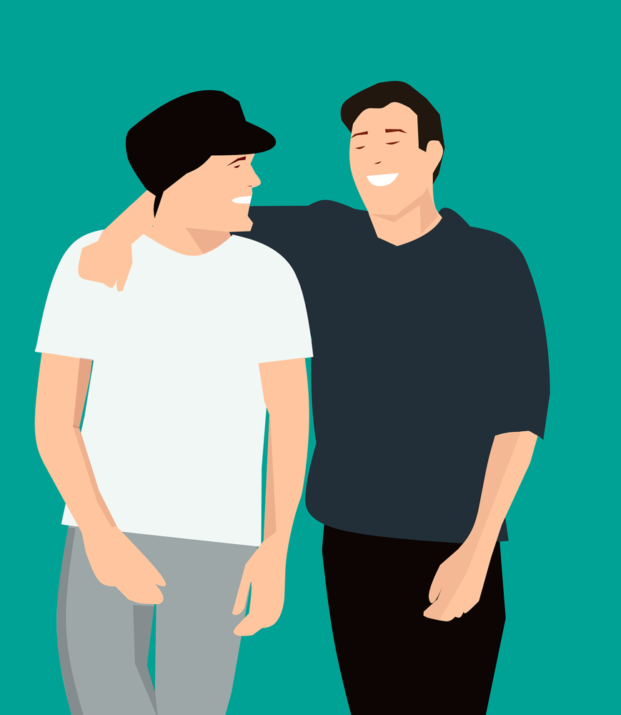
Coming out is when someone tells someone else about their sexual orientation.
Coming out
(duration 2 minutes 38 seconds) https://youtu.be/7YXcg8HJs18

Slide 6
Shh! Silence Helps Homophobia
(LGBT Youth Scotland film 7 minutes 2 seconds)
https://youtu.be/XQKGigb5l28

Slide 7
Bullying and violence at school
Half of lesbian, gay and bisexual young people report being bullied.
More than three in five (63%) frequently of often hear homophobic language at school.
More than 2 in 5 who do experience homophobic bullying don’t tell anyone.
Most bullying is verbal (46%) or gossip (41%). It also includes being ignored or isolated (27%), but can also be physical (10%), having things stolen (8%) or threats or sexual assault (5%).

Slide 8
Bullying and violence at school
It mostly happens in corridors and school grounds (around 35%) but also happens in classes during lessons (30%) and outside school (25%) and online (21%)
Just a third (32%) of lesbian, gay and bisexual young people who are bullied say teachers do anything, even when they are there when it’s happening.

Slide 9
How does this make young people feel?
“The bullying went on for years and still does. I’m totally alone and denying who I am” Rachel age 16
“I was constantly shouted at in corridors and things were thrown at me almost every day” Jack age 15
“It definitely demolishes any sense of self-worth or achievement. It makes you not want to stay in school” Natalie age 14

Slide 10
How would you react to or support a friend who was experiencing this bullying or violence?
What should adults do – at home or in school - to support lesbian, gay and bisexual young people?
What should young people in this school do?

Slide 11
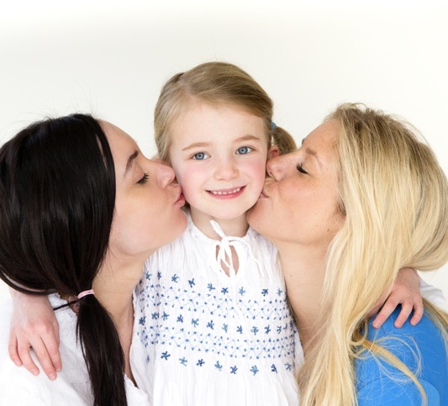
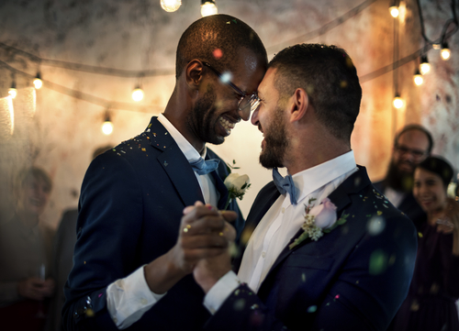
Lots of positive changes have happened to help make the lives of LGB people fair and equal. Things like:
Equal Marriage, so that lesbian and gay couples can get married.
Lesbian, gay and bisexual people can become parents and carers by adopting or fostering children.
Lesbian, gay and bisexual people can do any job.
What do you think has brought about some of the positive changes that have helped make things more equal for people?

Slide 12
“Being part of the LGBT community has meant so much to me in the past few years. Through events like Pride, LGBT youth groups and workshops I have met wonderful people who all celebrate and accept each other”.
Ella, age 17

Slide 13
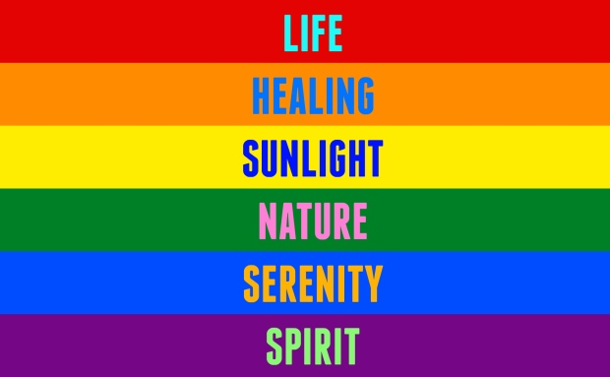
The Rainbow Flag has become the symbol of Pride. Rainbow flags have been used by many cultures and struggles. For the Pride flag, each colour represents something:

Slide 14
“But love makes everyone feel good, so you should share your love with anyone and everyone you want to. Nobody should make you feel bad for that.” Miles, age 5

Slide 15
LGBT Youth provides information and support: https://www.lgbtyouth.org.uk

