Slide 1
Going out: Keeping yourself and others safe
I can talk about my own safety and wellbeing in social situations.
I can plan and respond in social situations in order to ensure my own safety and wellbeing and that of others.
I am building understanding, skills and capacity to assert myself and express what I want and don’t want.
I am aware of how my behaviour, both verbal and non-verbal, can impact on others.

Slide 2
Safe Night Out
Plan Ahead…
Stay in Control…
Look after each other...

Slide 3
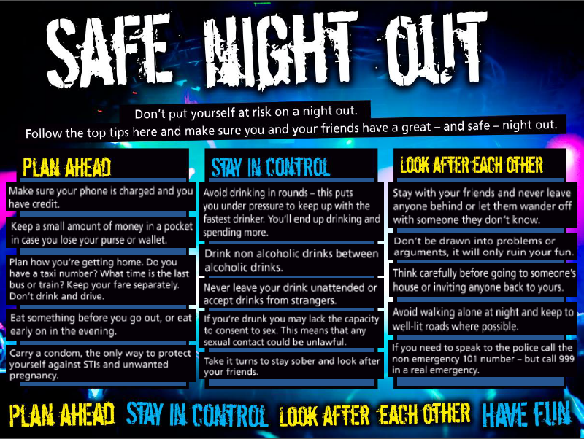
Safe Night Out

Slide 4
Just let it go
Stop the violence campaign
What do you do when it’s looking like there might be some kind of violence near you?

Slide 5
Good night out: an international initiative
“We are on a mission to end sexual harassment and assault in venues, bars, clubs, pubs and festivals across the world. Founded in 2014, The Good Night Out Campaign is an independent, international initiative dedicated to helping the night-time economy deal with, tackle and prevent harassment”.
http://www.goodnightoutcampaign.org/
Is sexual harassment an issue at parties or gigs or pubs here too?

Slide 6
Film: How do you know if someone wants to have sex with you?
https://youtu.be/qNN3nAevQKY
(Duration: 3 minutes 50 seconds)

Slide 7
If you are doing anything sexual with another person then you must be sure they are happy and freely agreeing to the sexual activity. This is called giving consent.
Sexual activity includes: kissing and hugging; touching each other’s bodies, including genitals (your private parts); and penetrative sex, this is when a person puts their fingers or penis or something else into a person’s mouth, vagina or anus (bottom).

Slide 8
Check-in: How am I? How are my friends?
Before the night begins.
?
?
?
In the middle of the night out/party.
?
?
?
As the night winds down.
?
?
?

Slide 9
Check-in: some ideas….
Before the night begins.
Do I have everything I need?
How are my friends feeling about the night?
Do I have someone to call and a place to stay in case something happens?
What’s my plan/our plan for getting home at the end of the night? Have we agreed one?
In the middle of the night out/party.
Am I having fun? Are my friends?
Is anything making me or someone else uncomfortable?
Am I getting too carried away?
Do I need to slow down?
As the night winds down.
If I want to stay out later, do I have a way to get home in the morning?
If a friend is planning to stay out later, will they be okay?
If plans have changed, what are my options at this point?
Given my circumstances, which is the best plan now?

Slide 10
If it doesn’t feel right, it probably isn’t.
Trust your instincts.

