Slide 1
Going out Part 2: Meeting and dating online
I can talk about my own safety and wellbeing in social situations – face-to-face and online.
I can plan and respond in social situations in order to ensure my own safety and wellbeing and that of others.
I am building understanding, skills and capacity to assert myself and express what I want and don’t want.
I am aware of how my behaviour, both verbal and non-verbal, can impact on others.

Slide 2
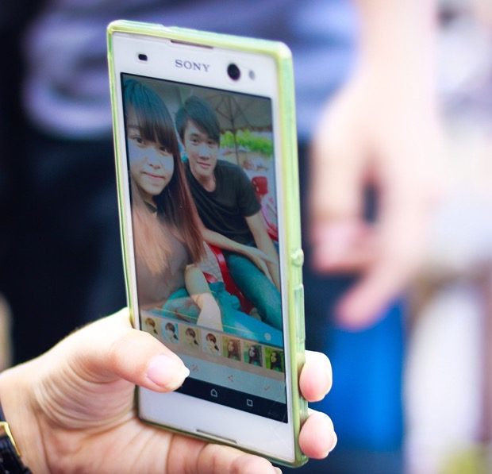
Do you feel freer or braver when you are online?
Does meeting someone online feel different to meeting face-to-face?

Slide 3
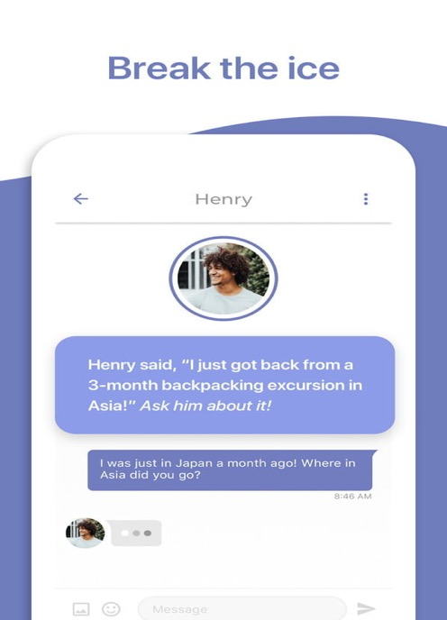
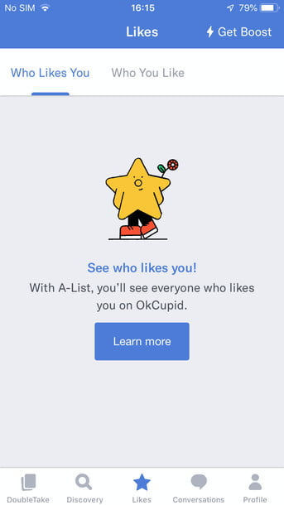
Exploring your identity online: We all feel different sometimes. It can feel like it’s hard to find people who get you: people who are into the same things, share the same experiences, and know where you’re coming from.
Do you think there are some young people who particularly look to online relationships to meet others and explore who they are?

Slide 4
Exploring your identity online
Apps, websites and social networks make it easy for people to connect. When you do find someone who gets you and knows what you’re going through, it feels great.

Slide 5
Exploring your identity online.
For LGBT young people being online can be particularly useful.
96 per cent of LGBT young people say the internet has helped them understand more about their sexual orientation and/or gender identity, and 93 per cent say they found the advice and support they needed through the internet
Source: Stonewall, Staying Safe Online, 2012

Slide 6
Exploring your identity online.
Young people with autism can find it easier to meet and connect to other people online and develop relationships. It allows them to socialise and express themselves.
Source: National Autistic Society; Safeguarding Young People on the Autism Spectrum 2014

Slide 7
What do you think the advantages might be for any young person exploring and meeting people they think are like them online? What are the risks?

Slide 8
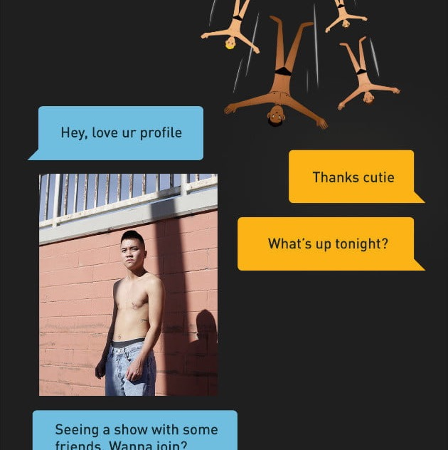
What apps do people use to meet others?
And specifically if they are wanting to ‘date’?

Slide 9
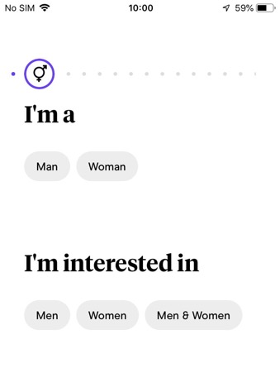
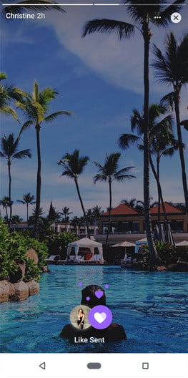
Online relationships and dating
Seven million UK residents are registered on dating sites, and around one in three relationships in the UK now start online (source: Sky News).
Why do you think so many people meet and get together online?

Slide 10
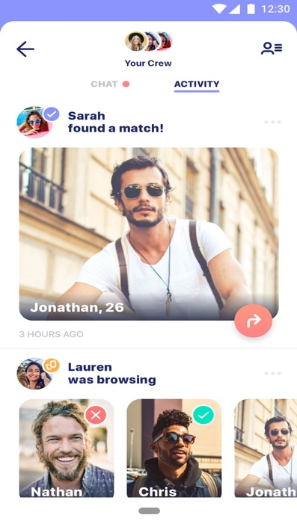
How are dating apps changing relationships?
CBS News (11 minutes 7 seconds) https://youtu.be/Sj78ZO-mBkU

Slide 11
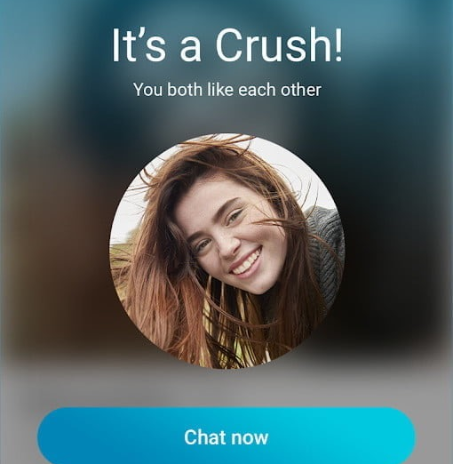
So you are chatting online…. They seem nice. You have chatted a few times. Then there is something that doesn’t feel right….
What are the warning signs that someone could be fake or an abuser?

Slide 12
So you are chatting online…. What are the warning signs that someone could be fake or an abuser?
They are just too good to be true. They share all your interests, they give you lots of attention, they make you feel special, things are moving fast…
Flattery. They praise pictures on your profile, say you’re sexy, fit…. It’s hard to think critically because they are praising you.
Let’s talk about sex. They try to get you to talk about sex...
Got any sexy pictures? They are asking you for pictures….
Can we go somewhere more private? They ask for private chats….
Our little secret? They don’t want other people to know you are chatting.
Mood swings. They flatter you and pay attention, then they ask for something, you hesitate or say ‘no’ so they take that attention away or turn nasty.
My camera’s broken. They don’t want you to see them.

Slide 13
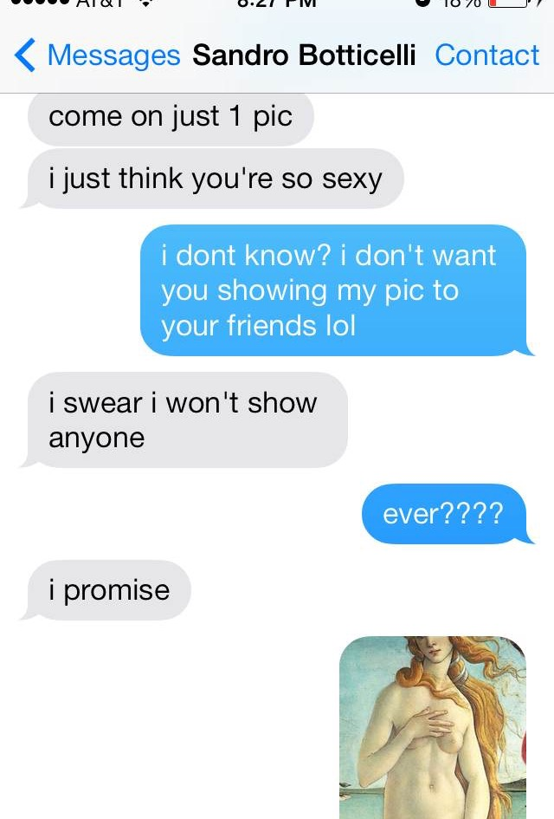
Worried your friend has met someone dodgy online?
How would you know and what could you do to help?

Slide 14
Worried your friend has met someone dodgy online?
How would you know? What would be the warning signs?
Have they become very secretive? And stopped sharing messages or their profile?
Are they distant?
Have they mentioned someone new? Or someone older?
Are they sad or withdrawn but won’t say why?
Are they unable to switch off from their phone or social media?
How could you help?
Listen, don’t judge, be there for them.
Help them understand the risks of chatting to people online – especially someone older.
Show them how to get help and understand they won’t be in trouble
You should tell an adult you trust or contact a helpline for advice – don’t keep a secret if a friend is in danger.
The Internet, Relationships and You: 11-18s | CEOP Education (thinkuknow.co.uk)

Slide 15
So what are the dangers of digital dating?
Some people – men and women – use the internet to look for sex and target young people. They use sites and apps where they know young people go to look for love, flirt or find support.
Some adults don’t care who they have sex with but think young people are easier to trick, pressure or force into having sex.
Online a person can pretend to be something they are not – a friend, a mentor, a boyfriend or girlfriend. You can even pretend ot be a completely different person. It can be hard to tell the difference between someone genuine and someone dangerous.
Dark side of online dating: Crimes rise dramatically in last five years
By Siobhan Robbins, Sky News Correspondent

Slide 16
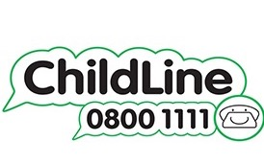
And remember….
Think about how you look and present yourself online. Fakers and abusers target young people with sexy images/names on their profiles.
Keep private stuff private – don’t share personal details like phone numbers or school or address.
If someone claims to be a ‘friend of a friend’ check them out – have they actually ever met?
Don’t share sexual pictures/nudes and don’t do anything on video chat with a stranger - they might share or threaten to share.
ChildLine is always available for a chat
The Internet, Relationships and You: 11-18s | CEOP Education (thinkuknow.co.uk)

Slide 17
If you decide to meet up what rules should you follow?

Slide 18
Question: If you decide to meet up, what rules should you follow?
First, please remember, it’s always risky to meet up with someone face-to-face. There are some common sense rules if you do.
Always meet and stay in a busy public place.
Take a trusted responsible adult with you, not a friend. If the person you are meeting isn’t being honest, taking a friend will put you both at risk. (If you tell the person you are bringing an adult they shouldn’t have a problem with that; if they do, don’t go).
Make sure someone knows who you are meeting, where you are going, and when you will be back.
If your instinct tells you something is wrong, it probably is. If the person doesn’t look like the person you expected then leave as soon as possible.
Do not accept a lift from someone you meet.
Stay sober.
Take your phone, keep it switched on, with credit.
Your personal belongings can be stolen, don’t leave them unattended.
If you are worried about your safety or think you are in danger do not hesitate, phone 999.

