Slide 1
When I feel sad or worried
I can communicate my feelings.
I can talk about positive things about me
I recognise when I have positive emotions, and when I feel sad or worried.
I can reflect on my relationships with others and how they impact on my emotional wellbeing.
I know who or where I can go to for support or if I have a worry or a question.

Slide 2
Feelings check-in
When I woke up this morning, I felt…
Just before coming into school, I felt…
Right now, I feel…

Slide 3
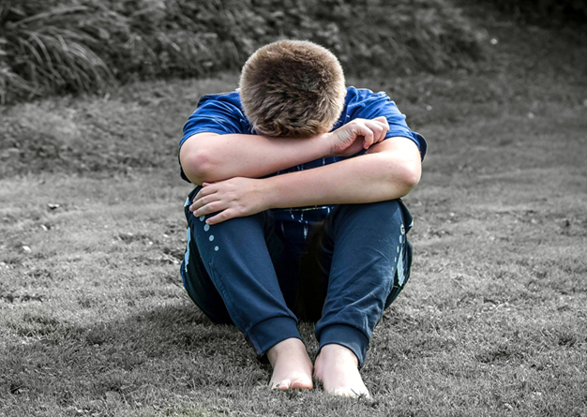
When someone feels sad what can they do?
When someone feels worried what can they do?

Slide 4
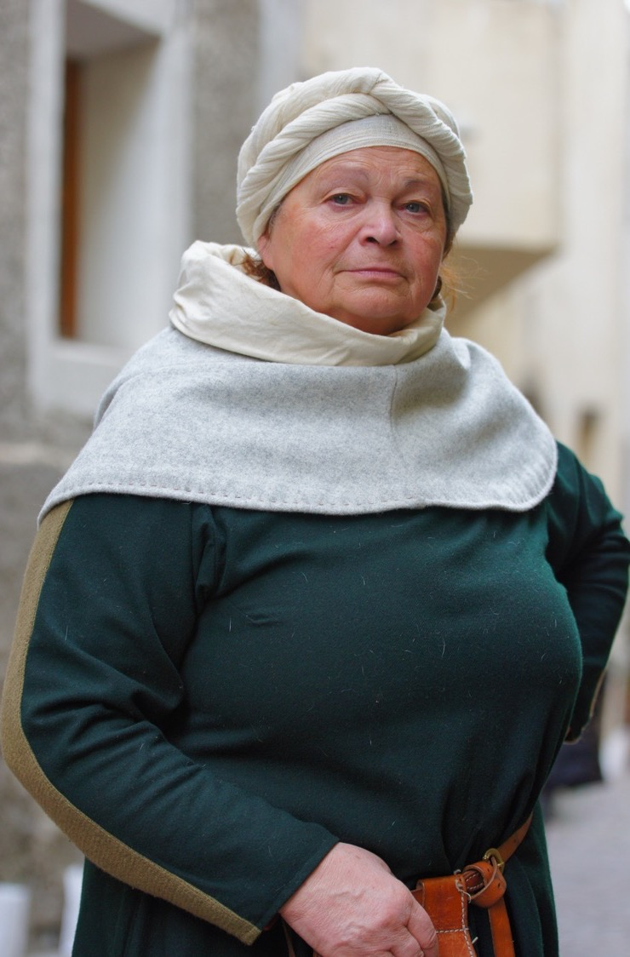
Old Wormwart’s cure for worrying

Slide 5
Things to remember
Managing our feelings, our emotions, is one of the most important life skills a person can develop.

Slide 6
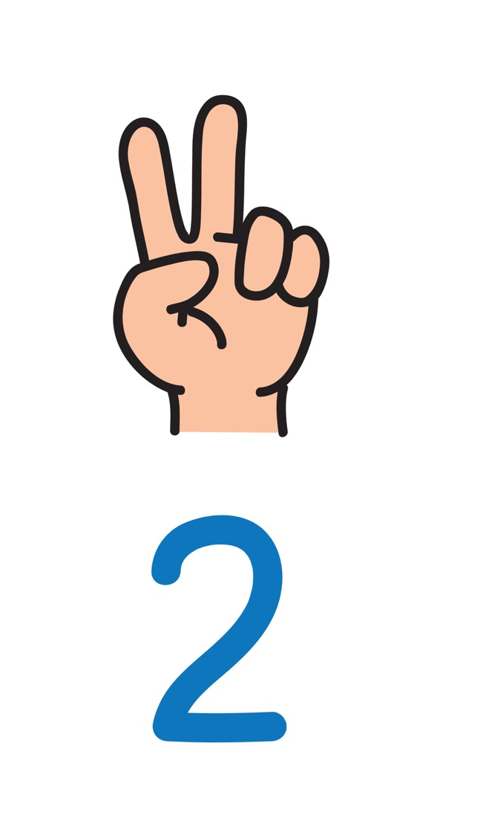
Things to remember
Notice how you feel. Pay attention to how strong the feeling is. If a feeling feels too big then it’s time to share with someone.

Slide 7
If you feel sad or worried talking to another person will help.
ChildLine is always there for you - online or phone 0800 1111

