Slide 1
Contraception and Condoms
I can name the main methods of contraception available.
I understand that decisions and practices regarding contraception are a part of relationships which are safe and enjoyable.
I know where to go for information and advice on contraception.

Slide 2
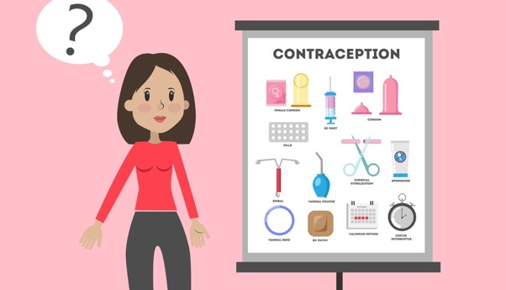
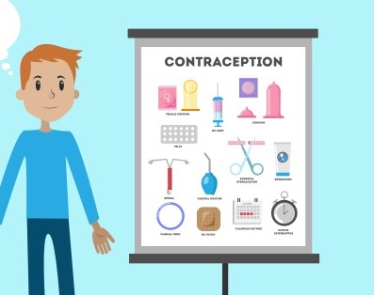
Today is about contraception.
Contraception protects someone from getting pregnant.
A person might also use contraception to control or stop menstruation, such as managing heavy periods.
In the session you will find out about contraception, especially what’s called Long Acting Reversable Contraception (Injections and implants) and Emergency Contraception and Condoms.

Slide 3
In a recent Scottish study, we learned that 1 in 5 young people have had sexual intercourse at age 15.
When they did:
31% used a condom.
26% of young women were using the contraceptive pill.
9% used a condom and the young women was using the pill.
34% did not use a condom or other contraceptive.

Slide 4
NHS Inform
https://www.nhsinform.scot/healthy-living/contraception/getting-started/the-different-types-of-contraception

Slide 5
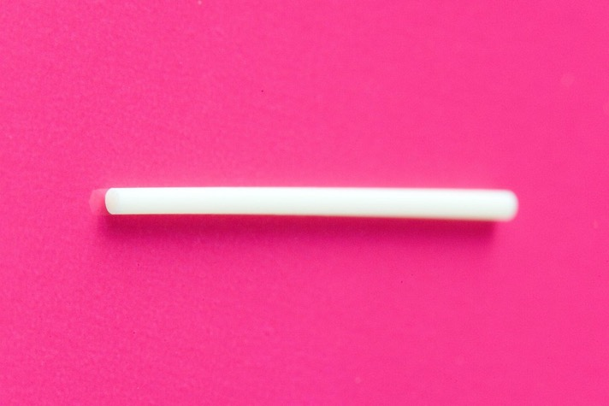
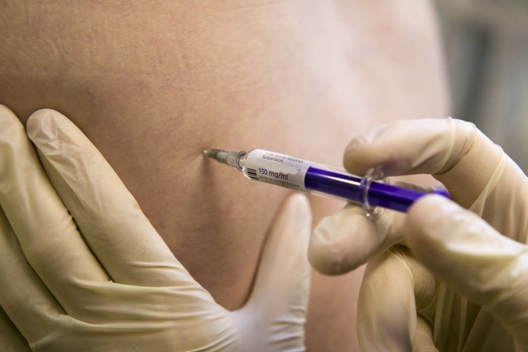
Implant and Injection.
What did you know about already?
What’s new to you?
Anything would like to know more about?
Animation: Cows talk Contraceptive Implants https://youtu.be/Pw1HruBL5Zs

Slide 6
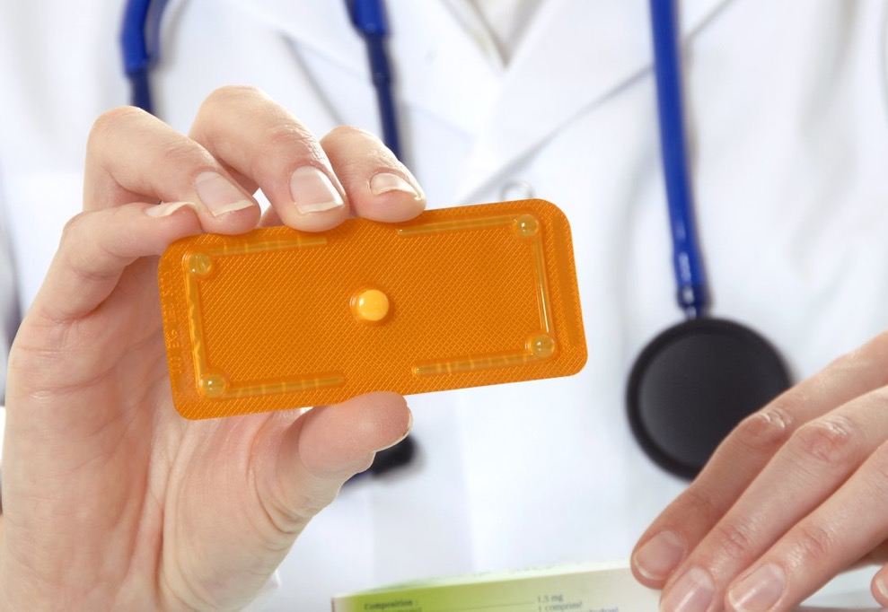
NHS Inform
https://www.nhsinform.scot/healthy-living/contraception/emergencies/emergency-contraception
Emergency contraception
What did you know about already?
What’s new to you?
Anything would like to know more about?
Animation: Elephants talk Emergency Contraception https://youtu.be/LkCQYaFlPzY

Slide 7
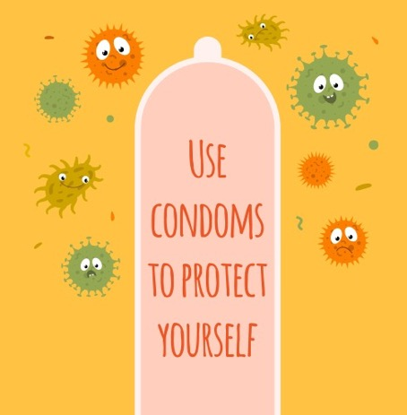
Condoms
“I wouldn’t have sex without using something, I think I’m more afraid of getting pregnant than catching an STI though. They seem a lot less stressful!”

Slide 8
Condoms
“I feel like guys get really embarrassed about condoms, they treat it like it’s a joke or something and they are fine with that, but actually when it comes to it, they don’t know what to do”.

Slide 9
Condoms
“I definitely think it’s more expected for girls to protect themselves, guys don’t seem that bothered”.

Slide 10
Condoms
“There is a real thing that guys don’t think it’s manly to use condoms, you never hear people talking about condoms unless it’s like a joke or making fun of someone”.

Slide 11
Condoms
“I think it’s both of your responsibility, I mean even if you are a lassie. It’s not like you wouldn’t notice if a guy hadn’t put a condom on. I think it’s ok for girls to refuse having sex, and guys as well for that matter, if their partner doesn’t want to be protected. You have to share the responsibility and the result, if it goes wrong, equally. It’s about respecting each other”.

Slide 12
Condom demonstration
https://vimeo.com/684152273
What did you know about already?
What’s new to you?
Anything would like to know more about?

Slide 13
Are all male/external condoms the same?
No, they come in different sizes. They can be different length or different width.
Male/external condoms also come in different colours, some have flavours or different thickness or shape to give a different feel.
Flavoured condoms are only for oral sex, they should not be used for penetrative sex.
When a condom fits properly it is more effective – so fit is really important. Also, the better fit, the better it will feel. It helps for boys to practice with different types and sizes of condom on their own to make sure they use one that’s comfortable and fits well.

Slide 14
Internal (Female) condoms: How do they work? (duration 1 minute 5) https://youtu.be/EfwstN51ZIw
What did you know about already?
What’s new to you?
Anything would like to know more about?
Pufferfish talk Condoms
https://youtu.be/ehRpXeX0SyI

Slide 15
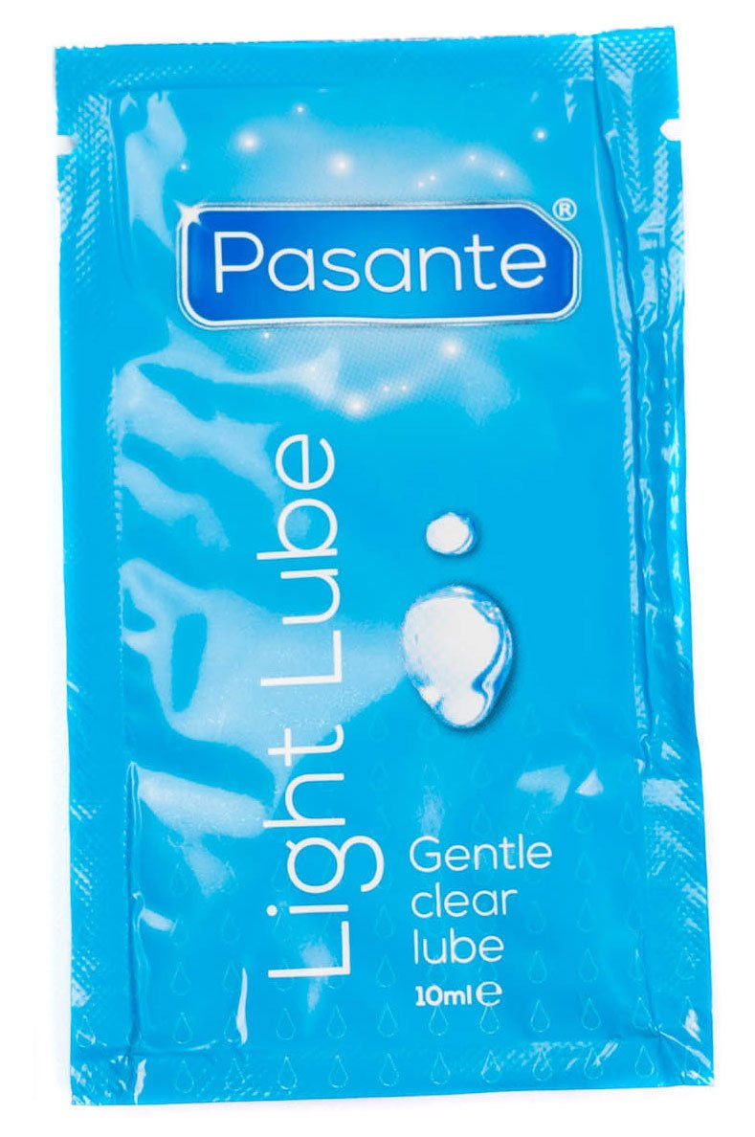
What is lubricant/lube?
You can use lube for penetrative sex if this helps make it more comfortable.
If you have anal sex – penis in anus (bottom) sex – then condoms and lube both need to be used.

Slide 16
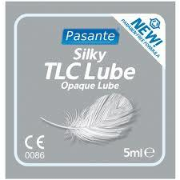
What is lubricant/lube?
Lube should always be what’s called water based or silicone based. You will get this free with your condoms.
Never use anything that is an oil or oil-based (like massage oil or baby oil) with male condoms as this breaks the condoms.

Slide 17
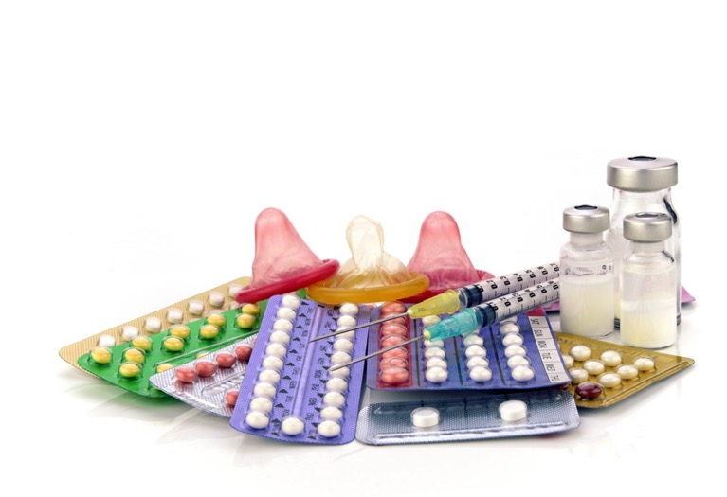
What did you know about already?
What’s new to you?
Anything would like to know more about?
Other types of contraception
NHS Inform https://www.nhsinform.scot/healthy-living/contraception/getting-started/the-different-types-of-contraception

Slide 18
A few things to remember
Talking about contraception or condoms is important because otherwise people make assumptions that one person has got it sorted – they might not have.
If you sort what you need, then the experience of sex will be more relaxed, safe and enjoyable.

Slide 19
A few things to remember
You have a right to access accurate information and to get contraception and condoms.
Remember the importance of consent. Just because someone has sorted contraception or got condoms, it doesn’t mean they are intent on having sex. You still need to talk and pay attention when it comes to consent.

Slide 20
Our local sexual health services, clinics and pharmacies:
(Insert information from your locality here)

