Slide 1
Condoms
I can explain what a condom and lubricant is used for.
I know how to use condoms.
I know how to access condoms.

Slide 2
What is a condom and how does it work?
There are 2 kinds of condoms - the external condom that fits over the penis, and internal condom, that fits inside the vagina.

Slide 3
A man fits the condom over his erect penis.
When he has sex, he ejaculates semen and sperm from the end of his penis. The semen and sperm collect in the condom and so it cannot enter the vagina, mouth or anus (bottom) of his partner.

Slide 4
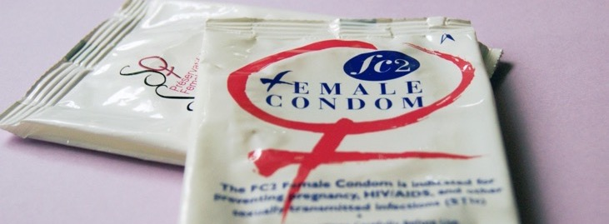
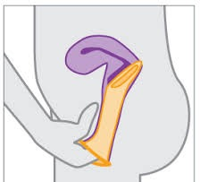
An internal/female condom fits inside the vagina.
When the man puts his penis inside the vagina during sex and ejaculates, the semen and sperm collects in the condom.
Notes:
This drawing isn’t very good, but we need a picture here showing where it goes (as with the last slide showing the condom)

Slide 5
Anyone of any age can get condoms. There is no age limit.

Slide 6
Condoms prevent pregnancy by stopping the man’s semen and sperm from reaching and fertilising the woman’s egg.
Condoms are 98% reliable at preventing a pregnancy if they are used correctly.
Some people use condoms alongside other forms of contraception to increase their confidence in preventing pregnancy.
Notes:
Not helpful to put 85% when 98% is easily achievable. We’re trying to encourage young people to use them.

Slide 7
When condoms are used correctly they can stop a person passing on or catching a sexually transmitted infection (STI).
Using a condom during sex is the only way to protect you from STI’s.

Slide 8
If a condom comes off during sex do not put it back on. Use a new one.
After using a condom carefully take it off the penis, making sure you don’t spill any of the collected semen and sperm.
Then, wrap it in a tissue and put it in a bin.
Notes:
Some people with LD can’t tie knots. It just adds another thing they can’t do to the process and it’s not necessary.

Slide 9
Male condom: Condom demonstration (duration 1 minute 43) https://vimeo.com/684152273
Female condoms: How do they work? (duration 1 minute 5) https://youtu.be/EfwstN51ZIw

Slide 10
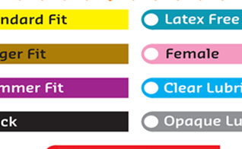
Are all condoms the same?
No, they come in different sizes. They can be different length or different width.
Male condoms also come in different colours, some have flavours or different thickness or shape to give a different feel.
Flavoured condoms are only for oral sex, they should not be used for penetrative sex.

Slide 11
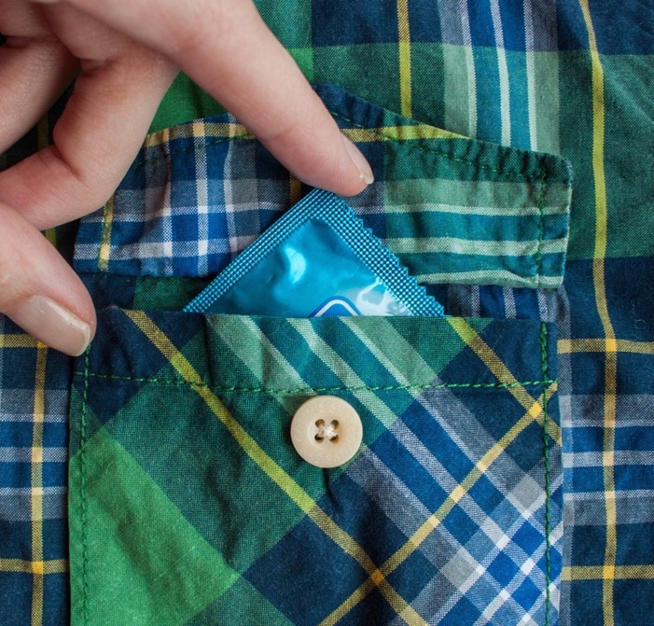
Are all condoms the same?
When a condom fits properly it is more effective. Also, the better fit, the better it will feel.
Boys can practice with different types and sizes of condom on their own to make sure they use one that’s comfortable and fits well.

Slide 12
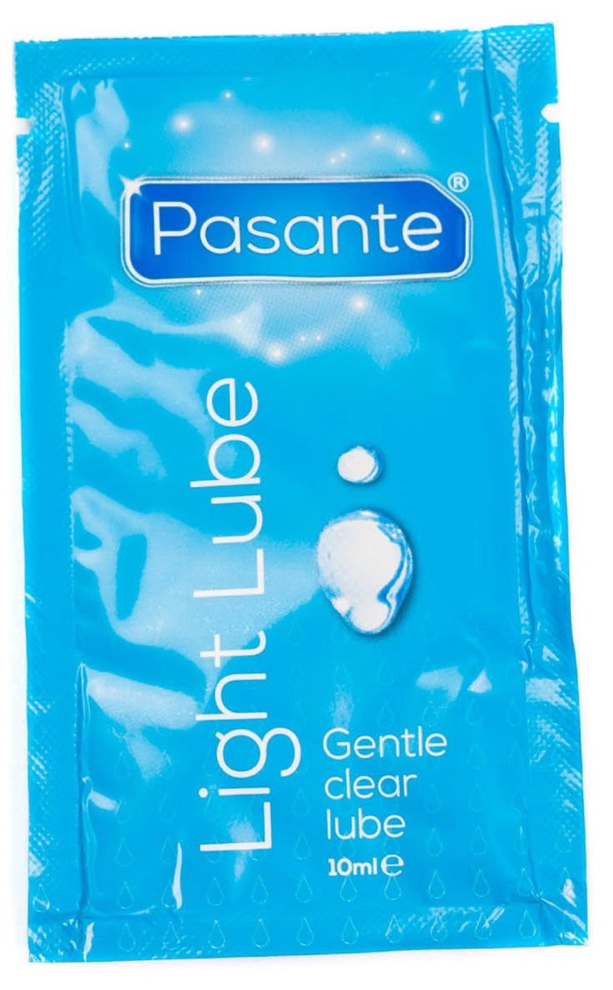
What is lubricant/lube?
Lube is a liquid or gel that people apply during sex to make the vulva, vagina, penis or anal area wetter or slippery.
Lube can be used for vaginal sex if there is a lot of dryness. It can also be used to make sex more comfortable.
If you have anal sex – penis in anus (bottom) sex – then both condoms and lube should be used together.

Slide 13
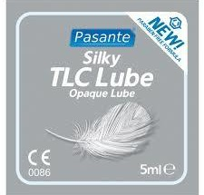
Lube should always be water based or silicone based.
Never use anything that is an oil or oil-based lubricant (like massage oil or baby oil) with male condoms as this can cause the condom to break.

Slide 14
What should you do if your condom bursts, rips or slips off when you are having sex? Do one of these things:
Go to your local Sexual Health clinic as soon as you can. Time really matters if you need Emergency Contraception or you have been exposed to HIV.
Local chemists also provide emergency contraception. You can ask to speak to the Pharmacist when you go in.
Speak to an adult you trust and get information and help as soon as you can.

Slide 15
Where can you get condoms and lube?
Free condoms are available in many places such as local sexual health clinics and local free condom schemes. In some places you can get them in youth clubs or community centres or young people’s drop-ins.
You can buy condoms and lube in a lot of shops and supermarkets but the condoms you get for free are just as effective as those you can buy.
There is a condoms for free service. You can use this if you are under 16: INSERT LOCAL DETAILS

Slide 16
Condoms: How to use them effectively
(duration 2 minutes 54)
https://youtu.be/oaLdNErJ-Fk

Slide 17
OPTIONAL SLIDES about Emergency Contraception

Slide 18
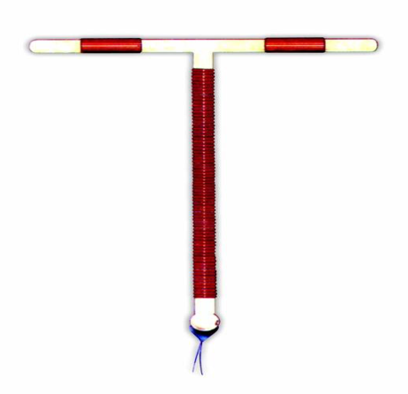
Emergency contraception
You may need Emergency Contraception if you have had unprotected sex.
Unprotected sex is sex without using any contraception, or if your contraceptive has failed – for example, your condom split.
Emergency contraception is for emergencies only. It cannot be used as a regular method of contraception.
There are 2 types of emergency contraception.

Slide 19
The emergency contraception pill
Some pills can be taken up to 72 hours (3 days) after sex. Other pills can be taken up to 120 hours (5 days) after sex.
The emergency contraception pill works better if you take it as soon as possible after sex.

Slide 20
Emergency contraception: The IUD (Coil)
The IUD is sometimes called the coil. It is a small copper and plastic device which is put into the uterus. This must be fitted by a doctor or nurse.
The I.U.D. should usually be fitted within 5 days of sex.
The IUD works better if you have it fitted as soon as possible after sex.

Slide 21
Emergency Contraception
You can get emergency contraception for free.
You can get the emergency contraceptive pill from a sexual health clinic or a local pharmacy.
You can get the IUD/coil fitted at a sexual health clinic.

