Slide 1
Choices about contraception
I can explain what contraception is.
I can name the main methods of contraception a young person might use.
I know how to access information and advice from sexual health services.

Slide 2
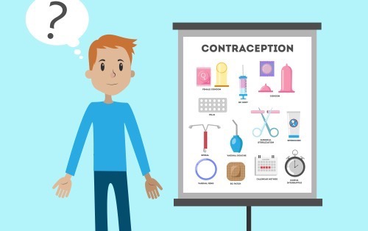
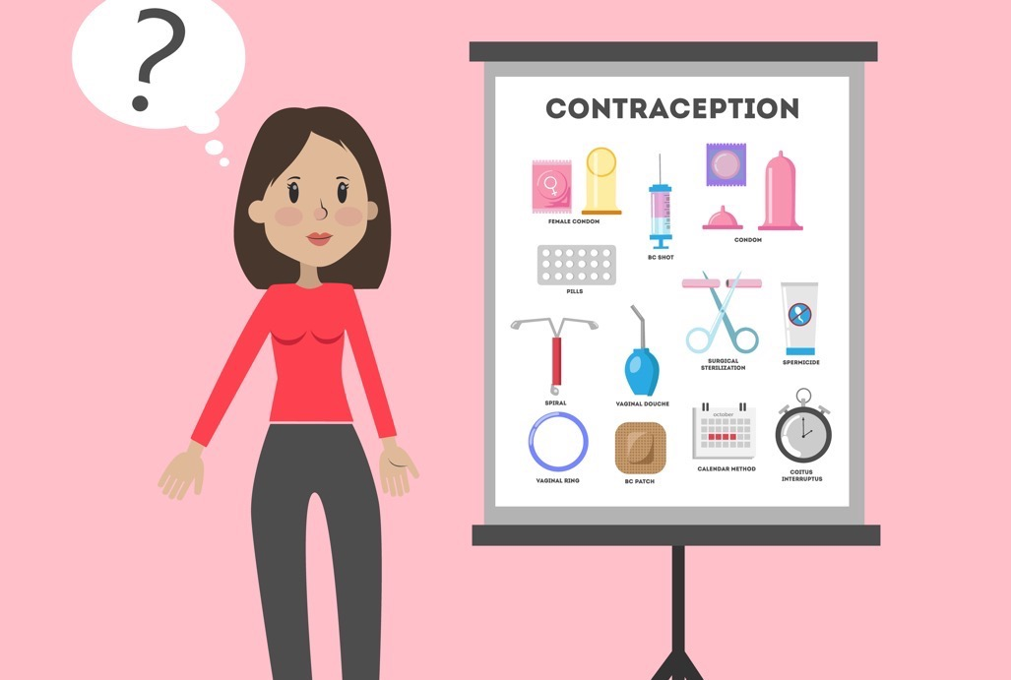
Why do people use contraception?
When a man and woman have sex (which includes the man putting his penis in the woman’s vagina) then the man can ejaculate sperm in to the woman’s vagina.
If the sperm meets the woman’s egg, she may become pregnant.
If a woman and man don’t want to have a baby, then they can use contraception.

Slide 3
How many different types of contraception have you heard of?
Do you have any questions about contraception?

Slide 4
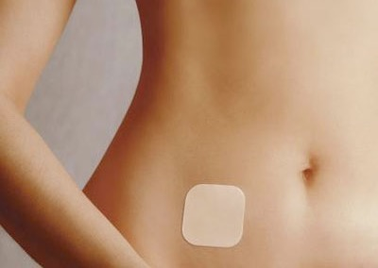
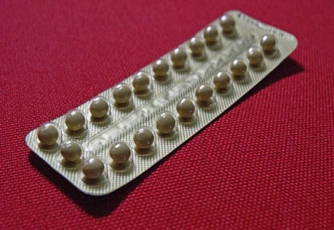
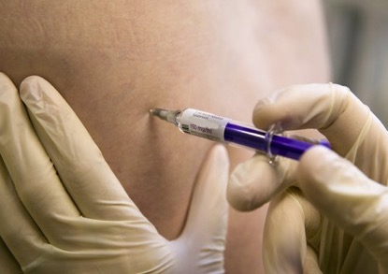
Contraception that a woman can use
These are the most commonly used contraceptives for women:
Contraceptive Pill
Patch
Implant (rod)
Injection (jag)

Slide 5
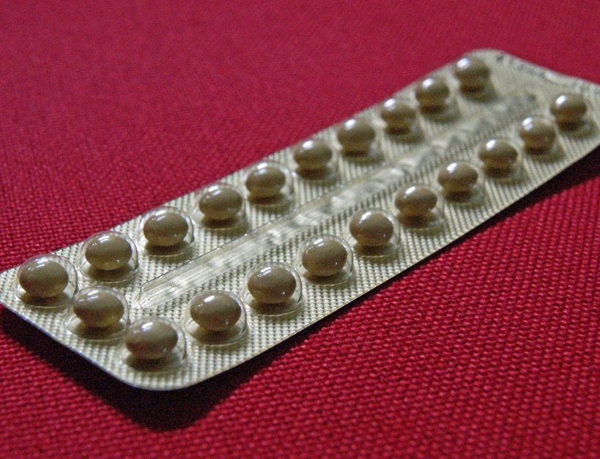
Contraceptive Pill
There are different kinds of contraceptive pills.
It works by releasing a hormone into your body.
The pill is available from a doctor or Sexual Health clinic.

Slide 6
Pills are over 99% effective at preventing pregnancy if taken correctly.
You need to remember to take a pill every day.
The Pill is available from your GP or a Sexual Health clinic.

Slide 7
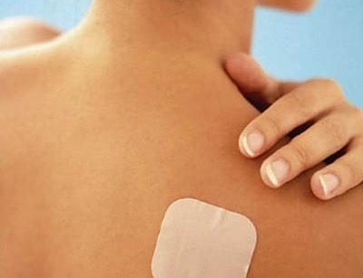
Patch
This is a very sticky patch that you stick on your body.
It works by releasing a hormone into your body.

Slide 8
Each patch lasts for 1 week.
You change the patch every week for 3 weeks, then have a week off without a patch.
The patch is over 99% effective at preventing pregnancy.
The patch is available from your Sexual Health clinic.

Slide 9
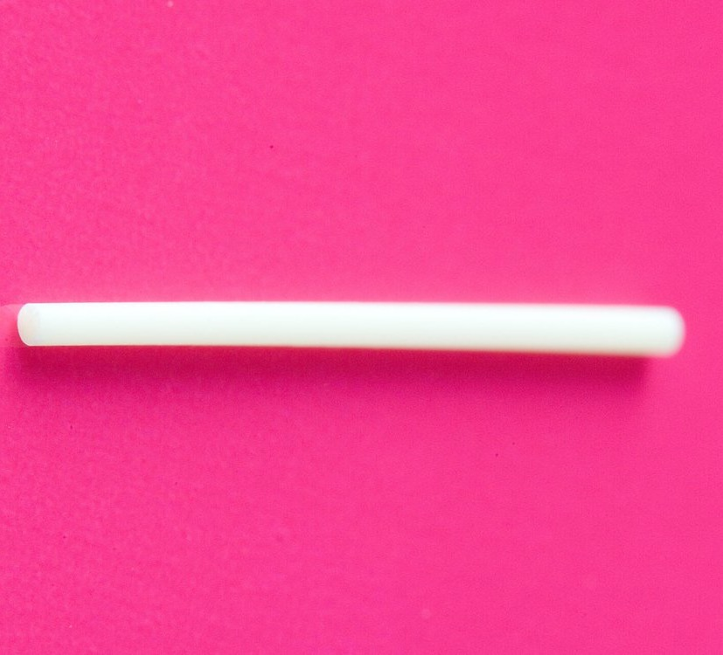
Implant
A little plastic rod put under the skin on the arm.
It works by releasing a hormone into your body.
The implant lasts for up to 3 years.

Slide 10
The nurse or doctor puts it in for you.
The implant is over 99% effective at preventing pregnancy.
After 3 years, the doctor can take it out and put another implant in for you.
The patch is available from your GP or a Sexual Health clinic.

Slide 11
Injection
An injection is given by a nurse at a doctor’s surgery or Sexual Health clinic. Or you might be offered the injection that you do yourself at home. The injection works by releasing a hormone into your body.

Slide 12
Injection.
The injection can be given between every 11 to 14 weeks. Before the 14 weeks is up you need to get your next injection. The injection can be over 99% effective if you get your injections in time.

Slide 13
Condoms do 2 things:
They protect both men and women from sexually transmitted infections.
They are a contraceptive (they stop the sperm meeting the egg).

Slide 14
Male condoms
Condoms work by collecting the semen and sperm when the man ejaculates during sex.
This stops the semen and sperm travelling up the vagina and meeting the egg.
Condoms are 98% effective at preventing pregnancy if used correctly.

Slide 15
Internal (Female condoms)
A internal condom fits inside the vagina.
When the man puts his penis inside the vagina during sex and ejaculates, the semen and sperm collects in the condom.
Internal condoms are 95% effective at preventing pregnancy if used correctly.

Slide 16
Where can you get contraception and condoms ?
You can get contraception from your GP, sexual health clinics (including young people’s clinics) and pharmacies.
Free condoms are available in many places such as local sexual health clinics and local free condom schemes. In some places you can get them in youth clubs or community centres or young people’s drop-ins.
You can buy condoms and lube in a lot of shops and supermarkets.
The condoms you get for free are just as effective as those you can buy.
There is a condoms for free service. You can use this if you are under 16: INSERT LOCAL DETAILS

Slide 17
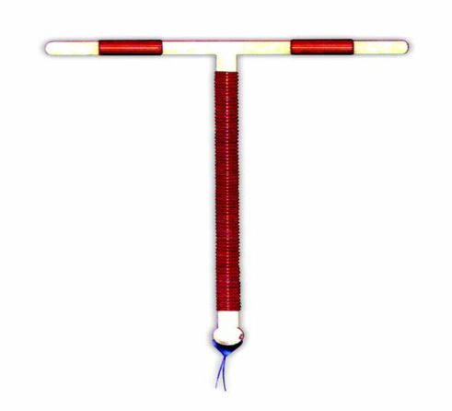
Emergency contraception
You may need Emergency Contraception if you have had unprotected sex.
Unprotected sex is sex without using any contraception, or if your contraceptive has failed – for example, your condom split.
Emergency contraception is for emergencies only. It cannot be used as a regular method of contraception.
There are 2 types of emergency contraception.

Slide 18
The emergency contraception pill
Some pills can be taken up to 72 hours (3 days) after sex. Other pills can be taken up to 120 hours (5 days) after sex.
The emergency contraception pill works better if you take it as soon as possible after sex.

Slide 19
Emergency contraception: The IUD (Coil)
The IUD is sometimes called the coil. It is a small copper and plastic device which is put into the uterus. This must be fitted by a doctor or nurse.
The I.U.D. should usually be fitted within 5 days of sex.
The IUD works better if you have it fitted as soon as possible after sex.

Slide 20
Emergency Contraception
You can get emergency contraception for free.
You can get the emergency contraceptive pill from a sexual health clinic or a local pharmacy.
You can get the IUD/coil fitted at a sexual health clinic.

Slide 21
Birth Control Basics: Condoms, The Pill and Patch
(duration 2 minutes 9 seconds)
https://youtu.be/50vmQzjRkuk

Slide 22
What is bridging contraception?
Bridging contraception is a short-term supply of the contraceptive pill. You can get it from your pharmacy. It bridges the gap between emergency contraception and longer-term contraception. This lowers the risk of unplanned pregnancy as you wait to get your appointment and decide what long-term plan you have for contraception.

Slide 23
What if I am under 16?
Contraception services are free and confidential including for people under 16.
If you are under 16 and want contraception a doctor, nurse or pharmacist can provide it. They will want to make sure you understand what contraception is for and how you use it.
Doctors, nurses and pharmacists have strict rules they must follow when dealing with people under 16. The doctor, nurse or pharmacist will not tell your parents or carers if you ask for contraception, or if you are given contraception. They will encourage you to consider telling your parents or carers, but they won’t make you.

Slide 24
Who is responsible for contraception?

Slide 25
Who is responsible for contraception?
“I’d assume they (the girl) were using contraception”.
“Boys just expect girls to use contraception”.
“Some people don’t use anything and think pregnancy will never happen”.

Slide 26
Who is responsible for contraception?
“I think it’s both of your responsibility. I think it’s ok for girls to refuse having sex, and guys as well, if their partner doesn’t want to be protected. You have to share the responsibility and the result if it goes wrong (like getting pregnant) equally”.

Slide 27
Who is responsible for contraception?
“The most important thing that helps make sure that young people plan and use contraception is talking about it together”. (Sexual Health Nurse)

Slide 28
A few things to remember
The only way to prevent a pregnancy is to not have penetrative sex, or plan and use contraception.

Slide 29
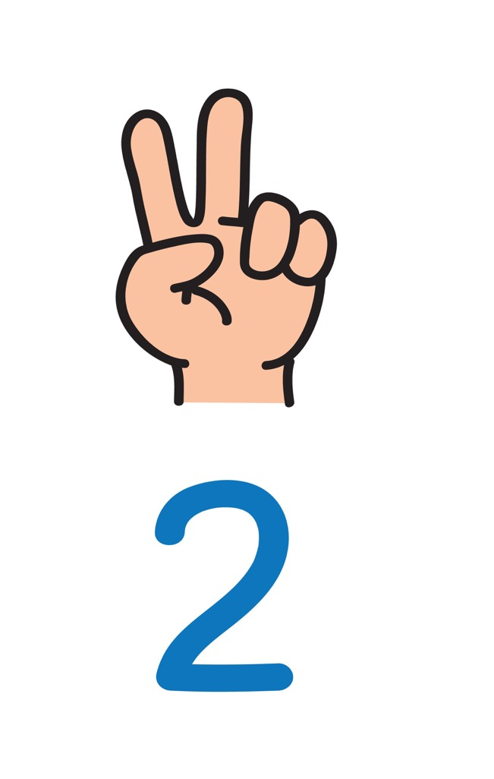
Young people have a right to information and to get contraception and condoms.
You can go to a sexual health clinic or visit your GP and talk about contraception before you start to have sex.
Notes:
Lots of places don’t have young person’s drop ins for condoms etc.

Slide 30
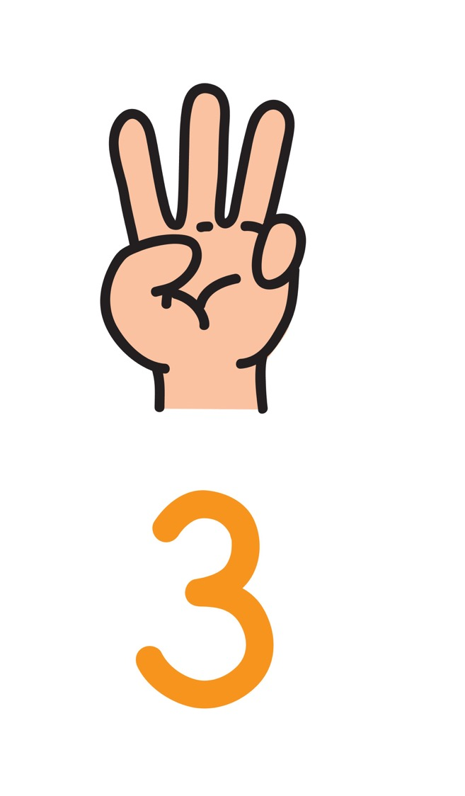
Talking about contraception and/or condoms with your partner is important.
It’s important to discuss what contraception you will use before you have sex, and not make assumptions about whose responsibility it is.
Both women and men can share responsibility for making good choices about contraception.

Slide 31
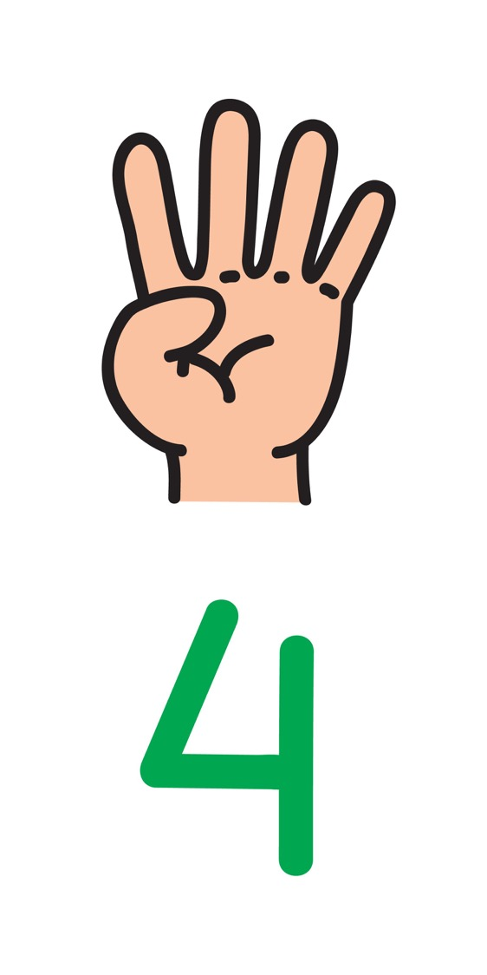
Contraception won’t protect you against STIs - you should use condoms as well.

Slide 32
If you have these discussions beforehand, then the experience of sex will be more relaxed, safe and enjoyable.

Slide 33
Remember the importance of consent.
Just because someone has sorted contraception or got condoms, it doesn’t mean they want to have sex.
It just means they are planning ahead.
You still need to talk and pay attention when it comes to consent.

Slide 34
Our local sexual health services, clinics and pharmacies:
(Insert information from your locality here)

Slide 35
Let’s look back and review: What questions did you have about contraception? Did you get an answer?

