Slide 1
If I were a parent or carer
I can talk about what a parent/carer does to make sure their child is healthy, happy and safe.
I can describe the diversity we find in family life.
I can discuss some of the challenges of being a parent/carer.
I talk about the kind of parent or carer I would be.

Slide 2
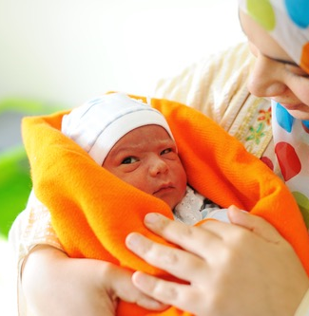
What might be difficult or tough about being a parent or a carer when your child is…
A baby?

Slide 3
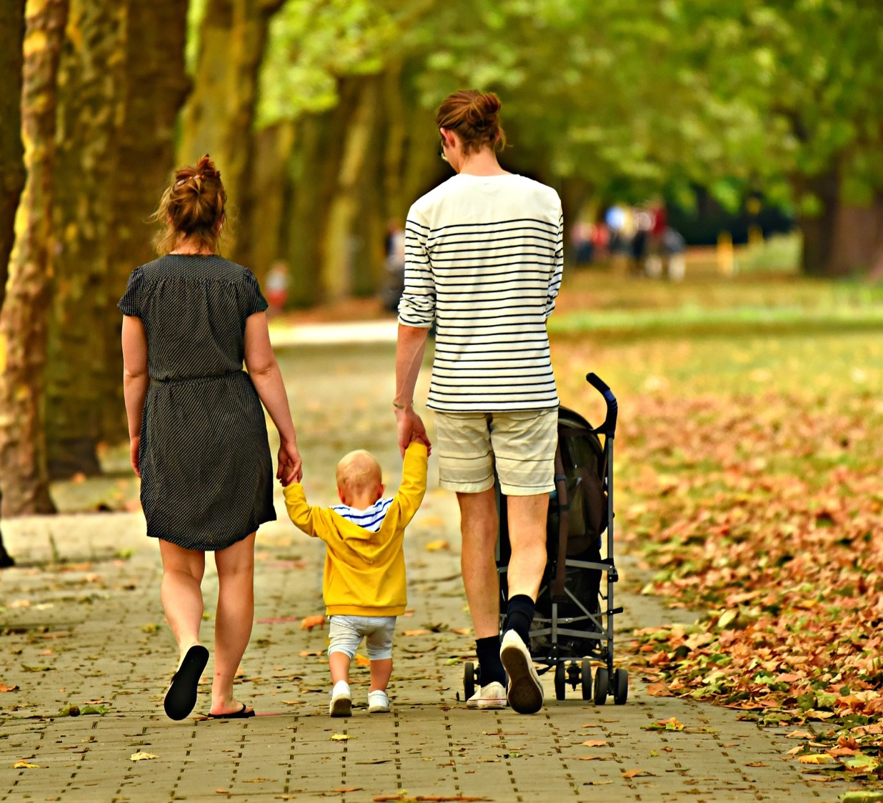
What might be difficult or tough about being a parent or carer when your child is… A toddler?

Slide 4
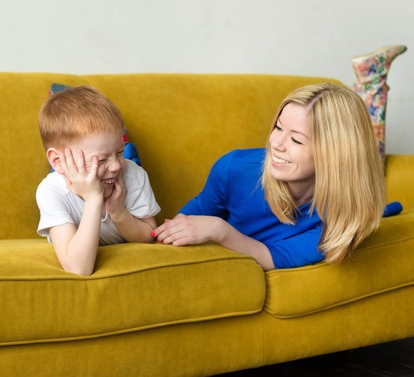
What might be difficult or tough about being a parent or carer when your child is… A 5-year old?

Slide 5
What might be difficult or tough about being a parent or carer when your child is…: A 10-year old?

Slide 6
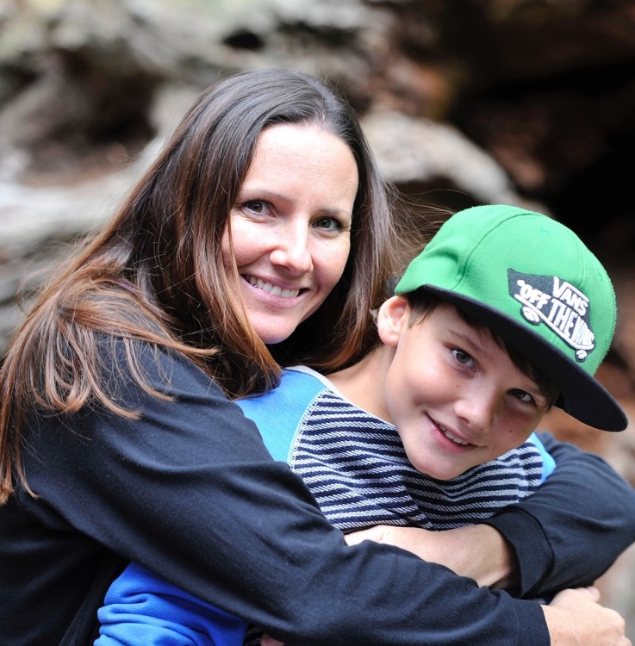
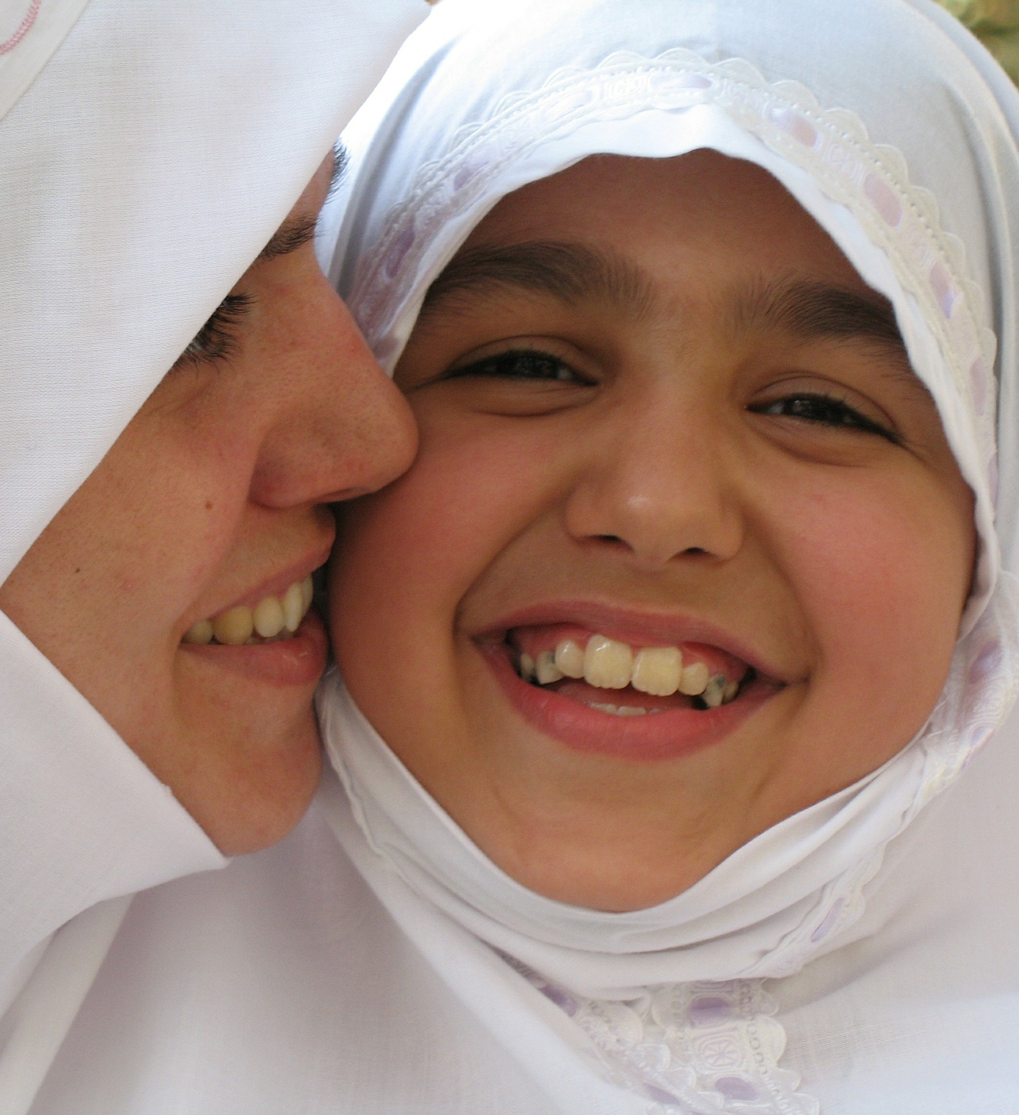
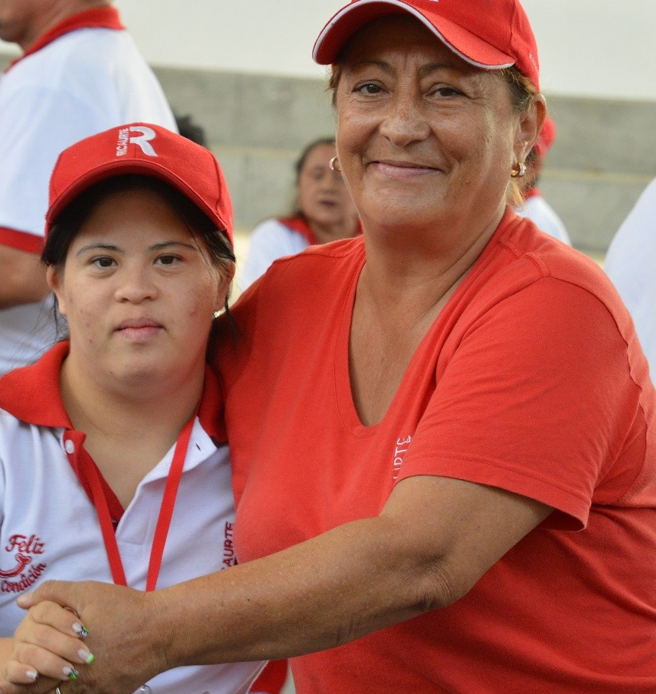
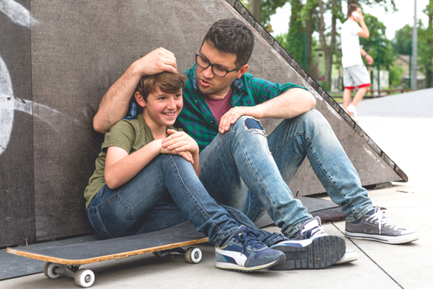
What might be fun and amazing about being a parent or a carer?

Slide 7
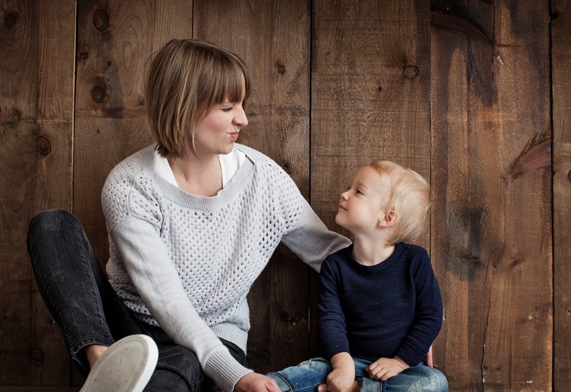
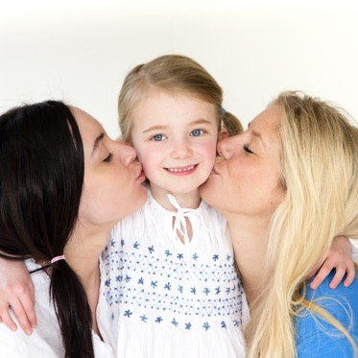
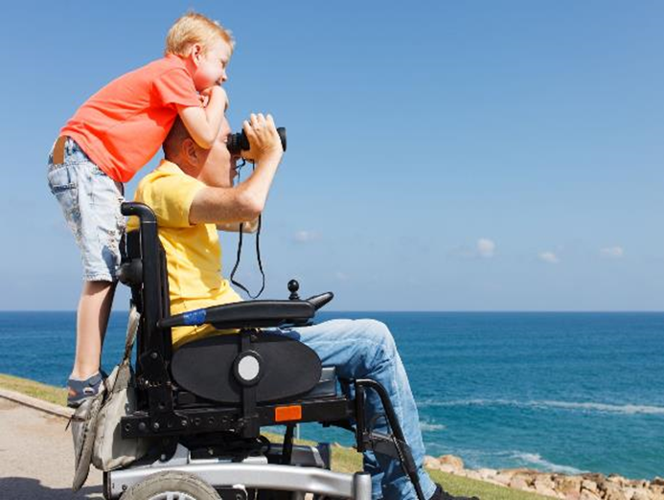
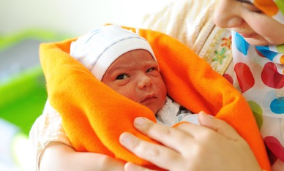
Do you ever imagine being grown up and having children that you care for?

Slide 8
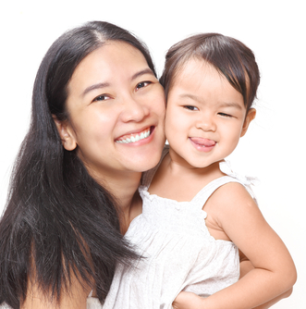
Me as parent or carer
How will I make sure my child is healthy?
How will I make sure my child is happy?
How will I make sure my child is safe?

