Slide 1
What does a parent/carer need to know and do?
I can talk about what a parent/carer does to make sure their child is healthy, happy and safe.
I can describe the diversity we find in family life.
I can discuss some of the challenges of being a parent/carer.
I talk about the kind of parent or carer I would be.

Slide 2
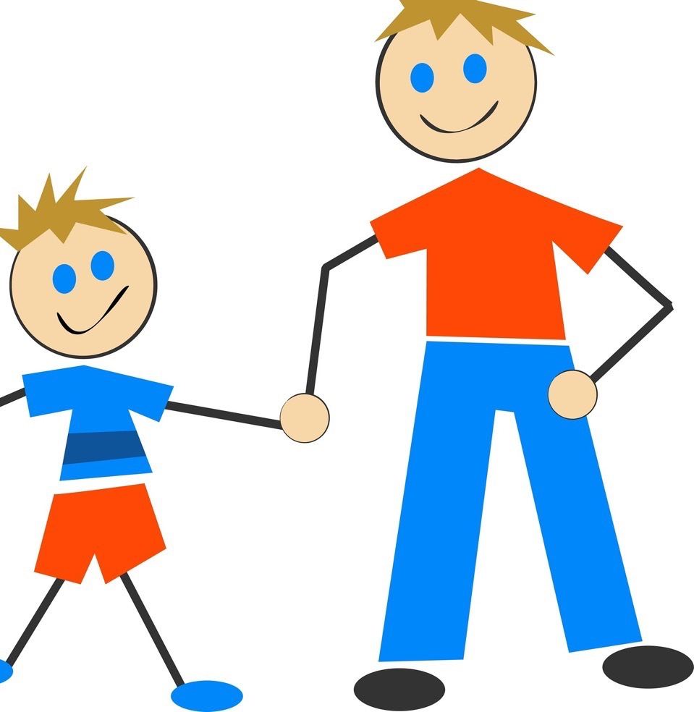
What is a parent or carer?
A parent or carer is an adult in your life who looks after you and cares for you.
Parents and carers are really important in a child’s life.

Slide 3
All our families are different.

Slide 4
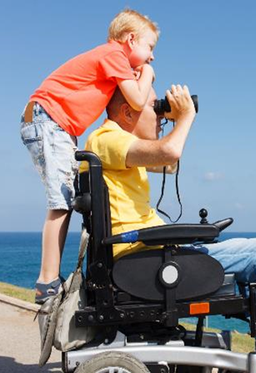
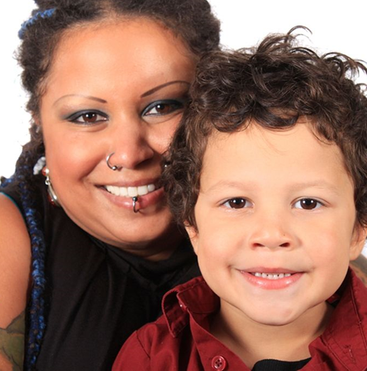
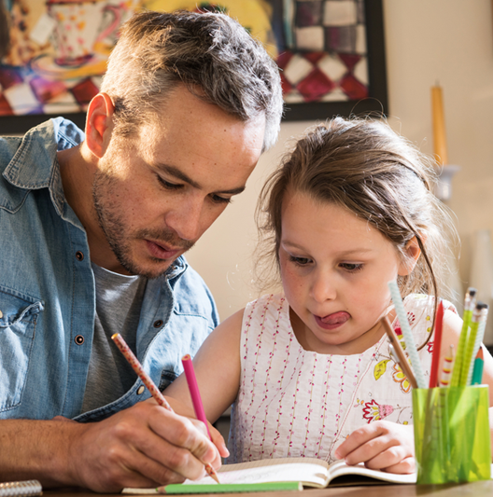
Some families are small.
Maybe there is one parent or carer.

Slide 5
Some families have a mum and a dad.

Slide 6
Some children live with a new parent when they are adopted

Slide 7
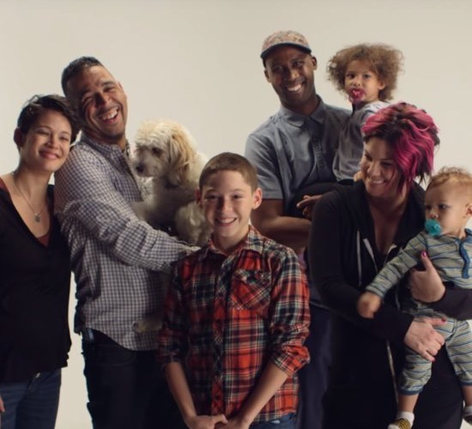
Some families have 2 mums and 2 dads

Slide 8
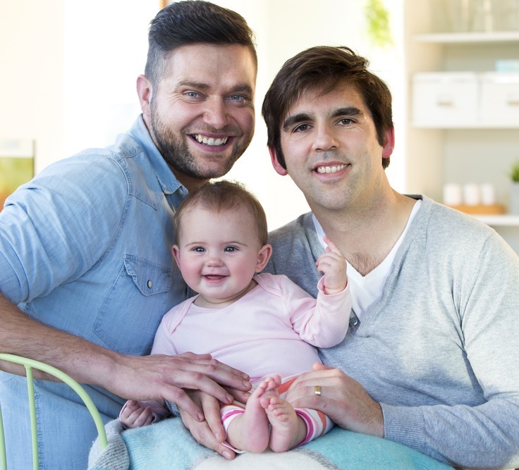
Some families have 2 dads

Slide 9
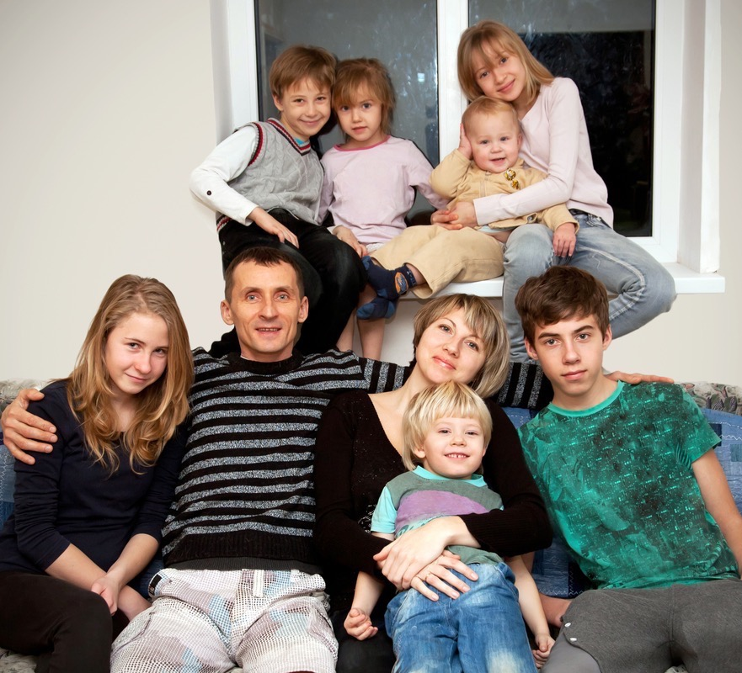
Some families are big.

Slide 10
Some children live with foster carers

Slide 11
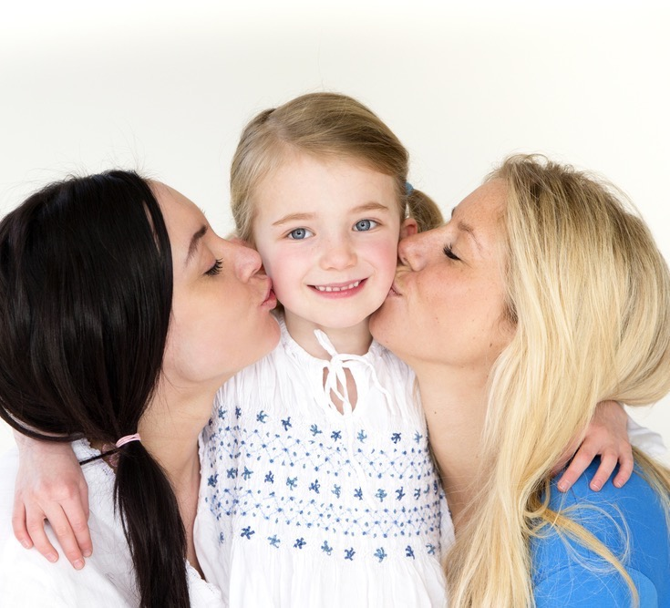
Some families have 2 mums

Slide 12
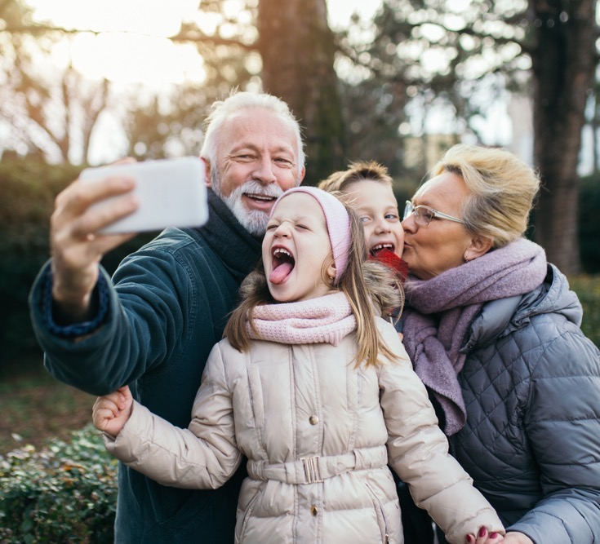
In some families, children live with their grandparents, they are their carers.

Slide 13
Talking about your parent or carer: Who looks after you? How would you describe them? What do you like to do together? What’s your favourite thing about the person who looks after you?

Slide 14
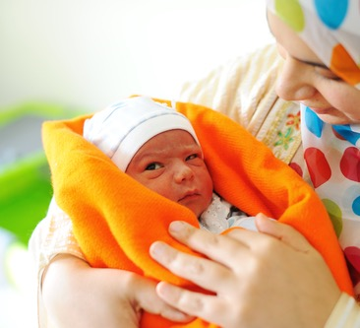
What does a parent or carer do for a baby to make sure they are healthy, happy and safe?

Slide 15
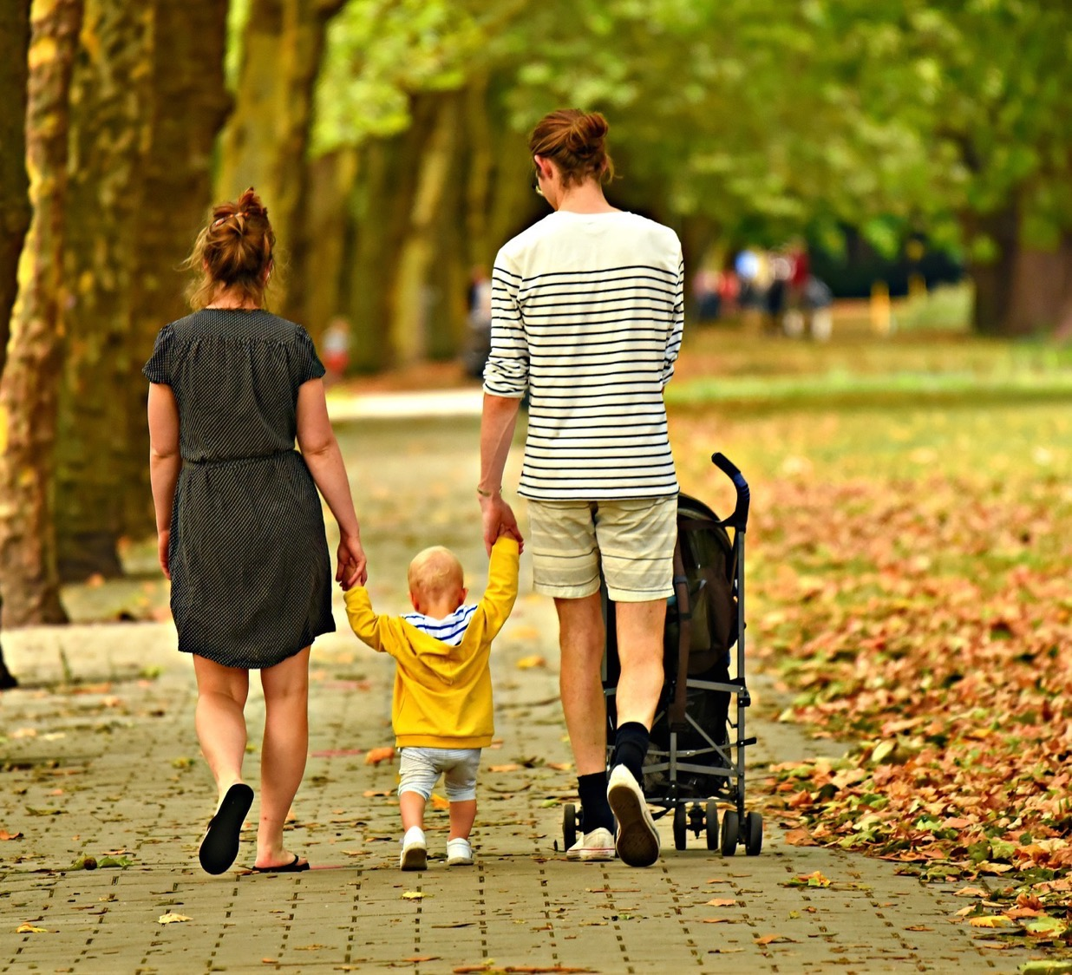
What does a parent or carer do for a toddler to make sure they are healthy, happy and safe?

Slide 16
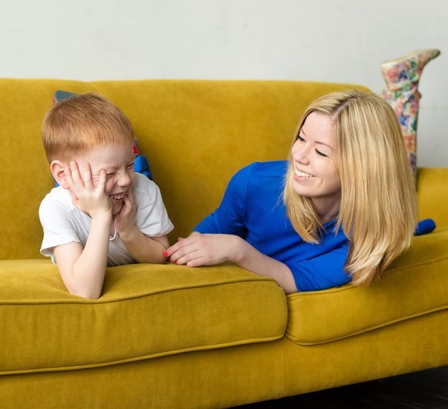
What does a parent or carer do for a 5-year-old to make sure they are healthy, happy and safe?

Slide 17
What does a parent or carer do for a 10-year old to make sure they are healthy, happy and safe?

Slide 18
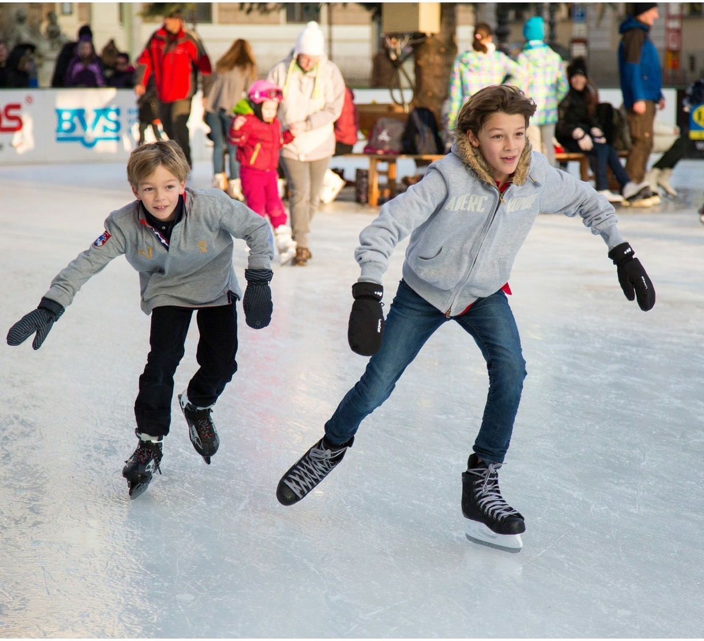
What does a parent or carer do for a 15-year old to make sure they are healthy, happy and safe? ?

Slide 19
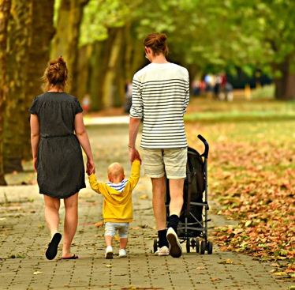
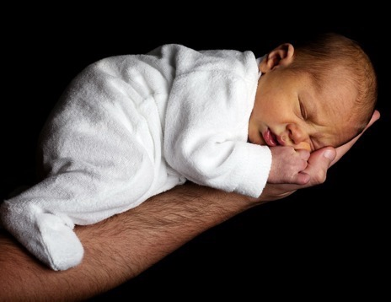
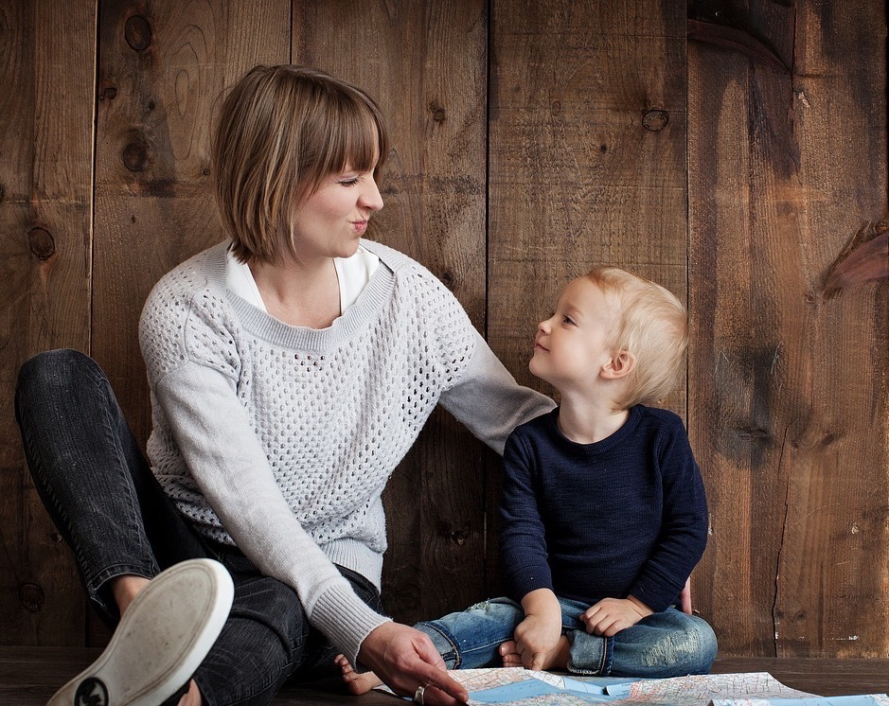
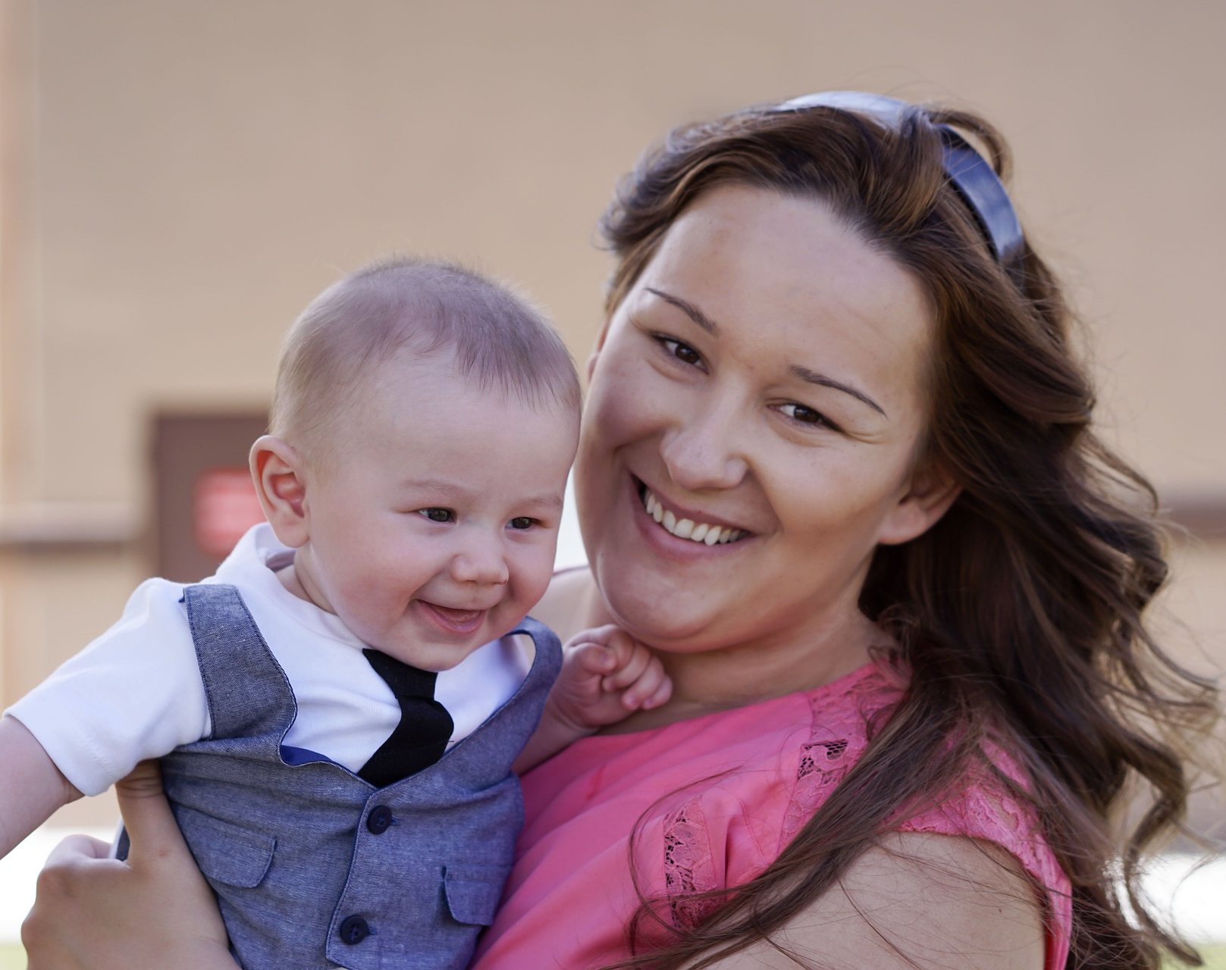
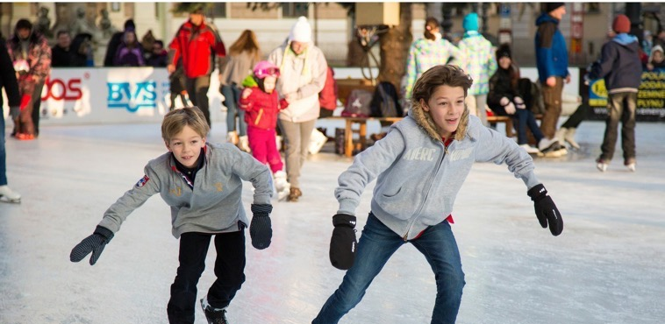
What do you think are the most important things a parent or carer does for their child?

Slide 20
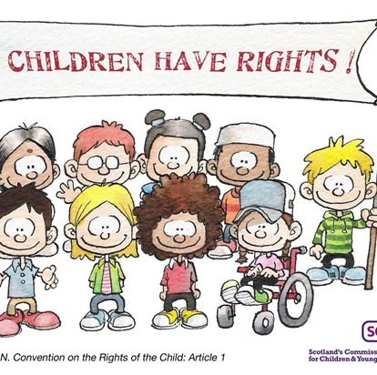
What does a parent or carer need to know about children’s human rights and the UNCRC?

Slide 21
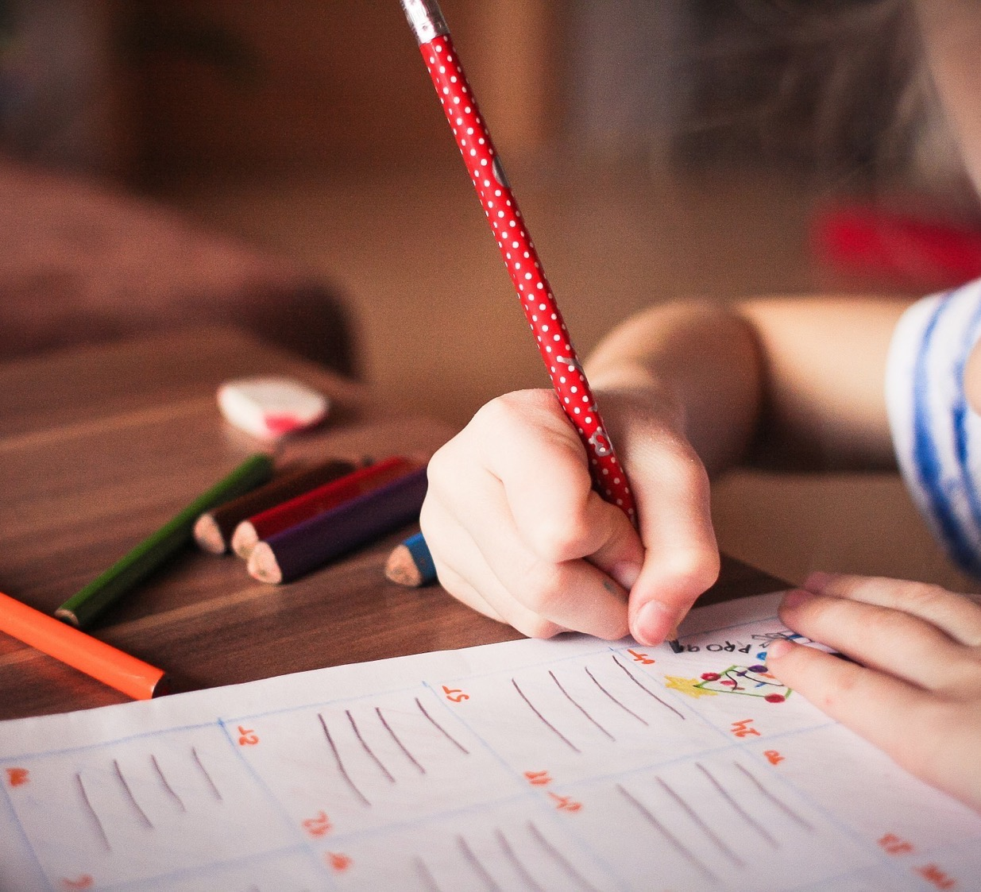
Dear adults… These are the things you should remember you need to do for your children.

