Slide 1
THEMATIC UNIT: CONTRACEPTION AND CONDOMS
A unit of learning for young people aged 14+/16+ learning at Curriculum for Excellence Early, First or Second Level
Condoms

Slide 2
Part 1: There is only one type of contraception a man can use. It is called a condom.

Slide 3

A man fits the condom over his penis when it is hard (erect).
During sex, his sperm comes out. The sperm collects in the condom instead of going into the woman’s vagina. So, the sperm cannot meet the egg.

Slide 4
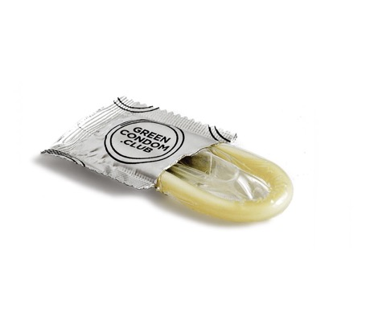
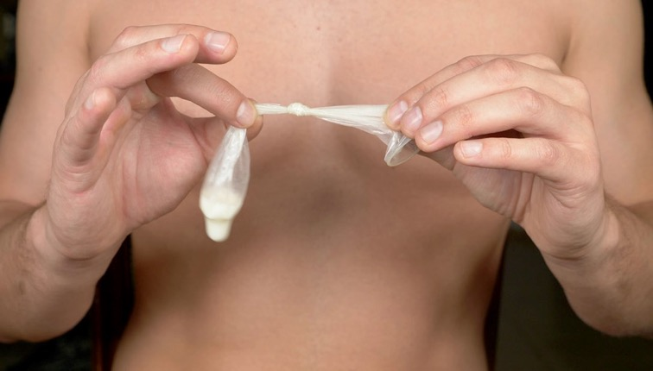
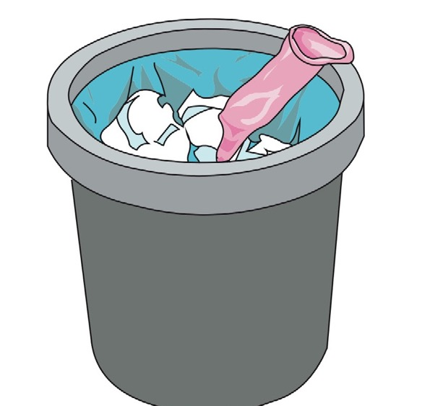
You can only use a condom one time.
When it has been used, put it in some tissue and in the bin.
Never flush it down the toilet.

Slide 5

It is a good idea to practice how to put a condom on properly before using them when having sex with someone.
Male condom: Condom demonstration (duration 1 minute 43) https://vimeo.com/684152273

Slide 6
Part 2: Are all condoms for men the same?

Slide 7
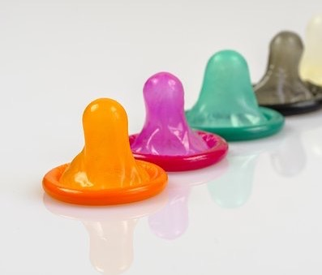
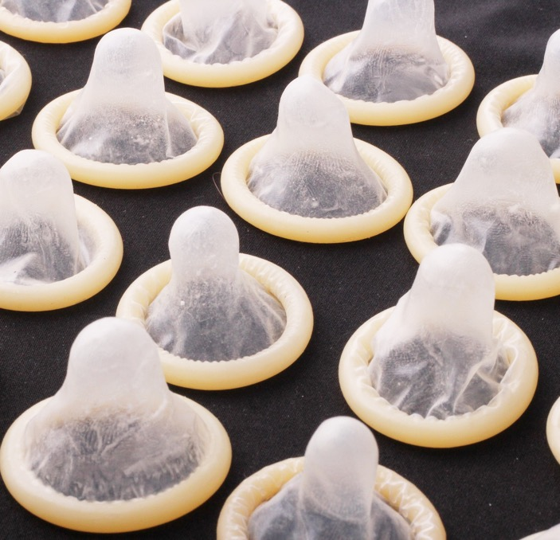
Condoms come in different sizes.
They can be different length or different width.
Condoms come in different colours, some have flavours or different thickness or shape to give a different feel.

Slide 8
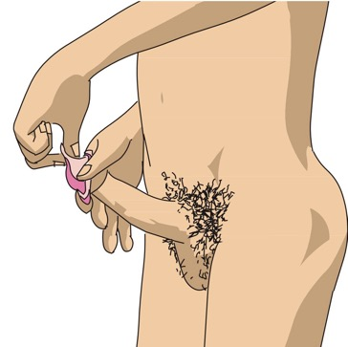
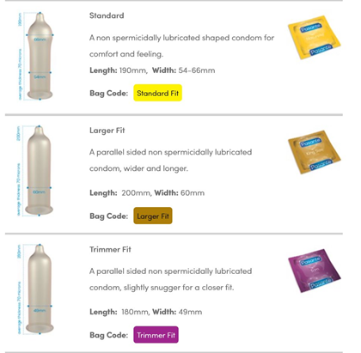
A condom should fit properly. If it fits it will feel better.
It helps to practice with different types and sizes of condom on your own to make sure you use one that’s comfortable and fits well.
You can do this in your bedroom, in private.

Slide 9
Part 3: There is also a condom for women

Slide 10
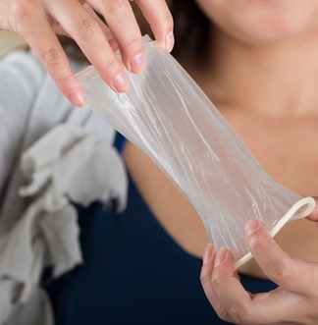
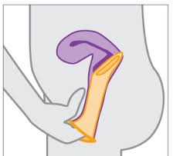
A female (woman’s) condom fits inside her vagina.
During sex, the man’s sperm comes out of his penis (when he ejaculates). The sperm collects in the condom. So, the sperm cannot meet the egg.

Slide 11
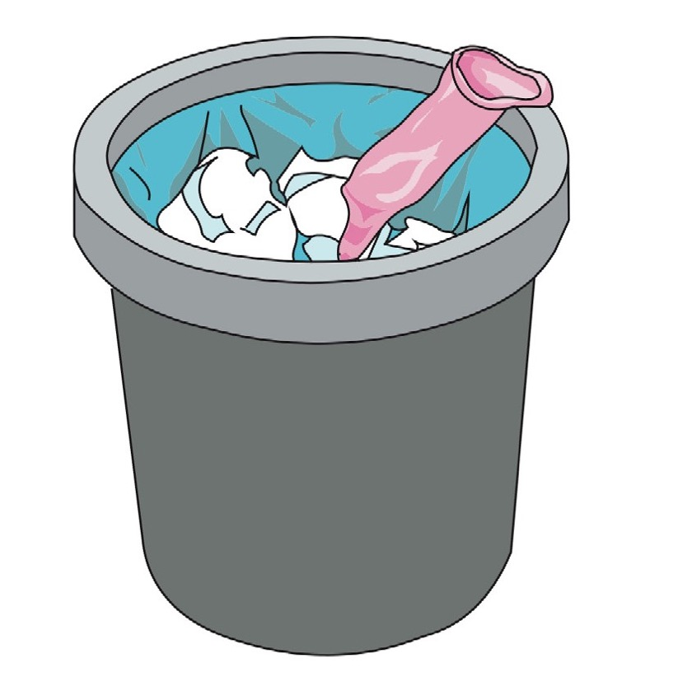
You can only use a condom one time.
When it has been used put it in some tissue and in the bin.
Never flush it down the toilet.

Slide 12
Female condoms: How do they work? (duration 1 minute 5) https://youtu.be/EfwstN51ZIw

Slide 13
Part 4: Condoms offer protection from infections too

Slide 14

A person can have an infection called a sexually transmitted infection.
If a person has a sexually transmitted infection (STI) it can be passed on to another person when they have sex.
If a man or woman uses a condom when they have sex this can protects them from the STI.

Slide 15
Anal sex is when a man puts his penis in another person’s bottom.
If people have anal sex, they should always use a condom.
This protects both of them from sexually transmitted infections.

Slide 16

If you were worried about sexually transmitted infections who would you speak to?

Slide 17
Part 5: What is lubricant/lube?

Slide 18

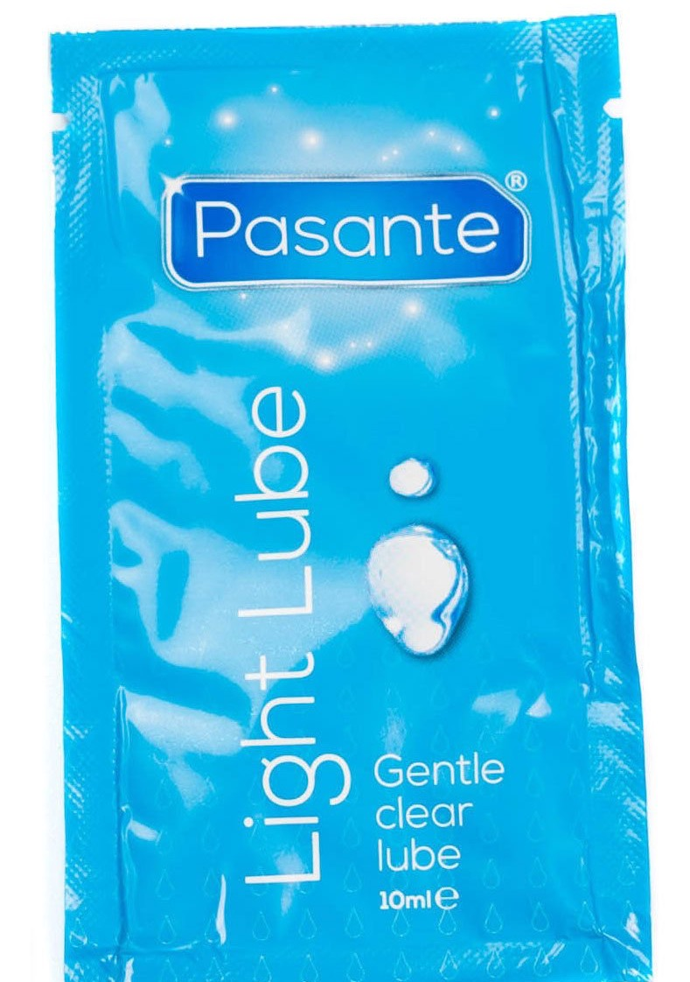
Lube is a liquid or gel that people put on their penis or vulva and in their vagina or bottom when they have sex. It makes the vulva, vagina, penis or bottom wetter or slippery.

Slide 19
Lube can be used to makes sex more comfortable and feel better.

Slide 20
If you have anal sex – penis in anus/bottom sex – then both condoms and lube should be used together.

Slide 21
Lube should always be water based or silicone based. Never use anything that is an oil or oil-based lubricant (like massage oil or baby oil) with male condoms as this can make the condom break.

Slide 22
Part 6: Where can I get condoms?

Slide 23

You can get condoms for free from insert local condom provision scheme/nearest place
You can get condoms for free from your local pharmacy, your GP and a sexual health clinic.
You can buy condoms at the supermarket.

