Slide 1
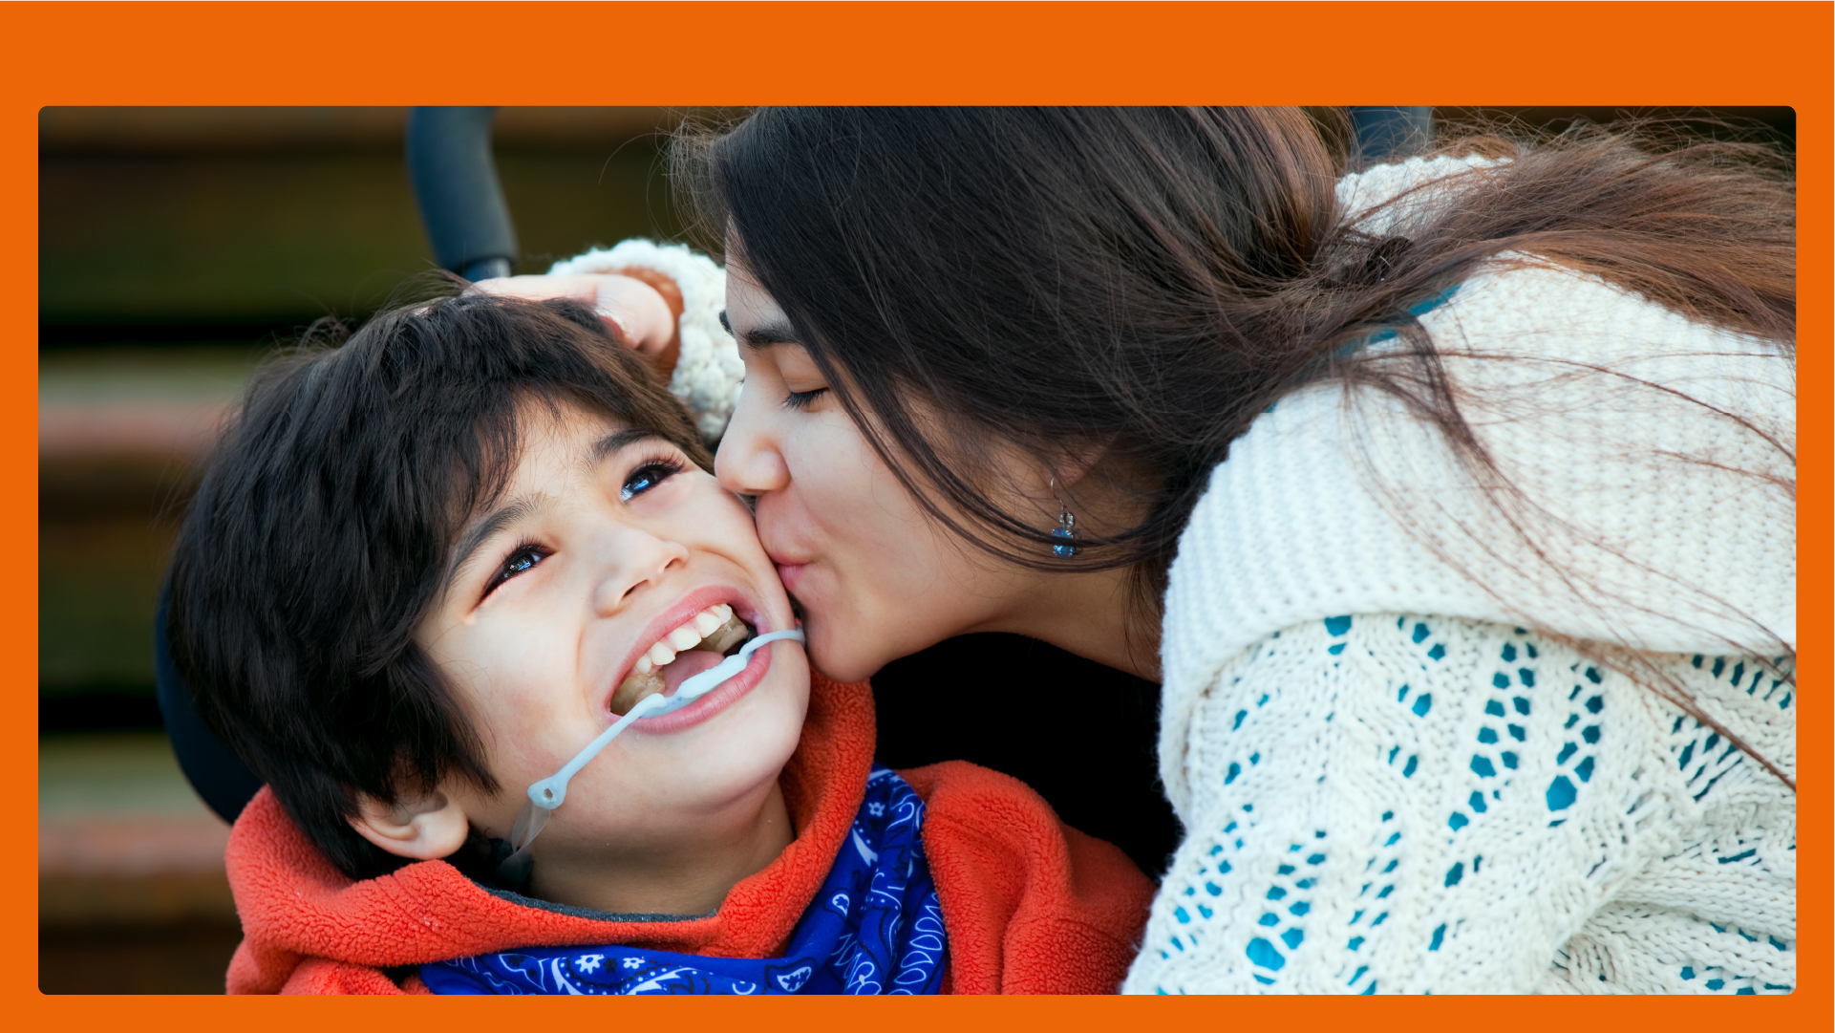
A kiss is a way to say hello to someone you love.

Slide 2

A kiss is a way to say good bye to someone you love.

Slide 3

Someone might kiss their girlfriend or boyfriend.

Slide 4

Some people do not like to be kissed.

Slide 5

There is no kissing at school.

