Slide 1
A hug is a way to touch someone.

Slide 2
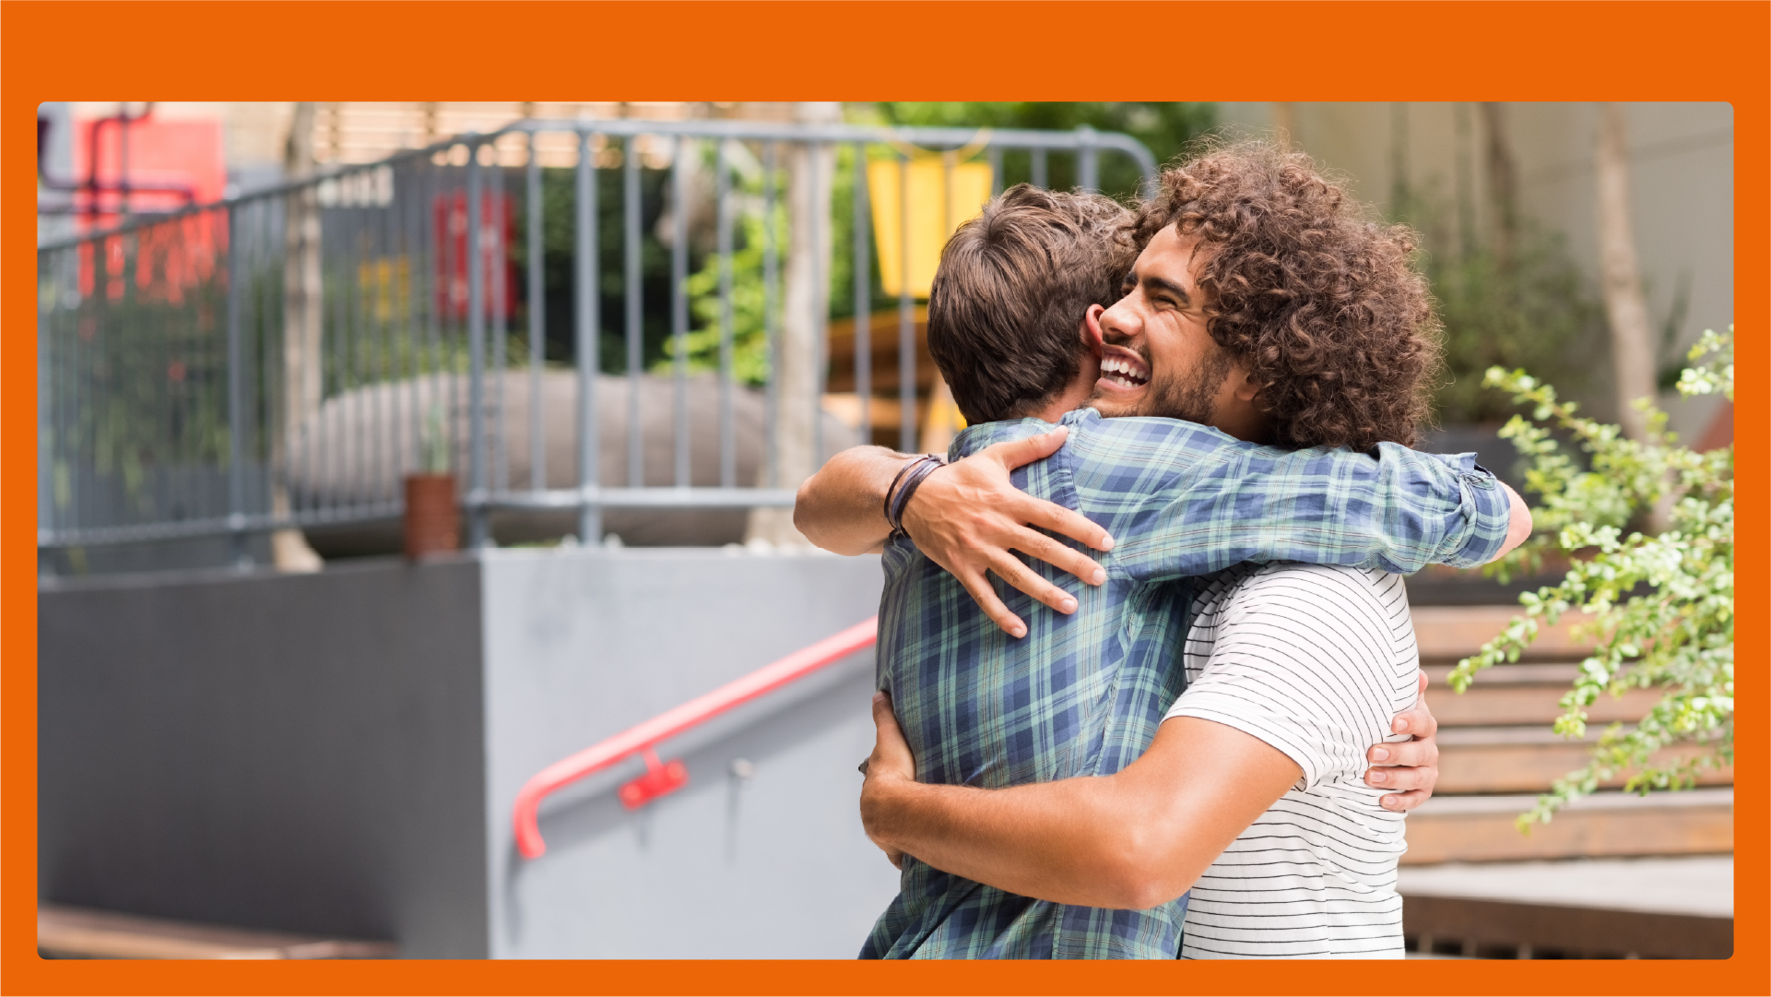
A hug is a way to say hello.

Slide 3
A hug is a way to say I am happy to see you.

Slide 4
A hug is a way to celebrate, like when someone scores a goal!

Slide 5
A hug is a way to show love for someone.

Slide 6
A hug is a way to cheer someone up if they are sad.

Slide 7
If I want to hug someone I must ask them.

Slide 8
If they say yes, I can hug them.

Slide 9
If they say no, I must not hug them.

Slide 10
Sometimes people don’t like hugs.

