Slide 1
How human life begins, pregnancy and birth
I can explain how human life begins, what pregnancy is and how a baby is born.

Slide 2
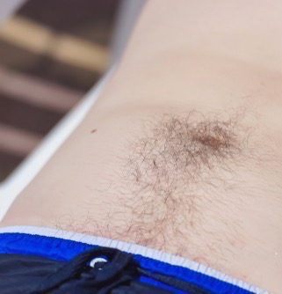
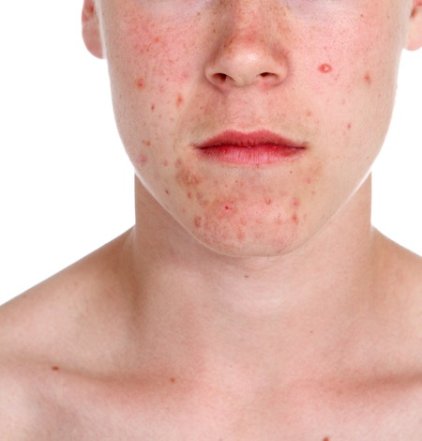
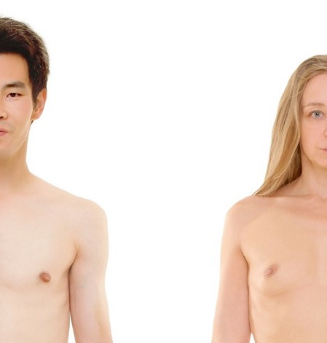
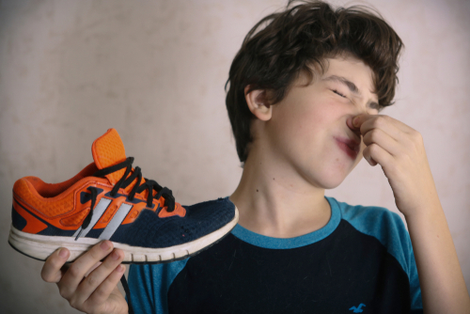
When we go through puberty what happens to: Hair? Voices? Breasts? Skin? Smell? Body shape?

Slide 3
When we go through puberty what happens to our feelings and emotions?

Slide 4
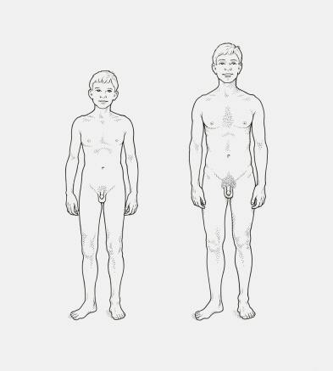
Names of parts of my body

Slide 10
Part 1
How human life begins

Slide 11
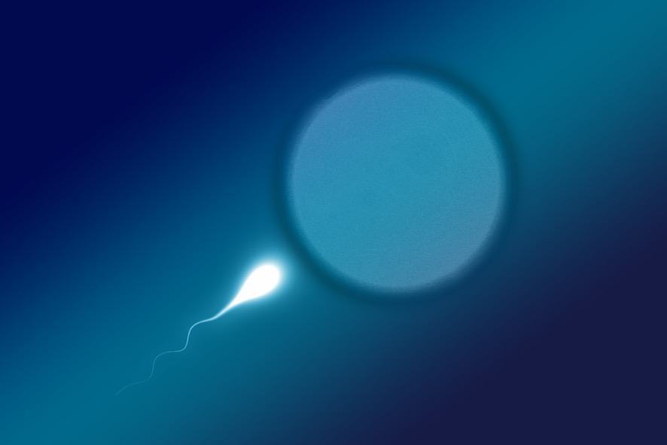
A baby is made by adults. To make a baby, you need a tiny little egg from a woman and you need the seed (called the sperm) from a man.

Slide 12
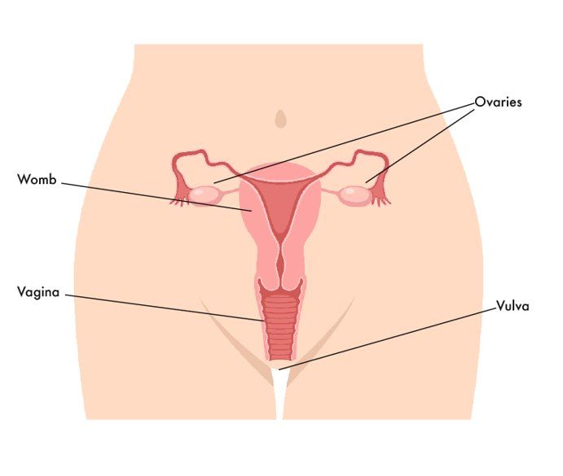
A woman’s eggs are kept inside her body, in her ovaries. Every month a woman releases an egg.

Slide 13
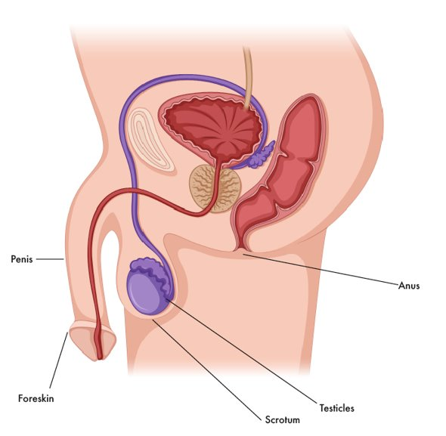
A man’s sperm is made in his testicles which are inside the bag of skin (scrotum) that hangs behind his penis.

Slide 14
When the egg and the sperm come together they can start a baby. This is called fertilisation.
Fertilisation can happen in different ways.

Slide 15
During sex, the man’s penis goes inside the woman’s vagina. When the man ejaculates, the sperm comes out and goes to meet the egg inside the woman’s body.

Slide 16
Some parents need help to start the pregnancy.
Some babies start when the egg and sperm come together in a laboratory. The doctor then puts the fertilised egg back into the woman’s womb. This is called IVF.

Slide 17
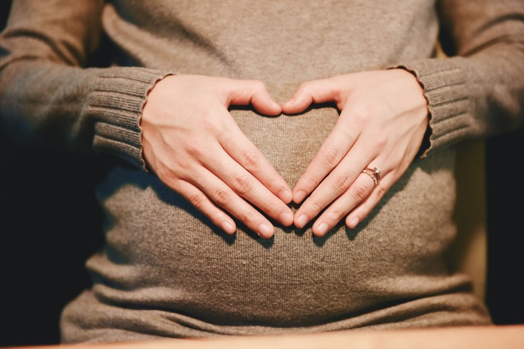
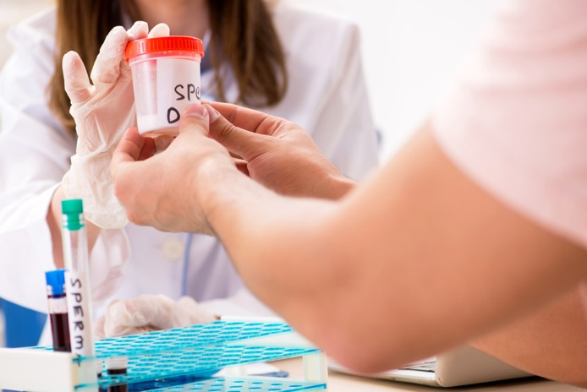
Other babies are created when a man gives his sperm to the woman. She puts the sperm inside her vagina. If the sperm swim to meet her egg, she can become pregnant.

Slide 18
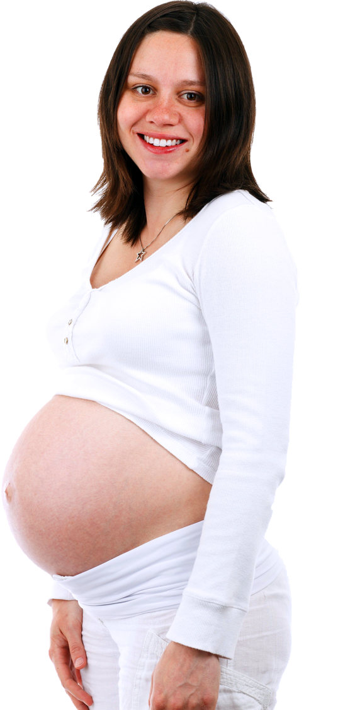
So, once the egg and sperm meet, then the egg grows in a safe place called the womb. The woman will be pregnant for 9 months.

Slide 19
Part 2
The baby grows - Pregnancy

Slide 20
A baby lives and grows inside the woman’s womb for 9 months. What will a pregnant woman and her baby need to be healthy, happy and safe?

Slide 21
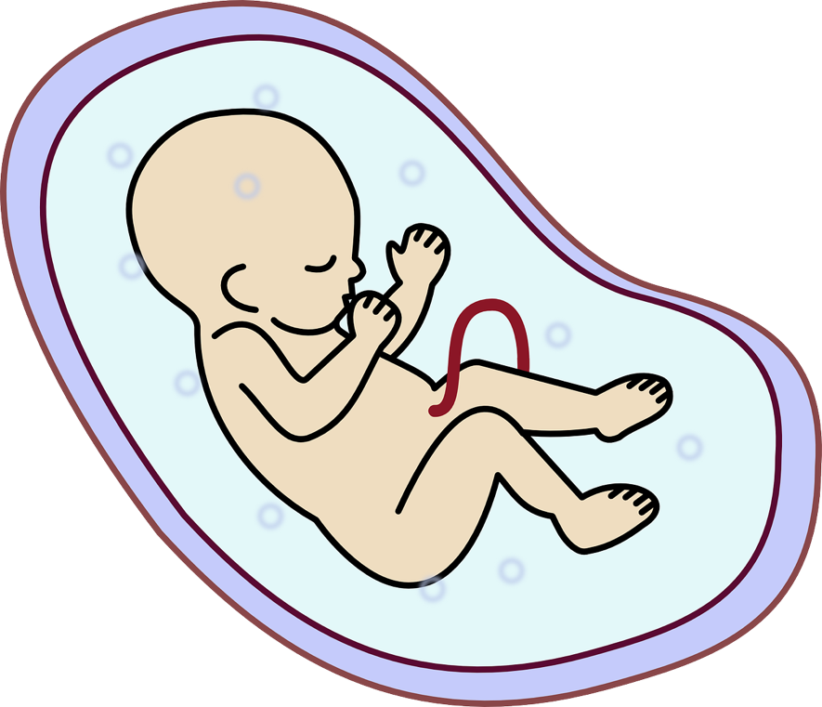
A baby lives and grows inside the woman’s womb for 9 months.
The baby and woman are connected by the umbilical cord that attaches to the baby to the mum. The baby gets everything it needs to grow through the umbilical cord.

Slide 22
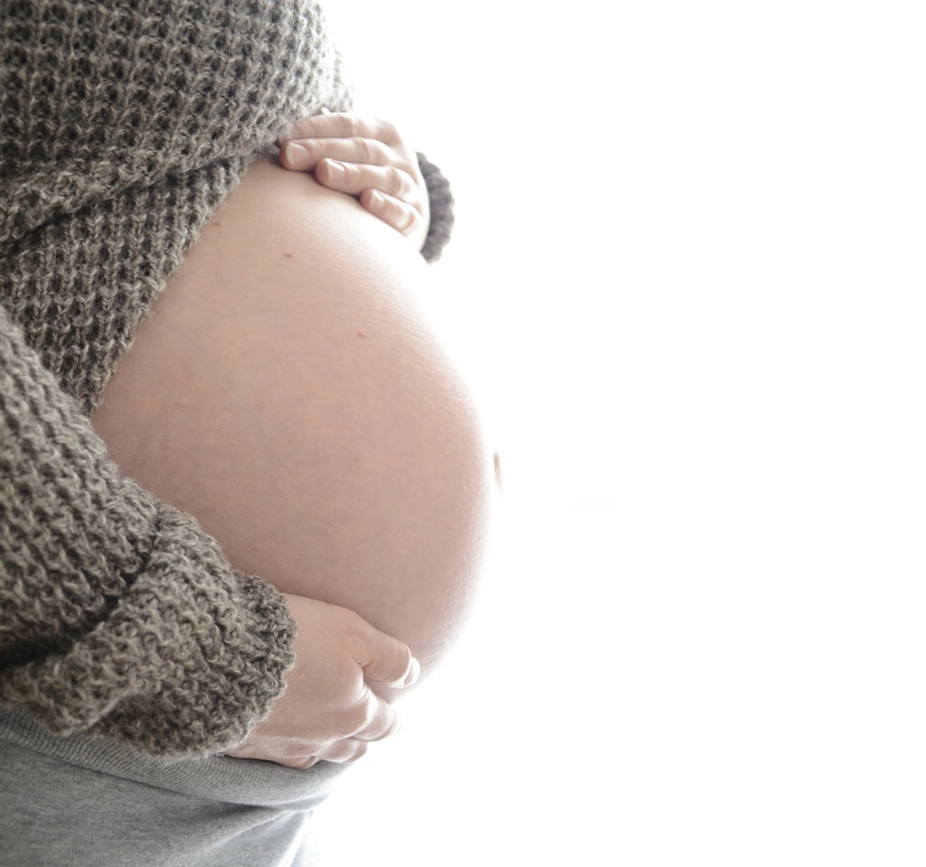
For the baby, the womb is like a bag of warm cosy water and the baby can hear the mum’s heartbeat like a drum.

Slide 23
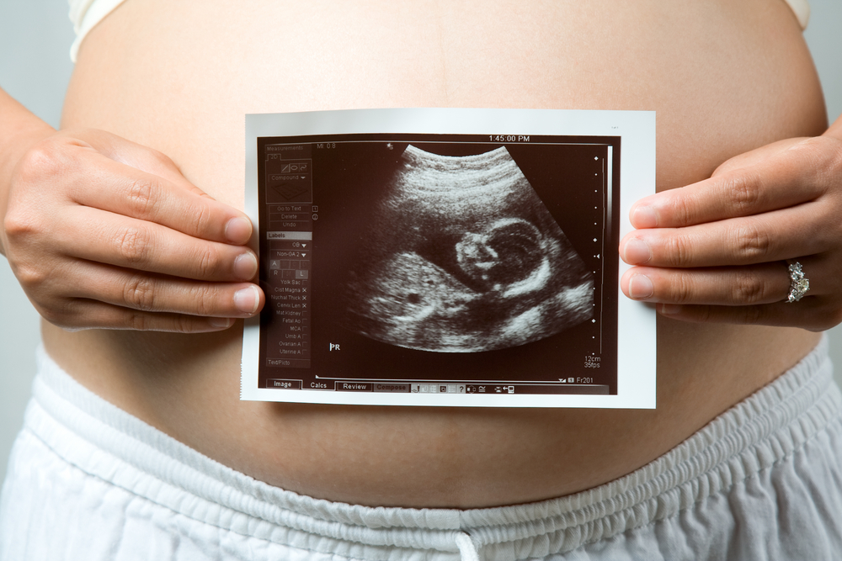
When a woman is pregnant she will go to see the doctor and nurse to make sure everything is going well with her pregnancy.
The woman can take the baby’s dad or her partner or friend with her. Sometimes they get a picture of the baby inside the woman.

Slide 24
To begin the baby in the womb is very small.
After 1 month the baby is just the size of a pea. Then the baby begins to grow arms and legs. The baby has a little beating heart.
By the second month the baby is about the size of a raspberry. It has grown fingers and toes.

Slide 25
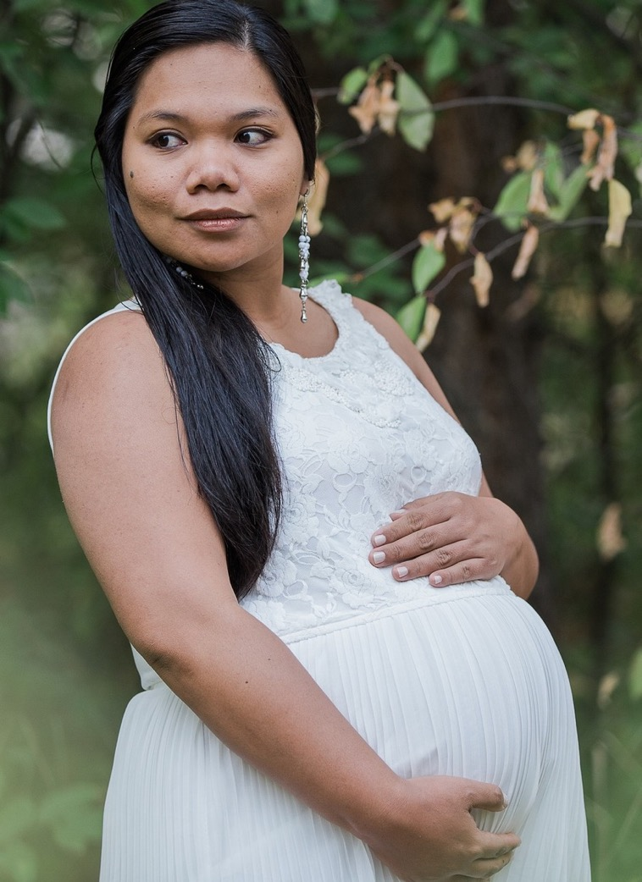
In the next 3 months inside the woman’s womb the baby keeps growing. By the 4th month the baby is the size of a plum. The baby can start to hear. The woman will start to feel her baby moving around inside.

Slide 26
In the final 3 months inside the woman’s womb the baby keeps growing, so much that it needs to be curled up inside the womb. The baby’s brain grows all this time too.
The baby is getting stronger and getting ready to be born.

Slide 27
How a baby develops during pregnancy (duration 4 minutes 17) https://youtu.be/h82ltr84_Yg

Slide 28
Now that we have heard more about pregnancy. Lets review all the things we said a mum and baby need to be healthy, happy and safe? Anything to add now?

Slide 29
Part 3
How a baby is born

Slide 30
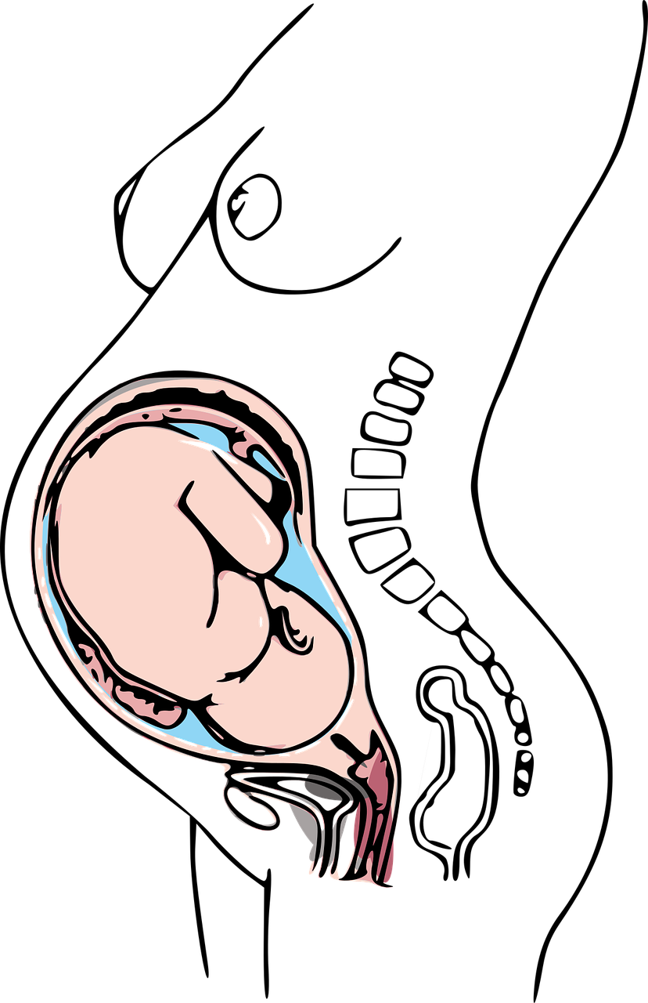
How a baby is born.
After 9 months of being safe and cosy inside the womb it is time for the baby to be born.
The baby changes its position so that the head is downwards getting ready to come out.

Slide 31
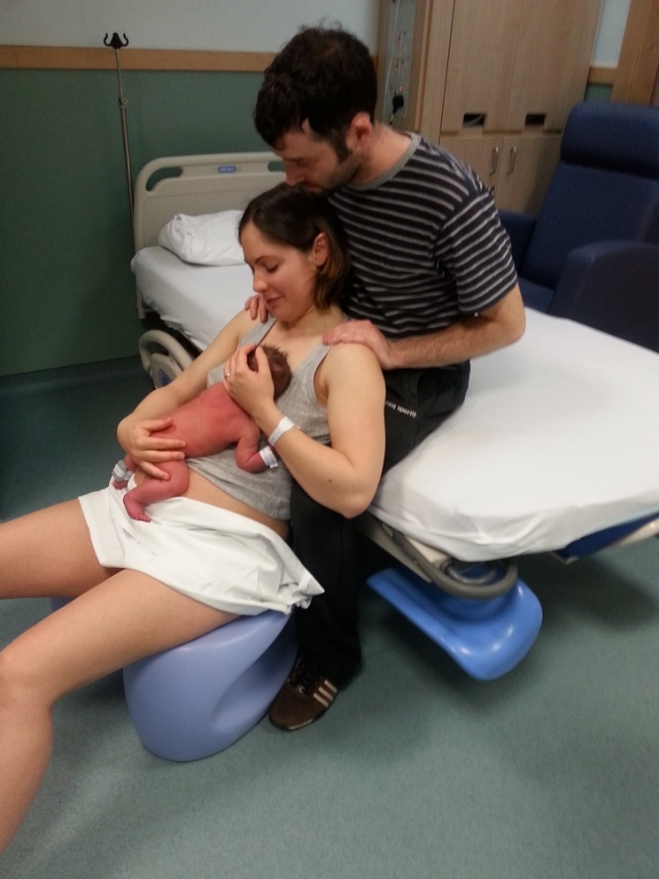
The woman feels some pains in her tummy and she feels the need to push down so that the baby can come out.

Slide 32
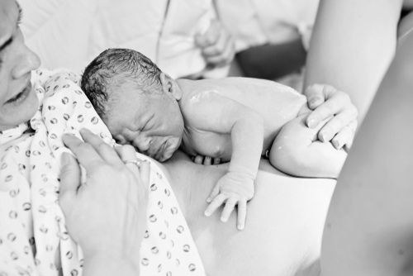
The baby comes down from the womb out of the woman’s vagina. This can take a few hours.
Notes:
Nearly all babies are born this way but some babies can’t be born like this and a doctor has to make an opening in the mummy’s tummy to lift the baby out – this is called a Caesarean.

Slide 33
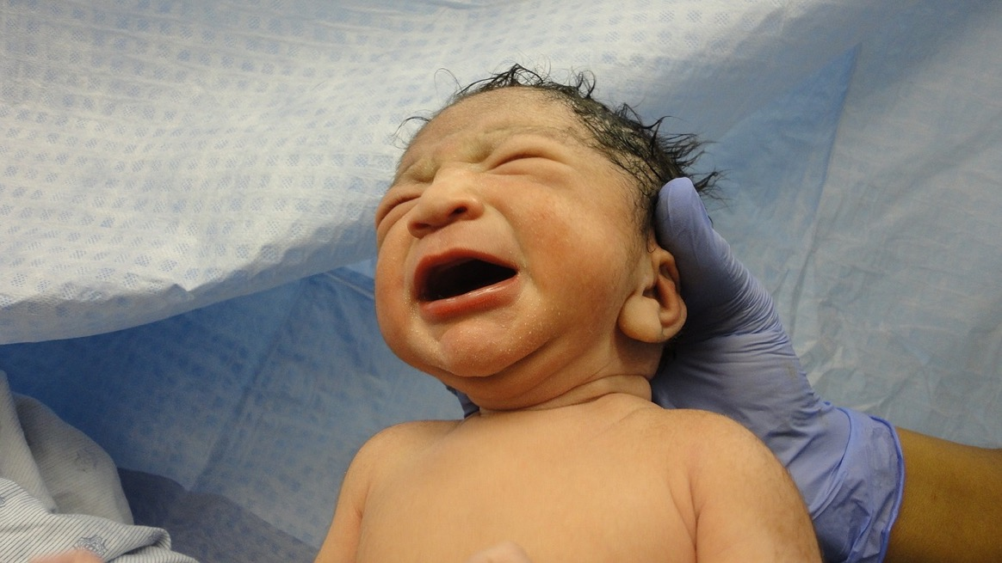
The baby will cry as it leaves the womb and enters the world.

Slide 34
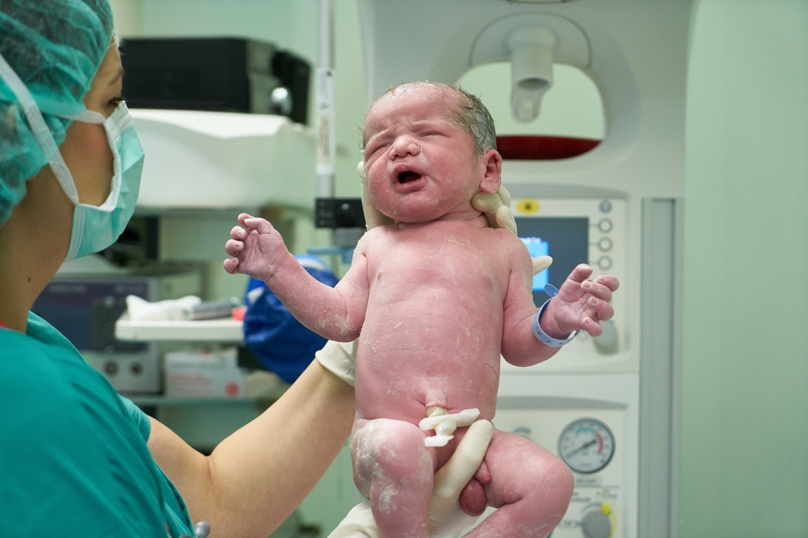
The umbilical cord is cut and then the baby is separate from the mum.

Slide 35
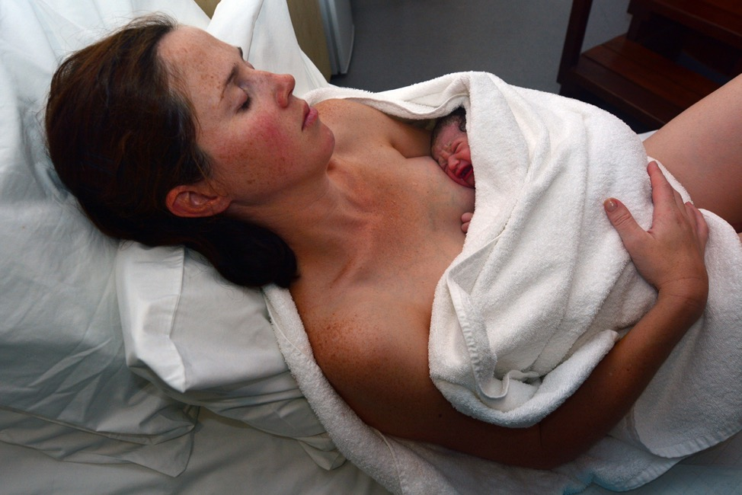
Some babies are born in hospital.
Some babies are born at home.
The dad or partner or friend or other family member can be there to help and support the woman.

Slide 36
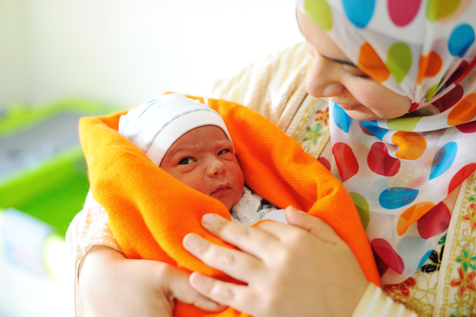
Isn’t it amazing how human life begins!

