Slide 1
Pornography A unit of learning for young people aged 14+/16+ learning at Curriculum for Excellence Early, First or Second Level

Slide 2
Part 1: What is pornography?

Slide 3
Pornography is sometimes called porn

Slide 4
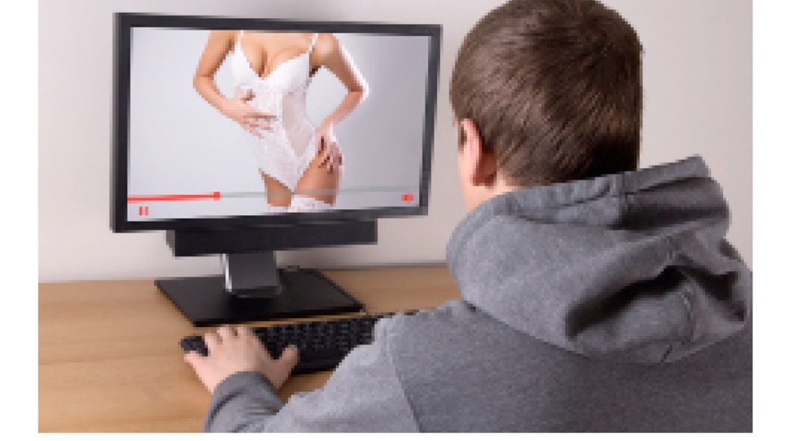
Pornography is a photograph, image, film or words that are about something sexual.
Porn can show people’s sexual body parts or show people having sex.

Slide 5
Most people find pornography on the internet.
This can be free.
But some websites ask you to pay to watch.

Slide 6
There are different types of pornography.
Some shows a man and a woman having sex. Some shows two men having sex. Some shows two women having sex. Some shows a group of people having sex.

Slide 7
Part 2: Why do people watch pornography?

Slide 8
Developing sexual feelings is a normal part of growing up. A person might watch pornography because they want to see something sexy.

Slide 9
If someone feels sexy, they might touch their private parts. This is called masturbation.

Slide 10
If you masturbate this must only be in your bedroom, in private.

Slide 11
Part 3: Be careful!

Slide 12
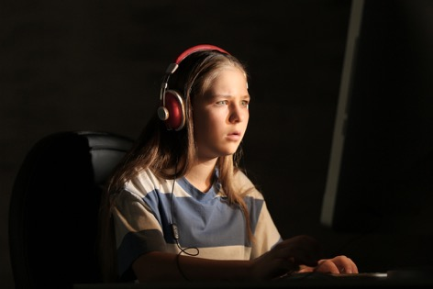
Some porn can be upsetting because it shows a person being hurt or abused.

Slide 13
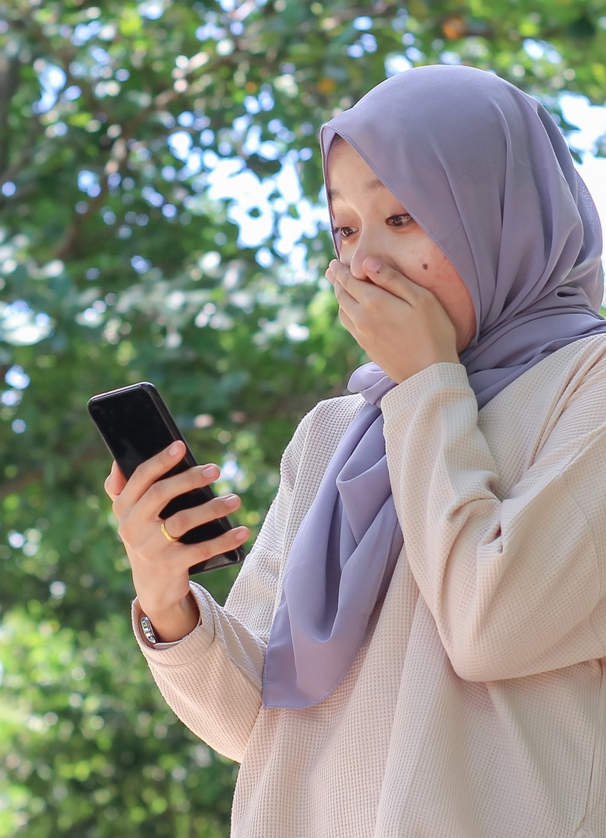
It is wrong and against the law for an adult or other young person to show you pornography. If someone shows you porn then tell an adult you trust.

Slide 14
If you see something you don’t understand or is upsetting it helps to tell an adult you trust.

Slide 15
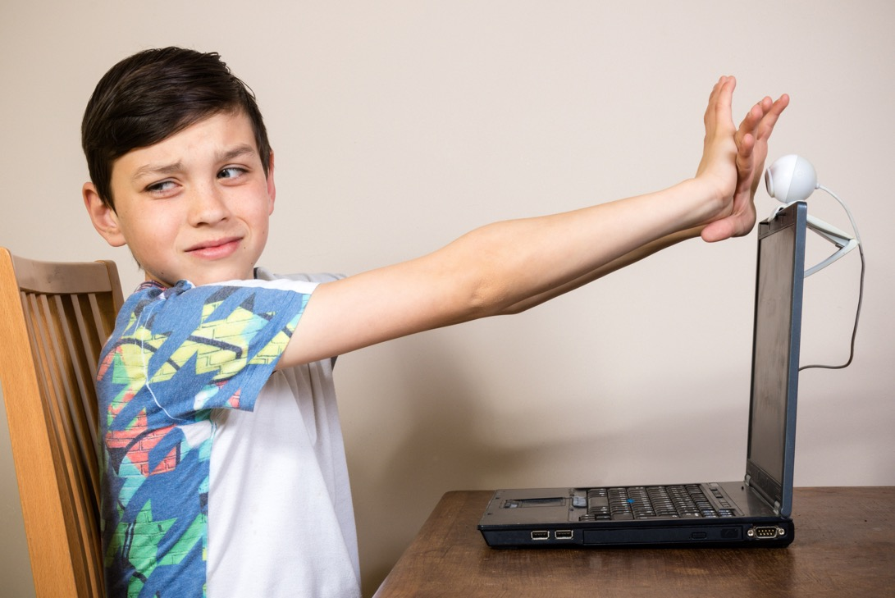
If someone asks you to take and share photos or film of you, tell an adult you trust.

Slide 16
Who can you speak to if you are upset or have a question?

Slide 17
Part 4: The people and the sex you see in pornography is different from real life.

Slide 18
When you look at pornography you see real people, but they are acting.

Slide 19
The people in pornography have different bodies from most people.
The men might have big muscles or big penises.

Slide 20
The women might be thin, have no hair on their vulva and have big breasts.
It’s okay not to look like the people in porn.

Slide 21
In pornography the sex can be rough or violent.
This is not what sex should be like in real life.

Slide 22
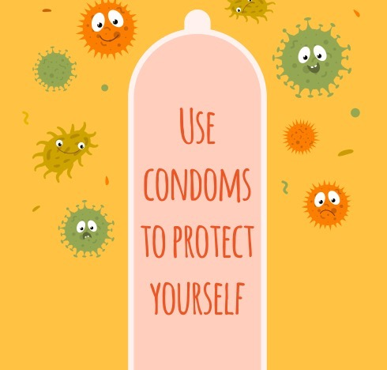
In pornography the men often don’t use condoms.
You should always use a condom in real life.

Slide 23
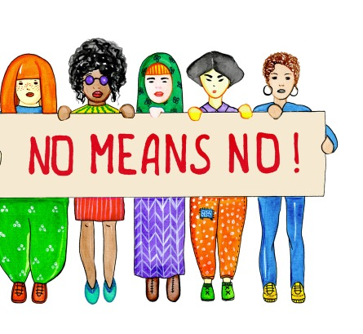
In pornography people don’t ask their partner if they want to have sex or do something sexual. When you ask this is called consent. In real life you must always ask and have consent.

Slide 24
Part 5: If you choose to watch pornography

Slide 25
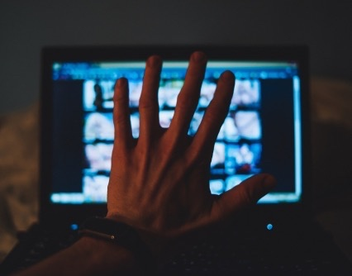
Some people do not like pornography. Some people watch it.

Slide 26
If you watch it you must only do this in your private place such as in your bedroom. Where is your private place?

Slide 27
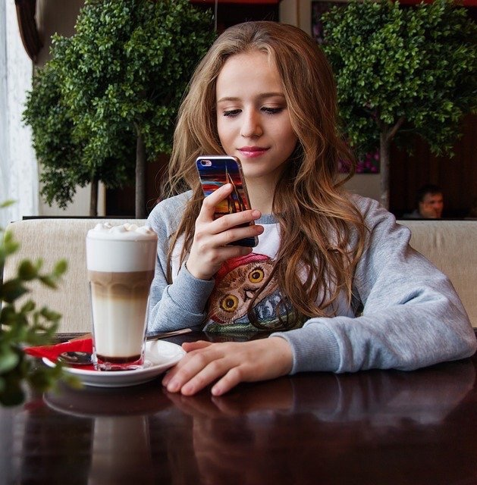
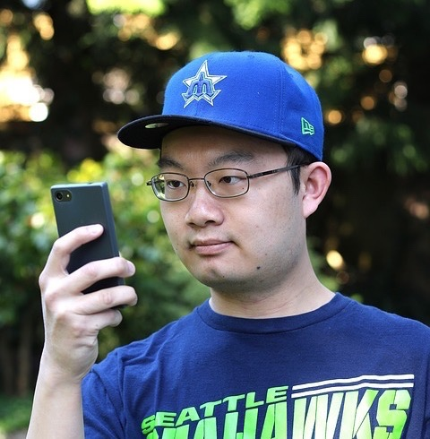
You must never watch pornography at school or college, when you are in a bus or car or when you are in a public place like a shop, library or on the street.

Slide 28
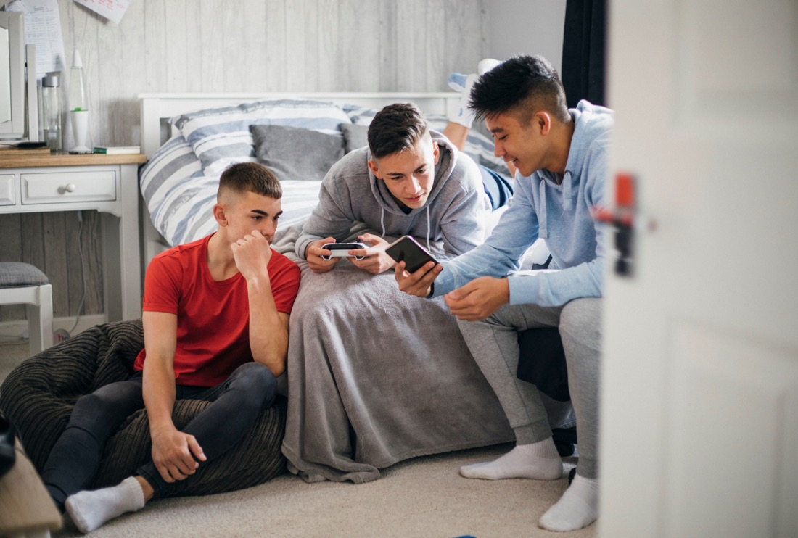
You must never show another young person what you are watching. It is against the law to share what you watch with another young person.

