Slide 1
THEMATIC UNIT: SEX/SEXUAL INTERCOURSE A unit of learning for young people aged 14+/16+ learning at Curriculum for Excellence Early, First or Second Level
Important things about sex

Slide 2
The law says you must be 16 years or older to have sex.
But you should not have sex just because you are 16 or older.

Slide 3
Sex should feel nice.
Adults learn what they like and don’t like.

Slide 4
You can say no to kissing.
So can other people.

Slide 5
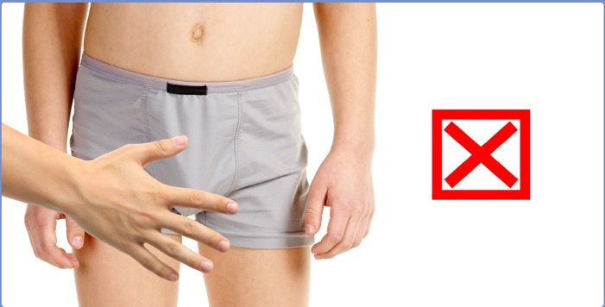
You can say no to touching.
So can other people.

Slide 6
You can say no to sex. So can other people.
You can say no to sex even if you have said yes before. So can other people.

Slide 7
Adults should only have sex when both of them want to.
No-one should ever make another person have sex.

