Slide 1
When you like someone that’s okay.

Slide 2
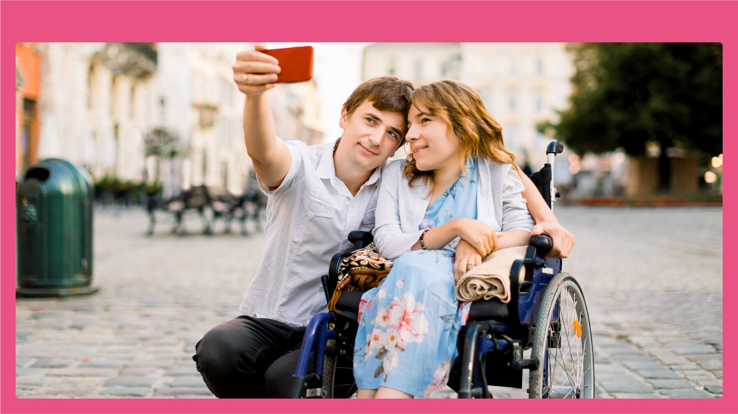
When you like someone you might want them to be your girlfriend or boyfriend.

Slide 3
When you like someone they might like you back. They might want to be your girlfriend or boyfriend.

Slide 4
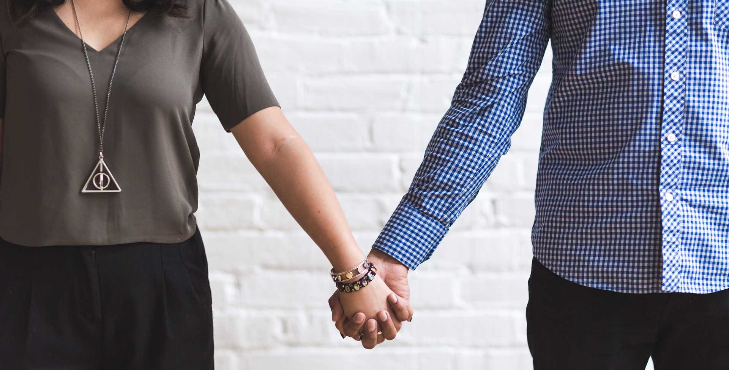
You can hold hands.

Slide 5
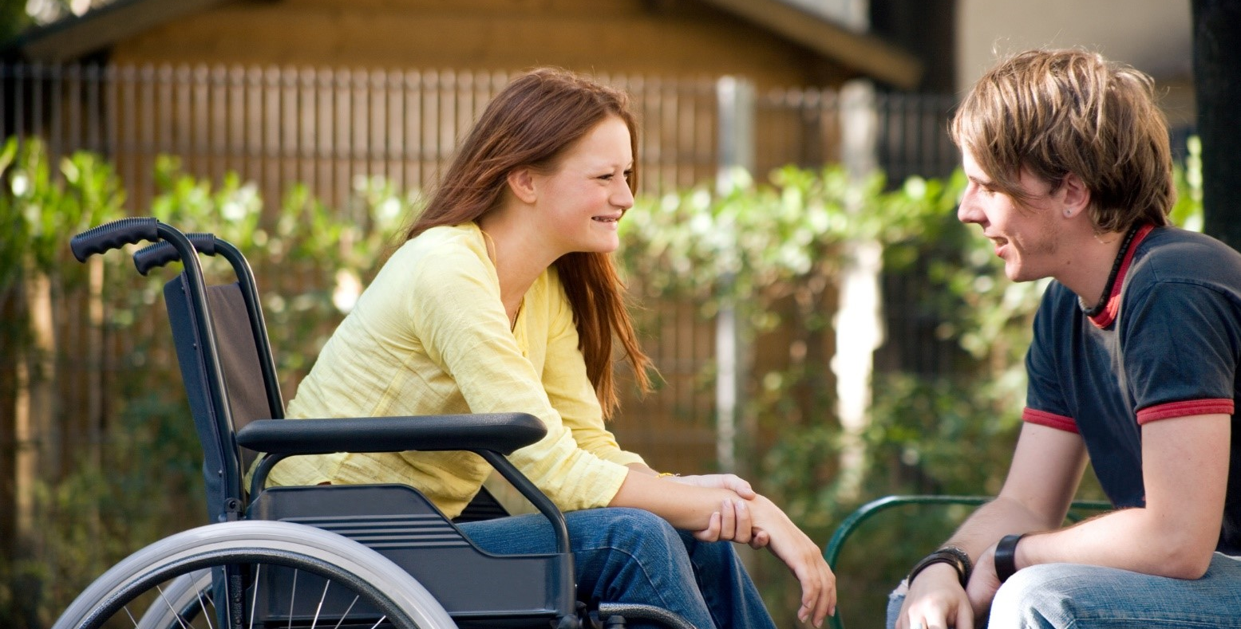
You can talk.

Slide 6
You can message each other.

Slide 7
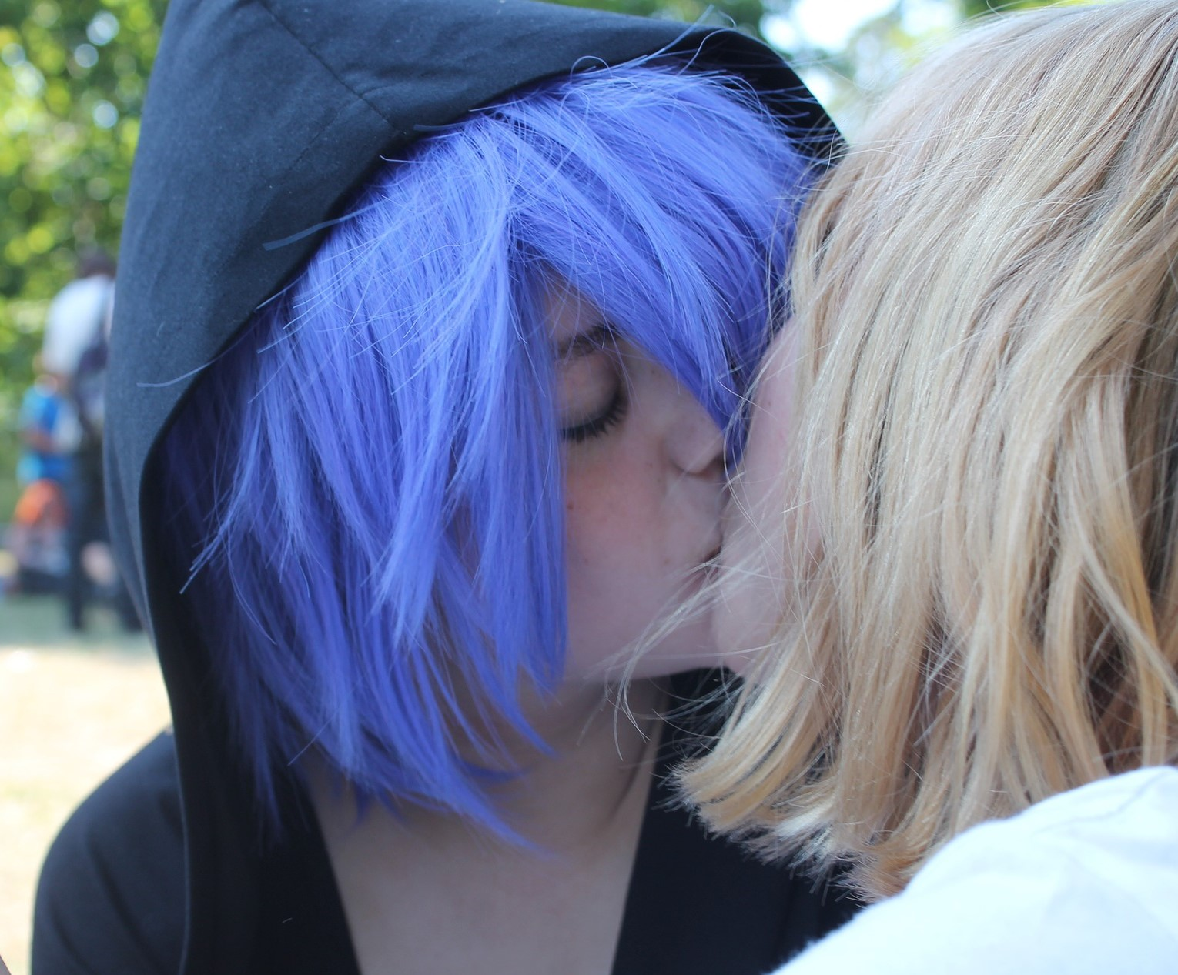
You can kiss.

Slide 8
You can hug.

Slide 9
When you like someone they might not feel the same way. That’s okay too.

Slide 10
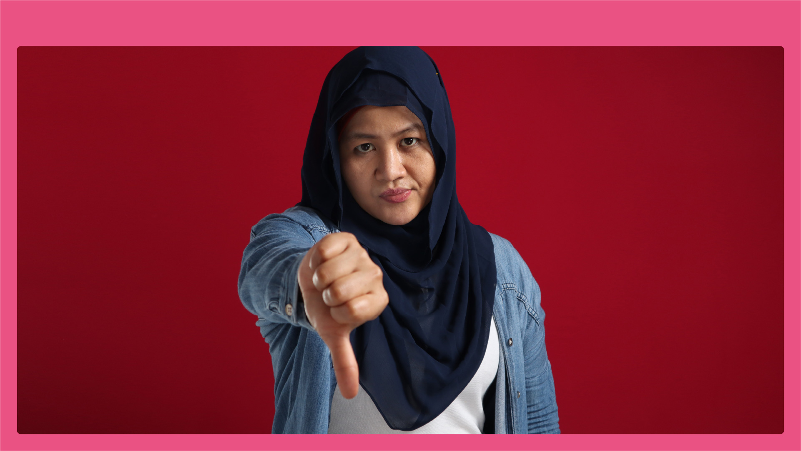
You must not make someone be your girlfriend or boyfriend. That would make them sad and unhappy.

