Slide 1
Menstruation - I am growing up. My body is changing.

Slide 2
Menstruation - I will have my period. This is a good thing.

Slide 3
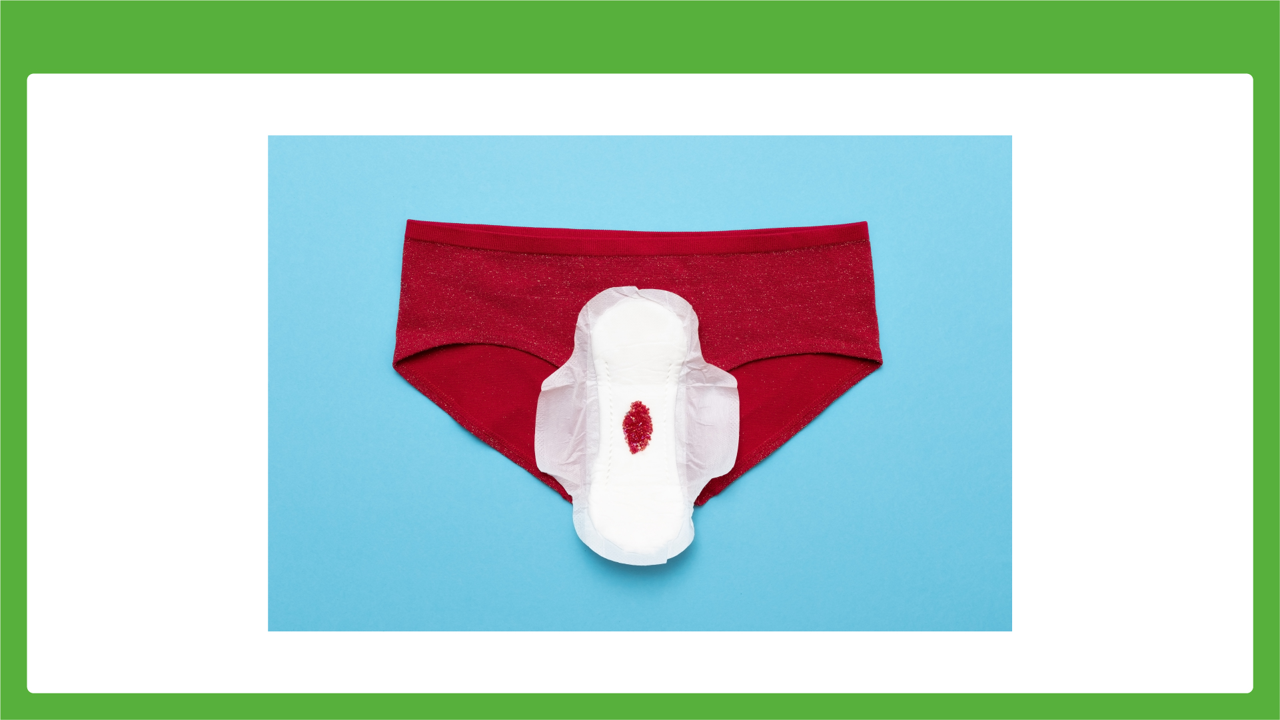
Menstruation - With my period I will have some blood come out of my vagina. This is normal.
This happens for 2 to 7 days.

Slide 4
Menstruation - I will wear a sanitary towel in my pants.

Slide 5
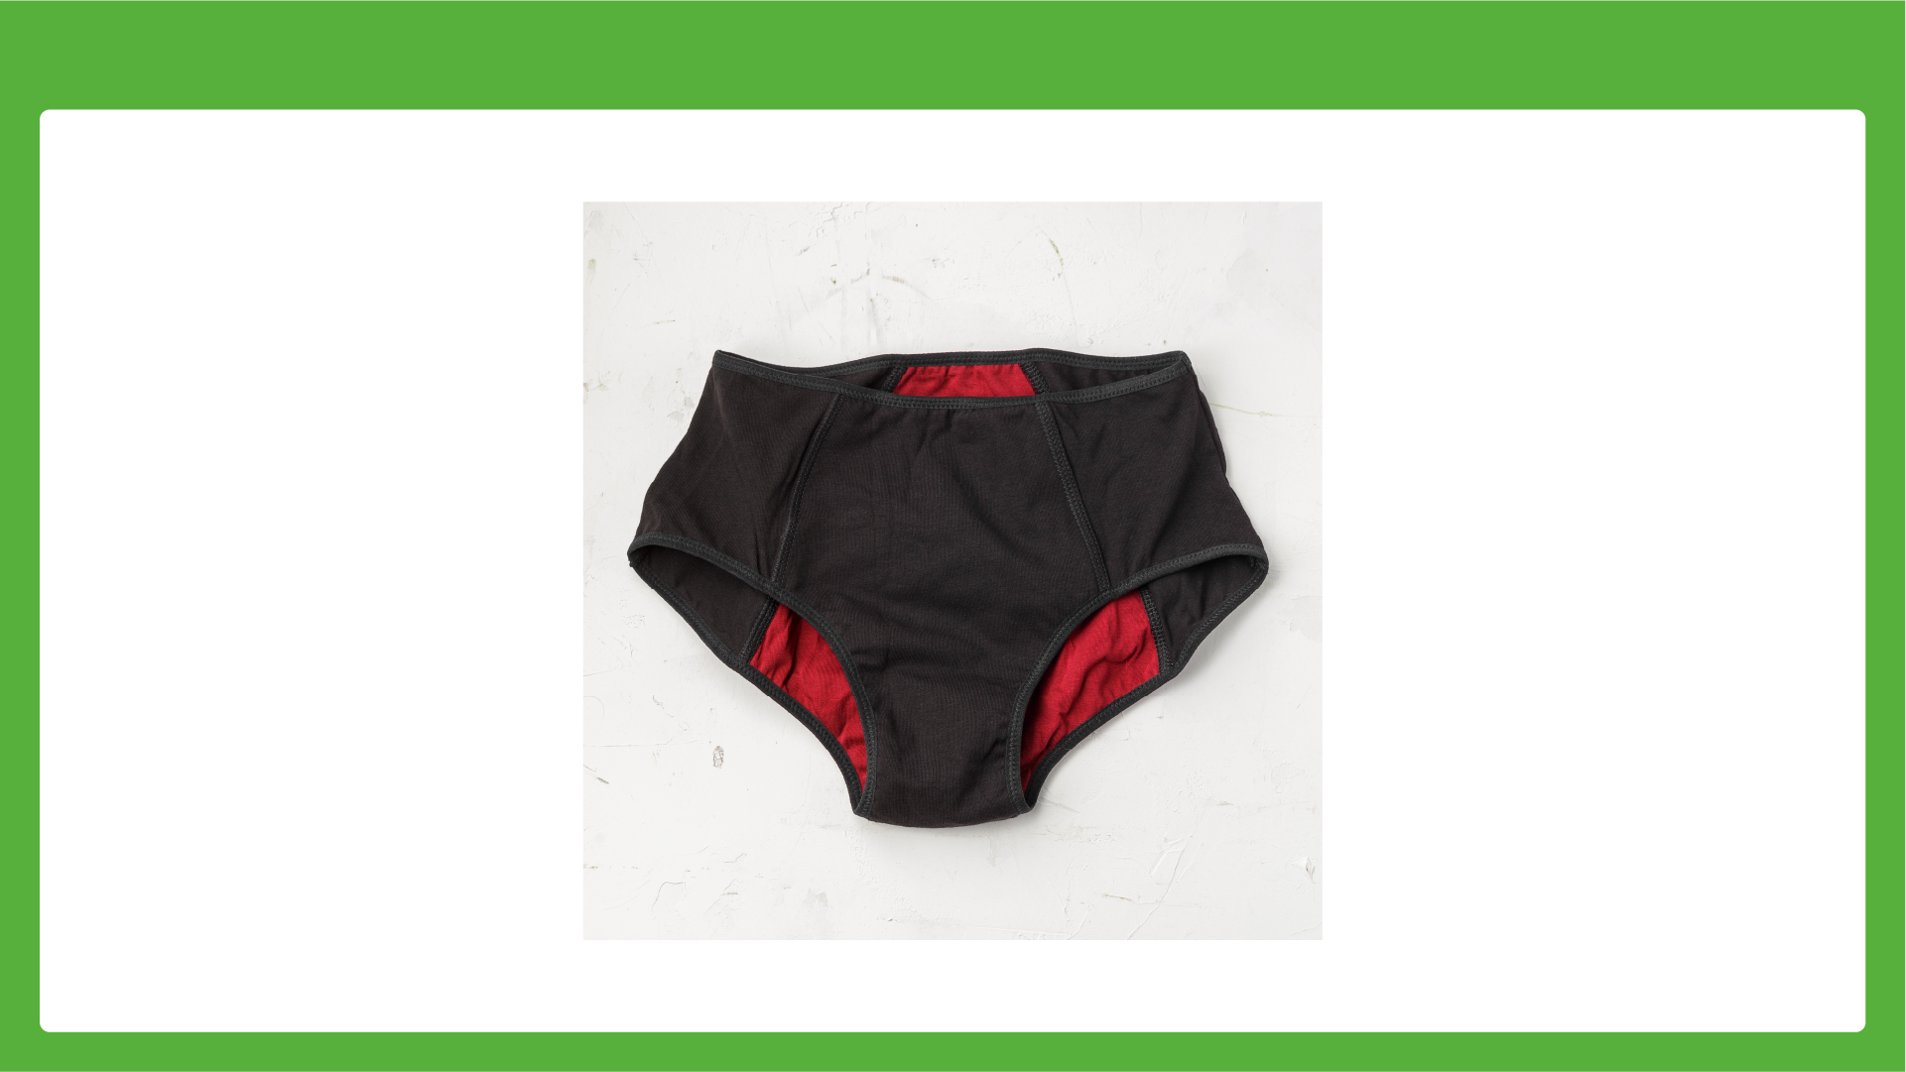
Menstruation - I will wear period pants.

Slide 6
Menstruation - I can talk about my periods if I am upset.

