Slide 1
Safe and happy online
I can discuss my online life.
I understand that my online presence requires me to have strategies for safe use.
I can identify adults that I trust and who can help when I have a worry or a question.

Slide 2
What do you do online? What games or apps or websites do you visit?

Slide 3
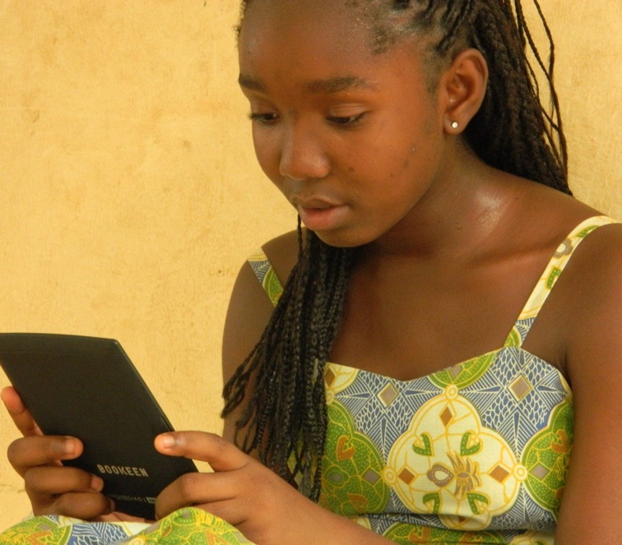
How do we get online? Who uses: A phone? A tablet/iPad? A laptop? A computer? A games console?

Slide 4
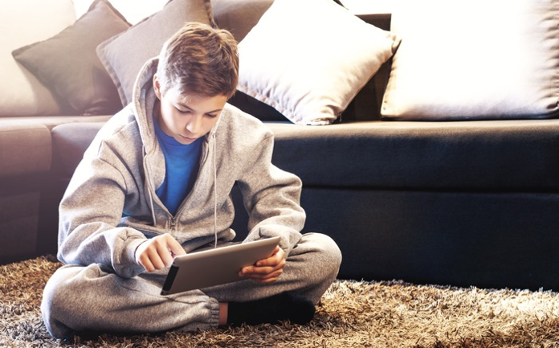
What do you do online?
Do you:
Chat?
Read?
Send messages?
Play games?
Watch things on YouTube?
Create things?
Find out things for hobbies or for schoolwork?
Take photos? Send photos to people?

Slide 5
Do you have any rules that you follow online?

Slide 6
Films: Sharing Pictures (6 minutes) Playing Games (9 minutes 15) Both films available here: Jessie Friends videos (thinkuknow.co.uk)

Slide 7
Top tips: 1 People you don’t know are strangers. When you are online or playing a game people are not always who they say they are.

Slide 8
Top tips: 2 Be nice to people. Be as nice as you would be if you were in school or playing together.

Slide 9
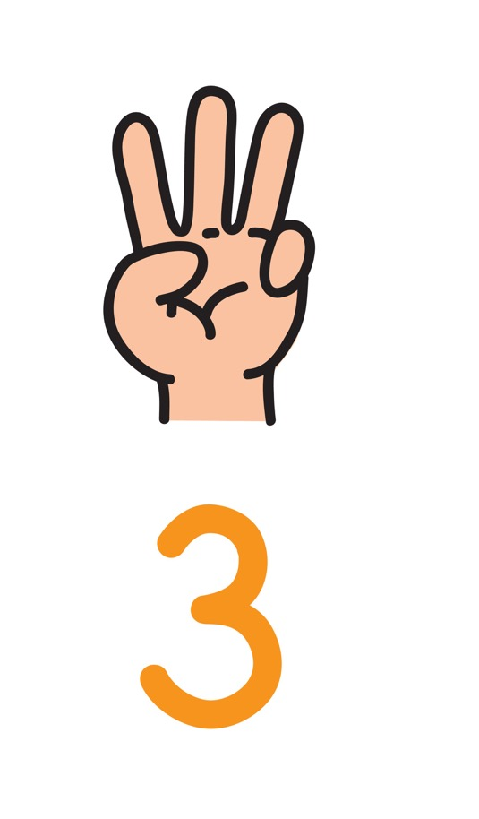
Top tips: 3 Keep your personal information private. Don’t tell people online where you live or the school you go to. Never take a photo of you and send it to a stranger, even if they ask. Photos are also private.

Slide 10
Top tips: 4 If you ever get that feeling in your body that tells you something isn’t right, maybe you feel a bit worried, then tell an adult you trust.

Slide 11
Activity: Safe and Happy Online posters

Slide 12
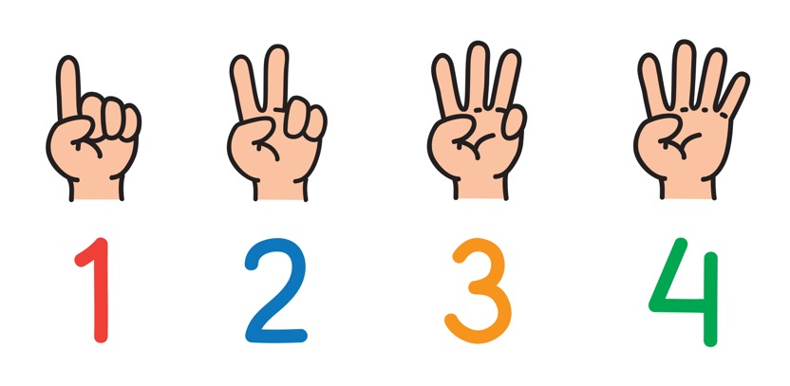
People you don’t know are strangers. When you are online or playing a game people are not always who they say they are.
Be nice to people. Be as nice as you would be if you were in school or playing together.
Keep your personal information private. Don’t tell people online where you live or the school you go to. Never take a photo of you and send it to a stranger, even if they ask. Photos are also private.
If you ever get that feeling in your body that tells you something isn’t right, maybe you feel a bit worried, then tell an adult you trust.

Slide 13
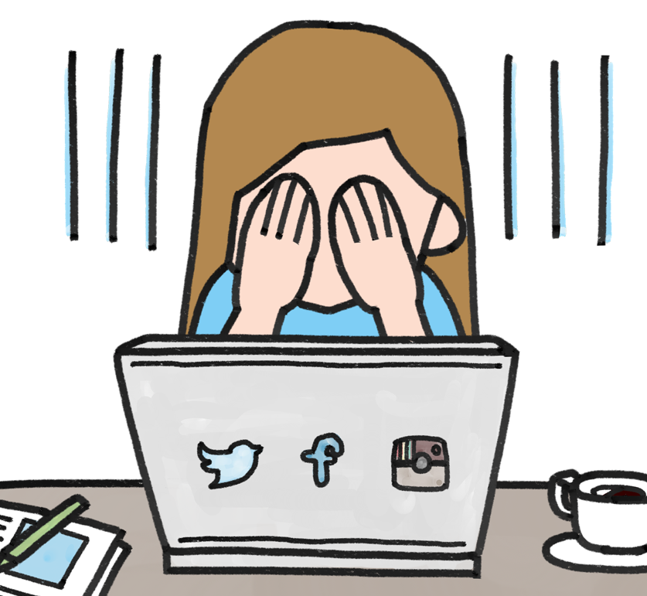
It’s great to watch things, play games and have fun online. If you feel upset about anything you have seen or if someone says something which makes you feel bad or worried inside, tell a grown up at home or at school.

