Slide 1
Sex (+drugs + alcohol)
I can talk about my own safety and wellbeing in relationships.
I can talk about the impact that drugs and alcohol have on relationships.
I know how to access information, help or support if I need to.

Slide 2
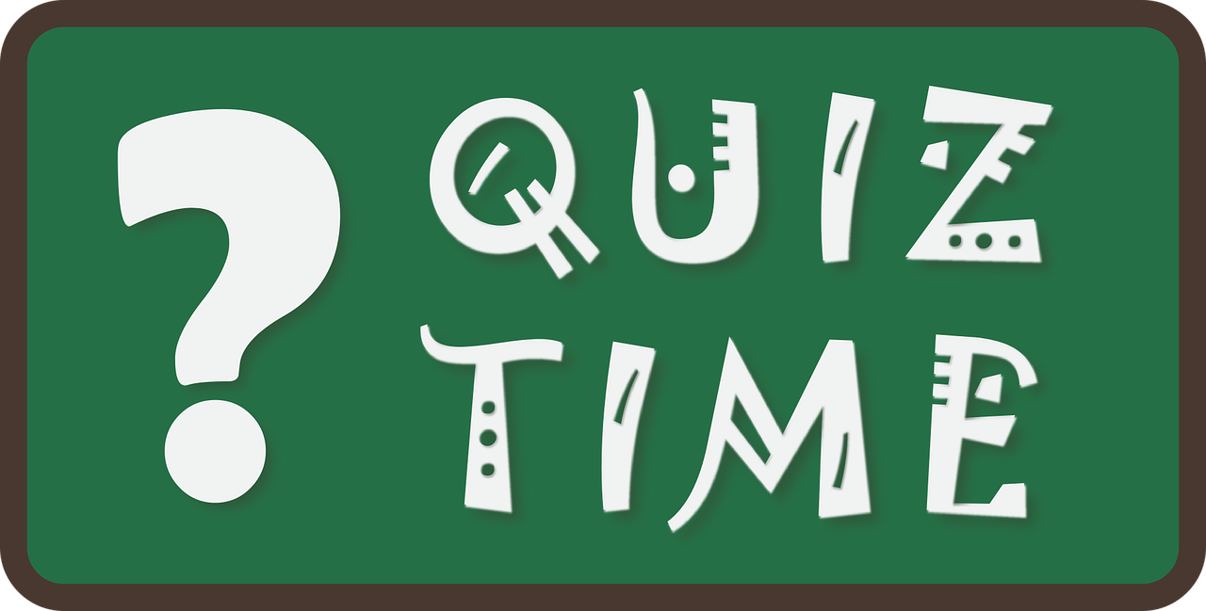

Slide 3
1.
Drinking as a teenager increases your chance of having unprotected sex.

Slide 4
2.
In a survey 70 per cent of young people who regretted having a sexual episode said that alcohol had been a factor.

Slide 5
3.
Alcohol affects teenage growth.

Slide 6
4.
Over 1000 young people under the age of 15 in the UK are admitted to hospital each year with acute alcohol poisoning.

Slide 7
5.
Alcohol causes more deaths than all other drugs related deaths combined. Scotland has the highest rate of all UK countries.

Slide 8
6.
In a survey 28 per cent of young adults said that they'd had sex with someone they wouldn't normally fancy – and in most cases they blamed alcohol.

Slide 9
7.
Alcohol is a factor in 75% of stabbings, 70% of beatings and 60% of murders.

Slide 10
8.
The number of teenagers aged 11 to 15 who have tried alcohol is going down.

Slide 11
9.
Drinking alcohol when pregnant risks causing permanent brain damage to your baby.

Slide 12
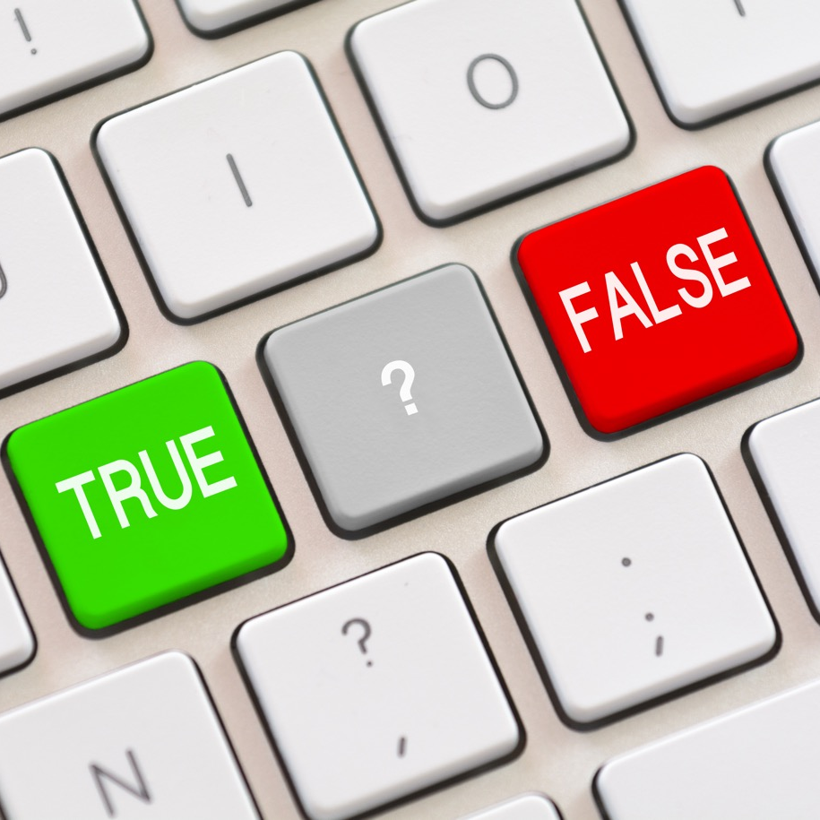
10.
In a survey, almost one in 10 young people said that they'd got so drunk that they couldn't even remember whether they had sex – or what sort of sex it was.

Slide 13
All statements are TRUE

Slide 14
Statement | Source/more info
Drinking as a teenager increases your chance of having unprotected sex. | Alcohol is a major factor in inducing men and women to have sex without a condom. 2014 Ipsos-MORI survey of young people, carried out for the Family Planning Association
In a survey 70 per cent of young people who regretted having a sexual episode said that alcohol had been a factor. | 2014 Ipsos-MORI survey of young people, carried out for the Family Planning Association
Alcohol affects teenage growth | www.healthtap.com Excess alcohol use has many negative side effects on many of your body systems, including nutrition, livers, kidney and brain. It can result in nutritional deficiencies and hormonal influences that affect growth
Over 1000 young people under the age of 15 in the UK are admitted to hospital each year with acute alcohol poisoning. | www.alcoholhelp.com
Alcohol causes more deaths than all other drugs related deaths combined. Scotland has the highest rate of all UK countries. | Office for National Statistics
In a survey 28 per cent of young adults said that they'd had sex with someone they wouldn't normally fancy – and in most cases they blamed alcohol. | 2014 Ipsos-MORI survey of young people, carried out for the Family Planning Association
Alcohol is a factor in 75% of stabbings, 70% of beatings and 60% of murders | British Medical Association
The number of teenagers aged 11 to 15 who have tried alcohol is going down | Currently 38% report having tried alcohol, the lowest since surveys began The Health and Social Care Information Centre
Drinking alcohol when pregnant risks causing permanent brain damage to your baby. | NHS recommends that if you are planning to get pregnant, at risk of getting pregnant or currently pregnant you should not drink alcohol. Drinking alcohol in pregnancy damages the baby.
In a survey almost one in 10 young people said that they'd got so drunk that they couldn't even remember whether they had sex – or what sort of sex it was. | 2014 Ipsos-MORI survey of young people, carried out for the Family Planning Association

Slide 15
An ugly truth is something that is true and that you need to hear, but it’s probably not something you want to know, because it’s not good news.
UGLY TRUTHS

Slide 16
UGLY TRUTHS
Alcohol Truth Project film: https://vimeo.com/144344497

Slide 17
UGLY TRUTHS
The alcohol industry spends over £800 million each year to market and promote alcohol in the UK – and a lot of it targets young adults.

Slide 18
How do alcohol and drugs impact on sex and relationships? Young people talked about:
Using alcohol and drugs to feel more confident and feel free
Alcohol and regret
Alcohol and drugs causing problems in relationships
Taking risks
Sexual violence.

Slide 19
Information and support about relationships, alcohol and drugs
A.D.A.M. is a website for young people who are concerned about or may be affected by another person’s drinking www.chatresource.org.uk/adam/
For honest information about drugs: https://www.talktofrank.com
Whether you have taken drugs, are thinking of taking them, are just curious or want to know more: https://knowthescore.info
Your local sexual health clinic for young people will talk about anything to do with relationships and sexual health.
Remember that ChildLine is for young people your age. There’s lots online and you can talk confidentially with someone https://www.childline.org.uk/

