Slide 1
My body
I can communicate my feelings.
I can talk about positive things about me.
I recognise when I have positive emotions, and when I feel sad or worried.
I can reflect on my relationships with others and how they impact on my emotional wellbeing.
I know who or where I can go to for support or if I have a worry or a question.

Slide 2
Feelings check-in
When I woke up this morning, I felt…
Just before coming into school, I felt…
Right now, I feel…

Slide 3
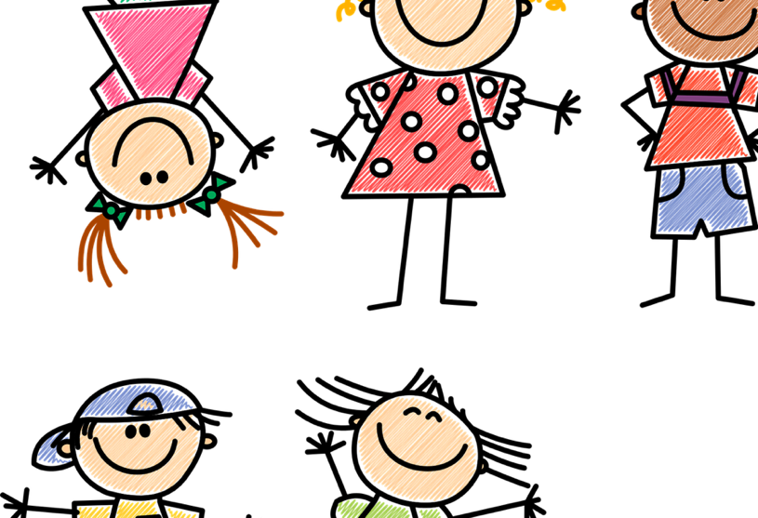
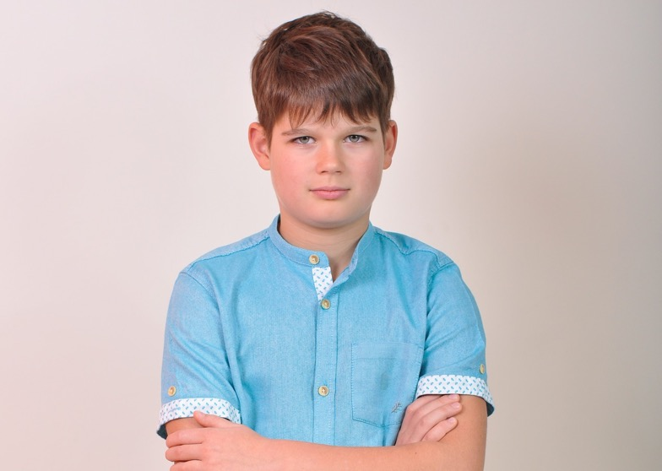
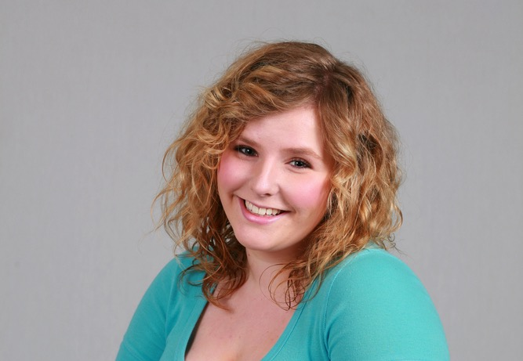
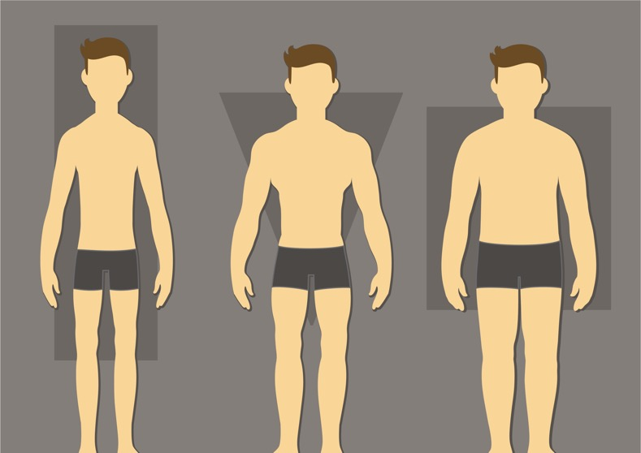
What is body image? Why does it matter?
All our bodies are different, and that’s a good thing.
How our bodies look is only one part of who we are.
Body image is the way we think and feel about the size, shape and overall appearance of our bodies.

Slide 4
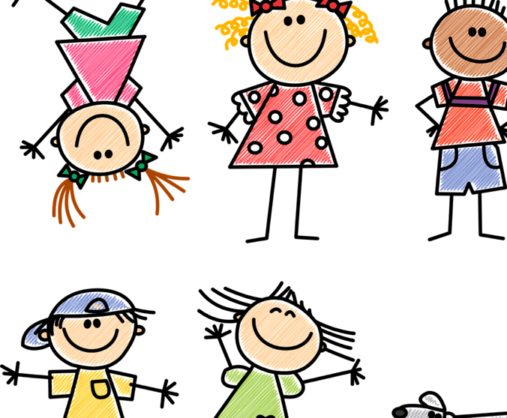
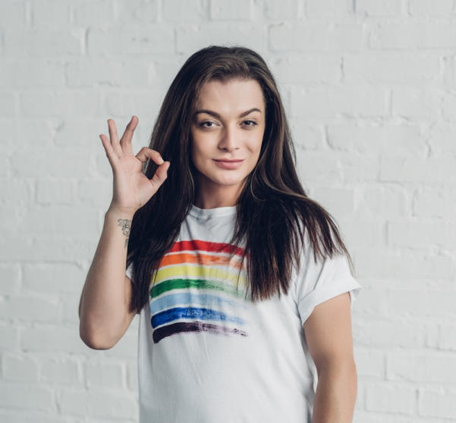
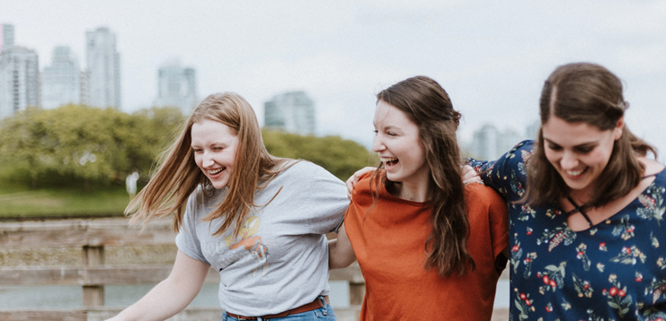
What is body image? Why does it matter?
A positive body image means that you like how you look and feel positive about your body.
A positive body image means that you don’t worry about how you look.
A positive body image means we can be confident and try new things.

Slide 5
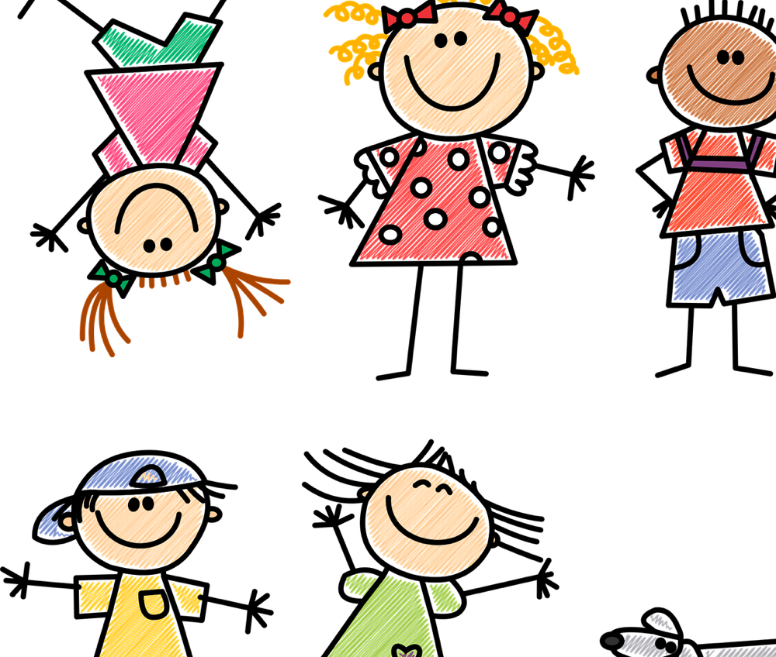
My favourite thing about what my body can do is…

Slide 6
Is everything we see real?
Bodies: Different shapes and sizes All Beautiful: https://youtu.be/Fcy_VQZG5Dg (1 minute 53)

Slide 7
Why don’t I like the way I look? https://youtu.be/v7zUHOEYlN8 (4 minutes 32)

Slide 8
What would be your top tips to other children to help them to be positive about their body – this means to have a positive body image?

Slide 9
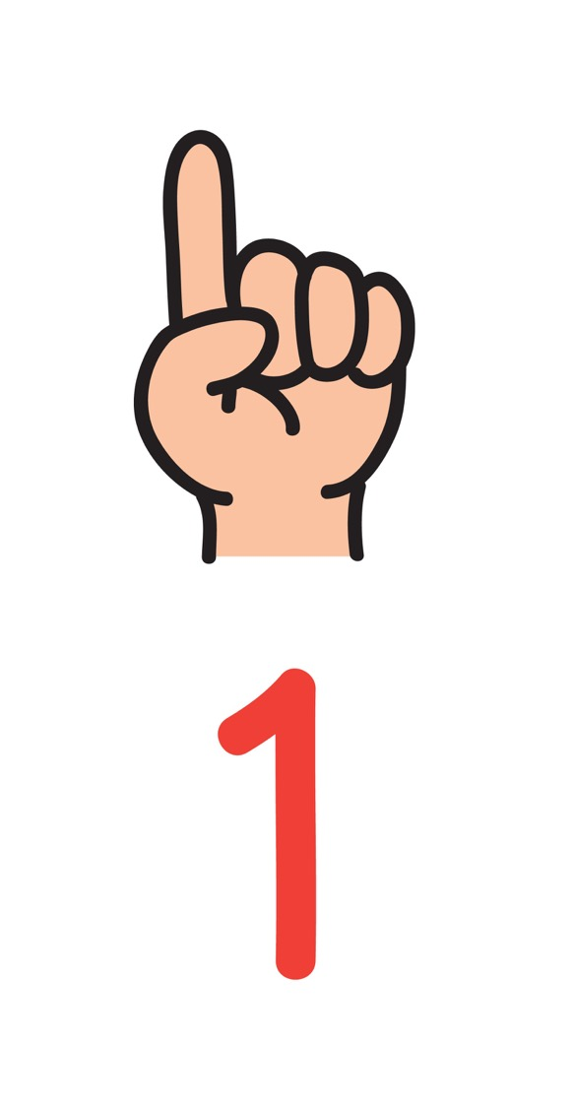
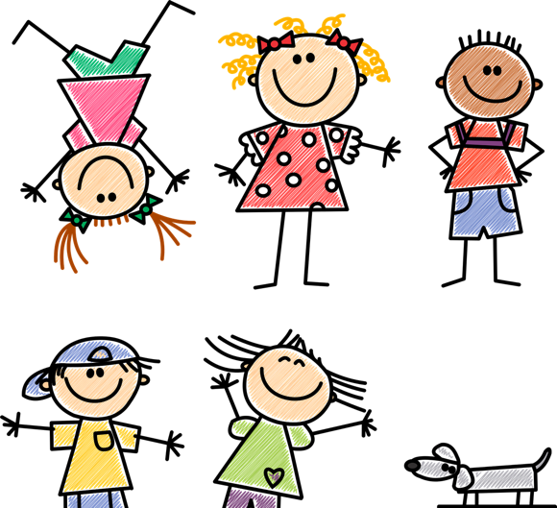
Top tip 1 for a positive body image:
Try to make healthy choices – eat as healthy as you can and be active through play and exercise.

Slide 10
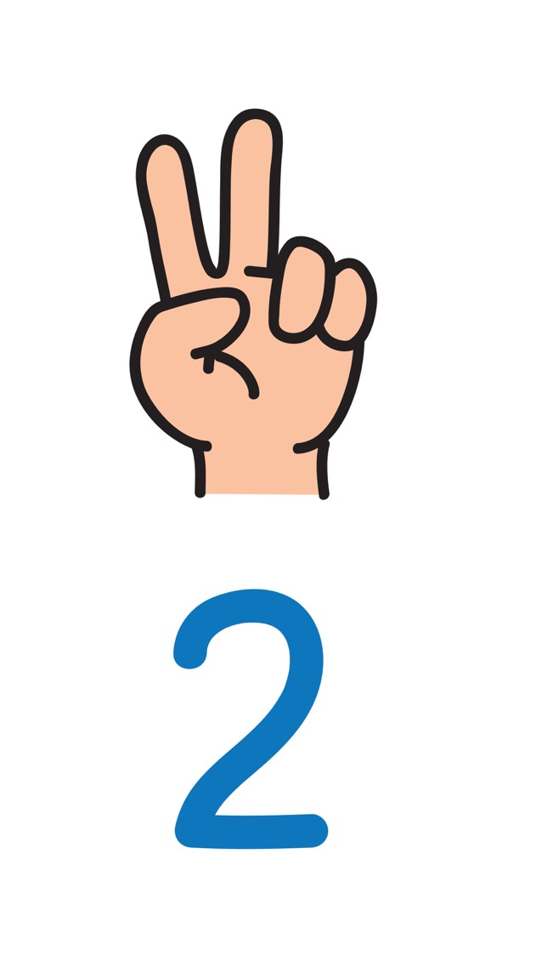
Top tip 2
If you visit websites or watch programmes that say that girls or boys have to look a certain way, just remember that we are all different and that is okay.

Slide 11
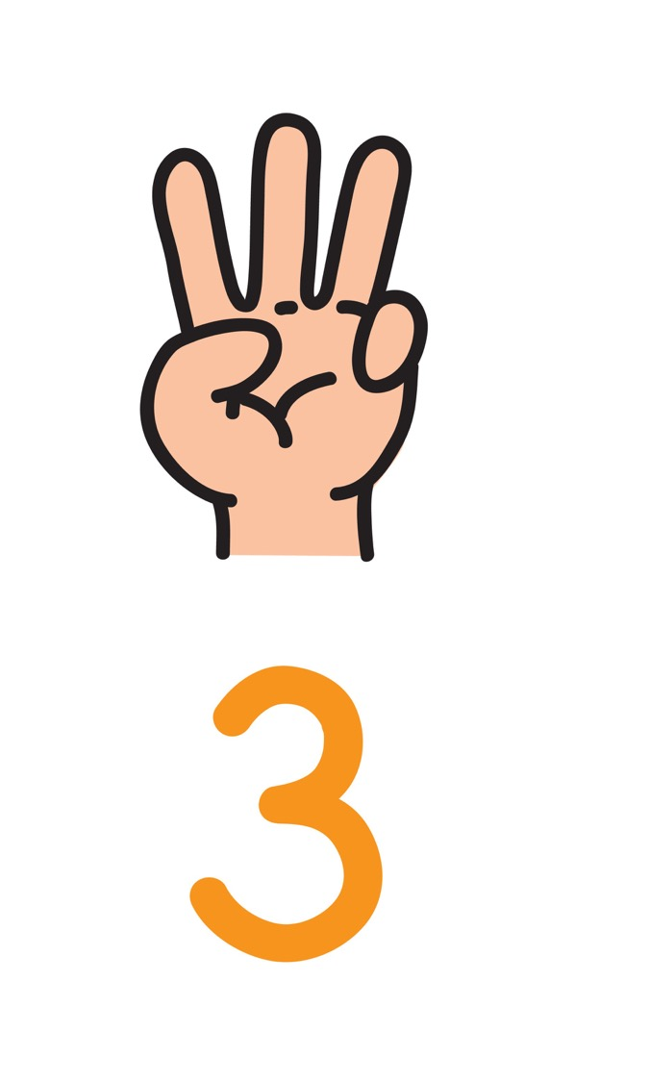
Top tip 3
Never make bad comments to a person about how they look. Support your friends – remind them about how much you appreciate them for who they are.

Slide 12
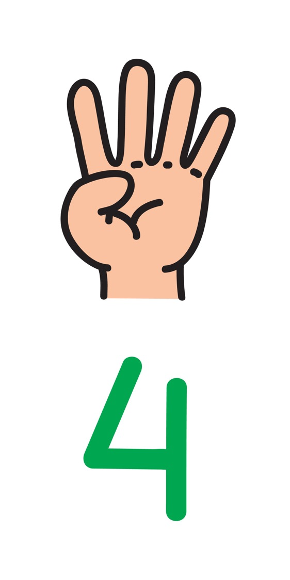
Top tip 4:
If you have a question or a worry about your body or about how you look, speak to an adult.
Think for a moment… who would you speak to?

Slide 13
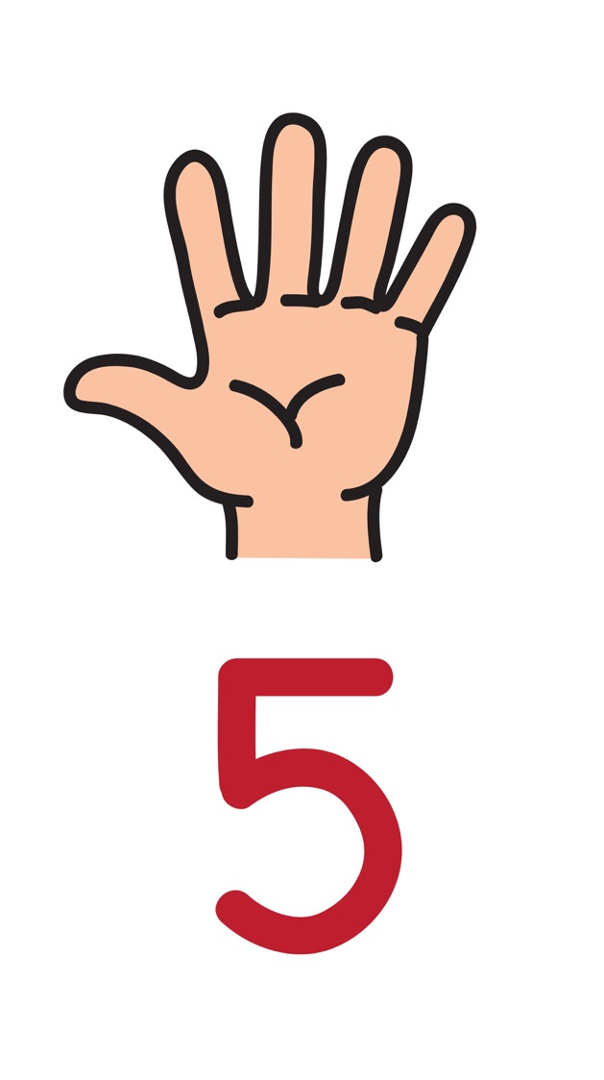
Top tip 5:
Always remember that you are unique and special.

