Slide 1
My Feelings
I can communicate my feelings.
I can talk about positive things about me
I recognise when I have positive emotions, and when I feel sad or worried.
I can reflect on my relationships with others and how they impact on my emotional wellbeing.
I know who or where I can go to for support or if I have a worry or a question.

Slide 2
Feelings check-in
When I woke up this morning, I felt…
Just before coming into school, I felt…
Right now, I feel…

Slide 3
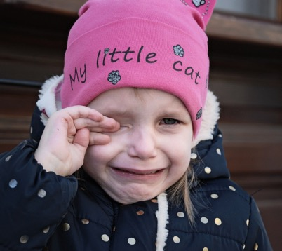
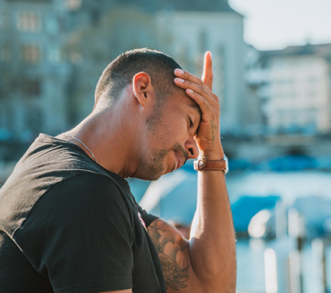
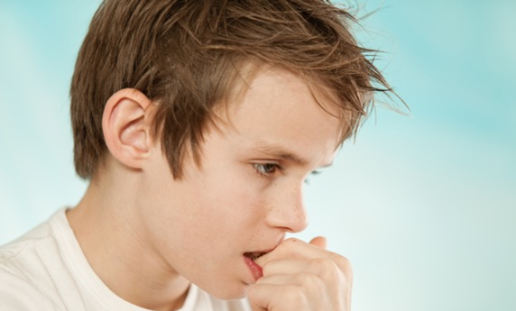
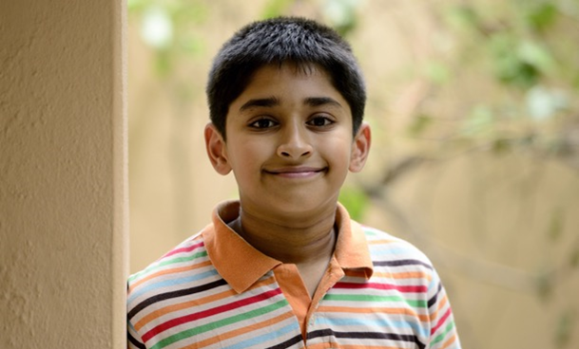
How many feelings can a person have?

Slide 4
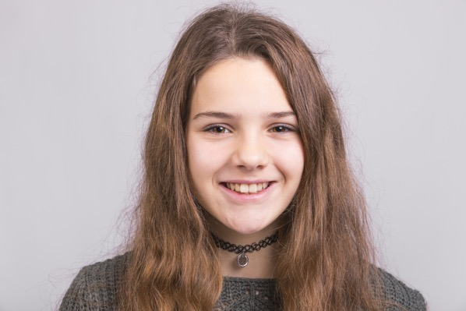
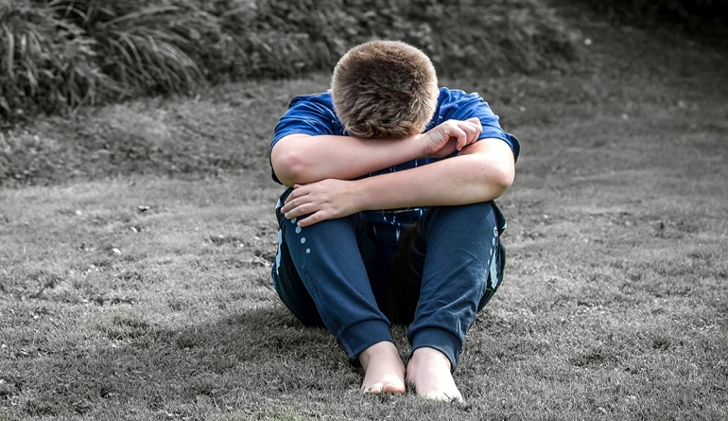
Make 2 piles from your list of feelings
Which feelings are comfortable?
Which feelings are uncomfortable? These are feelings that feel too big to cope with.

Slide 5
Coping with feelings: How do you currently cope with uncomfortable feelings?

Slide 6
Coping with feelings: Do you think you could cope better, if so how?

Slide 7
Coping with feelings: Who could help you in this and how do you think you could help yourself?

Slide 8
Coping with feelings: Are there some feelings that can be comfortable, but they make you feel an uncomfortable feeling at the same time?

Slide 9
Coping with feelings
How do you currently cope with uncomfortable feelings?
Do you think you could cope better, if so how?
Who could help you in this and how do you think you could help yourself?
Are there some feelings that can be comfortable, but they make you feel an uncomfortable feeling at the same time?

Slide 10
Alisha and Emma

Slide 11
Mikey and his Mum

Slide 12
Chi

Slide 13
Questions to consider
What feelings is the character experiencing?
Can your character change or influence anything that is happening?
Is there anything going on that they really can’t change or influence?
What do you suggest they do?
What would you do as their friend?

Slide 14
Talking Mental Health
(5 minutes 27 seconds) https://www.youtube.com/watch?v=nCrjevx3-Js&feature=youtu.be

