Slide 1
Disability and Relationships:
An introduction to our RSHP learning this year
I know that I will be taking part in RSHP education this school year and I have a general idea about what this will be about.
I am able to ask questions about this learning.

Slide 2
Disability and Relationships:
An introduction to our learning this year
I know that I will be taking part in RSHP education this school year, and have a general idea about what this will be about.
I am able to ask questions about this learning.
Notes:
Teachers/Facilitators should read the Activity Plan that accompanies this PowerPoint. The Activity Plan explains the purpose of this lesson, essential reading before you deliver the session.

Slide 3
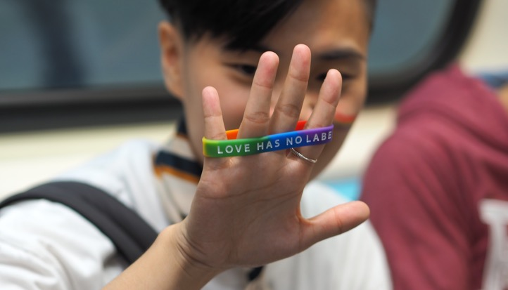

This lesson is an introduction to the learning we will do about the topic we call: Relationships, sexual health and parenthood education.

Slide 4

We will do our lessons on relationships, sexual health and parenthood education because people with disabilities have the same human rights as everyone else.

Slide 5
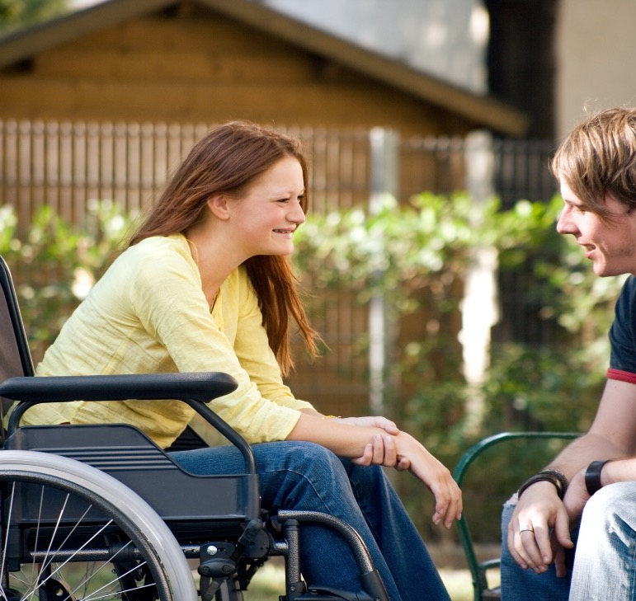
And because:
People with disabilities have relationships and fall in love.
When they are old enough (and if they want to) people with disabilities can have sex, they can marry and have a family.
In a relationship everyone has the right to be healthy, happy and safe.

Slide 6


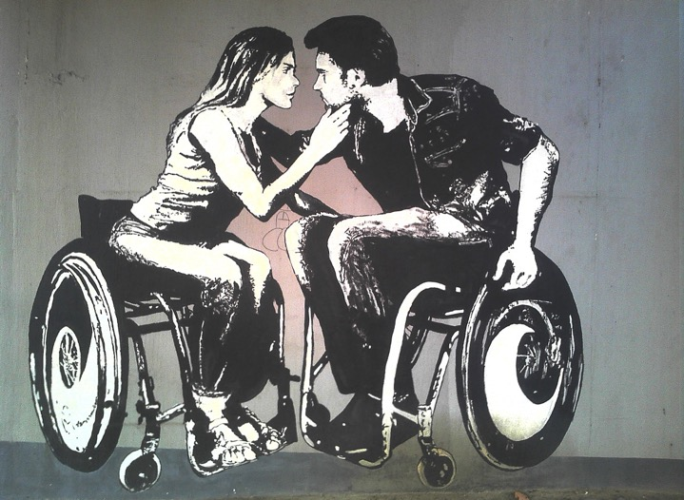
In our lessons we will talk about being attracted to someone.
When you like someone you can start to have feelings of attraction to them.
You might ‘fancy’ someone.
You might go out with them.
You might say you are in a relationship.
You might feel like you are in love!

Slide 7


What songs, poems, movies and stories can you think of that are about relationships or love?

Slide 8
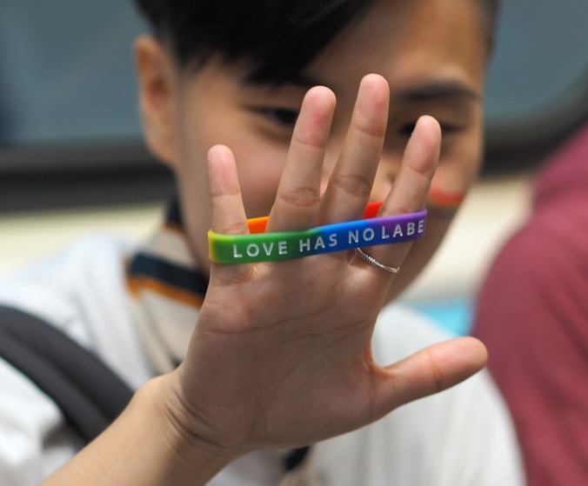

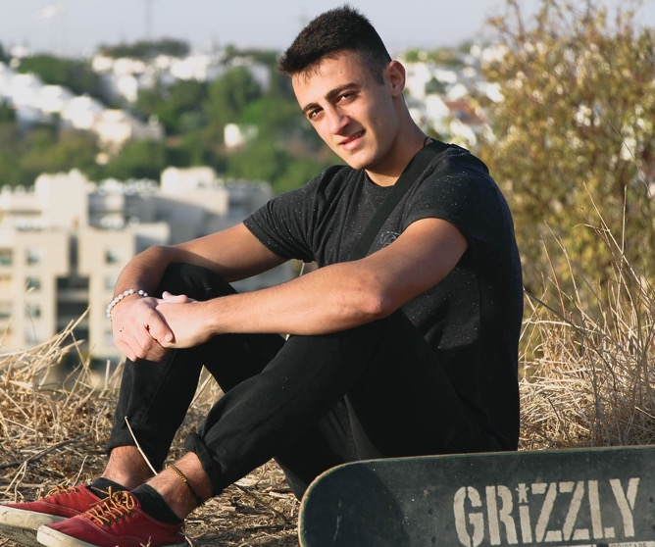
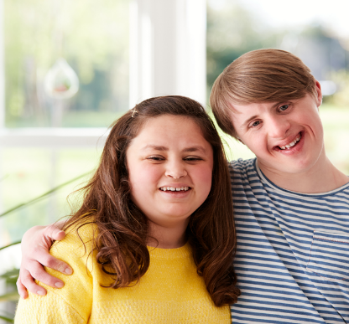
When we learn together we will think and talk about how young people with disabilities experience love and relationships.

Slide 9

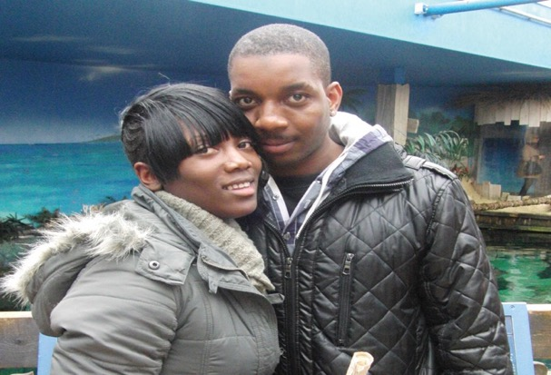
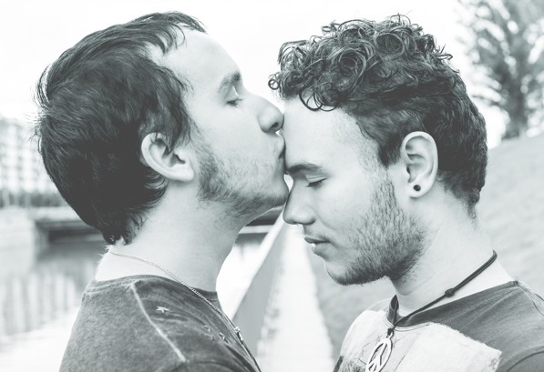
What might these people be thinking about each other?
Notes:
New page. Photos from Workbook

Slide 10

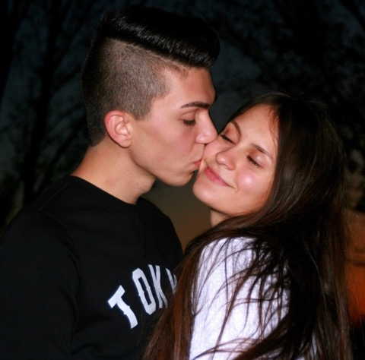
What might these people be thinking about each other?
Notes:
New page. Photo’s from Workbook

Slide 11
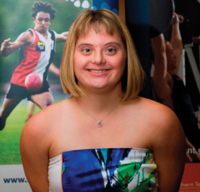

Sometimes, when a person has a disability their parents or carers or other people can worry about them being in a relationship.
Why do you think that they would worry?

Slide 12

When we learn together, we will also say that it is okay if you don’t want to be in a relationship with someone.
Do you think young people can feel under pressure to have a boyfriend or girlfriend?

Slide 13

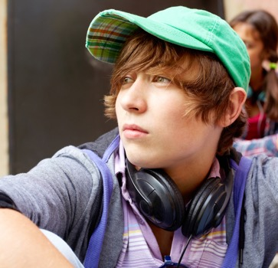
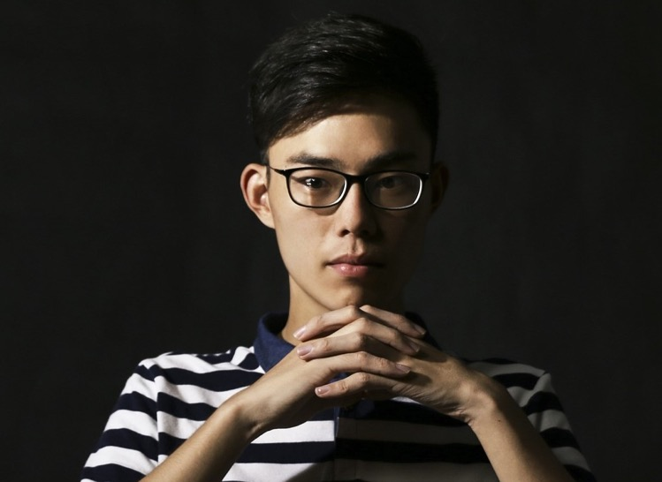
Disability and relationships
Sometimes when you have a disability there are important things you have to think about.
Some of these things will affect relationships.
How do you think having a disability can affect relationships?

Slide 14
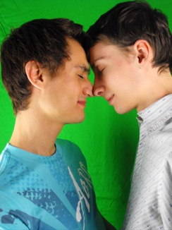
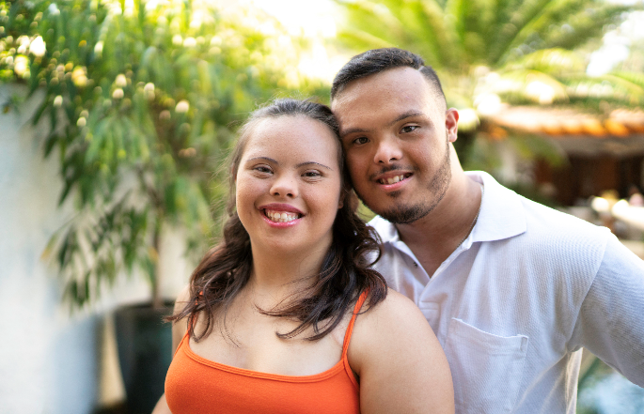
Do you think these things happen to people with disabilities?
Because of how our society is, a person with disabilities can be made to feel bad about themselves.
They can be put down by others.
This can leave the person feeling lonely or down. They can lack confidence.
When you have these experiences or feelings it is hard to socialise and meet others.

Slide 15
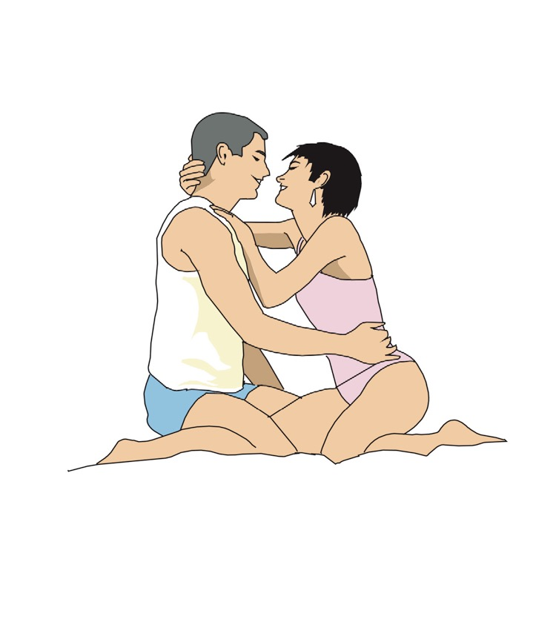
When we learn together we will talk about sexual relationships.
When they are old enough (and if they want to) people with disabilities can have sex, they can marry and have a family.
Sometimes when you have a disability there are important things you have to think about when it comes to having a sexual relationship.
How do you think having a disability can affect sexual relationships?

Slide 16
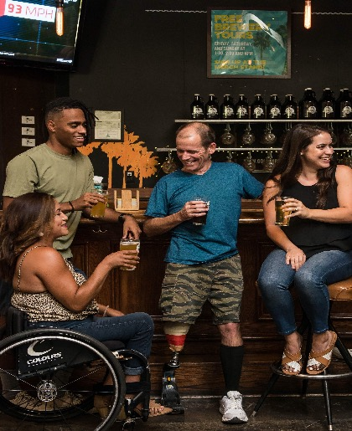
How might a ‘physical impairment’ affect relationships and sex?
It might be harder to meet people or to get into some places where people meet.
Mobility can affect how someone has sex.
Communication difficulties can mean its harder to express yourself or be understood.
Some medication can affect erections, contraception, pregnancy and plans to have children.

Slide 17
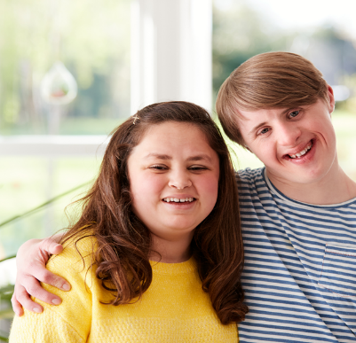
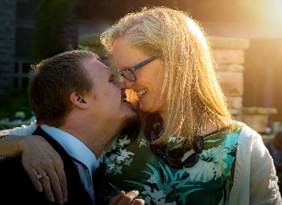
How might a ‘mental impairment’ or learning disability affect relationships and sex?
A person might not have opportunities to meet people.
It might be difficult to communicate or chat to new people.
They may need extra support to learn about sex and relationships.
Some people might need easy-read information on relationships, sex, contraception and parenthood.
Some medication can affect erections, contraception, pregnancy and plans to have children.

Slide 18

This has been a short introduction into the learning we will do about relationships, sexual health and parenthood.
When we are learning together it is important to remember that if you have a question or a worry about friendships or relationships you can speak to someone.
Who would you speak to?
You can also find lots of information here: https://www.easyhealth.org.uk/

Slide 19
This has been a short introduction into the learning we will do about relationships, sexual health and parenthood.
Do you have any questions about the RSHP learning we will do this year?

