Slide 1
Being a parent/carer: Connecting with and nurturing your child
I can discuss the skills and qualities of a parent/carer.
I can talk about what a parent/carer does to make sure their child is healthy, happy and safe.
I can discuss some of the challenges of being a parent/carer and how to seek help and support.
I talk about the kind of parent or carer I would be.

Slide 2
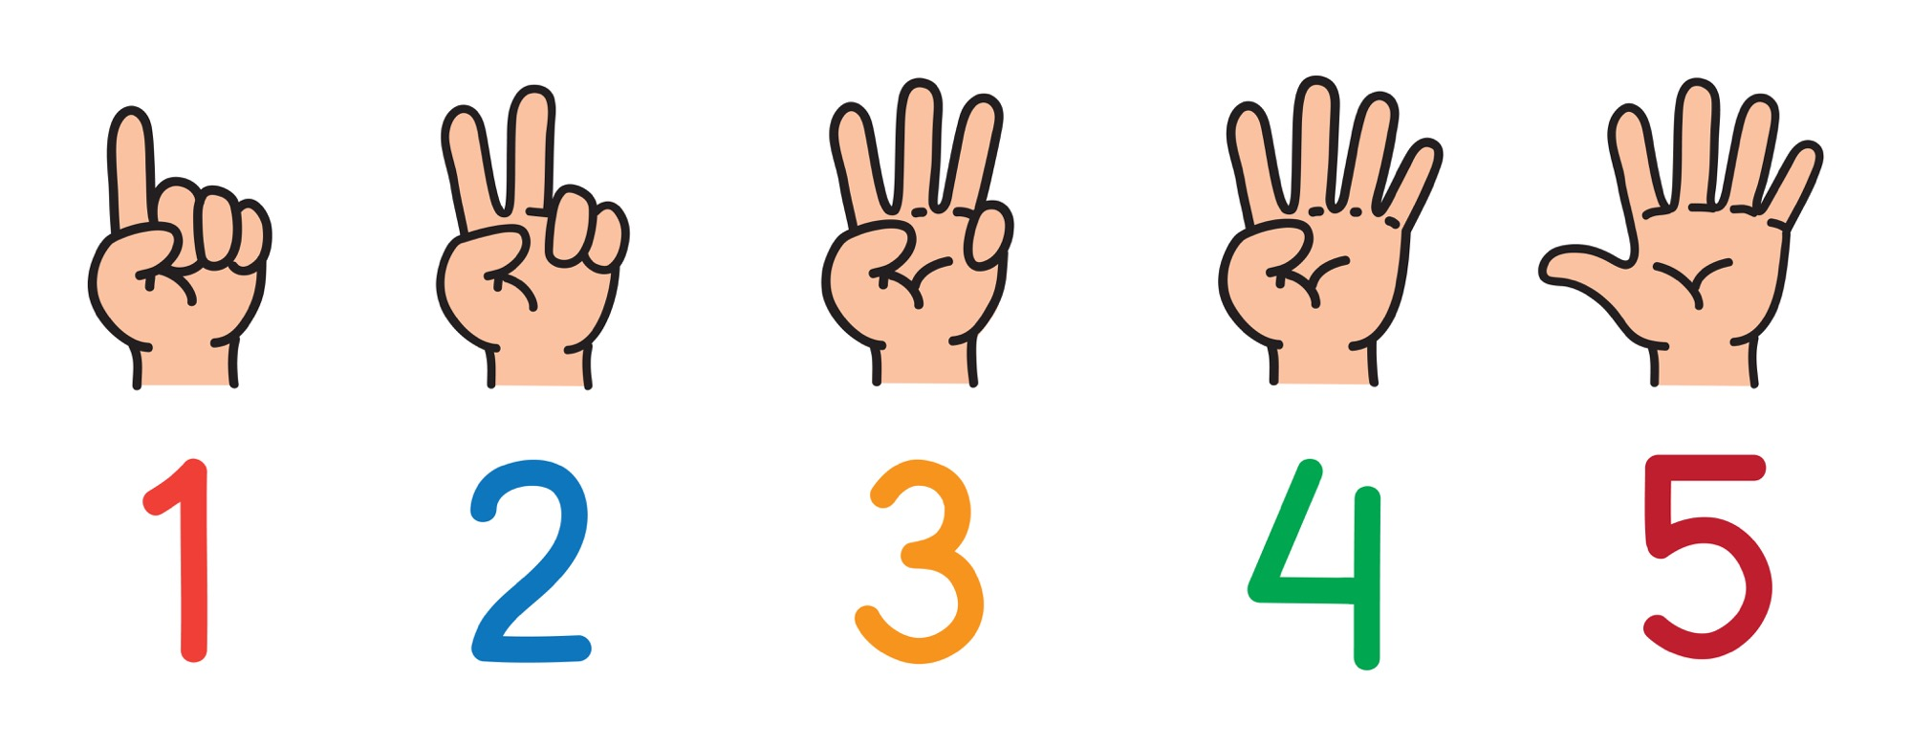
What do my parents/carers do for me now?

Slide 3
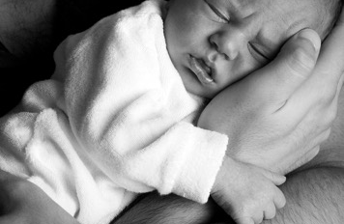
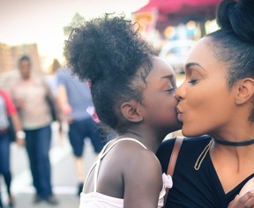
Nurture means to care or protect someone or something as it grows.
To be a nurturing parent or carer means giving your child lots of love and affection. If a parent/carer nurtures their child then the child feels protected and cared about, children feel important and good about themselves and their relationships.

Slide 4

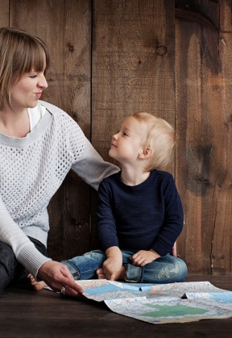

Imagine yourself as a parent or carer:
What would you do to nurture your child…?
As a baby
As a toddler
As a 5 year old
As a 10 year old
As a 15 year old

Slide 5

You as a parent QUIZ

Slide 6

Discussion:
Parenting has been called the ultimate long-term investment.
It's one of the most complex and challenging jobs you'll face in your lifetime -- and also the most rewarding.
Agree/Disagree/maybe….

