Slide 1
Being a parent/carer: What babies need/the best start in life
I can talk about what a parent/carer does to make sure their child is healthy, happy and safe.
I understand the challenges of being a parent/carer.
I know that all families are different.
I talk about the kind of parent or carer I would be.
I understand that parents/carers need support and help.

Slide 2
A National Outcome for Scotland
We grow up loved, safe and respected so that we realise our full potential.
We do all we can to ensure our children grow up in an atmosphere of happiness, love and understanding.

Slide 3
If babies and toddlers are to have the best start, and be loved, safe and respected, what can their parents and carers do?

Slide 4
What do parents and cares do for their baby every day?

Slide 5
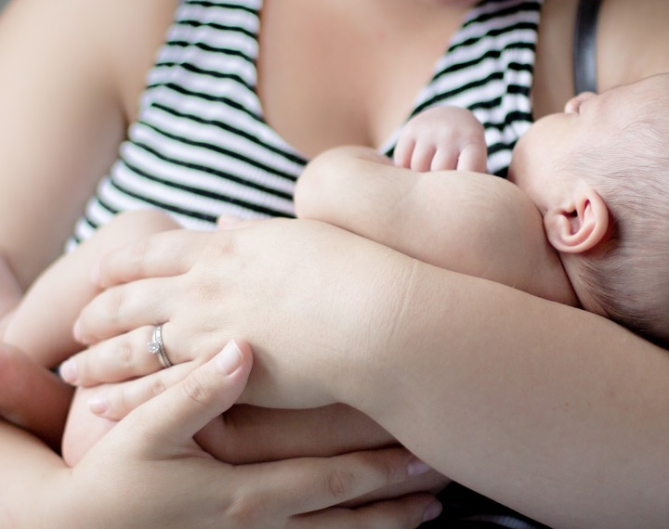
Things parents do every day for a baby:
Of all these tasks, what do you think would be the most difficult, and why?
Changing nappies
Cleaning/washing
Responding to crying
Dressing
Feeding/winding
Keep the child safe
Sleeping
Bonding
Talking and playing

Slide 6
Why do babies cry?
www.babycentre.co.uk/v25023732/seven-reasons-babies-cry-video
(duration 2 minutes 10 seconds)

Slide 7
What would you do if your baby was crying?

Slide 8
How to cope with a crying baby https://www.nct.org.uk/parenting/coping-crying-baby
(duration 2 minutes 39 seconds)

Slide 9
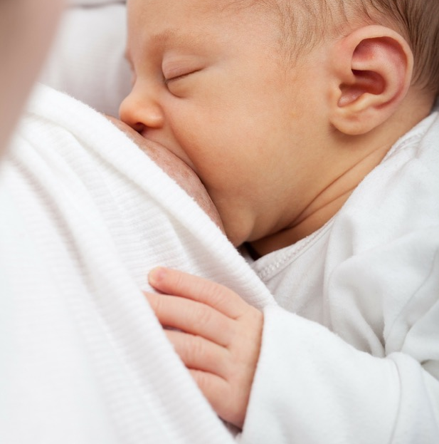
Breastfeeding can also be called nursing. It is the feeding of babies and young children with milk from a woman’s breast.
Health professionals recommend that breastfeeding begin within the first hour of a baby's life and continue as often and as much as the baby wants.
During the first few weeks of life, babies may nurse roughly every two to three hours and the duration of a feeding is usually ten to fifteen minutes on each breast. Older children feed less often.
Mothers can express milk (using a breast pump) so that it can be used later if they can’t be there to breastfeed.
Breastfeeding has a number of benefits to both mother and baby.

Slide 10
What do you think are the benefits of breastfeeding a baby?

Slide 11
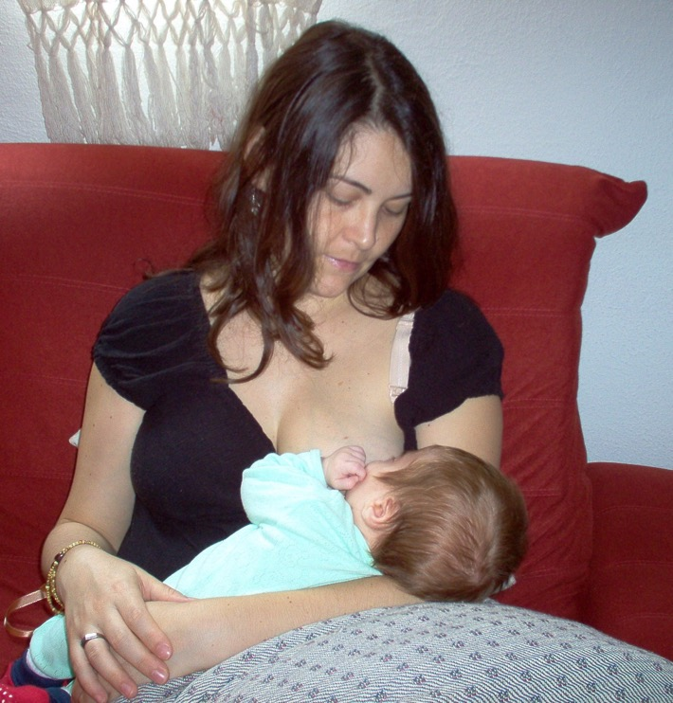
Breastfeeding is good news for baby and you
Breast milk is tailor-made for your baby and gives them all the nutrients they need in the first 6 months, and alongside other foods thereafter.
Breast milk boosts your baby’s ability to fight illness and infection.
Breastfeeding lowers your risk of breast cancer and ovarian cancer and burns about 500 calories a day.
Breastfeeding is a great way to strengthen the bond between you and your baby.

Slide 12
Breastfeeding
Choice of films
https://www.babycentre.co.uk/v25007241/how-to-get-a-comfy-attachment-video
(duration 2 minutes)
https://youtu.be/qzSB_4rOlJU
(duration 2 minutes 13)

Slide 13
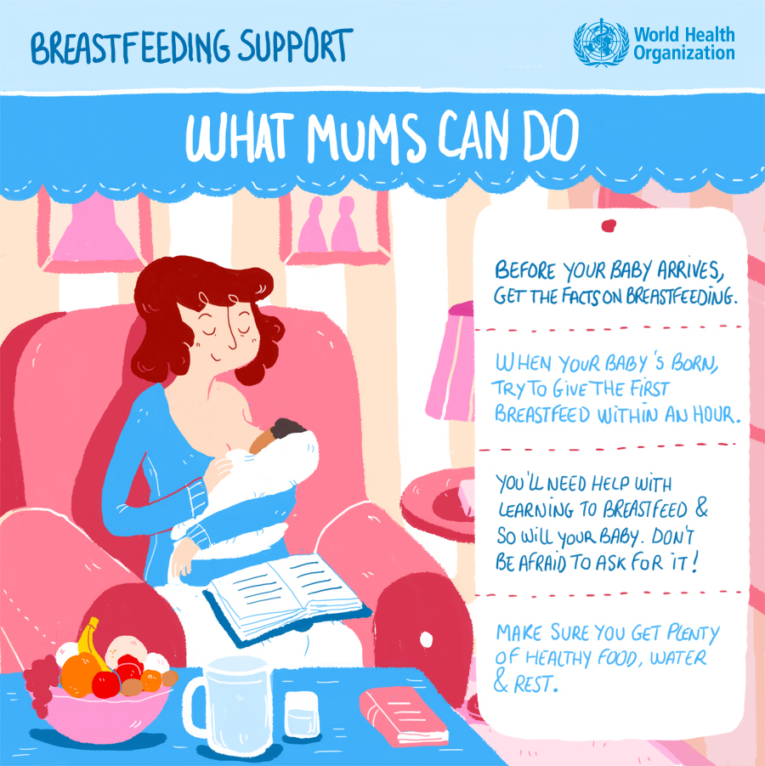
Breastfeeding:
What Mums can do

Slide 14
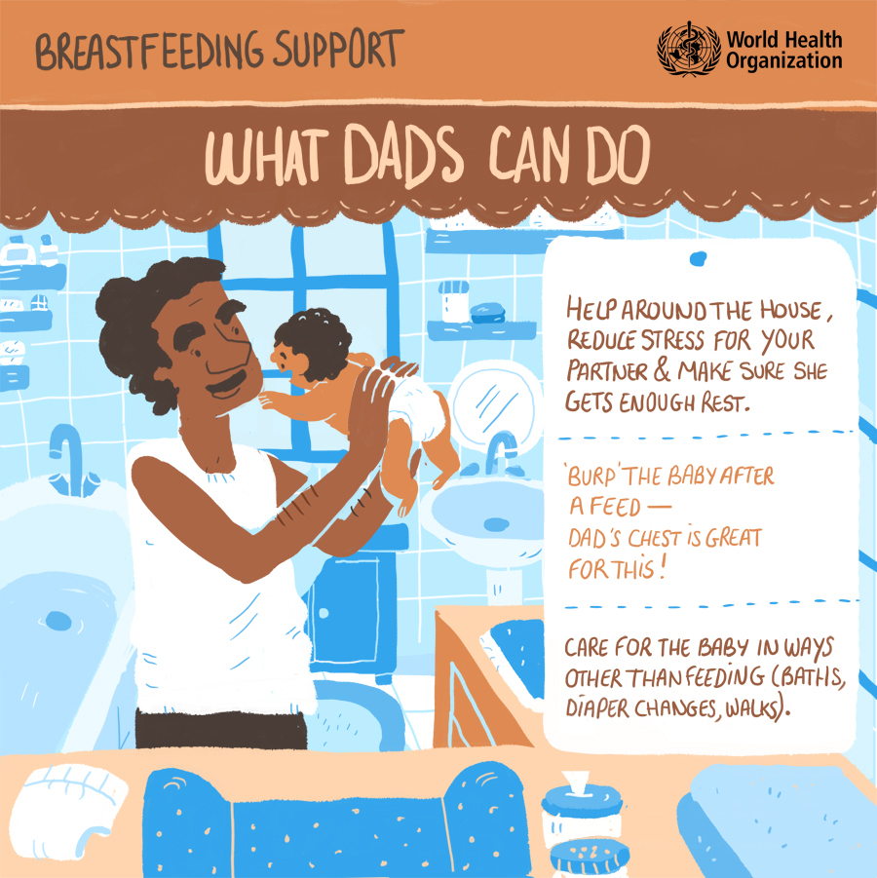
Breastfeeding:
What Dads can do

Slide 15
We grow up loved, safe and respected so that we realise our full potential. We do all we can to ensure our children grow up in an atmosphere of happiness, love and understanding.
What advice would you give to a parent or carer about what they can do to help make this happen for their child?

