Slide 1
Claiming our sexual rights
I know that my sexuality is about my feelings, thoughts, attractions and behaviours.
I can talk about my sexual rights including the right to personal and intimate relationships that are healthy, happy and safe.
I know where to find information, help and support if I need it.

Slide 2
Sexual Rights
The right to equality
The right to participation
The right to life and to be free from harm
The right to privacy
The right to personal autonomy and to be recognized as an individual before the law
The right to think and express oneself freely
The right to health
The right to know and learn
The right to choose whether or not to marry or have children
The right to have your rights upheld

Slide 3
Sexual Rights – produced by IPPF https://youtu.be/mPwfRBXVgxI (duration 1 minute 44)
What do the young people say about their Sexual Rights?
Why might some people have their Sexual Rights denied?

Slide 4
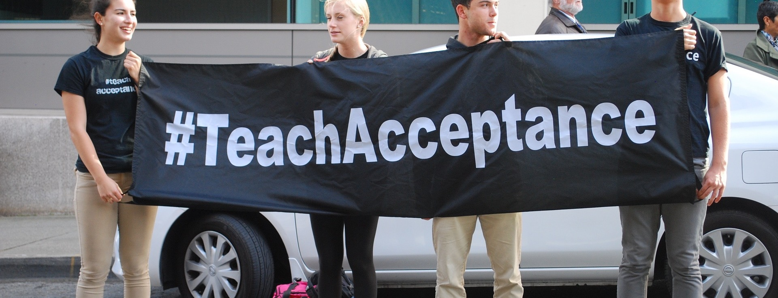
SEXUAL RIGHTS: The right to know and learn: All young people have the right to education and information, including comprehensive, gender-sensitive and rights-based sexuality education, including in school.

Slide 5
Activity:
The right to know and learn.
If young people have such a right what should it be like in practice?

Slide 6
Making the case
Pick a right you want to stand up for.
Say in your own words what it means to you
Say why it matters in today’s world
Explain what difference it will make if every person has this right.

Slide 7
Sexual Rights
The right to equality
The right to participation
The right to life and to be free from harm
The right to privacy
The right to personal autonomy and to be recognized as an individual before the law
The right to think and express oneself freely
The right to health
The right to know and learn
The right to choose whether or not to marry or have children
The right to have your rights upheld

Slide 8
INSERT LOCAL INFORMATION ABOUT SEXUAL HEALTH OR OTHER CONFIDENTIAL INFORMATION/SUPPORT SERVICES HERE

