Slide 1
More about Gender
I understand that how I look, how I behave, or my aspirations should not be limited by stereotypes, my sex or expectations of what boys and girls should do.
I can give examples of, and can challenge, stereotypes.
I show respect for others and I understand and accept diversity amongst my peers.

Slide 2
People use the words sex and gender. Sometimes people use them as if they mean the same thing. This can be confusing.
So, what’s the difference?

Slide 3
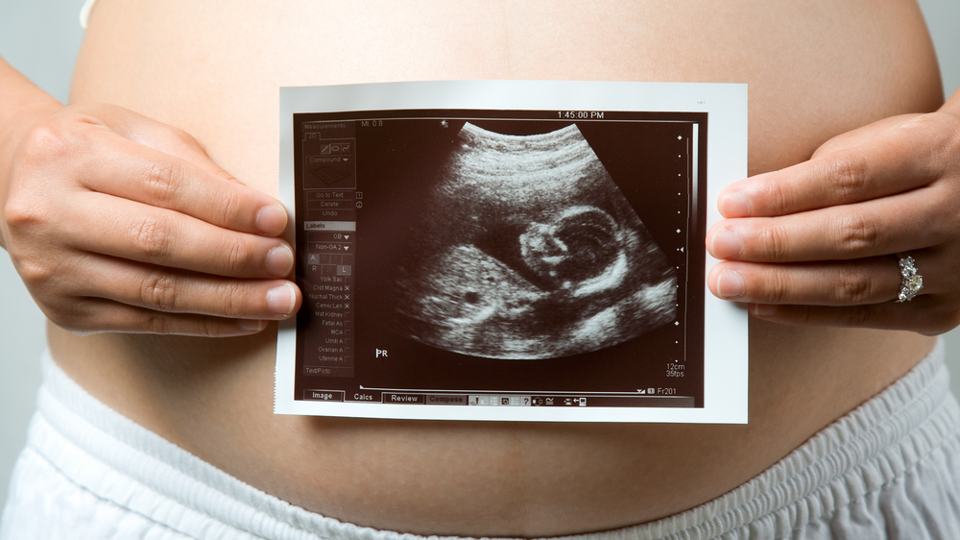
Our sex is fixed before we are even born.
A pregnant woman can find out the sex of her baby when she is pregnant and has a scan.

Slide 4
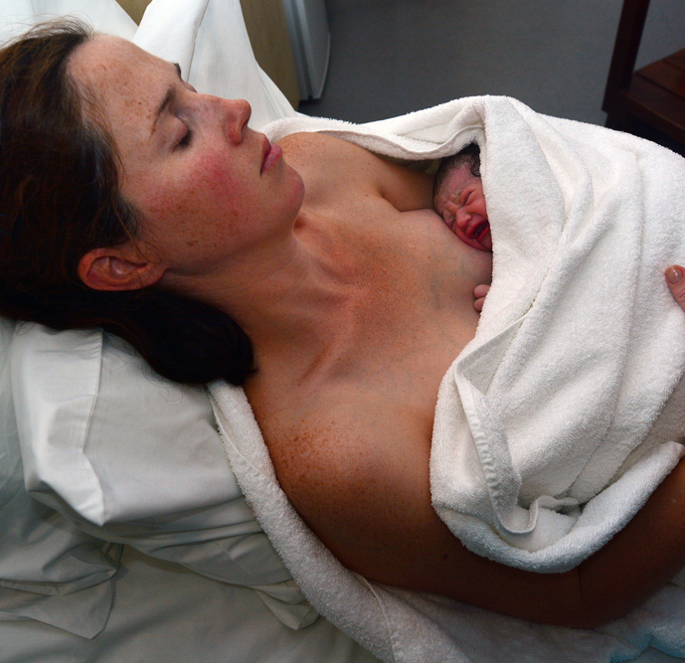
The midwife will also look at the baby when it is born and say whether it is a boy or a girl.
For some babies this is not clear and so some tests would be done to make a decision.

Slide 5
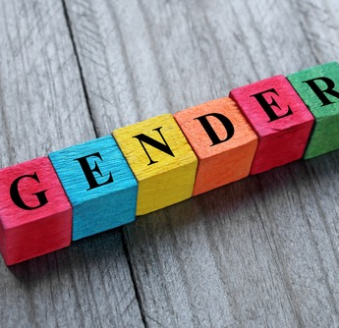
Gender is a different thing.
We could say that gender is a mix of:
Our biological sex
How we feel about our identity
How we choose to express ourselves.

Slide 6
Gender is also about how we experience life.
For example, if someone thinks we are a woman they might treat us one way, if they think we are a man they might treat us a different way

Slide 7
Do you think you dress in ways that give clues as to your biological sex?
Do you think you behave in ways that give clues to your biological sex?

Slide 8
Are you free to express who you are – in the way you look or how you behave?
Are your expressions limited by stereotypes of how masculine of feminine someone should be?

Slide 9
Can you think of examples of how people are treated differently when they are thought to be a woman or a man?
Does this happen to young people your age?
Have you been treated one way because you are/perceived to be a girl? Or in a particular way because you are/perceived to be a boy?

Slide 10
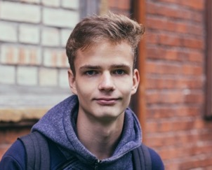
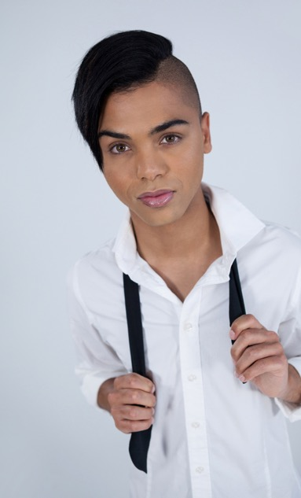
Most people describe themselves as girls/women or boys/men simply as a result of being born female or male (so because of their sex).
Some people see themselves in a different way because of how they feel about, or choose to express their gender.
When we talk about gender, there are lots of different terms people might use.

Slide 11
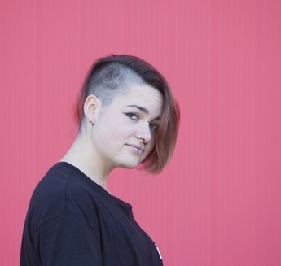
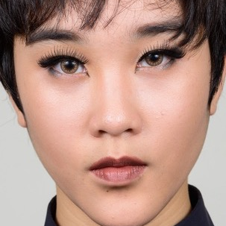
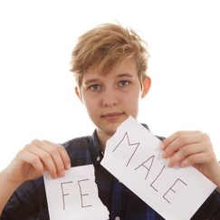
For some people their gender is not fixed, they don’t want to be defined by being either a man or a woman.
They might choose a different way to describe their gender, this might or might not match their sex, they might use the term gender fluid or gender non-binary.

Slide 12
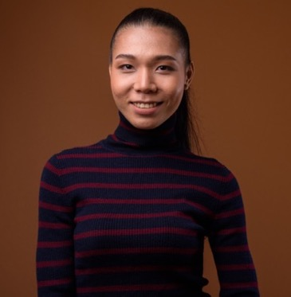
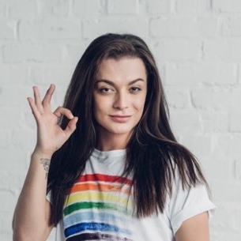
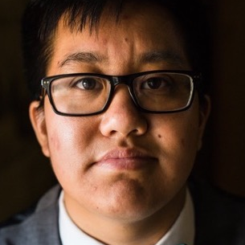
If a person describes themselves as transgender (sometimes people just say trans) they feel that the sex they were born does not fit with how they feel inside.
So, a transgender woman lives as a female/woman today, but was born a boy. A transgender man lives as a male/man today, but was born a girl.

Slide 13
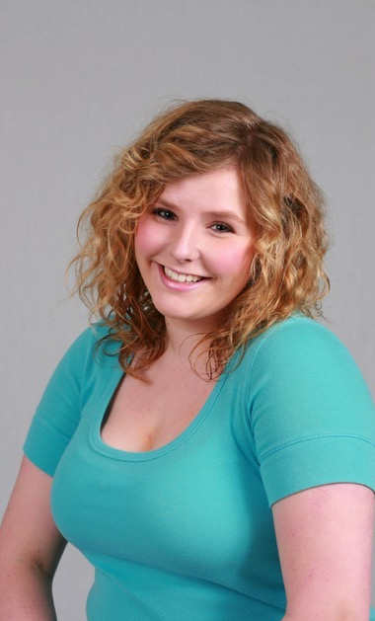
A person might describe themselves as cisgender if they identify with, or express themselves in line with gender expectations associated with their sex (so they would say their gender matches their sex).

Slide 14
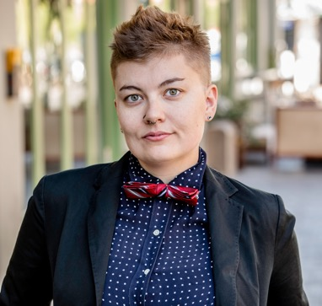
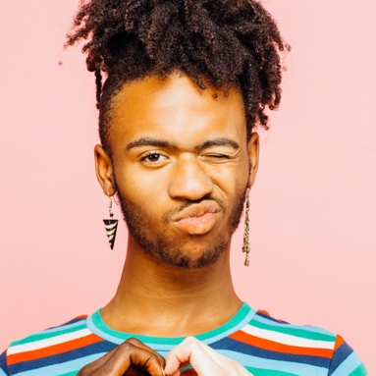
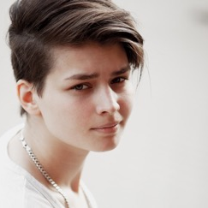
A person might describe themselves as gender non-conforming if they do not identify as trans or gender non-binary / gender fluid and they also do not identify with gender expectations associated with their sex.

Slide 15
Do you follow anyone who is exploring ideas of gender?
What are people talking about and sharing through social media?
How does this influence how young people feel about gender?

Slide 16
There are no rules about how to be a girl or a boy - be who you want to be.

Slide 17
Childline provides free confidential advice and support for all young people your age.
Whatever your worry, if it’s about you or someone you love, Childline counsellors are there to help. Speak to them by phone, online or email 24 hours a day.
Information and chat online https://www.childline.org.uk/
Phone 0800 1111

