Slide 1
Consent: What consent means in a relationship
I can explain what consent in relationships means.
I can explain what sexual consent is.
I am building understanding, skills and capacity to assert myself in relationships so that I can express what I want and don’t want.
I am building understanding that I am responsible for my actions towards others.
I know that I do not need to be in a relationship, and that relationships do not need to be sexual unless I wish them to be so.

Slide 2
What is a relationship?

Slide 3
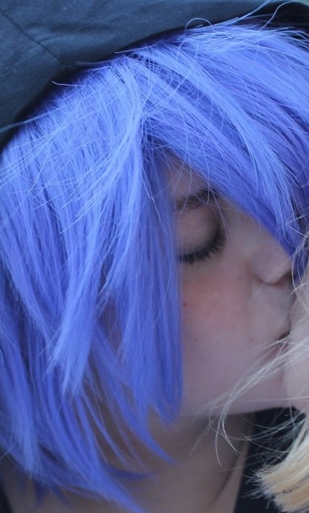
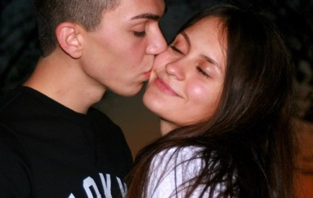
When we talk about a relationship we mean when a person is involved with another person in a way that is romantic or intimate or sexual.
It can be when people have a one-off date, or when people are together for a short time or in a long-term relationship.

Slide 4
What is a healthy relationship?

Slide 5
A healthy relationship is where both people DO:
Feel safe, equal, respected and happy.
Care about what each other want.
Keep and see friends and family when they want to.
Break up if they want to.

Slide 6
A healthy relationship is where both people DON’T:
Put pressure on the other person, and it’s as easy to say no as to say yes
Do things that make the other person feel uncomfortable, anxious or scared.
Have to spend time with the other person if they don’t want to. Each person can spend time on their own if they want to.

Slide 7
What do you think ‘Consent’ means?

Slide 8
Consent means
Asking someone if you can do something or if they want something.
If they say yes, they give consent.
If they say no, they do not give consent.
If they don’t say anything, or they aren’t sure or aren’t clear, they do not give consent.
If they give consent once, you still have to ask the next time.

Slide 9
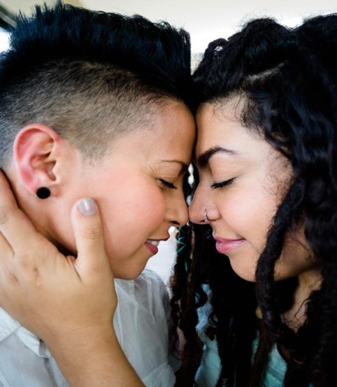
Intimate relationships and consent.
What kind of things do boyfriends/girlfriends do together that are ‘intimate’?
Do you need to have consent for all of them?

Slide 10
First Kiss and Showing Affection
(duration 2 minutes 44)
https://youtu.be/VDaFzW-fNLc
Ask. Listen. Respect
(1 Minute 11)
https://youtu.be/n6X5I7xoxEY

Slide 11
Sexual consent
Consent Explained
(duration 2minutes 44)
https://youtu.be/5vmsfhw-czA

Slide 12
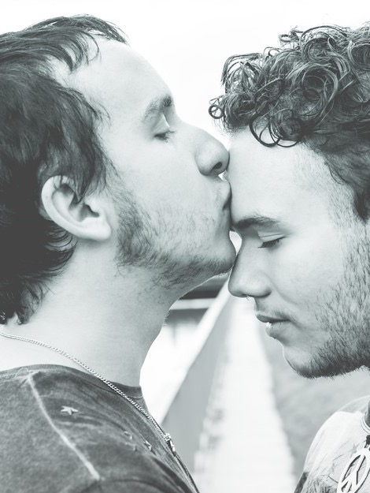
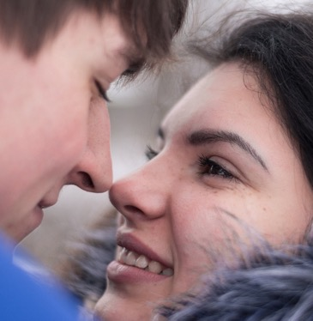
Sexual consent means
Sexual experiences are agreed, respectful and enjoyable. Both people feel safe and happy to have sex.
You need consent every time you are doing something sexual, the first time and every time.
If you are not sure, you do not have consent.

Slide 13
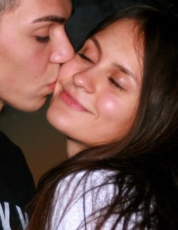
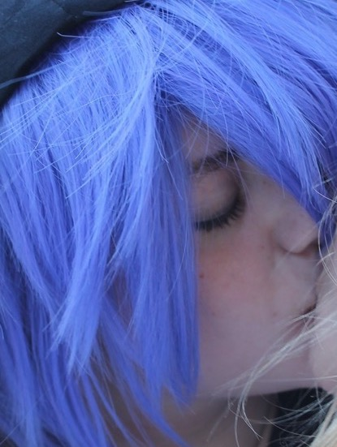
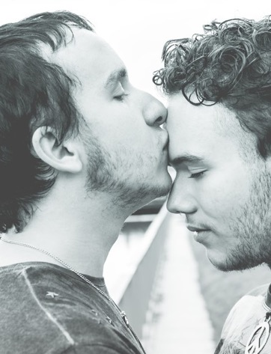
Sexual consent means
When a person gives consent to sex it must be freely given, not because they have been pestered or made to feel they have to.
You never do anything sexual when you don’t want to. If you have said ‘yes’ to something sexual before you can change your mind the next time.

Slide 14
Sexual consent means
You never feel any pressure to take or send or look at images or messages that are nude or sexual.
You do not put pressure on someone to do something sexual. If the other person changes their mind you must stop.
A person is not able to give their consent if they are incapable because of alcohol or drugs or because they are asleep or unconscious. Any sexual activity in these circumstances is sexual assault or rape.

Slide 15
How do you know if someone gives their consent?

Slide 16
How do you know if someone gives their consent?
Consent can be given verbally (so the person says that they agree) or non-verbally (known as body language).
Examples of how a person gives consent might include; pulling someone closer, direct eye contact, smiling, actively touching someone, nodding yes, saying things like ‘that feels good’ or ‘I still want to’. Good communication is part of good sex.

Slide 17
Consent:
What sounds clear? What sounds tricky?

Slide 18
Consent scenario 1
Jayne and David go on a date to the cinema. At the end of the date, David puts his arms around Jayne and gently pulls her closer. Jayne smiles and puts her arms around David.
‘’Can I kiss you?’’ asks David.
‘’Yes’’ says Jayne.
Has Jayne given her consent to be kissed?

Slide 19
Consent scenario 2
Lucy and Jennifer are at a party. Lucy really fancies Jennifer.
‘’Will you come to the toilet with me?’’ ask Lucy.
‘’Yes’’ says Jennifer.
In the toilet, Lucy pushes Jennifer against the wall and tries to lift her t-shirt up.
Jennifer pulls away.
Has Jennifer given her consent to be touched liked this?

Slide 20
Consent scenario 3
Andrew and Pete have just started going out. They’re both kissing on Andrew’s bed. They both touch each other’s bodies and start to undress one another.
‘’I really want to have sex with you’’ says Pete.
Andrew freezes. He stops kissing Pete.
‘’Tell me if you don’t want it’’ says Pete, and carries on undressing Andrew.
Andrew doesn’t say anything.
Has Andrew given his consent?

Slide 21
Consent scenario 4
Sam and Jo are both drunk at a party. They’ve had sex a few times before.
Jo says ‘’I don’t feel so good’’
Sam promises to look after her and leads her up to a bedroom to lie down.
Sam undresses Jo and puts her to bed. Then Sam undresses, gets in bed with Jo and begins touching her body and kissing her.
Jo is drunk and she just wants to go to sleep.
Has Jo given consent?

Slide 22
Cycling through Consent
https://youtu.be/-JwlKjRaUaw
Consent – cup of tea
https://youtu.be/u7Nii5w2FaI

