Slide 1
Sex: How people have sex/Having sex for the first time
I can describe what sex/sexual intercourse can involve.
I can discuss what I am looking for in relationships.
I understand that it is okay not to be in a relationship.
I understand that romantic relationships need not include sex.
I recognise the pressures young people face to be sexually active.

Slide 2
What is sex? Sex is something that adults can do when they love and care for each other. Sometimes people talk about ‘making love’.

Slide 3
You must be 16 years or older to have sex.

Slide 4
When a couple want to have sex they will go to a private place like their bedroom. They will kiss and cuddle and touch each other’s bodies. They will touch private parts of each other’s bodies.

Slide 5
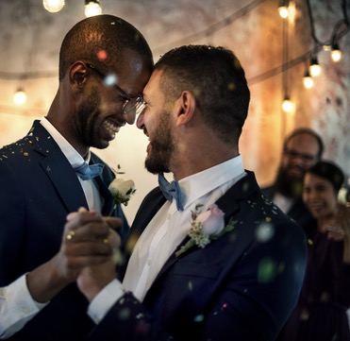
When the couple are two men, we say they are gay. When a couple are two women, we say they are gay or lesbian. When the couple is a man and a woman we say they are heterosexual or straight.

Slide 6
Sex should feel nice. Adults learn what they like and don’t like. A person can decide they don’t want to do something sexual at any time, and the other person must stop.

Slide 7
When a man is feeling aroused his penis will get hard, this is called an erection.

Slide 8
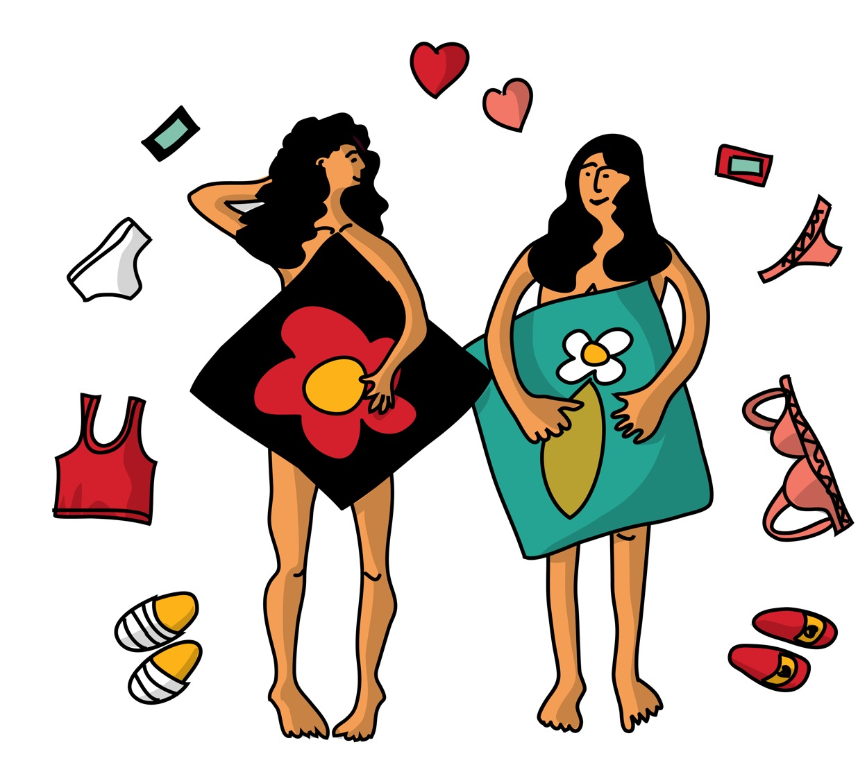
When a woman is feeling aroused her vulva and vagina might feel tingly and wet or slippery to touch.

Slide 9
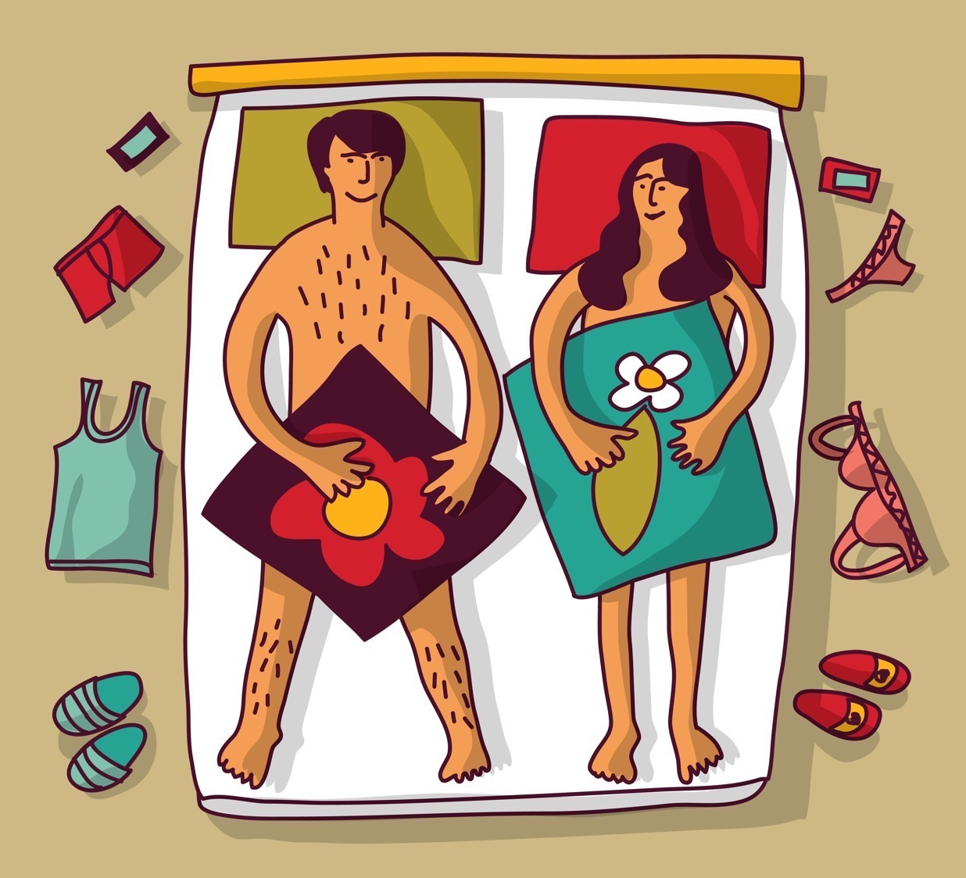
If a man and a woman both want to have sex, the man’s penis can be put inside the woman’s vagina and moved in and out.

Slide 10
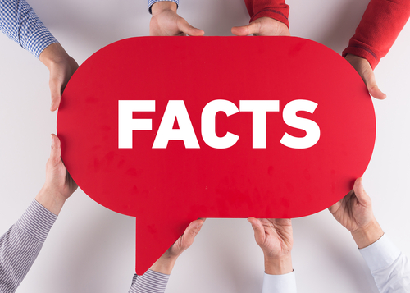
Oral sex is when a man or a woman kisses or licks the private parts of the other person’s body such as their penis or vagina.
Anal sex is when a man puts his penis in to a man or a woman’s anus (bottom).

Slide 11
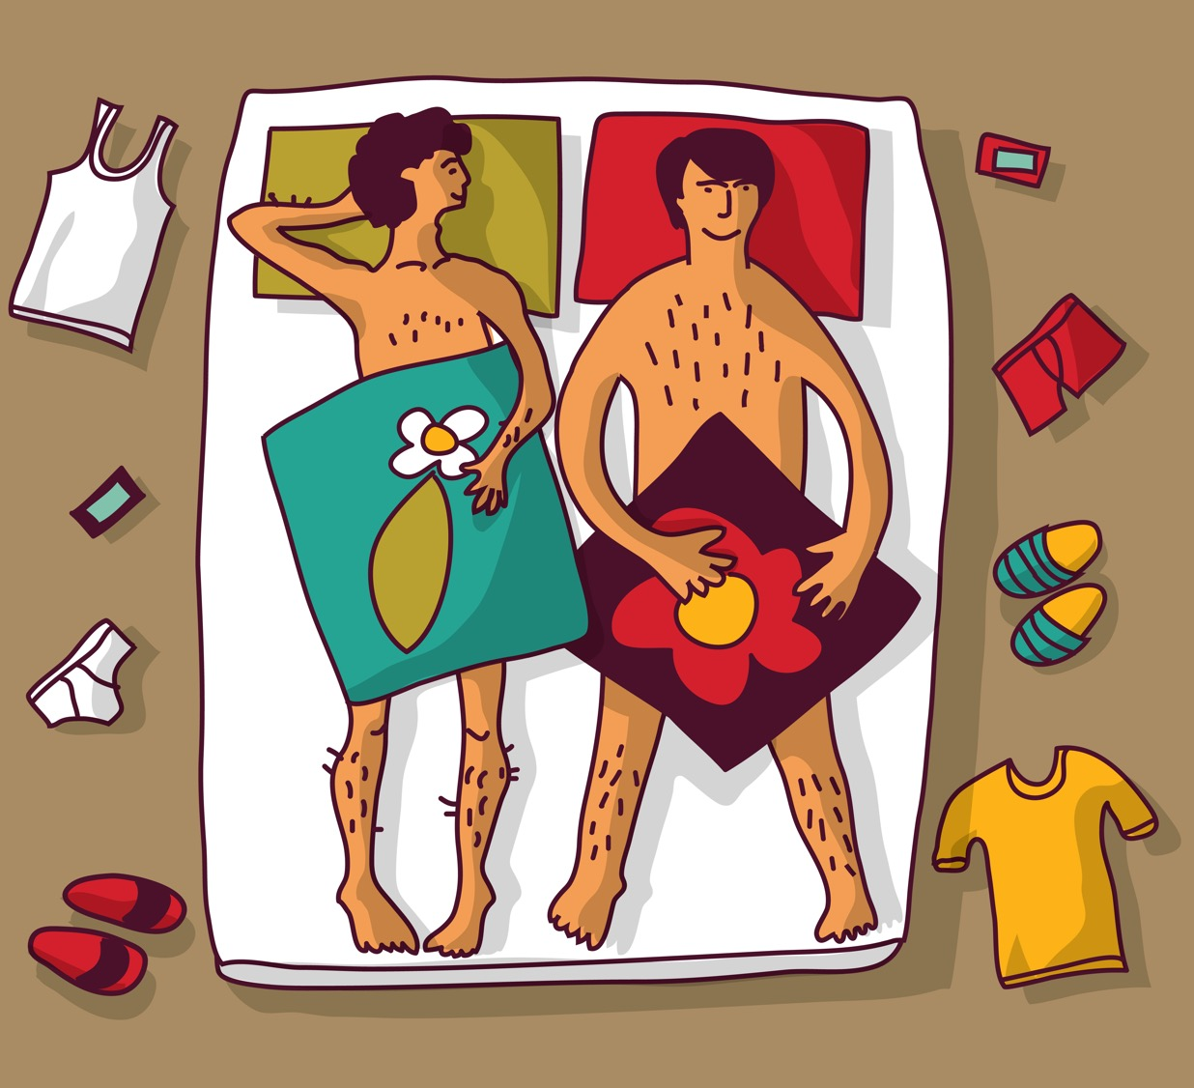
When people have sex, they might have an orgasm. For a woman an orgasm is a pleasurable feeling in her body. For a man, if he has an orgasm (called ejaculation) a white liquid called semen will come out of his erect penis. He will enjoy this feeling.

Slide 12
If a man has an orgasm (ejaculates) when his penis is inside the woman’s vagina, and if he doesn’t have a condom on, then the sperm may meet the egg and this is the way a woman can get pregnant.

Slide 13
If people have sex without using condoms then there is a risk of Sexually Transmitted Infections being passed on.

Slide 14
We have heard about what sex is. Now have a chat and think about this question:
What would you like to know more about?

Slide 15
First time sex
Virginity
(duration 2 minutes 33)
https://youtu.be/W7jhGB63TPo

Slide 16
First time sex:
True or False.
Work in small groups (3 per group) with a set of cards.
Discuss each card and decide if the answer is True or False – you can also answer Not Sure.

Slide 17
A girl can get pregnant the first time she has sex with a boy. TRUE or FALSE?

Slide 18
A girl can get pregnant the first time she has sex with a boy.
TRUE: If the sex includes the boy putting his penis in the girl’s vagina without a condom on, then a girl can get pregnant, even if it is the first time she has sex.

Slide 19
It is against the law to have sex under the age of 16. TRUE or FALSE?

Slide 20
It is against the law to have sex under the age of 16.
TRUE
The law says you need to be 16 to have sex – this is called the age of consent.

Slide 21
If you have sex before your 16th birthday you need to keep it a secret. TRUE or FALSE?

Slide 22
If you have sex before your 16th birthday you need to keep it a secret.
FALSE: You can still speak to someone at the sexual health clinic. They will make sure you are safe and give you advice, information and support.
Even if you are under 16, it is confidential unless they think you are in danger or being harmed in any way. This is Child Protection.

Slide 23
Drinking alcohol before sex makes it better. TRUE or FALSE?

Slide 24
Drinking alcohol before sex makes it better.
FALSE: If you drink alcohol, you are more likely to do something you regret.
You might agree to sex with someone when you don’t really want to.
You might have sex with no contraception or condoms.

Slide 25
Real sex is when a boy/man puts his penis in the girl/woman’s vagina. Nothing else is real sex. TRUE or FALSE?

Slide 26
Real sex is when a boy/man puts his penis in the girl/woman’s vagina. Nothing else is real sex.
FALSE: Sex is whatever you want it to be, you decide what you like and don’t like. The law says that sex includes masturbating together, touching each other sexually, vaginal sex (putting fingers or penis in the vagina), oral sex and anal sex (putting fingers or penis in the anus/bottom).

Slide 27
First time sex always hurts for girls. TRUE or FALSE?

Slide 28
First time sex always hurts for girls.
FALSE: This is a worry, but if the girl/young woman and their partner take time, feel relaxed and keep talking to each other then it will be fine.

Slide 29
You can’t talk to your parents or carers about sex. TRUE or FALSE?

Slide 30
You can’t talk to your parents or carers about sex.
FALSE: Well, okay, it might not be the easiest conversation, but research shows that most teenagers would like to talk to a parent or carer, and most parents or carers want to help.

Slide 31
First time sex: What do you think young people worry about?

Slide 32
Young people worry about doing it right.

Slide 33
The thought of having sex seems like a huge thing – that’s because it is. It’s an important way to show what you feel for someone. If you wait until you are both ready it will be fine.

Slide 34
Young people worry about their bodies.

Slide 35
It’s common to think that your body isn’t perfect. Or that your penis or vulva or breasts aren’t right. The reality is we are all very different. And if you have ever seen any pictures or videos of pornography, then its important to remember that normal people don’t look (or behave) like that.

Slide 36
Young people worry about pressure to be having sex.

Slide 37
Pressure to do anything you don’t want to do is never okay. Whether its pressure to drink, smoke, have sex or whatever. Be confident and strong and say ‘that’s not for me, thanks’.

Slide 38
Young people worry about not doing it.

Slide 39
You might already know some young people a bit older than you that say they are doing it. Chances are, they aren’t. Most young people wait until after their 16th birthday before they consider sex.

Slide 40
It’s hard to admit that you don’t know things about sex.
Having accurate information is important and there’s a chance to ask questions later in the activity.

Slide 41
What would you like to know more about?

Slide 42
Sex is about how you feel in your head and in your body.
So, it’s not just about ‘doing it’, it’s about how you feel about it.

